Slide 1
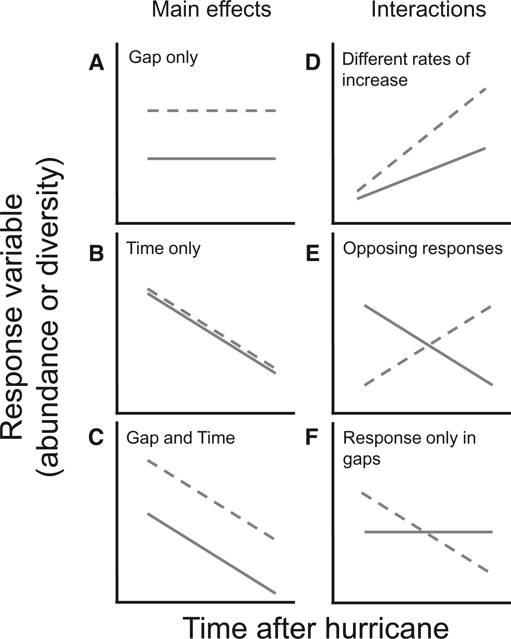
Fig. 1 Idealized examples of possible responses to hurricane-induced disturbances. Responses in gaps and closed ...
Notes:
Fig. 1 Idealized examples of possible responses to hurricane-induced disturbances. Responses in gaps and closed canopy plots are represented by dashed and solid lines, respectively.
Unless provided in the caption above, the following copyright applies to the content of this slide: © The Authors 2016. Published by Oxford University Press on behalf of Entomological Society of America. All rights reserved. For Permissions, please email: journals.permissions@oup.com

Slide 2
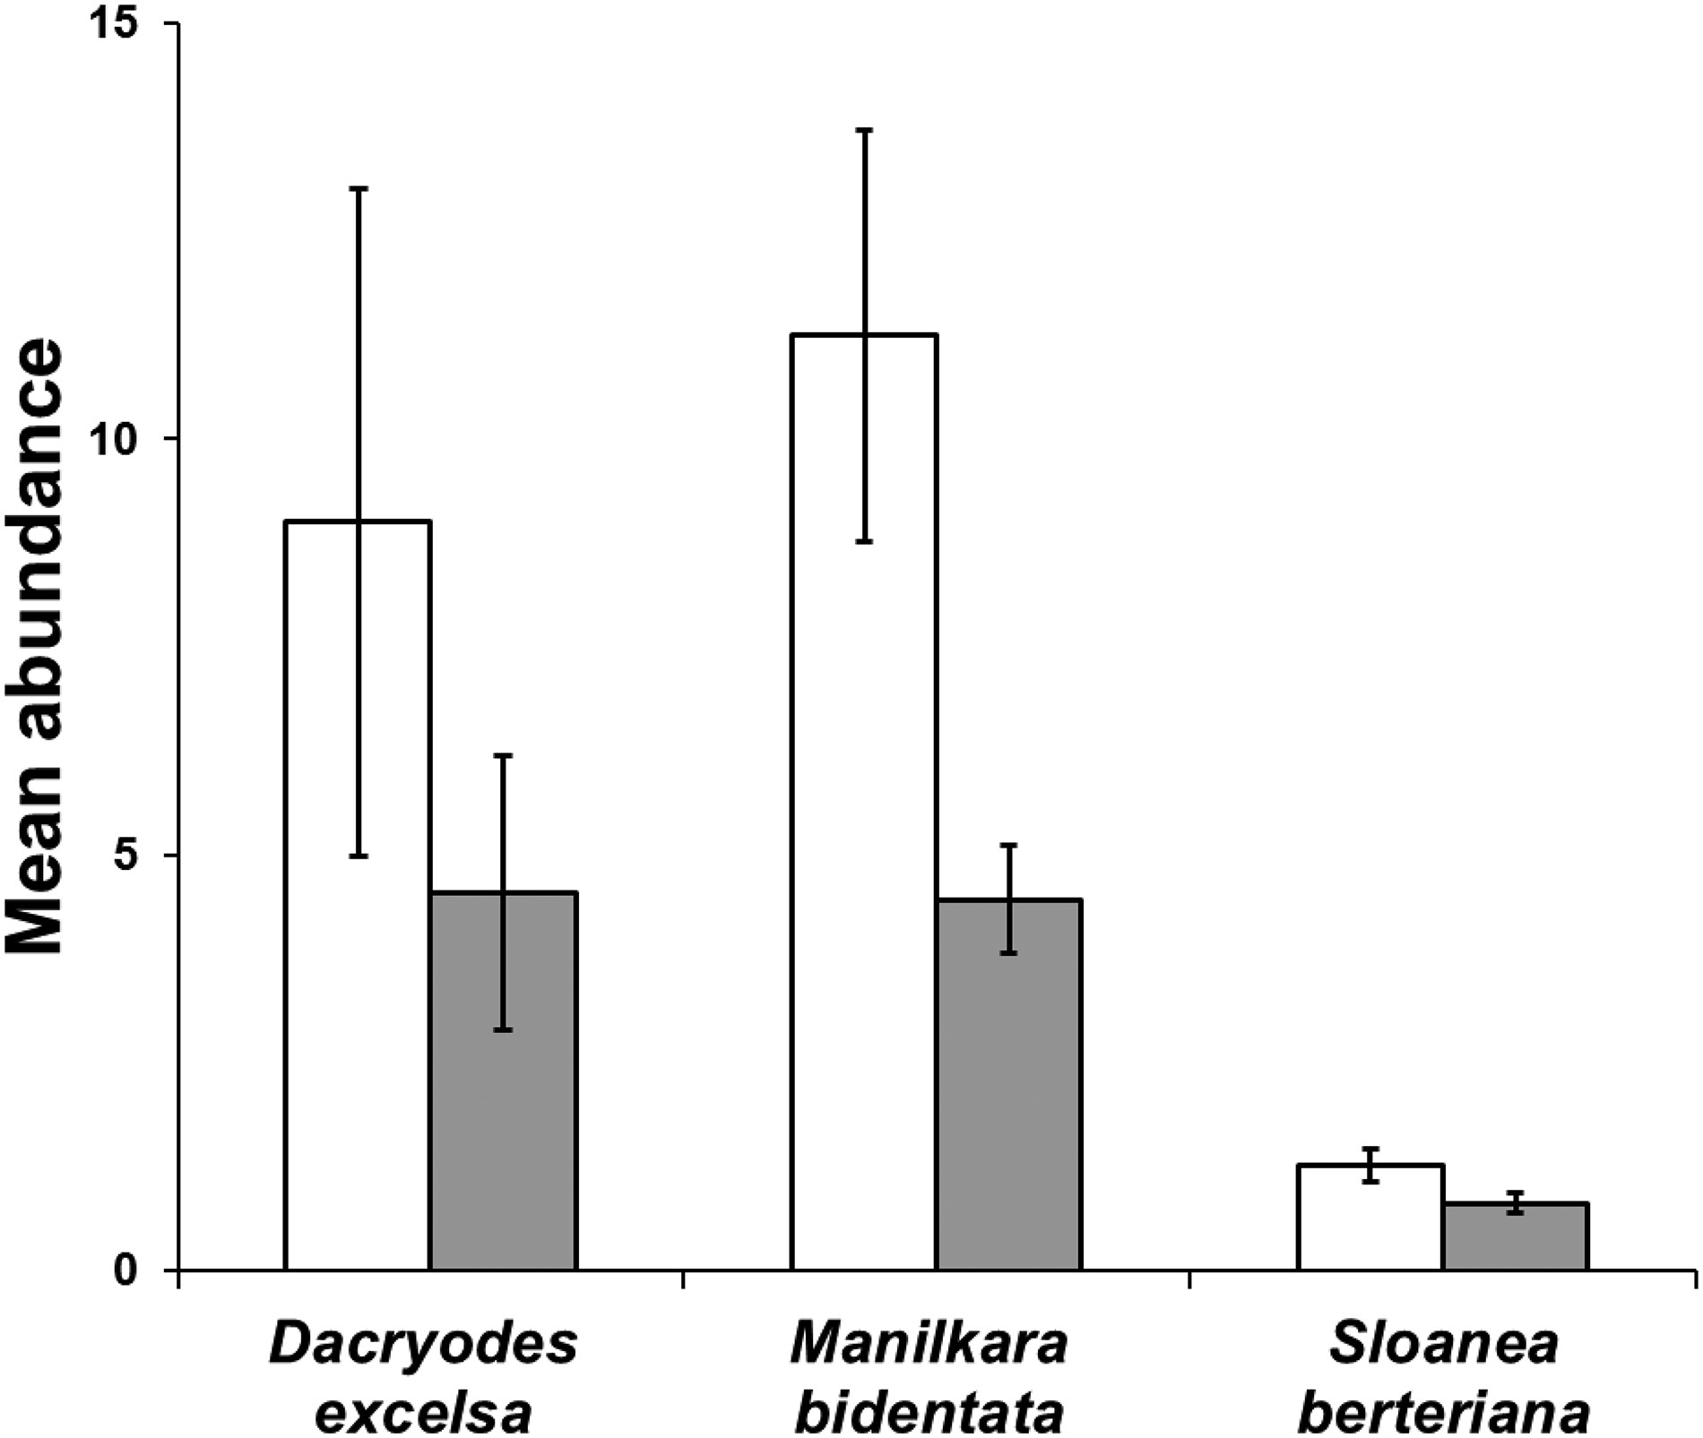
Fig. 2 Mean number of detritivores per sample in gaps (white) and non-gaps (gray) after Hugo on each of three ...
Notes:
Fig. 2 Mean number of detritivores per sample in gaps (white) and non-gaps (gray) after Hugo on each of three dominant canopy tree species. Error bars represent ±1 SE. The error bars are for descriptive purposes and do not represent the basis for significance in the linear mixed-effects models (Suppl. Table 2 [online only]), which controlled for variation in sample mass and for block effects.
Unless provided in the caption above, the following copyright applies to the content of this slide: © The Authors 2016. Published by Oxford University Press on behalf of Entomological Society of America. All rights reserved. For Permissions, please email: journals.permissions@oup.com

Slide 3
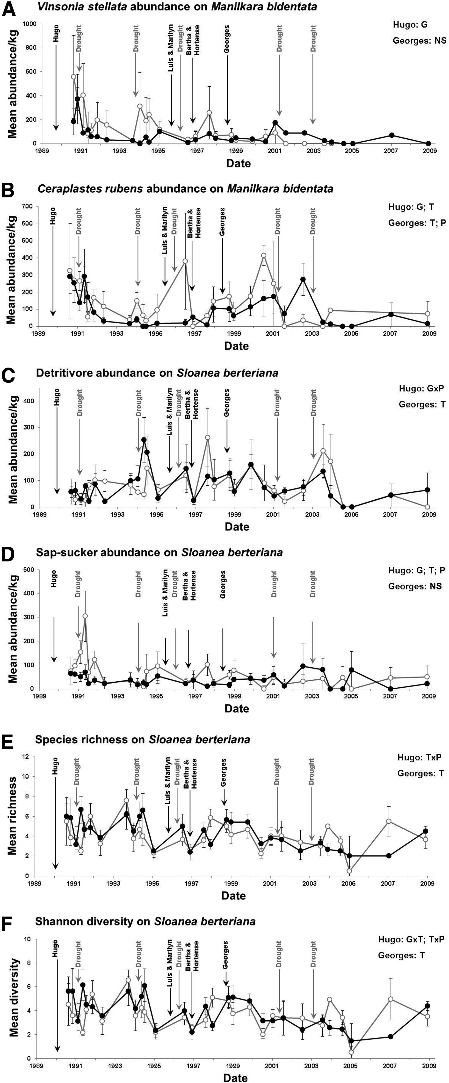
Fig. 3 Empirical examples of complex long-term patterns of taxon abundance, guild abundance, and taxonomic ...
Notes:
Fig. 3 Empirical examples of complex long-term patterns of taxon abundance, guild abundance, and taxonomic biodiversity for canopy arthropods in response to a complex disturbance regime in the Luquillo Mountains of Puerto Rico. Mean abundances (number of individuals) per sample per kilogram dry weight of foliage for (A) Vinsonia stellifera on Manilkara bidentata, (B) Ceroplastes rubens on M. bidentata, (C) detritivores on Sloanea berteriana, and (D) sap-suckers on S. berteriana. Mean taxonomic biodiversity per sample based on (E) species richness on S. berteriana and (F) Shannon diversity on S. berteriana. Data represent long-term trends (19 yr) in abundance or biodiversity (±1 SE) in response to hurricanes (black text and arrows) and droughts (gray text and arrows) on trees located in gaps created by hurricanes (open circles and gray lines) or located under closed canopy forest (filled circles and black lines). Significant effects from general linear mixed-effects models are noted on each panel: G, gap, P, precipitation, and T, time after hurricane.
Unless provided in the caption above, the following copyright applies to the content of this slide: © The Authors 2016. Published by Oxford University Press on behalf of Entomological Society of America. All rights reserved. For Permissions, please email: journals.permissions@oup.com

