Slide 1
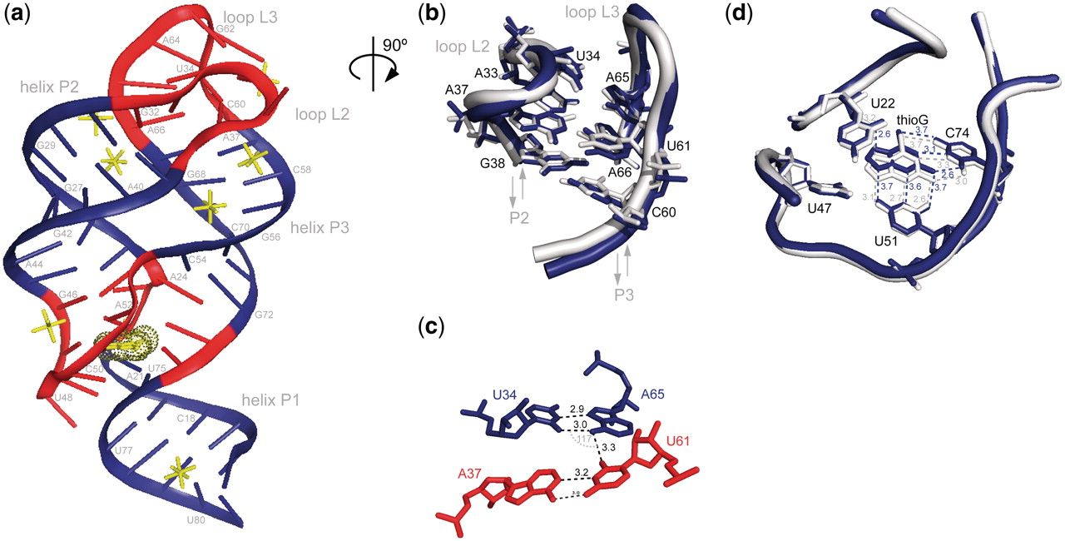
Figure 1. Crystal structure of the G37A/C61U-mutant (Gsw ^{loop} ) from the B. subtilis guanine-sensing ...
Notes:
Figure 1. Crystal structure of the G37A/C61U-mutant (Gsw loop ) from the B. subtilis guanine-sensing riboswitch aptamer domain in complex with the ligand thioguanine (thioG); ( a ) ribbon representation of the 3D structure of the Gsw loop –thioG complex (chain a). The ligand thioG is presented in yellow dots; helices P1, P2 and P3 are color coded in blue, ligand-binding core region and loop regions are color coded in red; cobalt hexamine ions are shown in yellow stick representation; ( b ) Close-up view (rotated by 90° along vertical axis) of tertiary loop–loop interactions (RNA backbone of residues 32–38 in L2 and 60–66 in L3 are given; gray: chain a, blue: chain b). Residues of inter-helical base quadruples are shown in stick representation (arrows indicate 5′- to 3′-helix direction); ( c ) stick representation of the inter-helical base quadruple, including the mutations; black dashed lines represent hydrogen bonds, mutated inter-base pair angle is annotated in gray [U34(O2)–A65(N6)–U61(O2) ∼117°]; ( d ) close-up view of ligand-binding region from crystal structure of Gsw loop –thioG. Local heterogeneity can be observed in molecules of one asymmetric unit in agreement with NMR spectra ( Supplementary Figure S2 ) (gray: chain a, blue: chain b, with respective atom distances annotated).
Unless provided in the caption above, the following copyright applies to the content of this slide: © The Author(s) 2011. Published by Oxford University Press.This is an Open Access article distributed under the terms of the Creative Commons Attribution Non-Commercial License (http://creativecommons.org/licenses/by-nc/3.0), which permits unrestricted non-commercial use, distribution, and reproduction in any medium, provided the original work is properly cited.

Slide 2
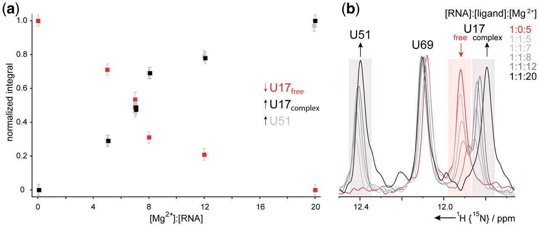
Figure 4. Dependence of the equilibrium of free Gsw ^{loop} and Gsw ^{loop} –hypoxanthine complex on ...
Notes:
Figure 4. Dependence of the equilibrium of free Gsw loop and Gsw loop –hypoxanthine complex on Mg 2+ concentration. Signals originating from nucleotide U51 can be detected only in the ligand-bound form, while signals from nucleotide U17 can be observed in the free (U17 free ) and the RNA–ligand complex (U17 complex ), however, with different chemical shifts. The signal of nucleotide U69 shows differences neither in intensity nor significantly in chemical shift in the two conformations. ( a ) Normalized integrals relative to the integral U17 total = U17 free + U17 complex for imino proton signal of U17 free , U17 complex and U51 as a function of the [Mg 2+ ]:[RNA] ratio. ( b ) Overlay of 1D NMR spectra ( 15 N-edited) of Gsw loop ( 15 N-uridine labeled) in the presence of equimolar concentrations of hypoxanthine and varying concentrations of Mg 2+ (signal-to-noise is normalized relative to signal of nucleotide U69).
Unless provided in the caption above, the following copyright applies to the content of this slide: © The Author(s) 2011. Published by Oxford University Press.This is an Open Access article distributed under the terms of the Creative Commons Attribution Non-Commercial License (http://creativecommons.org/licenses/by-nc/3.0), which permits unrestricted non-commercial use, distribution, and reproduction in any medium, provided the original work is properly cited.

Slide 3
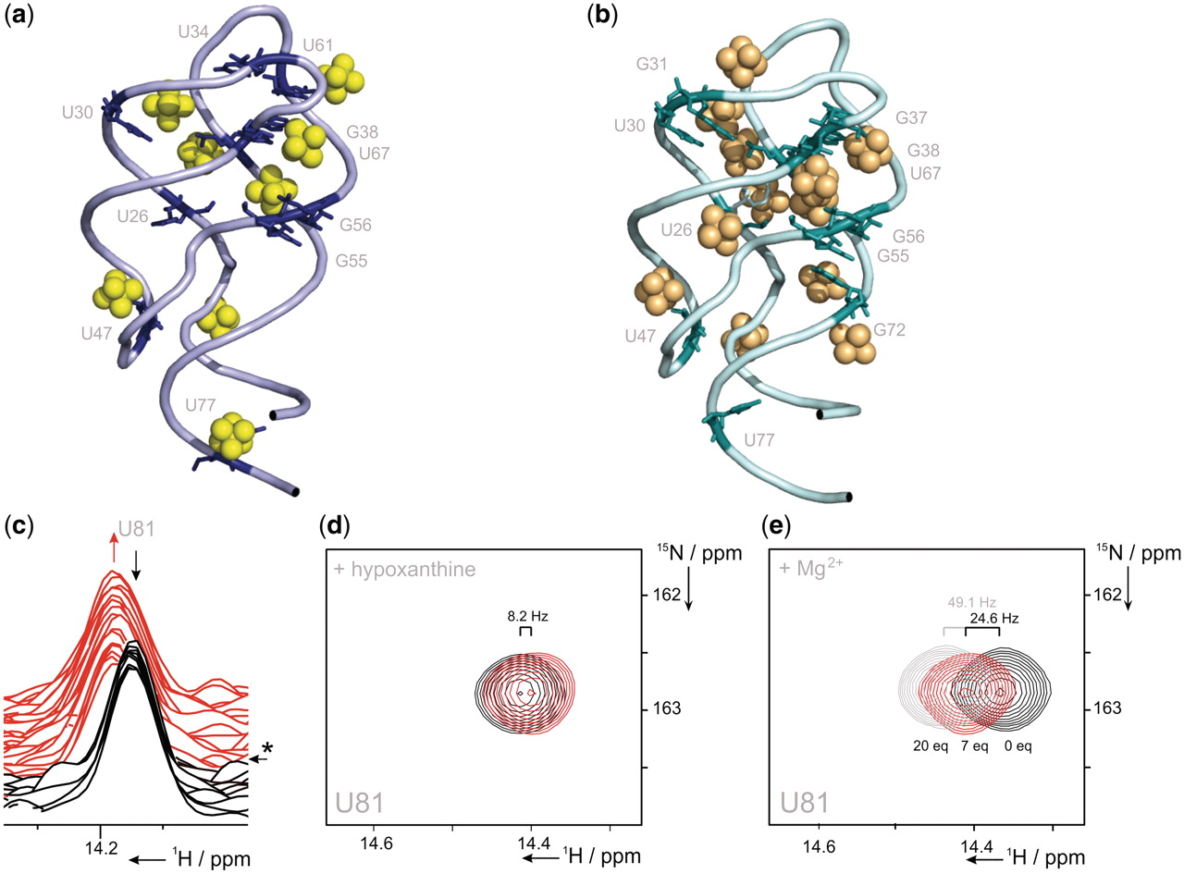
Figure 2. Hypoxanthine- and Mg ²⁺ -induced effects on conformation and folding of Gsw ^{loop} . ( a ...
Notes:
Figure 2. Hypoxanthine- and Mg 2+ -induced effects on conformation and folding of Gsw loop . ( a ) Mg 2+ binding by the Gsw loop –thioG complex (pdb: 3RKF). RNA residues of Gsw loop (sequence position/structural element (77)/P1, (26, 30)/P2, (55, 56, 67)/P3), (34, 61, 38)/loop region, (47)/binding pocket that show NMR imino proton chemical shift changes upon Mg 2+ titration Δδ (0–33eq) >15 Hz (12) are annotated in stick representation on the crystal structure of the G37A/C61U-mutant; cobalt hexamine ions are found in close proximity to the respective residues in the crystal structure (cobalt hexamine ions are highlighted in yellow); ( b ) Mg 2+ binding by the Gsw apt –hypoxanthine complex [pdb: 1U8D (10)]. RNA residues of Gsw apt (sequence position/structural element (77)/P1, (26, 30, 31)/P2, (55, 56, 67, 72)/P3), (37, 38)/loop region, (47)/binding pocket that show NMR imino proton chemical shift changes upon Mg 2+ titration Δδ (0–33eq) >15 Hz (28) are annotated in stick representation on the crystal structure of the wild-type Gsw apt –hypoxanthine complex. Cobalt hexamine ions are found in close proximity to the respective residues in the crystal structure (cobalt hexamine ions are highlighted in orange); ( c ) kinetics of Mg 2+ - and hypoxanthine-induced RNA–ligand complex formation. Spectral changes recorded for imino proton signal U81 over time [s] are illustrated (*): time point of injection ( t ∼ 0 s) of Mg 2+ and hypoxanthine; time resolution/1D spectrum ∼8.6 s; black: 1D-spectra before injection, red: 1D-spectra following injection); ( d ) addition of hypoxanthine leads to small chemical shift changes of the imino proton signal of nucleotide U81 in helix P1 (Δδ∼8.2 Hz) (overlay of 1 H, 15 N-HSQC spectral region of U81/Gsw loop at an [RNA]:[Mg 2+ ] ratio of ∼1:7 in presence (red) and absence of hypoxanthine (black)); ( e ) addition of Mg 2+ leads to significant chemical shift changes of U81 (overlay of 1 H, 15 N-HSQC spectral region at different [RNA]:[Mg 2+ ] ratios: Δδ (0–7eq) ∼24.6 Hz and Δδ (0–20eq) ∼49.1 Hz).
Unless provided in the caption above, the following copyright applies to the content of this slide: © The Author(s) 2011. Published by Oxford University Press.This is an Open Access article distributed under the terms of the Creative Commons Attribution Non-Commercial License (http://creativecommons.org/licenses/by-nc/3.0), which permits unrestricted non-commercial use, distribution, and reproduction in any medium, provided the original work is properly cited.

Slide 4
Figure 3. Ligand-induced folding of Gsw ^{loop} ([RNA]:[ligand]:[Mg ²⁺ ] ∼1:1:8, 700 MHz, 283 K). ...
Notes:
Figure 3. Ligand-induced folding of Gsw loop ([RNA]:[ligand]:[Mg 2+ ] ∼1:1:8, 700 MHz, 283 K). Normalized integrals over time [s] of exemplary imino proton signals of ( a ) nucleotide U49 within the ligand-binding core region and of ( b ) nucleotide G38 forming part of the long-range inter-helical base pairing interactions (dark gray solid line: monoexponential fit). ( c ) Secondary structure of the G37A/C61U-mutant of the guanine-sensing riboswitch aptamer domain of the B. subtilis xpt-pbuX operon (for further construct details, see Supplementary Data ).
Unless provided in the caption above, the following copyright applies to the content of this slide: © The Author(s) 2011. Published by Oxford University Press.This is an Open Access article distributed under the terms of the Creative Commons Attribution Non-Commercial License (http://creativecommons.org/licenses/by-nc/3.0), which permits unrestricted non-commercial use, distribution, and reproduction in any medium, provided the original work is properly cited.

Slide 5
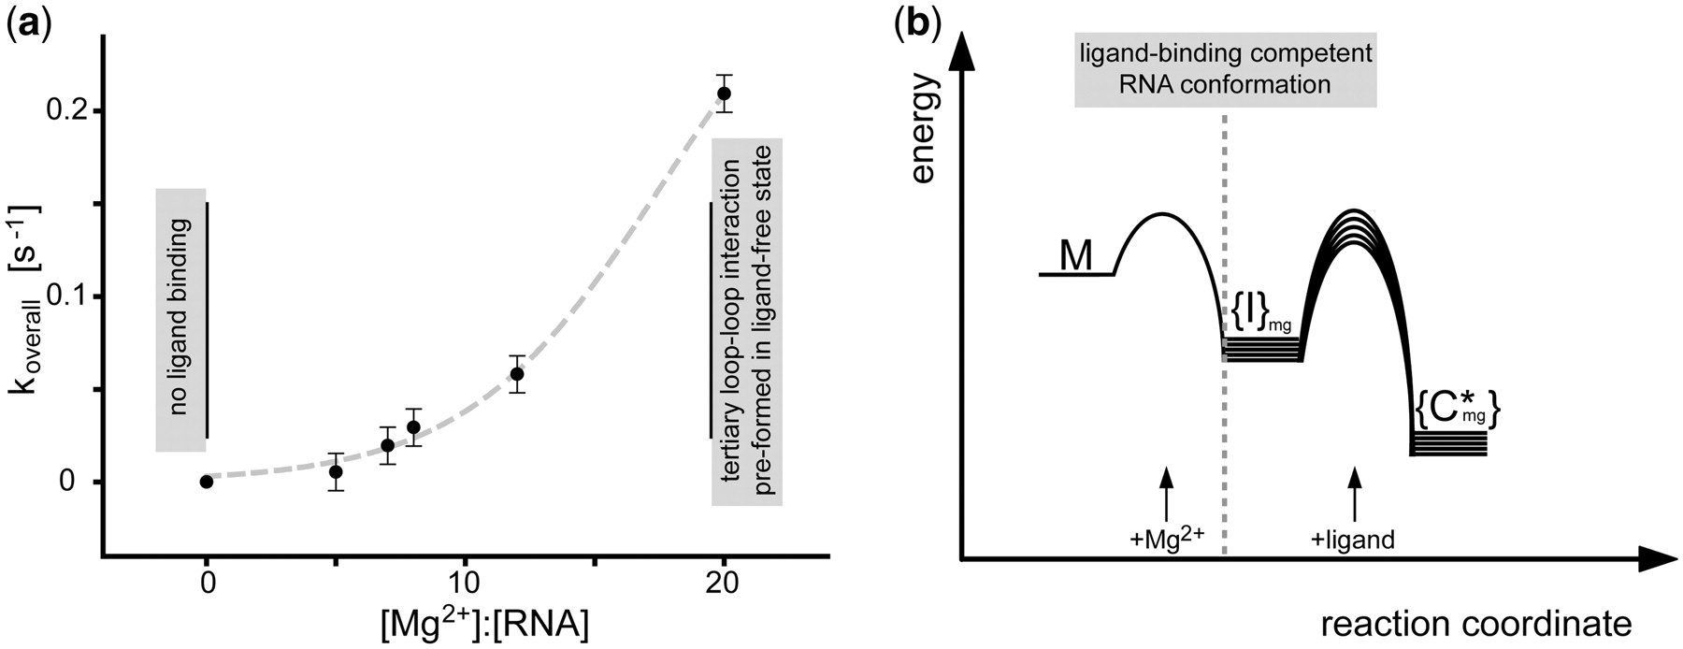
Figure 5. Mg ²⁺ dependence of the ligand-induced Gsw ^{loop} folding; ( a ) overall time constant ...
Notes:
Figure 5. Mg 2+ dependence of the ligand-induced Gsw loop folding; ( a ) overall time constant koverall [s −1 ] of ligand-induced RNA folding process as a function of [Mg 2+ ]:[RNA] ratio (the error is given from replica measurement at [Mg 2+ ]:[RNA] ∼7:1; additional data at higher [Mg 2+ ]:[RNA] ratios >20:1 could not be obtained due to the limited time-resolution of the NMR measurements; gray dashed line: sigmoidal fit; the choice of the fitting function was motivated by assuming that koverall [s −1 ] approaches saturation at an [RNA]:[Mg 2+ ] ratio of 1:20); ( b ) free activation energies of the Mg 2+ - and/or ligand-induced conformational transitions are schematically depicted. In the free G37A/C61U-mutant (M, absence of Mg 2+ ), secondary structure elements but neither the loop–loop interaction nor the ligand-binding region are pre-formed and Gsw loop cannot bind ligand ( 28 ). Through variation of the [RNA]:[Mg 2+ ] ratio, the ligand-binding capability can be restored ({I} mg ) as well as formation of the tertiary loop–loop interaction at high Mg 2+ concentrations ([RNA]:[Mg 2+ ] >1:18). In the schematic diagram, this observation leads to a conformational RNA ensemble, whose dynamic and structural properties are Mg 2+ dependent (signified by {}). The addition of Mg 2+ leads to a rapid RNA conformational change. The derivation is based on the experimental finding that the Mg 2+ -induced conformational transition, monitored for Gsw loop at an [RNA]:[Mg 2+ ] ratio <1:18 (M→{I} mg ), is faster than ∼8–10 s. The conformational transitions induced by Mg 2+ are very fast and associated with energetic barriers that are small compared to the barriers associated with ligand binding. The kinetics of ligand binding ({I} mg →{C*} mg ) strongly dependent on the [RNA]:[Mg 2+ ] ratio. The variation in kinetic rate constants from the [Mg 2+ ] concentration implies Mg 2+ -dependent differences of the free activation energy.
Unless provided in the caption above, the following copyright applies to the content of this slide: © The Author(s) 2011. Published by Oxford University Press.This is an Open Access article distributed under the terms of the Creative Commons Attribution Non-Commercial License (http://creativecommons.org/licenses/by-nc/3.0), which permits unrestricted non-commercial use, distribution, and reproduction in any medium, provided the original work is properly cited.

