Slide 1
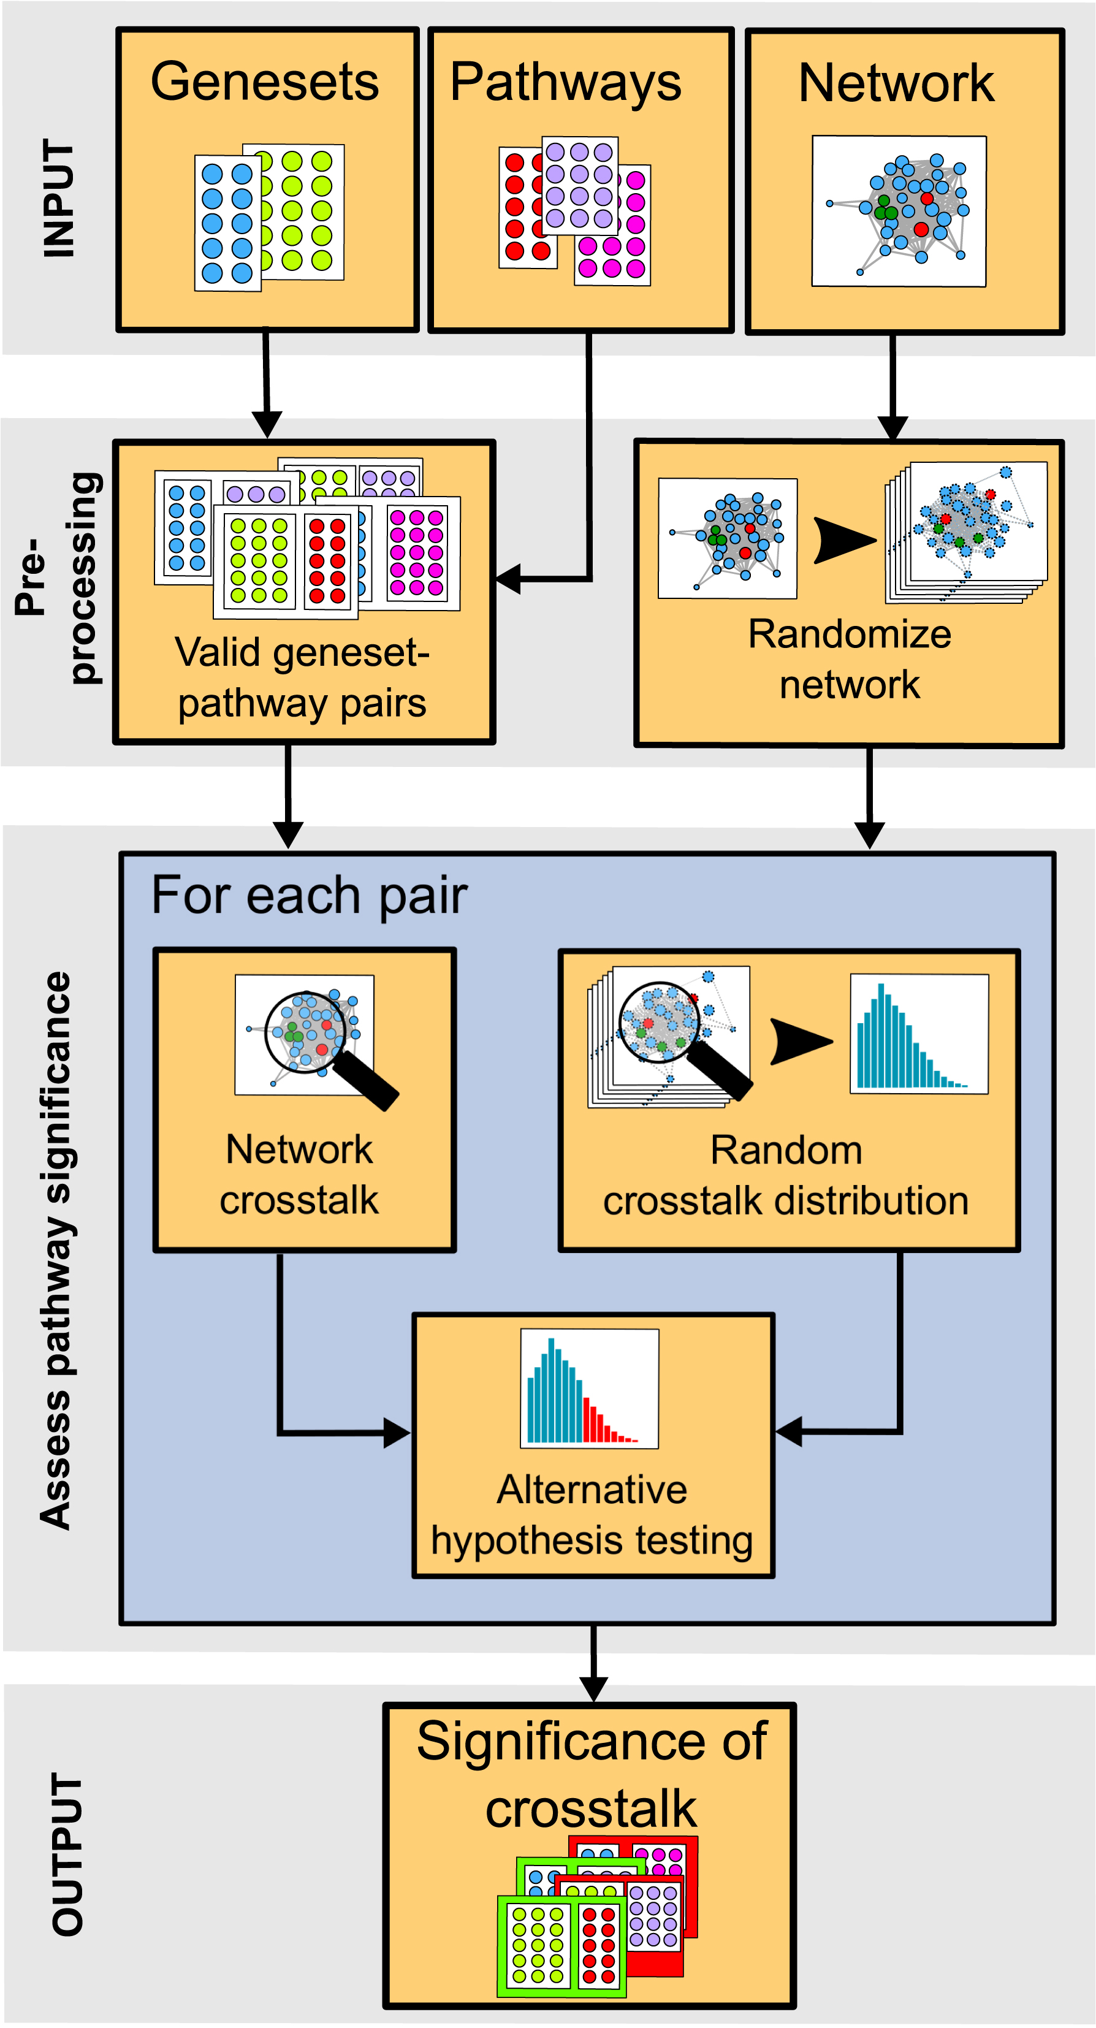
Figure 1. Workflow of BinoX. The algorithm is designed to assess the significance of crosstalk between multiple gene ...
Notes:
Figure 1. Workflow of BinoX. The algorithm is designed to assess the significance of crosstalk between multiple gene signatures and pathways using a genome wide functional association network as evidence. During preprocessing, BinoX validates gene set-pathway combinations by checking if any crosstalk exists. A random network model is generated based on the original network via Monte-Carlo simulation. The crosstalk significance between each gene set-pathway combination is estimated from the alternative (random) distribution (blue bars) and the observed original crosstalk (red bars). Finally the program summarizes the results and applies the Benjamini–Hochberg procedure to correct for multiple testing to distinguish between significant (green) and insignificant (red) crosstalk.
Unless provided in the caption above, the following copyright applies to the content of this slide: © The Author(s) 2016. Published by Oxford University Press on behalf of Nucleic Acids Research.This is an Open Access article distributed under the terms of the Creative Commons Attribution License (http://creativecommons.org/licenses/by-nc/4.0/), which permits non-commercial re-use, distribution, and reproduction in any medium, provided the original work is properly cited. For commercial re-use, please contact journals.permissions@oup.com

Slide 2
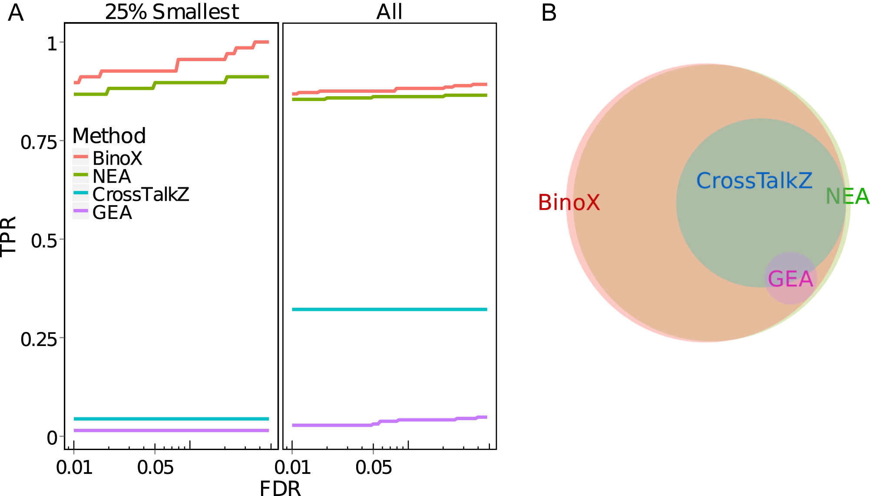
Figure 2. True positive rate (TPR) benchmark of BinoX, NEA, CrossTalkZ and GEA. The test was performed using KEGG ...
Notes:
Figure 2. True positive rate (TPR) benchmark of BinoX, NEA, CrossTalkZ and GEA. The test was performed using KEGG pathways separated into two parts with typical gene overlap. A true positive is defined as two parts from the same pathway having significant crosstalk. (A) The right panel shows the TPR for all pathways, and the left panel for the 25% smallest pathways. (B) Venn Diagram showing the overlap of true positives detected at FDR ≤ 0.05 by BinoX (98.1% of all detected), NEA (96.5% of all detected), CrossTalkZ (36.0% of all detected) and GEA (3.5% of all detected).
Unless provided in the caption above, the following copyright applies to the content of this slide: © The Author(s) 2016. Published by Oxford University Press on behalf of Nucleic Acids Research.This is an Open Access article distributed under the terms of the Creative Commons Attribution License (http://creativecommons.org/licenses/by-nc/4.0/), which permits non-commercial re-use, distribution, and reproduction in any medium, provided the original work is properly cited. For commercial re-use, please contact journals.permissions@oup.com

Slide 3
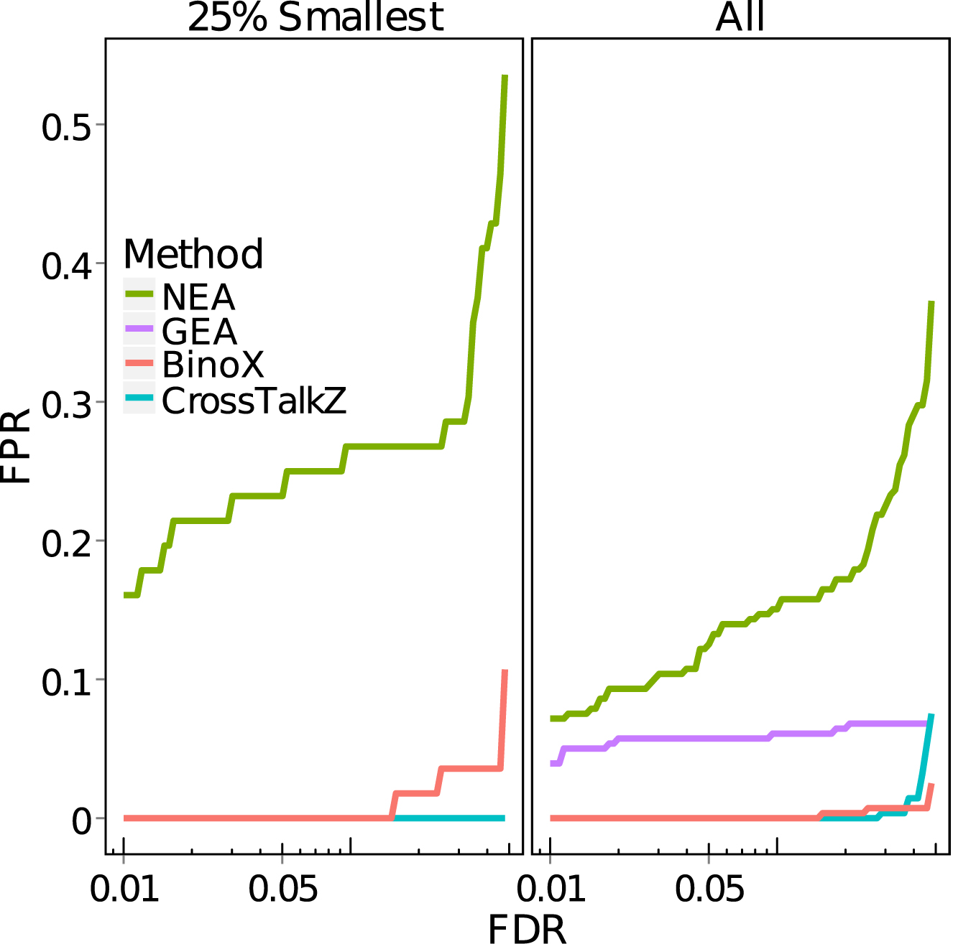
Figure 3. False positive rate benchmark of CrossTalkZ, NEA, GEA and BinoX. We generated random gene sets, mimicking the ...
Notes:
Figure 3. False positive rate benchmark of CrossTalkZ, NEA, GEA and BinoX. We generated random gene sets, mimicking the network structure of bisected KEGG pathways. Two random gene sets having significant crosstalk are defined as a false positive. The right panel shows the FPR for all gene sets, while the left panel is limited to the 25% smallest. As there are no overlapping genes in the latter dataset, GEA is unable to test any associations.
Unless provided in the caption above, the following copyright applies to the content of this slide: © The Author(s) 2016. Published by Oxford University Press on behalf of Nucleic Acids Research.This is an Open Access article distributed under the terms of the Creative Commons Attribution License (http://creativecommons.org/licenses/by-nc/4.0/), which permits non-commercial re-use, distribution, and reproduction in any medium, provided the original work is properly cited. For commercial re-use, please contact journals.permissions@oup.com

Slide 4
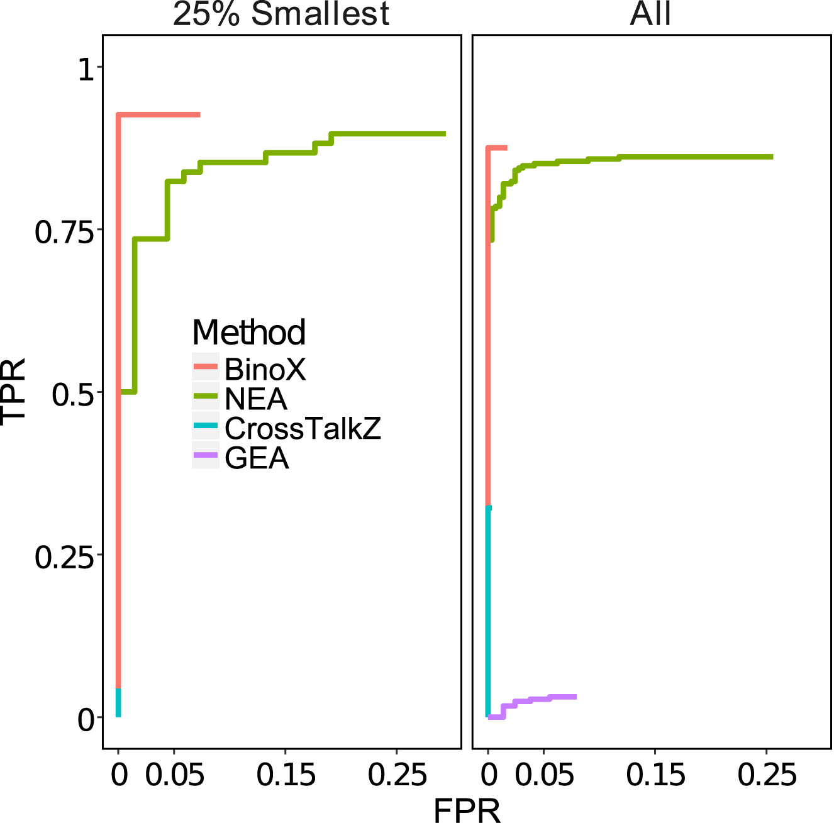
Figure 4. Partial Receiver Operating Characteristics curve, combining TPR and FPR while excluding all insignificant ...
Notes:
Figure 4. Partial Receiver Operating Characteristics curve, combining TPR and FPR while excluding all insignificant hits(FDR ≥ 0.05). Here GEA is not visible for the smallest 25% since it detects neither FP nor TP.
Unless provided in the caption above, the following copyright applies to the content of this slide: © The Author(s) 2016. Published by Oxford University Press on behalf of Nucleic Acids Research.This is an Open Access article distributed under the terms of the Creative Commons Attribution License (http://creativecommons.org/licenses/by-nc/4.0/), which permits non-commercial re-use, distribution, and reproduction in any medium, provided the original work is properly cited. For commercial re-use, please contact journals.permissions@oup.com

Slide 5
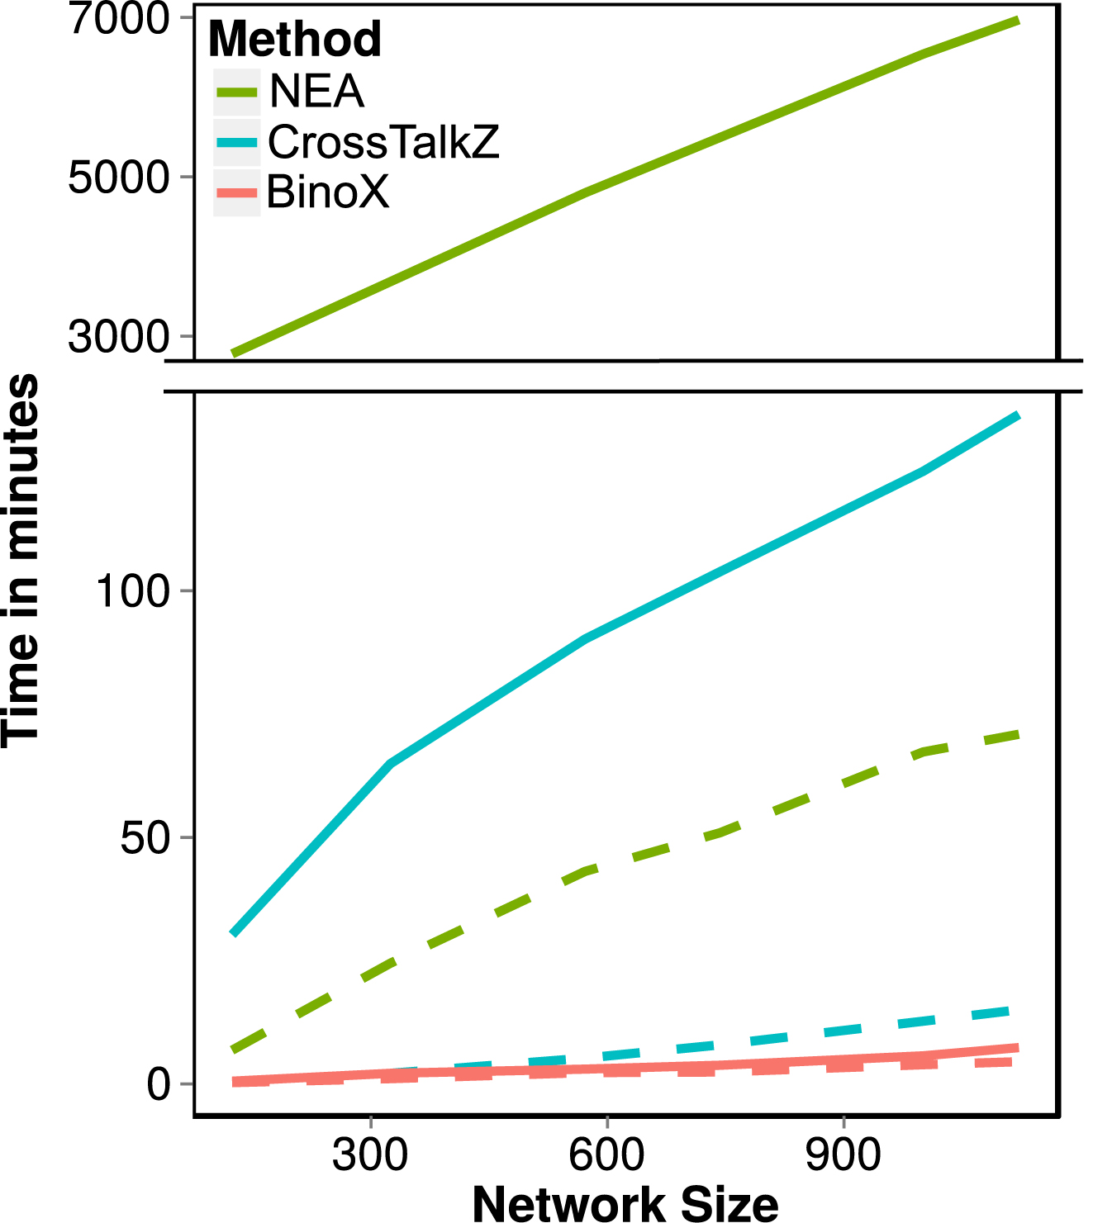
Figure 5. Compute times for CrossTalkZ, NEA and BinoX. Dashed lines: using a gene set of 120 randomly selected genes ...
Notes:
Figure 5. Compute times for CrossTalkZ, NEA and BinoX. Dashed lines: using a gene set of 120 randomly selected genes and calculating the crosstalk to itself for different network sizes. Solid lines: crosstalks between 2392 gene signatures and 288 KEGG pathways. Here NEA is shown with a separate scale. We did not use BinoX's pre-randomization mode which would have skipped the most computationally expensive part. The networks are from FunCoup 3.0 with link confidence 0.75, 0.8, 0.9, 0.9, 0.95, 0.99 and 1 (see Supplementary Table S1).
Unless provided in the caption above, the following copyright applies to the content of this slide: © The Author(s) 2016. Published by Oxford University Press on behalf of Nucleic Acids Research.This is an Open Access article distributed under the terms of the Creative Commons Attribution License (http://creativecommons.org/licenses/by-nc/4.0/), which permits non-commercial re-use, distribution, and reproduction in any medium, provided the original work is properly cited. For commercial re-use, please contact journals.permissions@oup.com

Slide 6
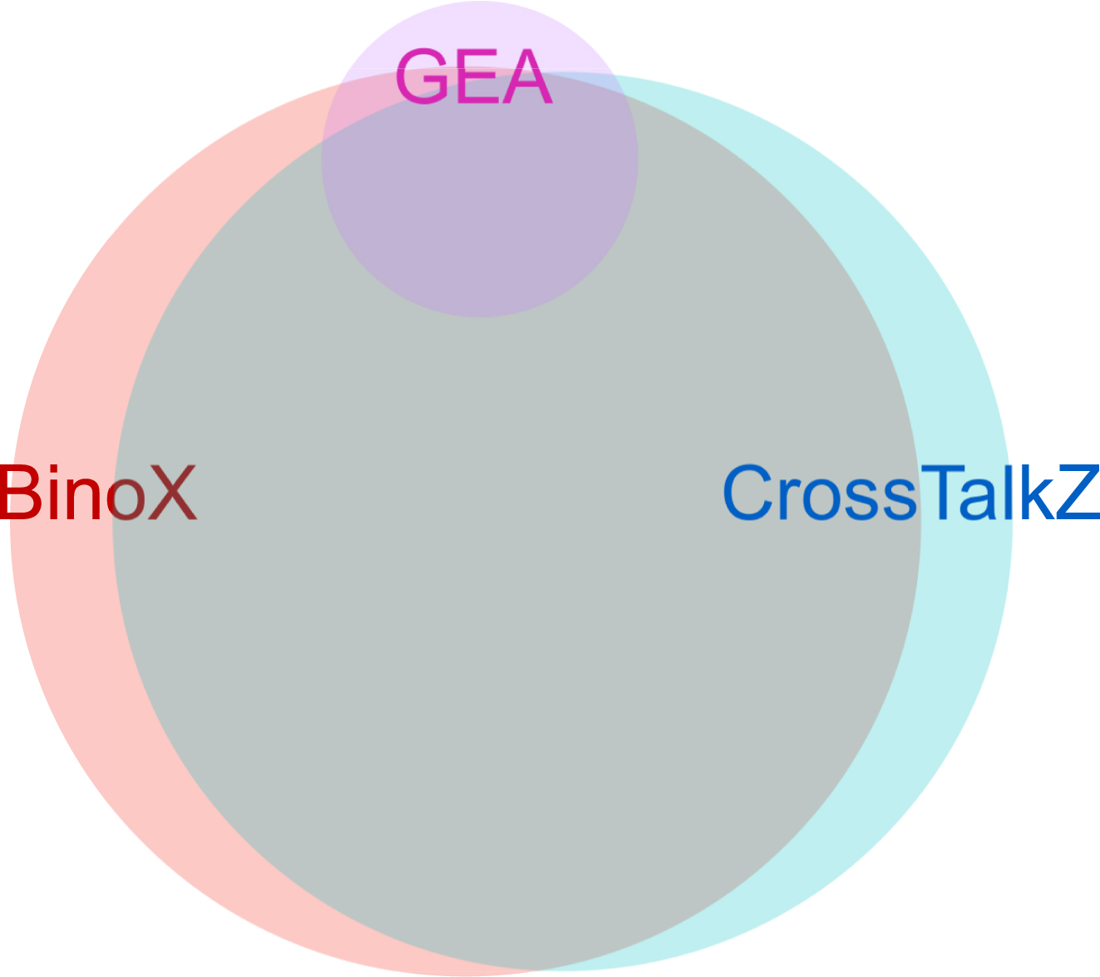
Figure 6. KEGG Pathway annotation for MSigDB. The Venn diagram is based on all significant pairs between 288 KEGG ...
Notes:
Figure 6. KEGG Pathway annotation for MSigDB. The Venn diagram is based on all significant pairs between 288 KEGG pathways and 2392 MSigDB gene signatures identified at a FDR ≤ 0.05. BinoX identified 207 600, CrossTalkZ 202 670 significant depletions and enrichments whereas GEA found only 25 106 significant enrichments.
Unless provided in the caption above, the following copyright applies to the content of this slide: © The Author(s) 2016. Published by Oxford University Press on behalf of Nucleic Acids Research.This is an Open Access article distributed under the terms of the Creative Commons Attribution License (http://creativecommons.org/licenses/by-nc/4.0/), which permits non-commercial re-use, distribution, and reproduction in any medium, provided the original work is properly cited. For commercial re-use, please contact journals.permissions@oup.com

