Slide 1
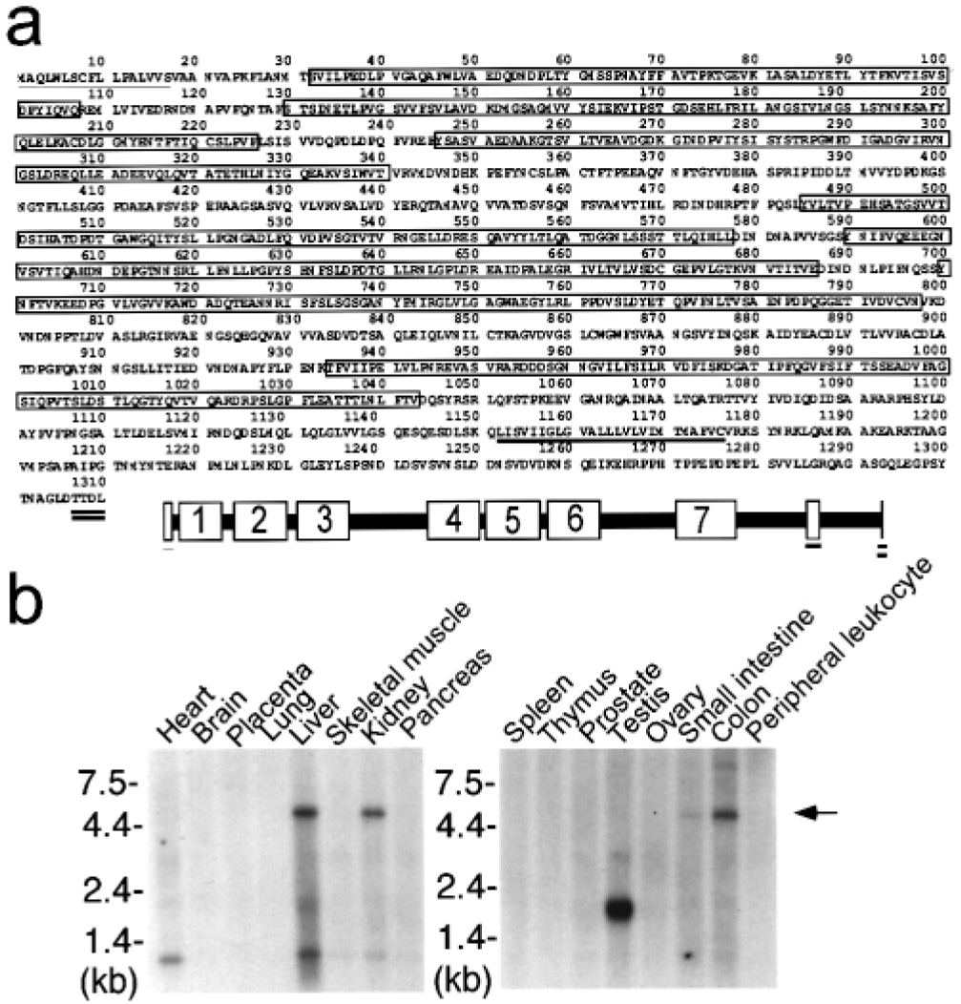
Fig. 1. A novel human Protocadherin LKC is predominantly expressed in liver, kidney and colon tissues. ( a ) The ...
Notes:
Fig. 1. A novel human Protocadherin LKC is predominantly expressed in liver, kidney and colon tissues. ( a ) The deduced amino acid sequence of Protocadherin LKC and its schematic representation. Protocadherin LKC has a signal peptide sequence (thin underline; 1–17), seven cadherin repeats (white boxes; 31–107, 129–226, 246–340, 485–577, 590–686, 700–797, 934–1043), a transmembrane domain (bold underline; 1152–1176) and a PDZ recognition sequence (double-bold underline; 1307–1310). ( b ) Northern blot analysis of Protocadherin LKC in several human tissues. Human multiple tissue northern blots (Clontech) were probed with Protocadherin LKC probe. Each lane contains 2 μg of poly(A)+ RNA. The source of each tissue sample appears on the top of the panel. The 5 kb Protocadherin LKC transcript is indicated by an arrow.
Unless provided in the caption above, the following copyright applies to the content of this slide: © Oxford University Press

Slide 2
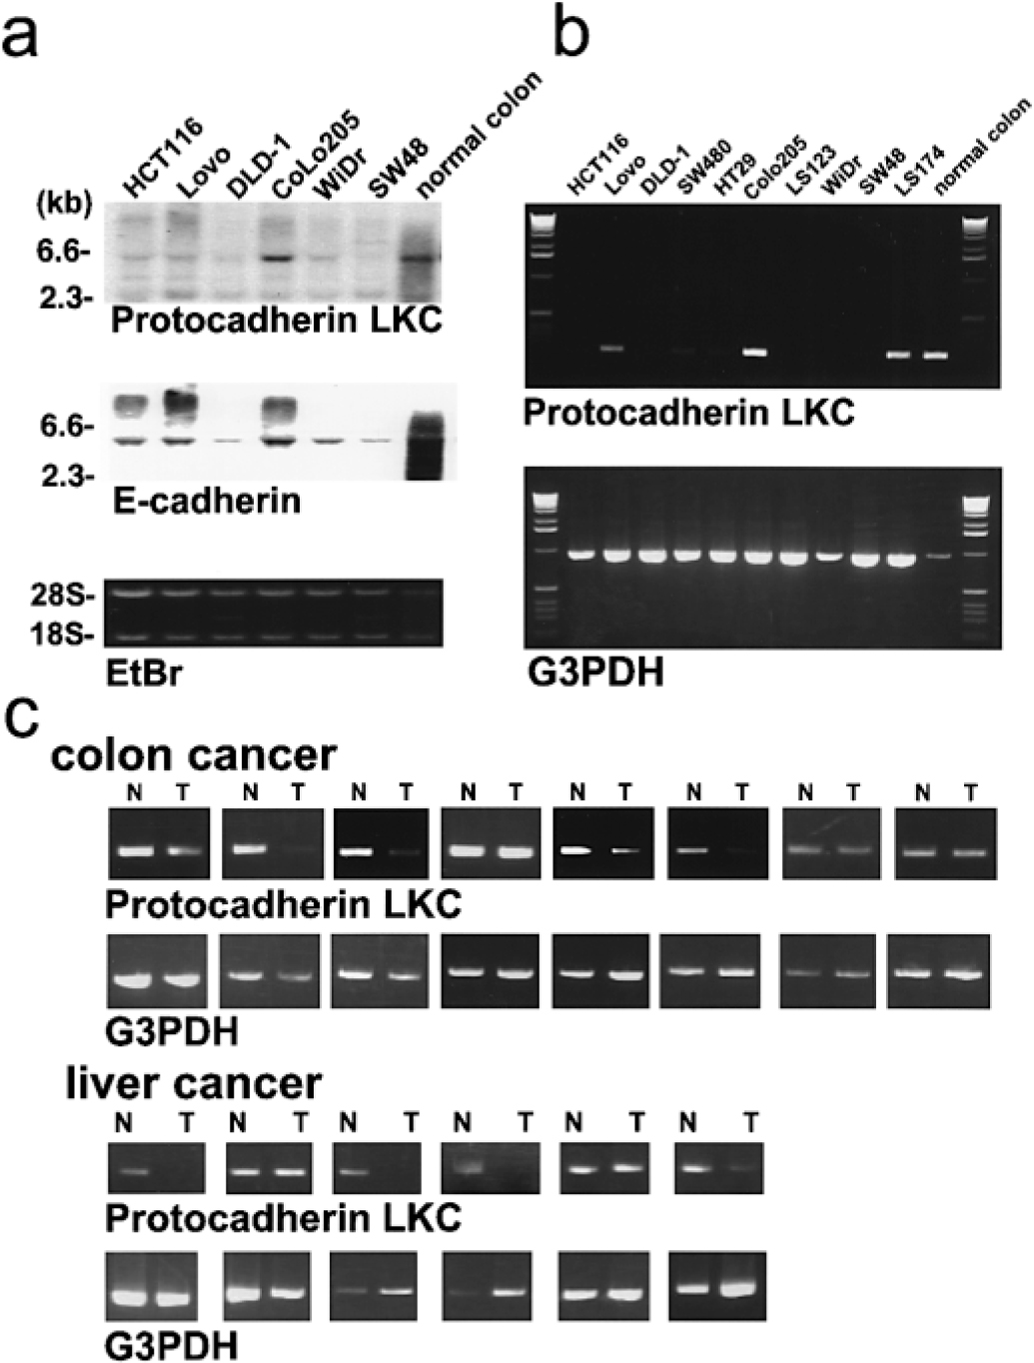
Fig. 2. Down regulation of Protocadherin LKC transcripts in colon and liver cancers. ( a ) Expression of ...
Notes:
Fig. 2. Down regulation of Protocadherin LKC transcripts in colon and liver cancers. ( a ) Expression of Protocadherin LKC and E-cadherin in colon cancer cell lines was determined by northern blot analysis. Each lane contains ∼3 μg of total RNA prepared from human colon cancer cell lines and normal colon tissue. The source of each tissue sample appears on the top of the panel. As a control, ethidium bromide (EtBr) staining was performed. ( b ) Expression of Protocadherin LKC in human colon cancer cell lines was determined by RT–PCR analysis. The name of each cell line appears on the top of the panel. As a control, G3PDH (glycerol 3-phosphate dehydrogenase) was amplified. ( c ) The expression of Protocadherin LKC in 14 matched pairs of colon and liver cancers (T) and surrounding normal (N) tissues was determined by RT–PCR analysis.
Unless provided in the caption above, the following copyright applies to the content of this slide: © Oxford University Press

Slide 3
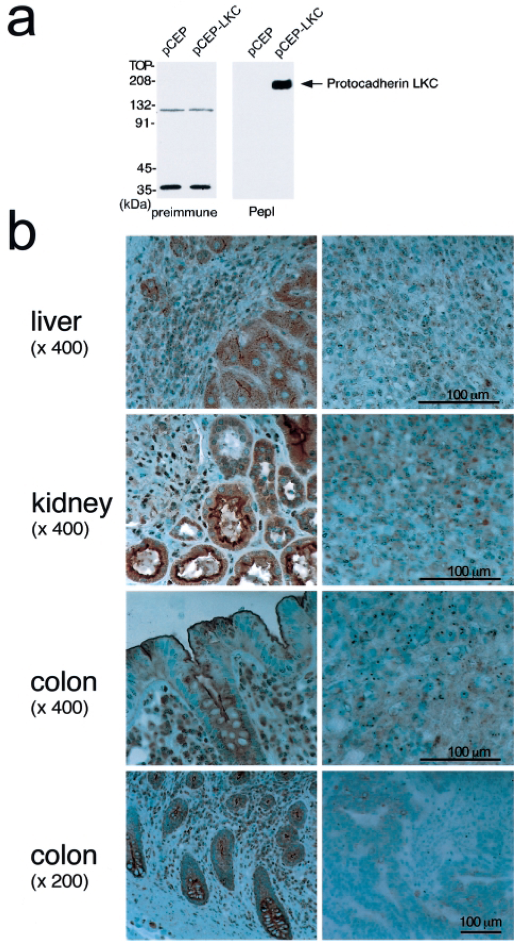
Fig. 3. Detection of Protocadherin LKC protein in liver, kidney and colon tissues and cancers. ( a ) Lysates from ...
Notes:
Fig. 3. Detection of Protocadherin LKC protein in liver, kidney and colon tissues and cancers. ( a ) Lysates from HEK293 cells transfected with Protocadherin LKC -expression (pCEP-LKC) and mock (pCEP) plasmids were resolved by 10% SDS–PAGE, and analyzed by western blot using anti-Protocadherin LKC antibody (PepI) and pre-immune serum. Approximately 180 kDa band, corresponding to Protocadherin LKC, is indicated by the arrow. ( b ) Immunohistochemical staining for Protocadherin LKC protein in four matched pairs of liver, kidney and colon cancer and surrounding normal tissues. Left panels: normal tissues, right panels: tumor tissues. Sections were stained with PepI antibody. Subsequently, 3,3′-diaminobenzidine tetrahydrochloride (DAB) was used for color development (brown) and sections were lightly counterstained with hematoxylin. Histopathologically, the tumors are hepatocellular carcinoma, clear cell type renal cell carcinoma, and moderately differentiated colon adenocarcinoma.
Unless provided in the caption above, the following copyright applies to the content of this slide: © Oxford University Press

Slide 4
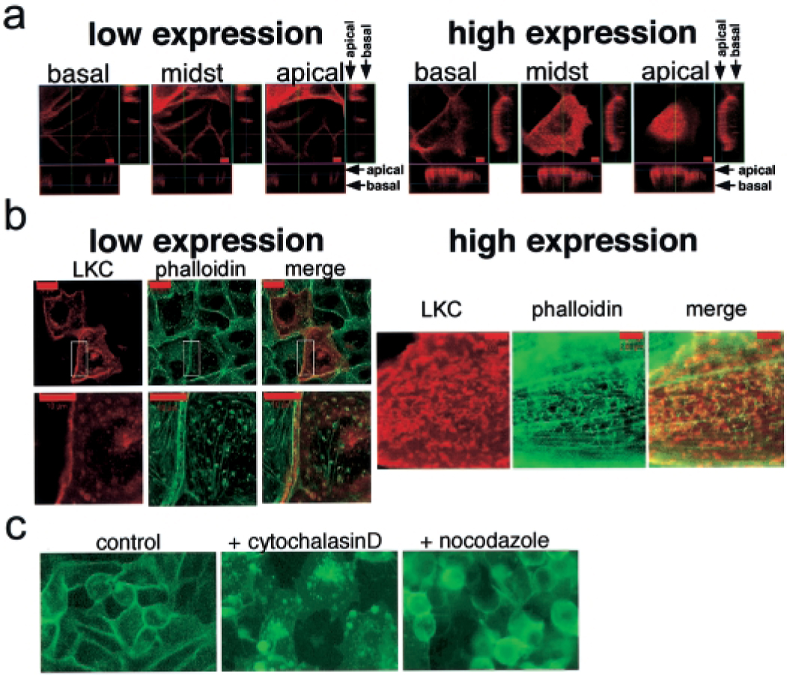
Fig. 4. Protocadherin LKC localizes at cell-to-cell junctions and the apical surface microvilli-like structures ...
Notes:
Fig. 4. Protocadherin LKC localizes at cell-to-cell junctions and the apical surface microvilli-like structures related to actin cytoskeleton. ( a ) pCEP-LKC plasmid was microinjected into MDCK cells, and after 48 h the cells were stained with anti-Protocadherin LKC antibody (red fluorescence). Microscopic images were obtained by laser scanning confocal microscopy (LSM510 Version 1.5/Curl Zeiss) and show the horizontal planes at different depths and in vertical sections (bar, 5 μm). ( b ) The microinjected cells were double-stained with anti-Protocadherin LKC antibody and Alexa™ 488 Phalloidin. The red fluorescence (LKC) and green fluorescence (phalloidin) indicate Protocadherin LKC protein and actin cytoskeleton, respectively. Merged images are also shown (merge). The cell-to-cell junction of microinjected and non-injected cells (left upper panel; bar, 20 μm white rectangles) was magnified to examine the relationship between Protocadherin LKC and cortical actin rim (left lower panels; bar, 10 μm). The protruding microvilli-like structures from the apical surface of the cells were also observed at high magnification (right panel; bar, 4 μm) ( c ) We established HCT116 clones stably expressing EGFP-fusion Protocadherin LKC (HCT116-B5) and treated them with cytochalasin D (0.5 μg/ml, 6 h), or nocodazole (0.5 μg/ml, 30 h). EGFP-fusion Protocadherin LKC protein (green) in living cells was observed using fluorescence microscopy.
Unless provided in the caption above, the following copyright applies to the content of this slide: © Oxford University Press

Slide 5
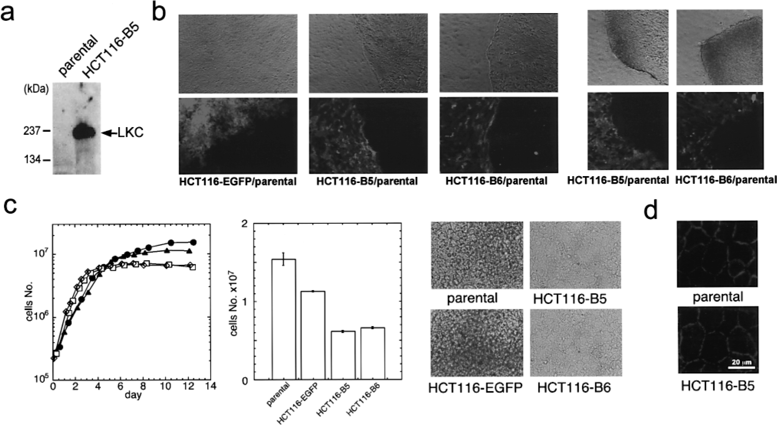
Fig. 5. Overexpression of Protocadherin LKC induces morphological changes and affects cell saturation density. ( a ) ...
Notes:
Fig. 5. Overexpression of Protocadherin LKC induces morphological changes and affects cell saturation density. ( a ) Lysates from HCT116 clones stably expressing EGFP-fusion Protocadherin LKC (HCT116-B5) and parental cells (HCT116) were analyzed by western blot using PepI antibody. An ∼180 kDa band corresponding to Protocadherin LKC is indicated by arrow. ( b ) HCT116 clones stably expressing EGFP (HCT116-EGFP) or EGFP-fusion Protocadherin LKC (HCT116-B5, HCT116-B6) were co-cultured with parental cells (HCT116). A mixture of parental cells and clone (1×10 3 cells) were seeded on 10 cm diameter dishes. The border of parental cells and each clone was examined at day 14 (left panels) and 21 (right panels) by fluorescence phase contrast microscopy. Upper panels indicate phase contrast microscopic images and lower panels fluorescence microscopic images. ( c ) 2×10 5 cells of HCT116-B5, HCT116-B6, HCT116-EGFP and parental HCT116 line were plated on 3.5-cm diameter dishes and cultured in the presence of serum. Triplicate dishes were counted at the indicated time points of the growth curves, and each determination represents the average value (left panel). Cell saturation density was estimated at day 12 (middle panel). Data represent the mean ± SD. At the same time point, cell morphology was observed by phase contrast microscopy (right panels). ( d ) Parental HCT116 and HCT116-B5 cells were stained with anti-E-cadherin antibody.
Unless provided in the caption above, the following copyright applies to the content of this slide: © Oxford University Press

Slide 6
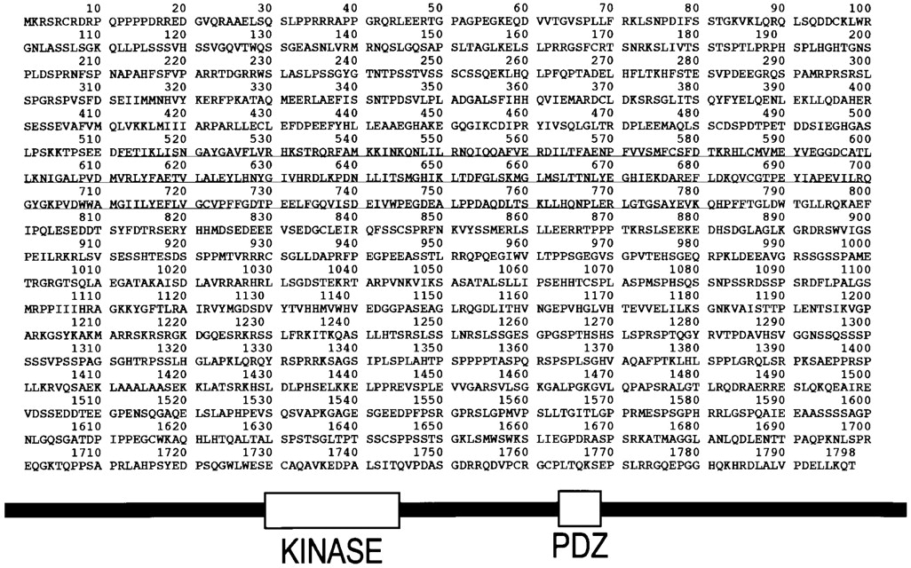
Fig. 6. Protocadherin LKC-interacting protein hMAST205. The deduced amino acid sequence of hMAST205 (human ...
Notes:
Fig. 6. Protocadherin LKC-interacting protein hMAST205. The deduced amino acid sequence of hMAST205 (human microtubule-associated serine/threonine kinase-205 kDa) and its schematic representation. hMAST205 has a Ser/Thr kinase domain (512–785) and a PDZ domain (1104–1191). Northern blot analysis of hMAST205 in several human tissues. Human multiple tissue northern blots (Clontech) were probed with hMAST205 probe. Each lane contains 2 μg of poly(A)+ RNA. The names of the tissues are shown on the top of the panels. The 7 kb hMAST205 transcript is indicated by an arrow.
Unless provided in the caption above, the following copyright applies to the content of this slide: © Oxford University Press

Slide 7
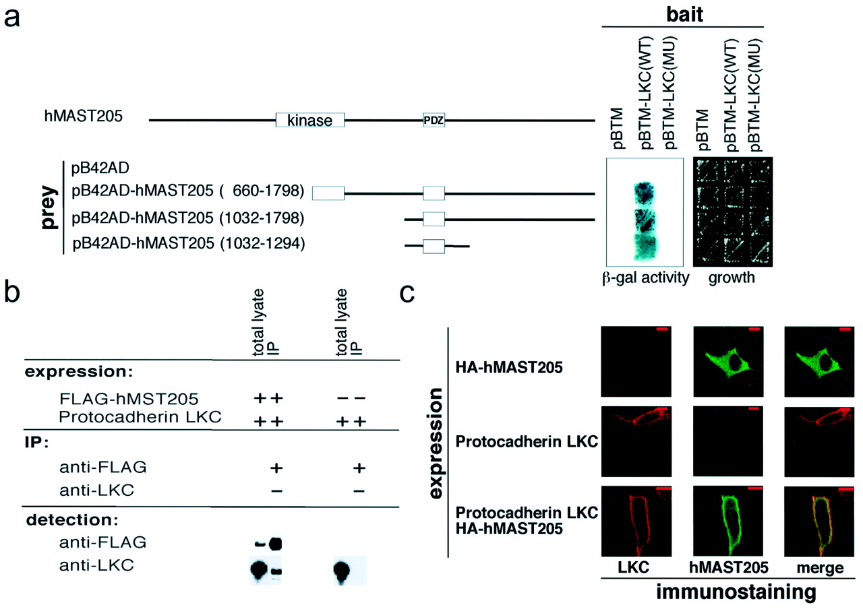
Fig. 7. Protocadherin LKC interacts with the PDZ domain of hMAST205 via its C-terminal tail. ( a ) Interaction of ...
Notes:
Fig. 7. Protocadherin LKC interacts with the PDZ domain of hMAST205 via its C-terminal tail. ( a ) Interaction of Protocadherin LKC with hMAST205 was detected by a yeast two-hybrid assay. The pLexA DNA-binding domain vector containing wild-type (pBTM-LKC(WT)) or mutant-type (pBTM-LKC(MU); Leu to Arg substitution at the PDZ-recognized peptide motif) intracellular domain of Protocadherin LKC was used as bait. Several deletion constructs of pB42AD-hMAST205 used as prey are shown on the left. For the negative controls, empty pB42AD and pBTM122DBD (pBTM) vectors were used. (Middle panel) β-Galactosidase activity and (right panel) growth of the yeast harboring each plasmid. ( b ) Immunoprecipitation of HEK293 cells transiently transfected with full-length Protocadherin LKC and/or FLAG-tagged C-terminal half of hMAST205 expression plasmids. The lysates were immunoprecipitated with anti-FLAG or anti-Protocadherin LKC antibody. The immunoprecipitates (IP) were separated by SDS–PAGE and analyzed by western blotting using anti-FLAG or anti- Protocadherin LKC antibody. Aliquots of the lysates (total lysate) were analyzed by western blotting using the same antibody. ( c ) Protocadherin LKC and/or HA-tagged hMAST205 expression plasmids were microinjected into the MDCK cells. After 48 h, the cells were fixed and double-stained with anti-Protocadherin LKC and anti-HA antibodies. The red fluorescence (left) and the green fluorescence (center) indicate Protocadherin LKC and hMAST205 proteins, respectively. Merged images are shown on the right (bar, 10 μm).
Unless provided in the caption above, the following copyright applies to the content of this slide: © Oxford University Press

