Slide 1
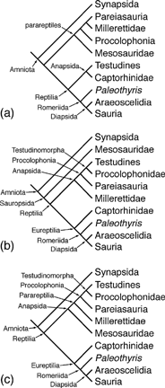
Figure 1 Cladograms showing the progression of ideas concerning amniote phylogeny and nomenclature that are in line ...
Notes:
Figure 1 Cladograms showing the progression of ideas concerning amniote phylogeny and nomenclature that are in line with traditional ideas for reptile interrelationships (i.e., Diapsida does not include Testudines). (a) Gauthier et al. (1988a). (b) Laurin and Reisz (1995). (c) Modesto (1999). The nomenclature shown employs a strict priority among the phylogenetic definitions for taxon names. Arrows indicate taxon names for clades.
Unless provided in the caption above, the following copyright applies to the content of this slide: © 2004 Society of Systematic Biologists

Slide 2
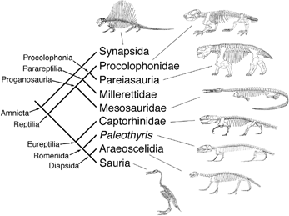
Figure 3 Amniote phylogeny illustrating revised nomenclature assuming diapsid identity of Testudines as hypothesized ...
Notes:
Figure 3 Amniote phylogeny illustrating revised nomenclature assuming diapsid identity of Testudines as hypothesized by Zardoya and Meyer (1998), Hedges and Poling (1999), and Rieppel and Reisz (1999), employing the revised phylogenetic definition for Reptilia suggested in the text. Arrows indicate taxon names for clades. Sources for skeletal reconstructions, from top to bottom: Dimetrodon from Romer and Price (1940); Procolophon from deBraga (2003) with permission from the National Research Council of Canada; Scutosaurus modified from Lee (1997); Mesosaurus original reconstruction by S. P. Modesto; Captorhinus (= Eocaptorhinus) from Heaton and Reisz (1980) with permission from The Paleontological Society; Paleothyris from Carroll (1969) with permission from The Paleontological Society; Araeoscelis reproduced from Reisz et al. (1984) with permission from R. R. Reisz and the Society of Vertebrate Paleontology; and Hesperornis from Marsh (1880).
Unless provided in the caption above, the following copyright applies to the content of this slide: © 2004 Society of Systematic Biologists

Slide 3
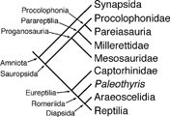
Figure 2 Amniote phylogeny illustrating revised nomenclature assuming the diapsid identity of Testudines as ...
Notes:
Figure 2 Amniote phylogeny illustrating revised nomenclature assuming the diapsid identity of Testudines as hypothesized by Zardoya and Meyer (1998), Hedges and Poling (1999), and Rieppel and Reisz (1999), and employing strict priority for phylogenetic definitions. The use of Reptilia here assumes the original crown group definition for the nomen (Gauthier et al., 1998a), not the definition provided by Laurin and Reisz (1995).
Unless provided in the caption above, the following copyright applies to the content of this slide: © 2004 Society of Systematic Biologists

