Slide 1
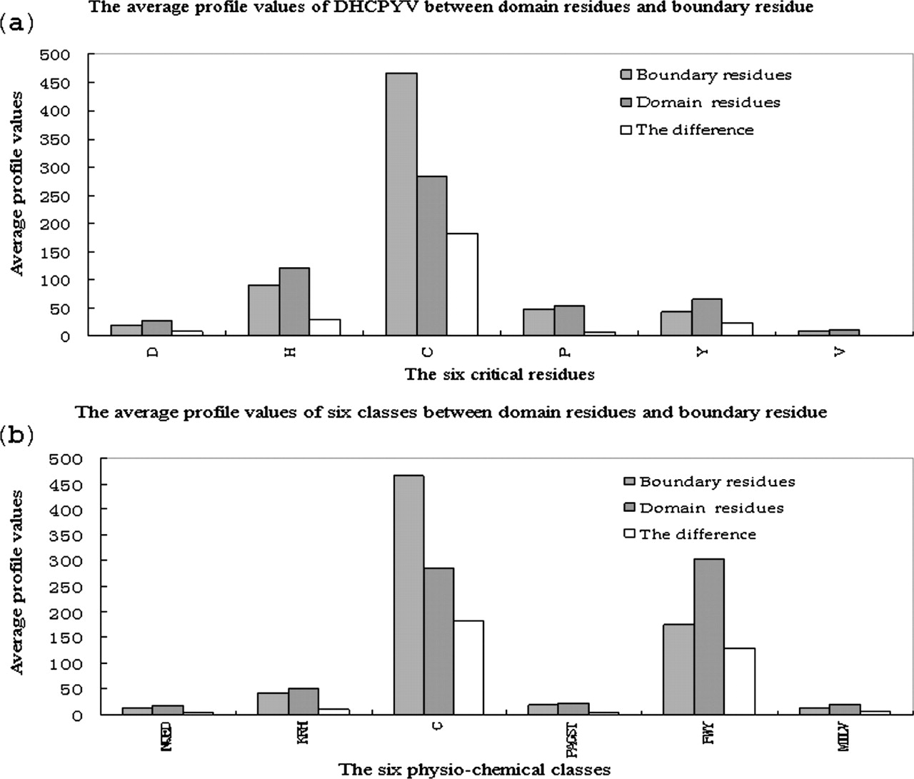
Figure 1 Comparison between average profile of critical residues ( a ) and the average profile of six physio-chemical ...
Notes:
Figure 1 Comparison between average profile of critical residues ( a ) and the average profile of six physio-chemical classes ( b ).
Unless provided in the caption above, the following copyright applies to the content of this slide: © The Author 2006. Published by Oxford University Press. All rights reserved The online version of this article has been published under an open access model. Users are entitled to use, reproduce, disseminate, or display the open access version of this article for non-commercial purposes provided that: the original authorship is properly and fully attributed; the Journal and Oxford University Press are attributed as the original place of publication with the correct citation details given; if an article is subsequently reproduced or disseminated not in its entirety but only in part or as a derivative work this must be clearly indicated. For commercial re-use, please contact journals.permissions@oxfordjournals.org

Slide 2
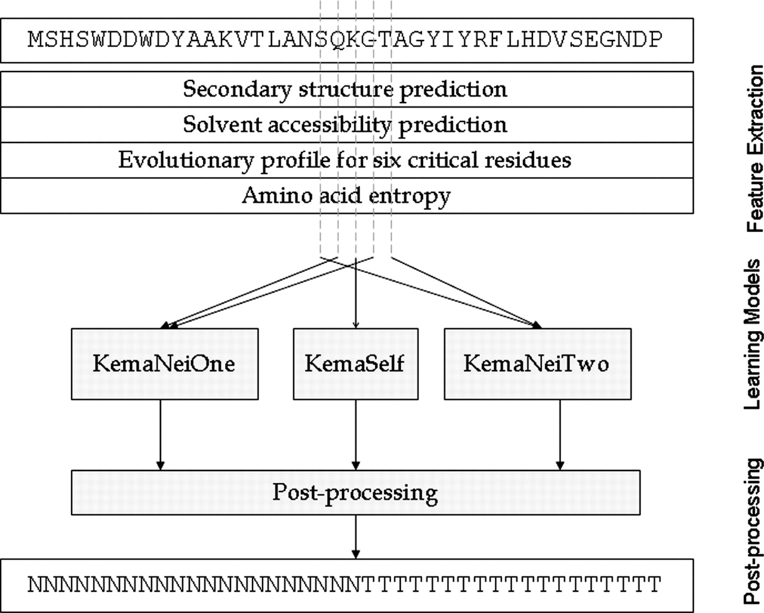
Figure 2 The architecture of KemaDom for domain prediction.
Notes:
Figure 2 The architecture of KemaDom for domain prediction.
Unless provided in the caption above, the following copyright applies to the content of this slide: © The Author 2006. Published by Oxford University Press. All rights reserved The online version of this article has been published under an open access model. Users are entitled to use, reproduce, disseminate, or display the open access version of this article for non-commercial purposes provided that: the original authorship is properly and fully attributed; the Journal and Oxford University Press are attributed as the original place of publication with the correct citation details given; if an article is subsequently reproduced or disseminated not in its entirety but only in part or as a derivative work this must be clearly indicated. For commercial re-use, please contact journals.permissions@oxfordjournals.org

Slide 3
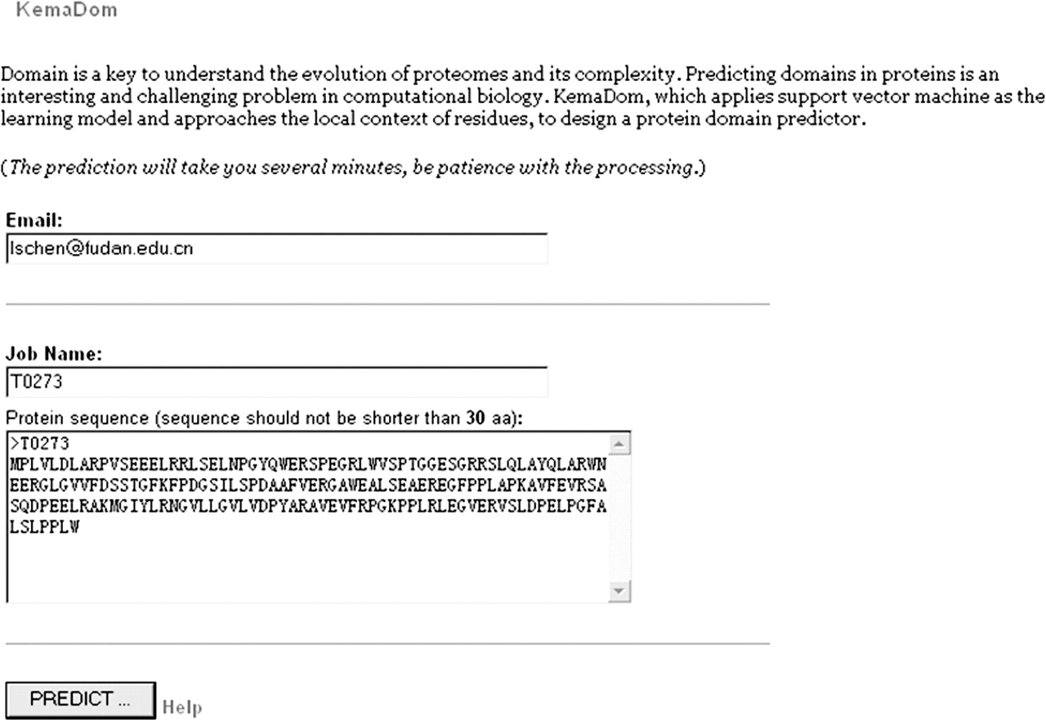
Figure 3 The interface of KemaDom. The Email address and the customized job name are required. The target sequence ...
Notes:
Figure 3 The interface of KemaDom. The Email address and the customized job name are required. The target sequence should be input with format which BioPerl (Bio::SeqIO) can recognize.
Unless provided in the caption above, the following copyright applies to the content of this slide: © The Author 2006. Published by Oxford University Press. All rights reserved The online version of this article has been published under an open access model. Users are entitled to use, reproduce, disseminate, or display the open access version of this article for non-commercial purposes provided that: the original authorship is properly and fully attributed; the Journal and Oxford University Press are attributed as the original place of publication with the correct citation details given; if an article is subsequently reproduced or disseminated not in its entirety but only in part or as a derivative work this must be clearly indicated. For commercial re-use, please contact journals.permissions@oxfordjournals.org

