Slide 1
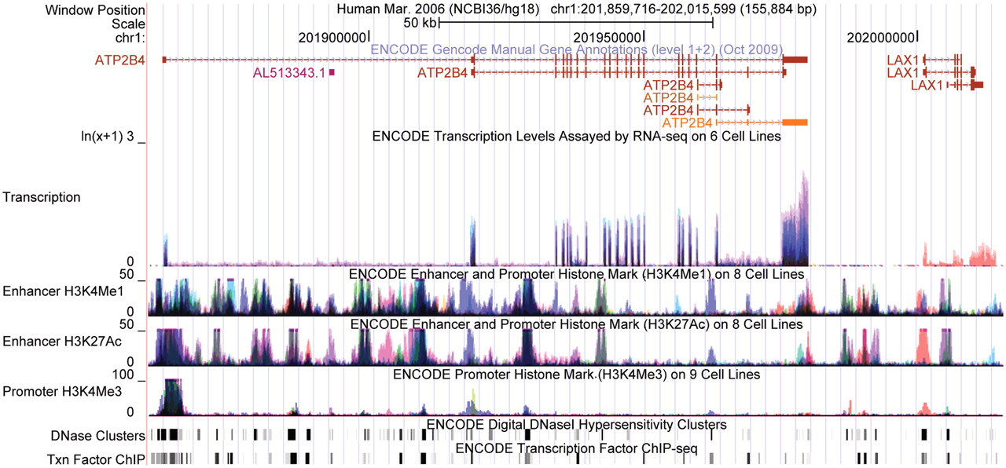
Figure 1. Constitutive and tissue-specific gene regulation under the ENCODE Integrated Regulation tracks. These tracks ...
Notes:
Figure 1. Constitutive and tissue-specific gene regulation under the ENCODE Integrated Regulation tracks. These tracks compare transcription, promoter marks and enhancer marks across the ENCODE Tier 1 and Tier 2 cell lines. Each cell line is rendered in one color, and darker regions indicate signals present in many cell types. ATP2B4 (left) is expressed constitutively, with the strongest expression in NHEK (lilac). Consistent with this, its leftmost promoter appears poised for activity in many tissues (indicated by the black signal in the Promoter H3K4Me3 track). Txn Factor ChIP shows abundant transcription factor binding at the promoter, and Enhancer H3K27Ac and Enhancer H3K4Me1 both show marks suggesting enhancer activity in many cell types. For contrast, LAX1 (right) shows expression only in GM12878 (orange). At the first promoter (shown in the upper isoforms), Promoter H3K4Me3 and Enhancer H3K27Ac show marks only in GM12878. At the second promoter (shown in the bottom isoform), Enhancer H3K27Ac appears active in NHEK (lilac), but Promoter H3K4Me3 does not appear to be active, suggesting that a transcriptional enhancer may be poised for activity but the promoter is not.
Unless provided in the caption above, the following copyright applies to the content of this slide: © The Author(s) 2010. Published by Oxford University Press.This is an Open Access article distributed under the terms of the Creative Commons Attribution Non-Commercial License (http://creativecommons.org/licenses/by-nc/2.5), which permits unrestricted non-commercial use, distribution, and reproduction in any medium, provided the original work is properly cited.

