Slide 1
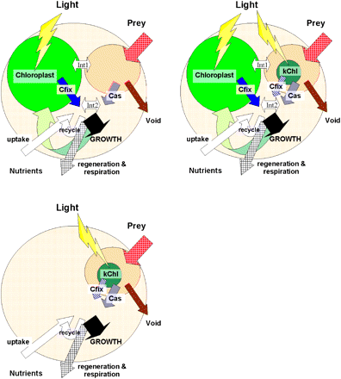
Fig. 1. Different configurations of mixotroph physiology described by the model of Flynn and Mitra (2009). Bottom ...
Notes:
Fig. 1. Different configurations of mixotroph physiology described by the model of Flynn and Mitra (2009). Bottom left: mixotroph performing photosynthesis using kleptoplastids from captured prey; digestion of chloroplasts is restricted by products of carbon fixation, so that when they fail then they are replaced. Top left: phototrophic mixotrophy obtaining additional nutrition by prey consumption. Int1 indicates competition for space within cells between chloroplasts and food vacuoles (only for phagotrophic species), Int2 indicates interactions between biosynthesis based upon newly fixed carbon or from prey digestion. Top right: combination of interactions from mixotroph and kleptochloroplastidic carbon-fixation and prey digestion. (This figure is available in colour at JXB online.)
Unless provided in the caption above, the following copyright applies to the content of this slide: © The Author [2009]. Published by Oxford University Press [on behalf of the Society for Experimental Biology]. All rights reserved. For Permissions, please e-mail: journals.permissions@oxfordjournals.org

