Slide 1
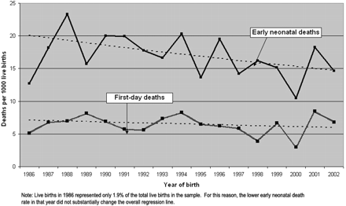
Figure 1 Trends in first-day (day 0) and early neonatal (days 0–6) deaths, Indonesia Demographic and Health Surveys, ...
Notes:
Figure 1 Trends in first-day (day 0) and early neonatal (days 0–6) deaths, Indonesia Demographic and Health Surveys, 1986–2002
Unless provided in the caption above, the following copyright applies to the content of this slide: Published by Oxford University Press in association with The London School of Hygiene and Tropical Medicine © The Author 2009; all rights reserved.

Slide 2
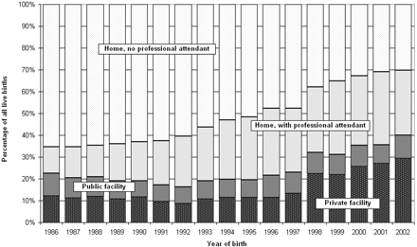
Figure 2 Trends in the distribution of live births by delivery context, Indonesia Demographic and Health Surveys, ...
Notes:
Figure 2 Trends in the distribution of live births by delivery context, Indonesia Demographic and Health Surveys, 1986–2002
Unless provided in the caption above, the following copyright applies to the content of this slide: Published by Oxford University Press in association with The London School of Hygiene and Tropical Medicine © The Author 2009; all rights reserved.

