Slide 1
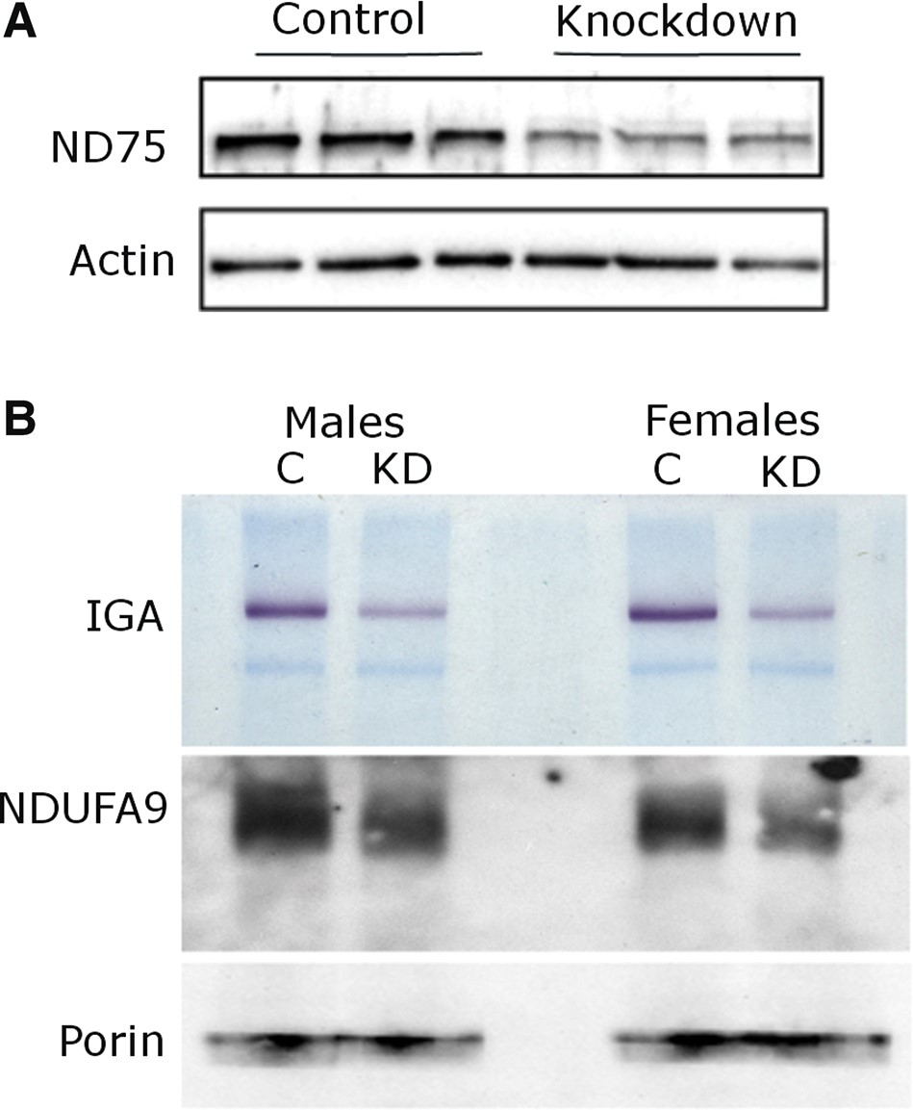
Figure 1. Reduction of ND75 and complex I in knockdown animals. (A) Western blot shows reduced ND75 levels (upper ...
Notes:
Figure 1. Reduction of ND75 and complex I in knockdown animals. (A) Western blot shows reduced ND75 levels (upper panel). The blot is reprobed for actin to illustrate equivalent protein loading (lower panel). (B) Native gel electrophoresis with complex I in-gel activity assay (IGA) shows reduction of complex I activity (upper panel). Immunoblotting of the same shows reduction in a distinct component of complex I (NDUFA9/CG6020 middle panel), and equivalent total amount of mitochondrial loading as illustrated by porin (lower panel). Flies are 10 days old. Driver is da-GAL4; control is da-GAL4/+.
Unless provided in the caption above, the following copyright applies to the content of this slide: © The Author 2014. Published by Oxford University Press. All rights reserved. For Permissions, please email: journals.permissions@oup.com

Slide 2
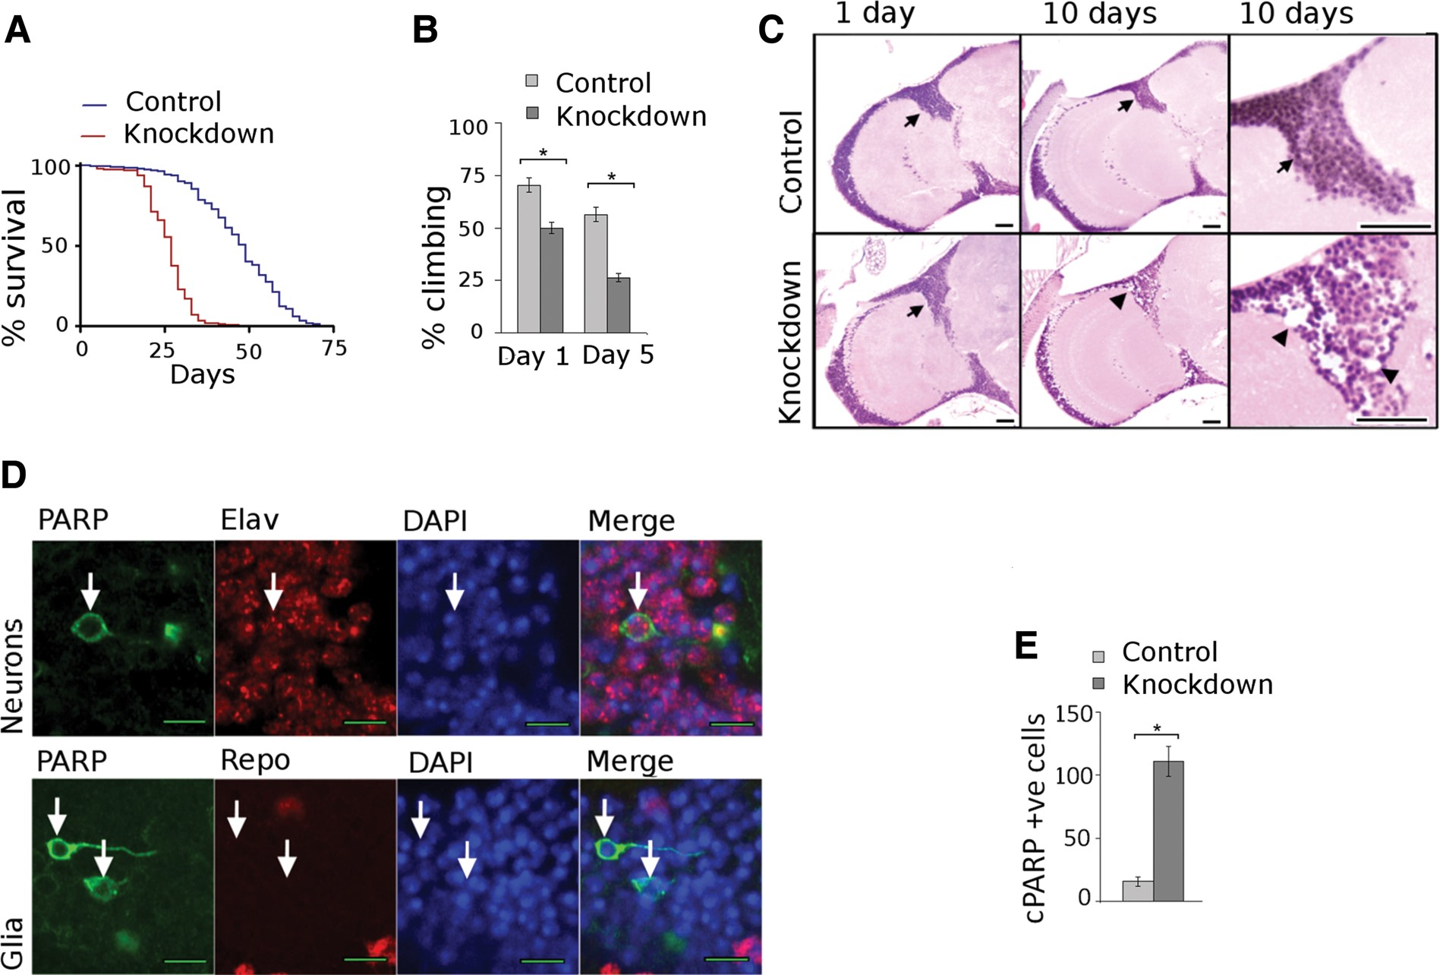
Figure 2. Complex I knockdown phenotypes. (A) Kaplan–Meyer survival curves show truncated lifespan in knockdown ...
Notes:
Figure 2. Complex I knockdown phenotypes. (A) Kaplan–Meyer survival curves show truncated lifespan in knockdown animals. N = 300 per genotype, P < 0.001, log rank test. (B) Climbing assays show progressive motor dysfunction in knockdown animals. N = 60 per genotype. *P < 0.05, Student's t-test. (C) Brain histology is normal in control animals at 1 and 10 days, while marked neuronal loss is seen in mutants at 10 days. Scale bars are 20 µm. (D) Caspase activation is detected by cleaved PARP in neurons (upper panel, arrows) but not in glia (lower panel, arrows). Scale bar is 5 µm. (E) Significantly higher number of cleaved PARP positive cells in brains of knockdown flies when compared with control flies. Flies are 10 days old. N = 5 per genotype. *P < 0.001, Student's t-test. Driver is da-GAL4; control is da-GAL4/+.
Unless provided in the caption above, the following copyright applies to the content of this slide: © The Author 2014. Published by Oxford University Press. All rights reserved. For Permissions, please email: journals.permissions@oup.com

Slide 3
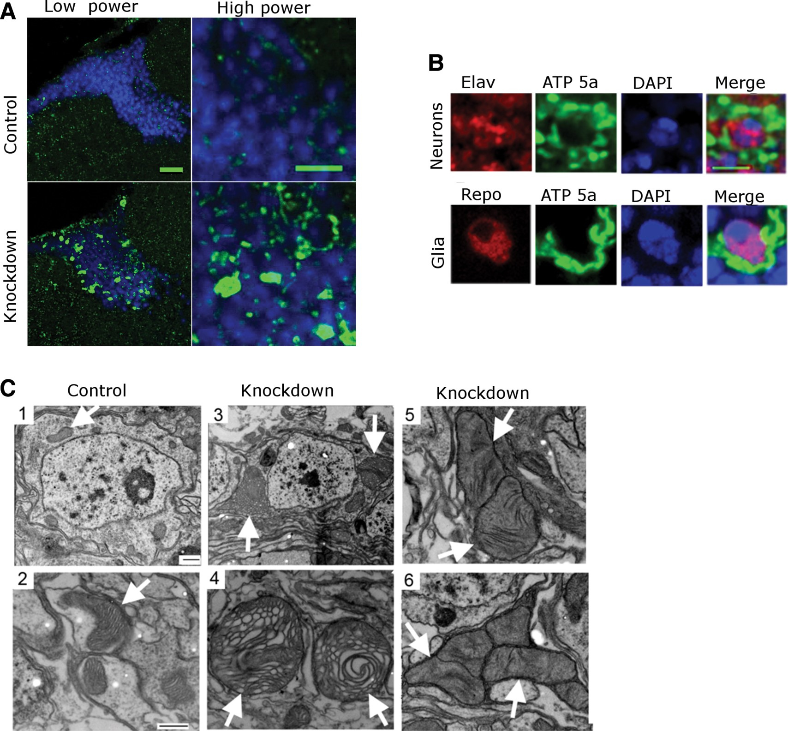
Figure 3. Mitochondrial enlargement in complex I deficiency. (A) Staining with an antibody to a subunit of complex V ...
Notes:
Figure 3. Mitochondrial enlargement in complex I deficiency. (A) Staining with an antibody to a subunit of complex V shows abnormal mitochondrial enlargement in the cortex of knockdown flies 10 days. Low power scale bar is 20 µm and high power scale bar is 5 µm. (B) Costaining with antibodies to complex V and either the neuronal marker elav or the glial marker repo, demonstrates colocalization of mitochondrial enlargement with both cell types. Scale bar is 3 µm. (C) Electron microscopy shows normal mitochondrial size with normal structure of the cristae (arrows) in control neurons (1,2). In contrast, knockdown flies (3,4,5,6) display mitochondrial enlargement and morphological abnormalities such as honeycombing, effacement of cristae and concentric lammelations. Flies are 30 days old in EM experiments. Scale bars are 500 nm in the EM images. Driver is da-GAL4; control is da-GAL4/+.
Unless provided in the caption above, the following copyright applies to the content of this slide: © The Author 2014. Published by Oxford University Press. All rights reserved. For Permissions, please email: journals.permissions@oup.com

Slide 4
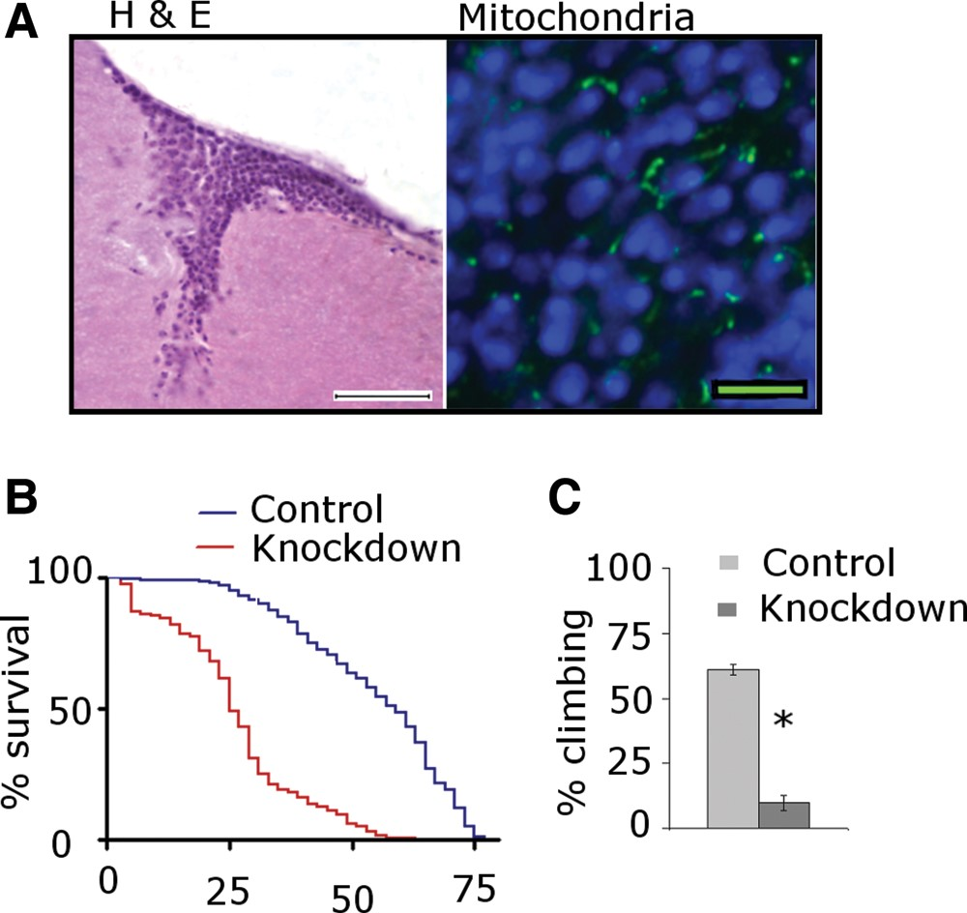
Figure 4. Neuronal complex I knockdown. (A) Selective knockdown of ND75 in neurons produces normal brain histology ...
Notes:
Figure 4. Neuronal complex I knockdown. (A) Selective knockdown of ND75 in neurons produces normal brain histology (left) and morphologically normal mitochondria (right). Scale bars are 20 µm in the H&E section and 5 μm in the immunostained section. Flies are 10 days old. (B) Kaplan–Meyer curves show significantly truncated lifespan with neuronal-selective ND75 knockdown animals. N = 300 per genotype; P < 0.001, log rank test. (C) Climbing assays show significant motor dysfunction in knockdown animals at 5 days. N = 60 per genotype. *P < 0.001, Student's t-test. Driver is elav-GAL4; control is elav-GAL4/+.
Unless provided in the caption above, the following copyright applies to the content of this slide: © The Author 2014. Published by Oxford University Press. All rights reserved. For Permissions, please email: journals.permissions@oup.com

Slide 5
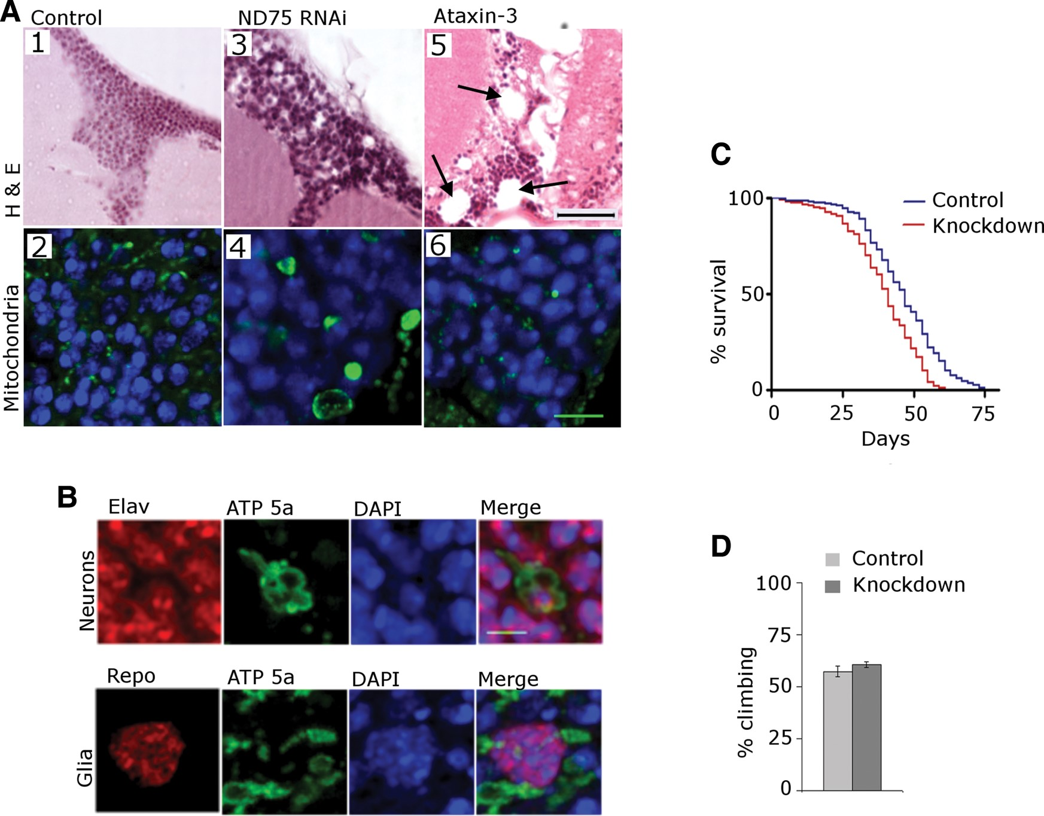
Figure 5. Glial contributions to neurotoxicity. (A) Selective knockdown of ND75 in glia produces cortical cell loss and ...
Notes:
Figure 5. Glial contributions to neurotoxicity. (A) Selective knockdown of ND75 in glia produces cortical cell loss and vacuolation in the brain (A3). Mitochondrial staining of the glial ND75 knockdown line (A4) demonstrates mitochondrial enlargement similar to that seen in ubiquitous complex I knockdown. H&E sections of the brains from flies expressing mutant human ataxin-3 in glia shows marked cortical and neuropil tissue disruption (A5), but normal mitochondrial size (A6). Scale bar is 20 µm in the H&E sections and 5 µm in the immunostained sections. (B) Co-staining with antibodies to complex V and either the neuronal marker elav or the glial marker repo, demonstrates mitochondrial enlargement in both cell types. Scale bar is 3 µm. (C) Kaplan–Meyer curves show truncation of lifespan in glial ND75 knockdown flies N = 300 per genotype; P < 0.001, log rank test. (D) Climbing assays show no motor dysfunction in knockdown animals. N = 60 per genotype. *P < 0.001, Student's t-test. Flies are 10 days old. Driver is repo-GAL4; control is repo-GAL4/+.
Unless provided in the caption above, the following copyright applies to the content of this slide: © The Author 2014. Published by Oxford University Press. All rights reserved. For Permissions, please email: journals.permissions@oup.com

