Slide 1
Figure 1. (a) In both the auditory and visual paradigm, perception is made difficult by having noise in the stimulus ...
Notes:
Figure 1. (a) In both the auditory and visual paradigm, perception is made difficult by having noise in the stimulus presentation. This creates a delay in target identification (for Experiment 2 M (mean) = 14.9 s, standard deviation [SD] = 6.4 s for sounds; M = 11.0 s, SD = 10.3 s for pictures) and dissociates the stimulus parameters from identification and onset of a specific conscious content. For each trial, the participant presses a button when he/she identified the target object. To separate brain activity related to this motor response from activity specific for identification, a second button press is made some time later during the same trial. This creates a unique blood oxygen level–dependent activation profile for the motor response (M), identification (I), and also the continuous sustained perception (SP) following identification, allowing an analytical separation of each effect within trials. (b) In Experiment 1, only auditory stimuli were used (supplementary wav-file online), and in Experiment 2, both auditory and visual stimuli were used. This example visual stimulus depicts a small bird in green lines “hidden” among distractor lines (noise).
Unless provided in the caption above, the following copyright applies to the content of this slide: © The Author 2006. Published by Oxford University Press. All rights reserved. For permissions, please e-mail: journals.permissions@oxfordjournals.org

Slide 2
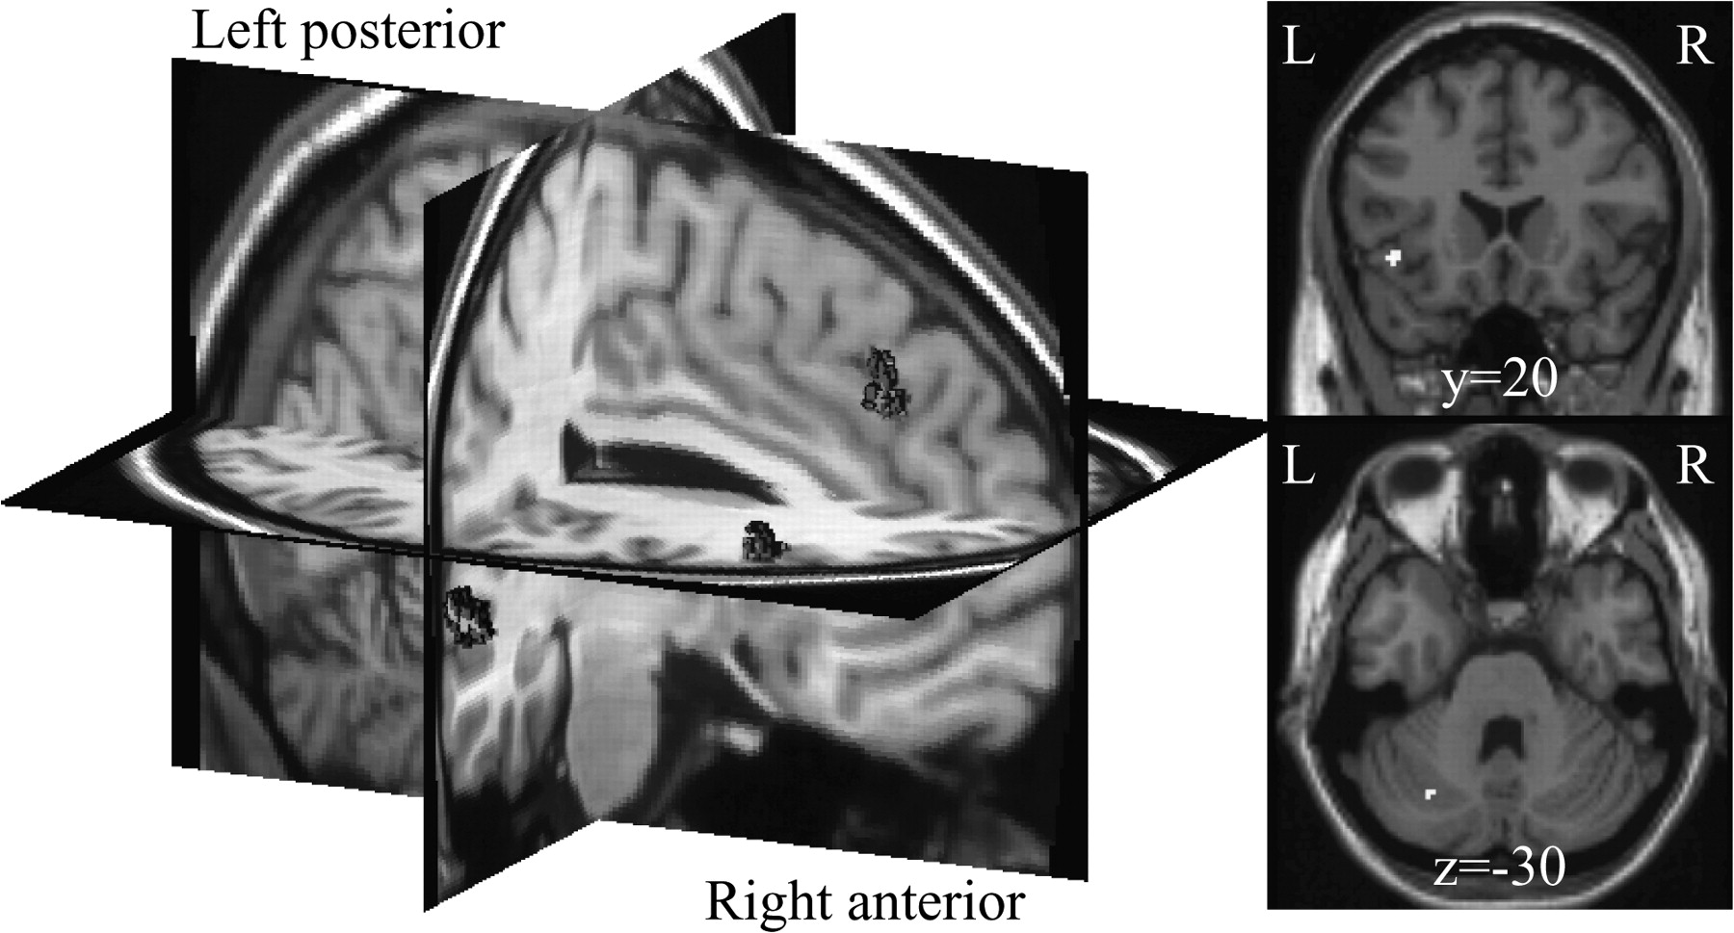
Figure 2. Identification of sounds in Experiment 1 activated right superior temporal cortex (MNI x, y, z = 64, −24, 4), ...
Notes:
Figure 2. Identification of sounds in Experiment 1 activated right superior temporal cortex (MNI x, y, z = 64, −24, 4), bilateral prefrontal cortex (−42, 20, −6; 52, 30, 18), ACC (6, 34, 38), and cerebellum (−28, −66, −30). All activations are significant at P < 0.05 corrected for whole-brain volume. Right hemisphere activations are illustrated as volume clouds (Van Essen and others 2001; left in figure), and left hemisphere activations are overlaid on single-subject T1-weighted images (right).
Unless provided in the caption above, the following copyright applies to the content of this slide: © The Author 2006. Published by Oxford University Press. All rights reserved. For permissions, please e-mail: journals.permissions@oxfordjournals.org

Slide 3
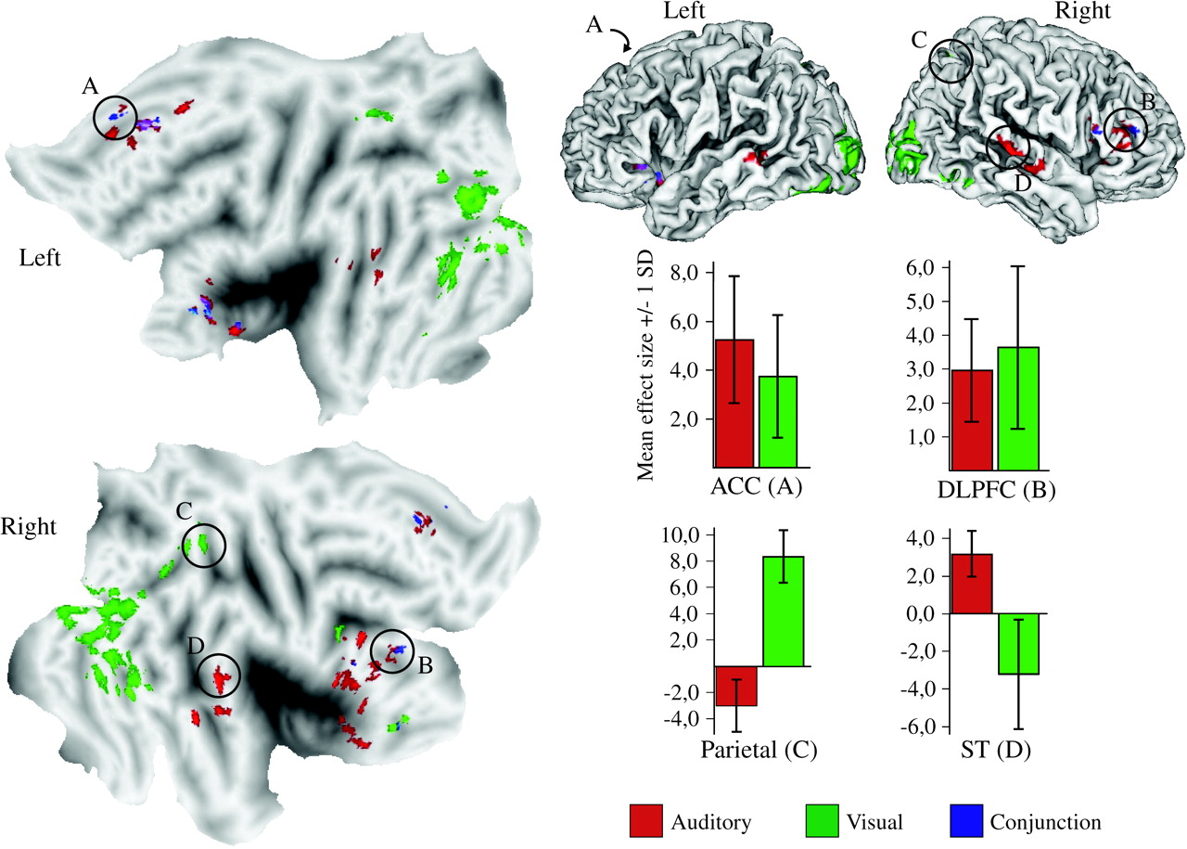
Figure 3. Lateral view (top right) of left and right hemispheres with auditory (red) and visual (green) activations ...
Notes:
Figure 3. Lateral view (top right) of left and right hemispheres with auditory (red) and visual (green) activations from Experiment 2 (P < 0.01 corrected for false discovery rate). Blue regions designate results from the conjunction analysis across modalities. Diagrams show group mean effect size in selected regions. The left part of the figure shows activations projected on flat maps (Van Essen and others 2001). The within-experiment comparison showed that ACC (A) and lateral PFC (B) were similarly activated for both auditory and visual awareness, whereas parietal (C) and occipitotemporal regions were exclusively activated for visual awareness and superior temporal cortex (D) exclusively for auditory awareness. (Center coordinates for (A): −2, 26, 44; (B): 48, 44, 14; (C): 22, −66, 54; (D): 66, −22, −10). Letter indexing designates the same regions in flat maps, lateral views, and diagrams.
Unless provided in the caption above, the following copyright applies to the content of this slide: © The Author 2006. Published by Oxford University Press. All rights reserved. For permissions, please e-mail: journals.permissions@oxfordjournals.org

