Slide 1
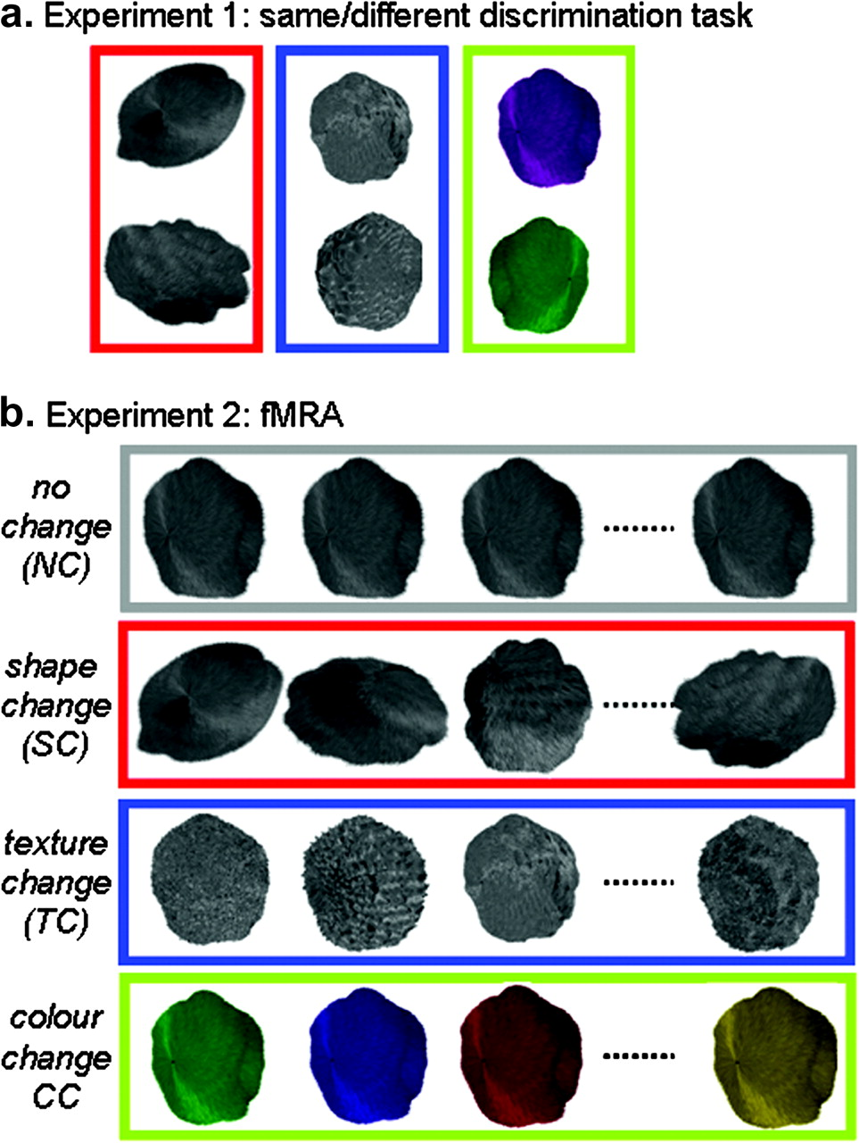
Figure 1. Visual stimuli for Experiments 1 and 2 were assembled using virtual 3D textured irregular objects resembling ...
Notes:
Figure 1. Visual stimuli for Experiments 1 and 2 were assembled using virtual 3D textured irregular objects resembling furry balls. (a) In Experiment 1, participants were asked to perform same–different judgments on objects that could vary in shape, texture or color only. Examples of trials are shown for the “different” condition only. (b) In Experiment 2, objects were assembled in order to create blocks of NC, SC, TC, and CC stimuli.
Unless provided in the caption above, the following copyright applies to the content of this slide: © The Author 2010. Published by Oxford University Press. All rights reserved. For permissions, please e-mail: journals.permissions@oxfordjournals.org

Slide 2
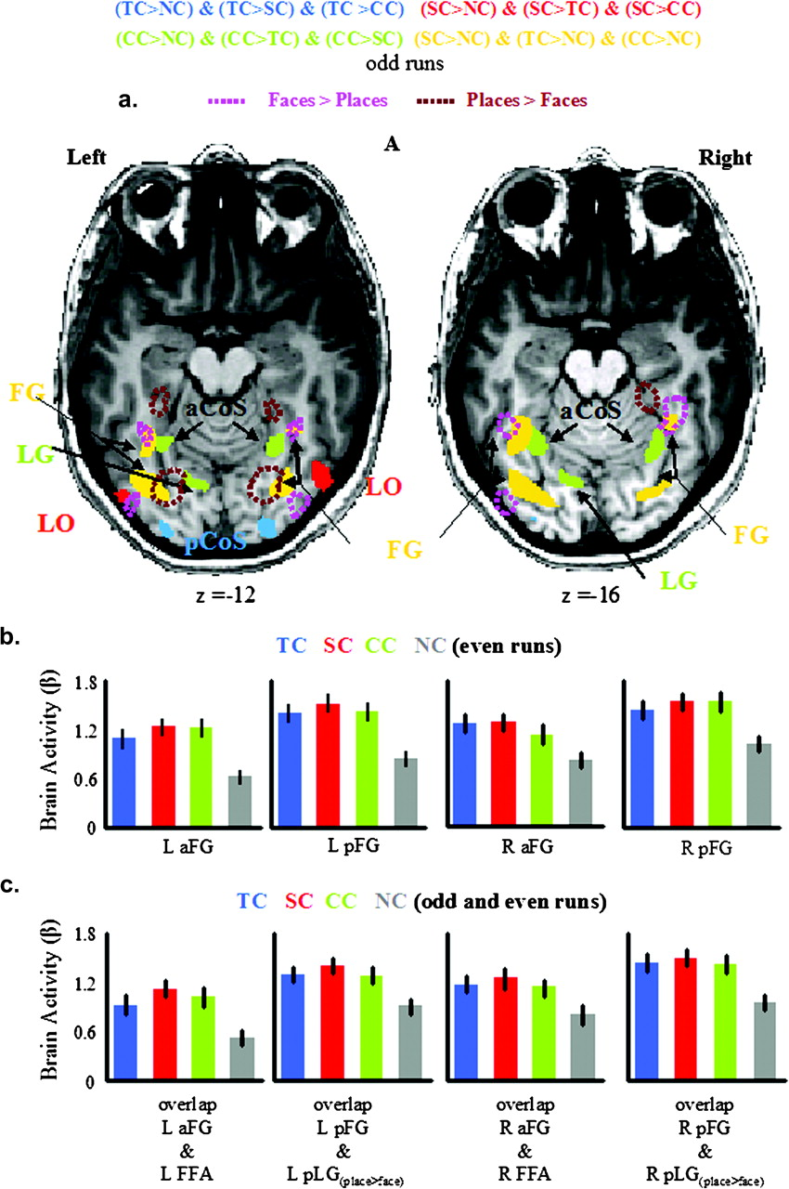
Figure 4. Group activation maps and beta weights for selective and common areas. (a) Rebound from adaptation for SC ...
Notes:
Figure 4. Group activation maps and beta weights for selective and common areas. (a) Rebound from adaptation for SC trials ([SC > NC]&[SC > TC]&[SC > CC]) in red, for TC trials ([TC > NC]&[TC > SC]&[TC > CC]) in blue, for color-change trials ([CC > NC]&[CC > TC]&[CC > SC]) in green and for the common activation of shape, texture, and color trials ([SC > NC]&[TC > NC]&[CC > NC]) in yellow. Activations for faces versus places (pink dotted lines) and places versus faces (dark brown dotted lines) from separate localizer runs are also reported. Common activations for SC, TC, and CC are localized bilaterally along the anterior and medial portion of the FG. As before, the group activation map is based on the Talairach averaged group results using odd runs only, shown for clarity on a single subject's anatomical scan. (b) Averaged beta weights (β) extracted for even runs only, measured in the common brain areas for SC, TC, CC, and NC blocks. (c) Averaged beta weights (β) extracted for even runs only from the voxels in which the common activated brain areas overlapped with the brain areas active for face versus place (left and right FFA) and for place versus face (left and right pLG). Bars represent standard error. FG = fusiform gyrus; other abbreviations as in Figure 3.
Unless provided in the caption above, the following copyright applies to the content of this slide: © The Author 2010. Published by Oxford University Press. All rights reserved. For permissions, please e-mail: journals.permissions@oxfordjournals.org

Slide 3
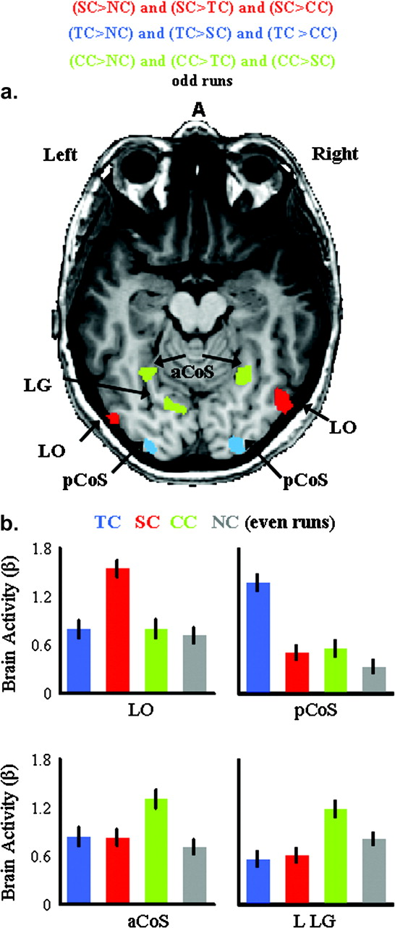
Figure 3. Group activation maps and beta weights for shape, texture, and color. (a) Rebound from adaptation for SC ...
Notes:
Figure 3. Group activation maps and beta weights for shape, texture, and color. (a) Rebound from adaptation for SC trials ([SC > NC]&[SC > TC]&[SC > CC]) in red, for TC trials ([TC > NC]&[TC > SC]&[TC > CC]) in blue, and for color-change trials ([CC > NC]&[CC > TC]&[CC > SC]) in green. SC activates bilateral LO. TC activates bilateral pCoS. CC activates bilateral aCoS and left LG. The group activation map is based on the Talairach averaged group results using odd runs only, shown for clarity on a single subject's anatomical scan. (b) Averaged beta weights (β) extracted from even runs only measured in each brain area for SC, TC, CC, and NC blocks. Bars represent standard errors. L = left, R = right, a = anterior, p = posterior, LG = lingual gyrus, LO = lateral occipital cortex, CoS = collateral sulcus. SC = shape change, TC = texture change, CC = color change, and NC = no change.
Unless provided in the caption above, the following copyright applies to the content of this slide: © The Author 2010. Published by Oxford University Press. All rights reserved. For permissions, please e-mail: journals.permissions@oxfordjournals.org

Slide 4
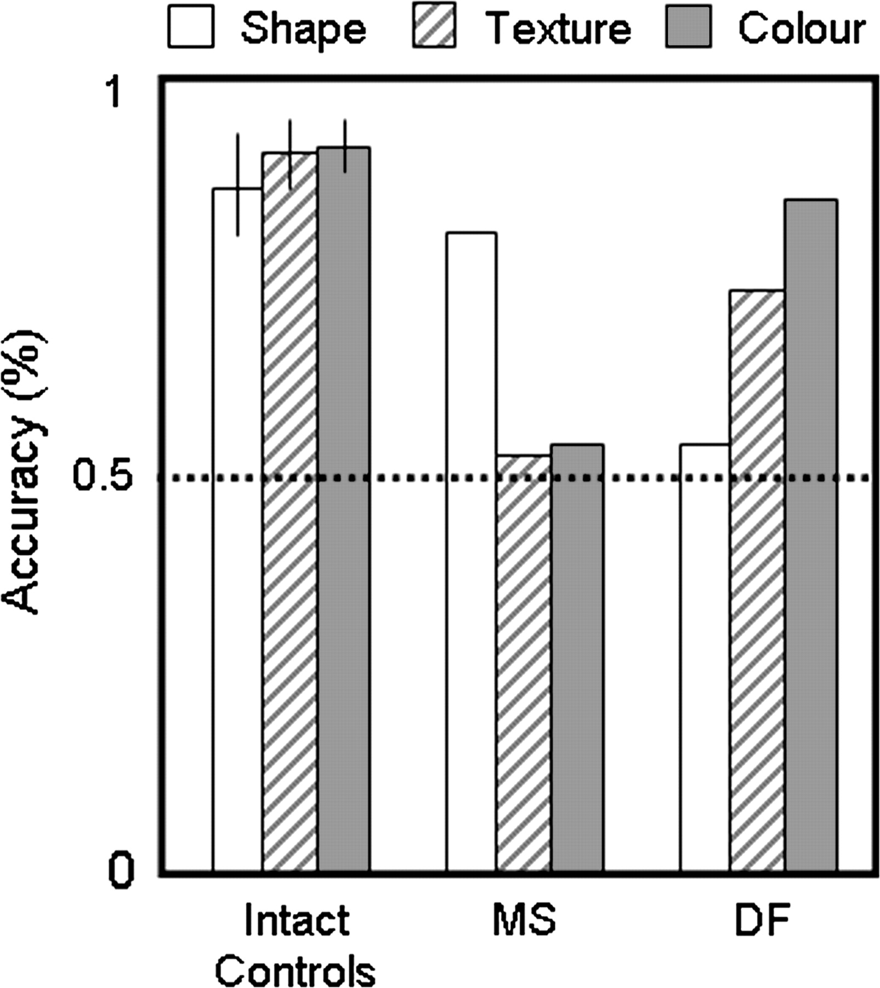
Figure 2. Percent correct responses for shape (white), texture (lined), and color (gray) trials plotted separately for ...
Notes:
Figure 2. Percent correct responses for shape (white), texture (lined), and color (gray) trials plotted separately for intact age-matched controls, patient DF and patient MS. Bars represent standard errors. The horizontal dotted line represents chance level.
Unless provided in the caption above, the following copyright applies to the content of this slide: © The Author 2010. Published by Oxford University Press. All rights reserved. For permissions, please e-mail: journals.permissions@oxfordjournals.org

Slide 5
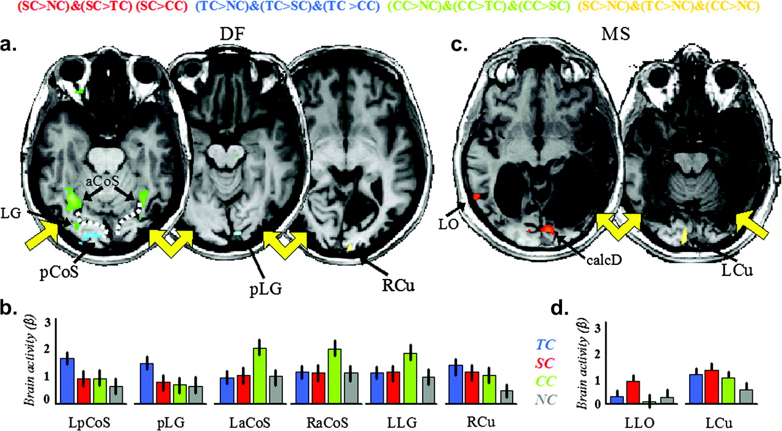
Figure 5. Activation maps and beta weights for shape, texture, and color in patients. Rebound from adaptation for SC ...
Notes:
Figure 5. Activation maps and beta weights for shape, texture, and color in patients. Rebound from adaptation for SC trials ([SC > NC]&[SC > TC]&[SC > CC]) in red, for TC trials ([TC > NC]&[TC > SC]&[TC > CC]) in blue, for CC trials ([CC > NC]&[CC > TC]&[CC > SC]) in green and for the common activation of shape, texture, and color trials ([SC > NC]&[TC > NC]&[CC > NC]) in yellow. SC activates left LO in patient MS only (c). TC activates right pCoS and left pLG in patient DF only (a). CC activates bilateral aCoS and left LG in DF only (a). Common activations for SC, TC, and CC are localized within LCu in MS (c) and RCu in DF (a). (b,d) Averaged beta weights (β) measured in each brain area for SC, TC, CC, and NC blocks. Yellow arrows highlight principal brain lesions. calcD = dorsal calcarine; Cu = cuneus; other abbreviations as in Figure 3.
Unless provided in the caption above, the following copyright applies to the content of this slide: © The Author 2010. Published by Oxford University Press. All rights reserved. For permissions, please e-mail: journals.permissions@oxfordjournals.org

