Slide 1
Figure 6. Mouse mEcap 18 cells and epididymal epithelial tissue possess conserved patterns of dynamin expression. (A–C) ...
Notes:
Figure 6. Mouse mEcap 18 cells and epididymal epithelial tissue possess conserved patterns of dynamin expression. (A–C) Immunofluorescence localization was conducted for each dynamin isoform (1–3) in fixed mEcap 18 cells (A: dynamin 1; B: dynamin 2; C: dynamin 3). (A) Staining for dynamin 1 (DNM1) was localized throughout the cytosol. (B) Dynamin 2 (DNM2) localized to the supranuclear domain in the majority of the cells. (C) Dynamin 3 (DNM3) localized exclusively to a portion of the plasma membrane in ∼11% of the cell population. For A–C, nuclei are labeled with PI (red). Arrowheads indicate representative labeling patterns observed across three independent experiments.
Unless provided in the caption above, the following copyright applies to the content of this slide: © The Authors 2016. Published by Oxford University Press on behalf of Society for the Study of Reproduction. All rights reserved. For permissions, please journals.permissions@oup.com

Slide 2
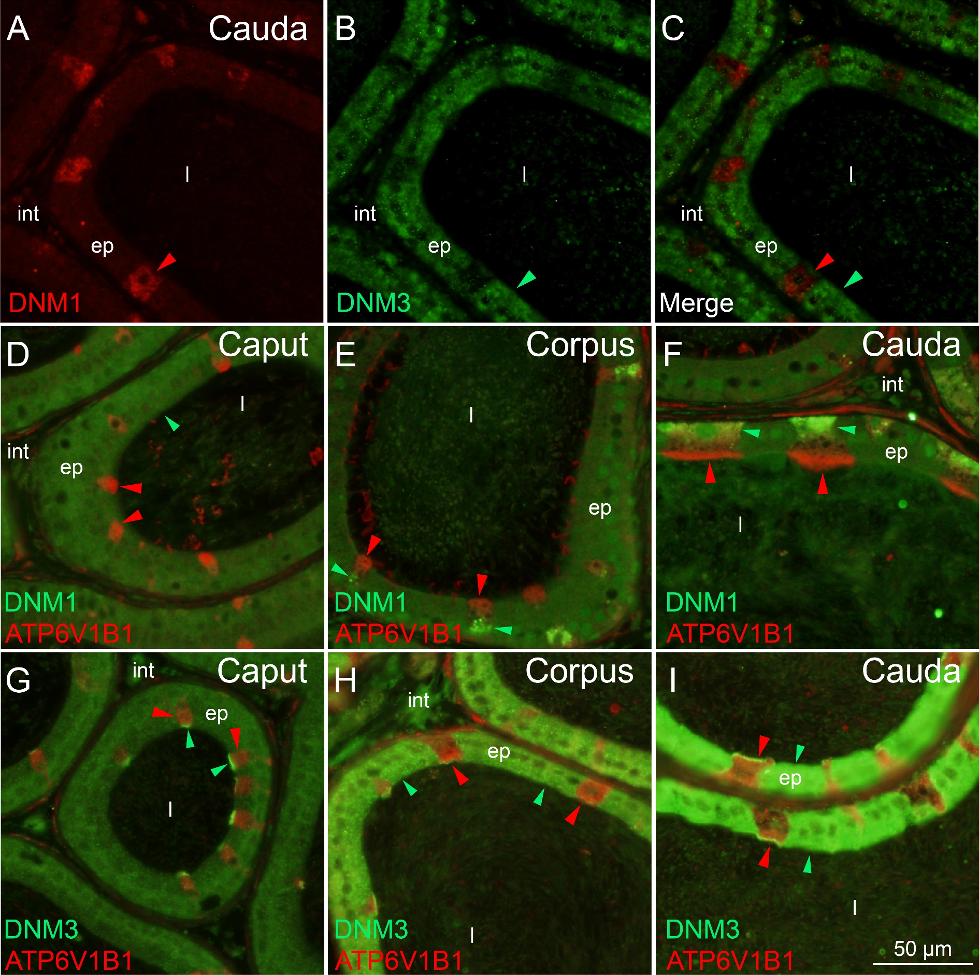
Figure 5. Colocalization of dynamin 1 and dynamin 3 with the clear cell marker, ATP6V1B1. (A–C) Representative ...
Notes:
Figure 5. Colocalization of dynamin 1 and dynamin 3 with the clear cell marker, ATP6V1B1. (A–C) Representative immunofluorescence images of dual staining of dynamin 1 (red arrowhead) and dynamin 3 (green arrowhead) in the cauda epididymis of adult mice. Dynamin 1 and 3 clearly resided in different epithelial cell populations with no colocalization being detected. (D–F) Representative immunofluorescence images of dual staining of dynamin 1 (green arrowheads) and ATP6V1B1 (red arrowheads) in the adult mouse epididymis. Dynamin 1 colocalized with ATP6V1B1 in the clear cells of the corpus and cauda but not caput epididymis. (G–I) Representative immunofluorescence images of dual staining of dynamin 3 (green arrowheads) and ATP6V1B1 (red arrowheads) in the adult mouse epididymis. Dynamin 3 colocalized with ATP6V1B1 in the clear cells of the caput epithelium, but displayed minimal overlap in the cells and instead occupied a distinct subcellular location. This localization pattern was altered in the corpus and cauda epithelium such that dynamin 3 was uniquely detected in the principal cells in these segments. ep, epithelial cells; int, interstitium; l, lumen.
Unless provided in the caption above, the following copyright applies to the content of this slide: © The Authors 2016. Published by Oxford University Press on behalf of Society for the Study of Reproduction. All rights reserved. For permissions, please journals.permissions@oup.com

Slide 3
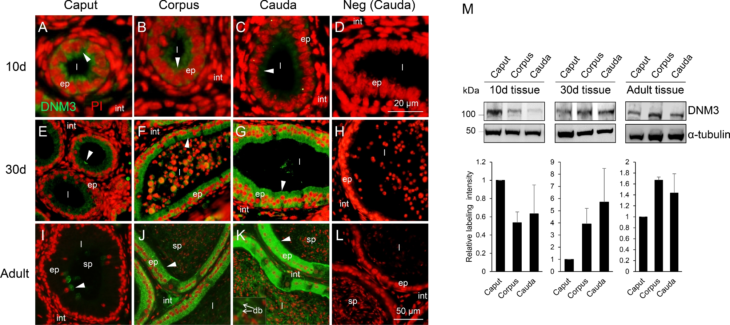
Figure 4. Detection of dynamin 3 in the mouse epididymis. (A–L) Immunofluorescence localization of dynamin 3 was ...
Notes:
Figure 4. Detection of dynamin 3 in the mouse epididymis. (A–L) Immunofluorescence localization of dynamin 3 was undertaken in the mouse epididymis (day 10, 30, and >8 weeks postnatum) by sequential labeling with antidynamin 3 (DNM3, green) and propidium iodide (PI, red). Representative negative control (Neg, secondary antibody only) images are also shown to demonstrate the specificity of antibody labeling. (M) The relative levels of dynamin 3 expression were quantified by immunoblotting of tissue homogenates prepared from epididymides at equivalent developmental time points. Blots were subsequently stripped and reprobed with anti-α-tubulin antibody to confirm equivalent protein loading and enable densitometric analysis of band intensity (n = 3). For the purpose of this analysis the labeling intensity of DNM3 was normalized relative to that of α-tubulin, with the band intensity in caput tissue at each time point being nominally set to a value of 1. These experiments were replicated on material from three animals, and representative immunofluorescence images and immunoblots are presented.
Unless provided in the caption above, the following copyright applies to the content of this slide: © The Authors 2016. Published by Oxford University Press on behalf of Society for the Study of Reproduction. All rights reserved. For permissions, please journals.permissions@oup.com

Slide 4
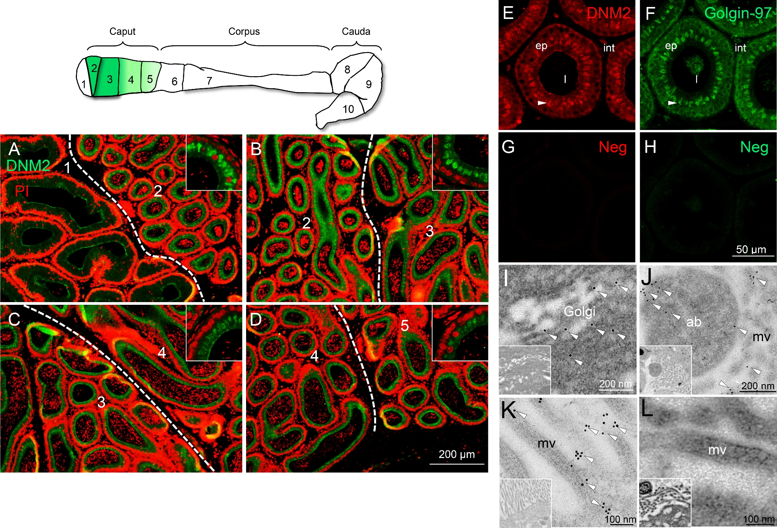
Figure 3. Dynamin 2 localizes to the Golgi apparatus of principal cells in the caput epithelium. (A–D) The spatial ...
Notes:
Figure 3. Dynamin 2 localizes to the Golgi apparatus of principal cells in the caput epithelium. (A–D) The spatial conservation of dynamin 2 supranuclear localization was assessed throughout zones 1–5 (corresponding to the initial segment and caput epididymis, respectively) of the adult mouse epididymis, with the border of different zones being demarcated by dotted lines. This analysis revealed a gradient of supranuclear staining, being initially detected in zone 2 and most intense staining in zones 2 and 3, before gradually decreasing distally in zones 4 and 5, and being undetectable in zone 6 (corpus). (E–H) Confirmation that this pattern of supranuclear localization corresponded to the positioning of the Golgi apparatus (arrowheads) was afforded by labeling of consecutive epididymal sections with anti-DNM2 (E, red) and Golgin-97 (a recognized Golgi marker; F, green). This approach was favored over that of dual labeling owing to incompatible antigen retrieval conditions necessary for optimal labeling with these antibodies. (G, H) NC: negative controls (secondary antibody only). (I, J) These studies were complemented with the use of immunogold ultrastructural analyses to confirm the presence of DNM2 in the Golgi apparatus of the caput (I), and in association with the microvilli (mv) and apical blebs (ab) in both the corpus and cauda epididymis (J, I) (arrowheads). (L) No such labeling was observed in control sections probed with secondary antibody only. v, vesicle; mv, microvilli; ab, apical blebs. These experiments were replicated on material from three animals, and representative immunofluorescence and immunogold images are presented.
Unless provided in the caption above, the following copyright applies to the content of this slide: © The Authors 2016. Published by Oxford University Press on behalf of Society for the Study of Reproduction. All rights reserved. For permissions, please journals.permissions@oup.com

Slide 5
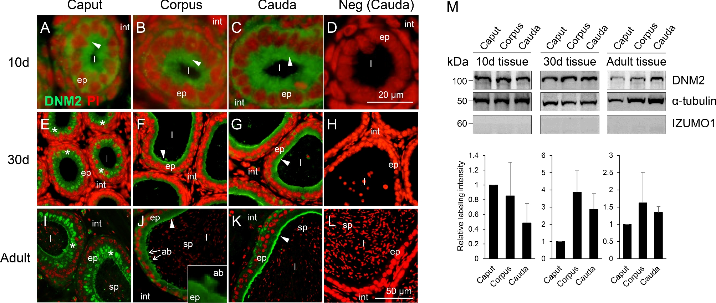
Figure 2. Detection of dynamin 2 in the mouse epididymis. (A–L) Immunofluorescence localization of dynamin 2 ...
Notes:
Figure 2. Detection of dynamin 2 in the mouse epididymis. (A–L) Immunofluorescence localization of dynamin 2 (arrowheads) was undertaken in the mouse epididymis (day 10, 30, and >8 weeks postnatum) by sequential labeling with antidynamin 2 (DNM2, green) and propidium iodide (PI, red). By 30 days postnatum, dynamin 2 localization was detected in the supranuclear region of caput epithelial cells (asterisks) and around the adluminal border and extending into apical blebs (ab) (arrows and inset in adult corpus) in the corpus and cauda epididymal segments. Representative negative control (Neg, secondary antibody only) images are included to demonstrate the specificity of antibody labeling (D, H, L). ep, epithelial cells; sp, sperm; int, interstitium; l, lumen. (M) The relative levels of dynamin 2 expression were quantified by immunoblotting of tissue homogenates prepared from epididymides at equivalent developmental time points. Blots were subsequently stripped and reprobed with anti-α-tubulin antibody to confirm equivalent protein loading and enable densitometric analysis of band intensity (n = 3). For the purpose of this analysis, the labeling intensity of DNM2 was normalized relative to that of α-tubulin with the band intensity in caput tissue at each time point being nominally set to a value of 1. Immunoblots were also probed with anti-IZUMO1 antibodies to control for sperm contamination. These experiments were replicated on material from three animals and representative immunofluorescence images and immunoblots are presented.
Unless provided in the caption above, the following copyright applies to the content of this slide: © The Authors 2016. Published by Oxford University Press on behalf of Society for the Study of Reproduction. All rights reserved. For permissions, please journals.permissions@oup.com

Slide 6
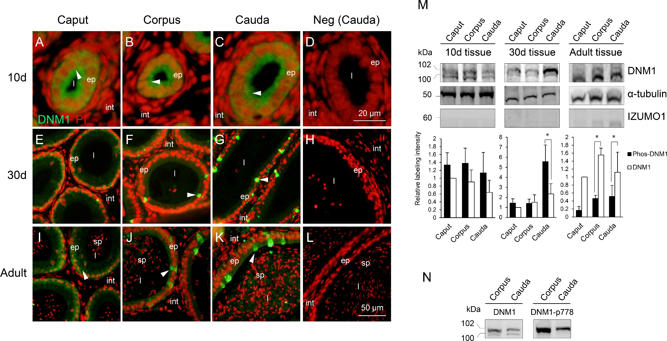
Figure 1. Detection of dynamin 1 in the mouse epididymis. (A–L) The spatial and temporal localization of dynamin 1 ...
Notes:
Figure 1. Detection of dynamin 1 in the mouse epididymis. (A–L) The spatial and temporal localization of dynamin 1 (arrowheads) was examined in the mouse epididymis at key developmental stages (day 10, 30, and >8 weeks postnatum) by sequential labeling with antidynamin 1 (DNM1, green) and the propidium iodide (PI, red) nuclear stain. Representative negative control (Neg, secondary antibody only) images are included to demonstrate the specificity of antibody labeling (D, H, L). ep, epithelial cells; sp, sperm; int, interstitium; l, lumen. (M) The relative levels of dynamin 1 expression were quantified by immunoblotting of tissue homogenates prepared from epididymides at equivalent developmental time points. Blots were subsequently stripped and reprobed with anti-α-tubulin antibody to confirm equivalent protein loading and enable densitometric analysis of band intensity (n = 3; *p < 0.05). For the purpose of this analysis the labeling intensity of DNM1, or phosphorylated-DNM1 (Phos-DNM1), was normalized relative to that of α-tubulin with the band intensity in caput tissue at each time point being nominally set to a value of 1. Prior to protein extraction, tissue was cleared of contaminating epididymal fluid and spermatozoa, and the efficacy of this treatment was assessed by labeling with anti-IZUMO1 antibodies (an intrinsic sperm protein that is not expressed in epididymal epithelium). (N) The detection of a doublet (of ∼100 and 102 kDa) with antidynamin 1 antibodies prompted an investigation of the potential for post-translational phosphorylation of the dynamin 1 protein. For this purpose, blots were probed with antidynamin 1 pSer778 antibodies, revealing cross-reactivity with the higher molecular weight band only. These experiments were replicated on material from three animals and representative immunofluorescence images, and immunoblots are presented.
Unless provided in the caption above, the following copyright applies to the content of this slide: © The Authors 2016. Published by Oxford University Press on behalf of Society for the Study of Reproduction. All rights reserved. For permissions, please journals.permissions@oup.com

Slide 7
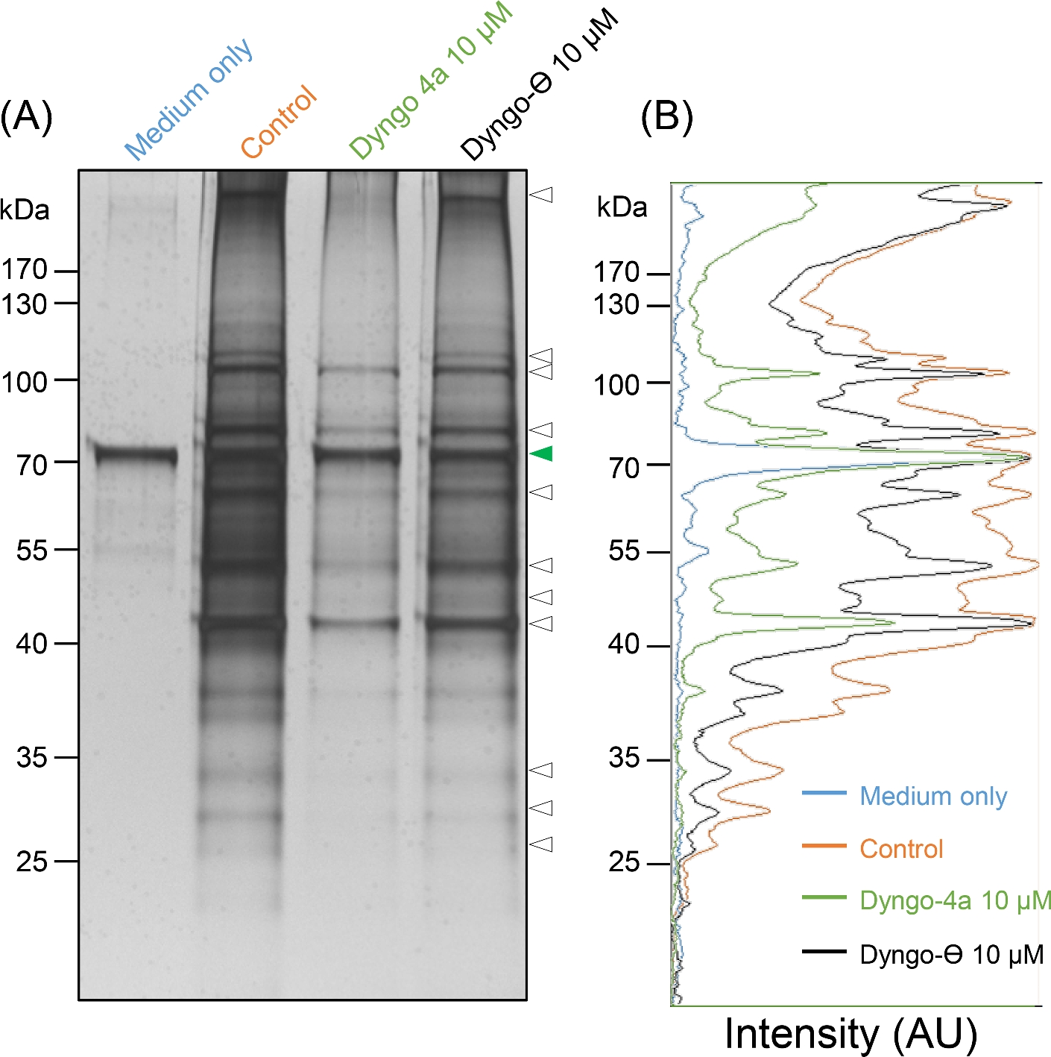
Figure 7. Dynamin inhibitors selectively modulate the secretion of proteins by cultured mouse mEcap18 cells. (A) ...
Notes:
Figure 7. Dynamin inhibitors selectively modulate the secretion of proteins by cultured mouse mEcap18 cells. (A) Silver-stained gel illustrating the complement of proteins recovered from an equivalent volume of medium after 12 h of mEcap18 cell culture in the absence (control), or presence of Dyngo 4a (10 μM; an inhibitor of dynamin isoforms 1 and 2) or Dyngo-Θ (10 μM, inactive isoform of Dyngo 4a). (B) The density of the bands was quantified by Image J and normalized to an internal control band (green arrow head) contributed by the culture medium. Dyngo 4a treatment selectively inhibited the secretion of a subset of protein bands such that they were substantially reduced (denoted by white arrowheads).
Unless provided in the caption above, the following copyright applies to the content of this slide: © The Authors 2016. Published by Oxford University Press on behalf of Society for the Study of Reproduction. All rights reserved. For permissions, please journals.permissions@oup.com

Slide 8
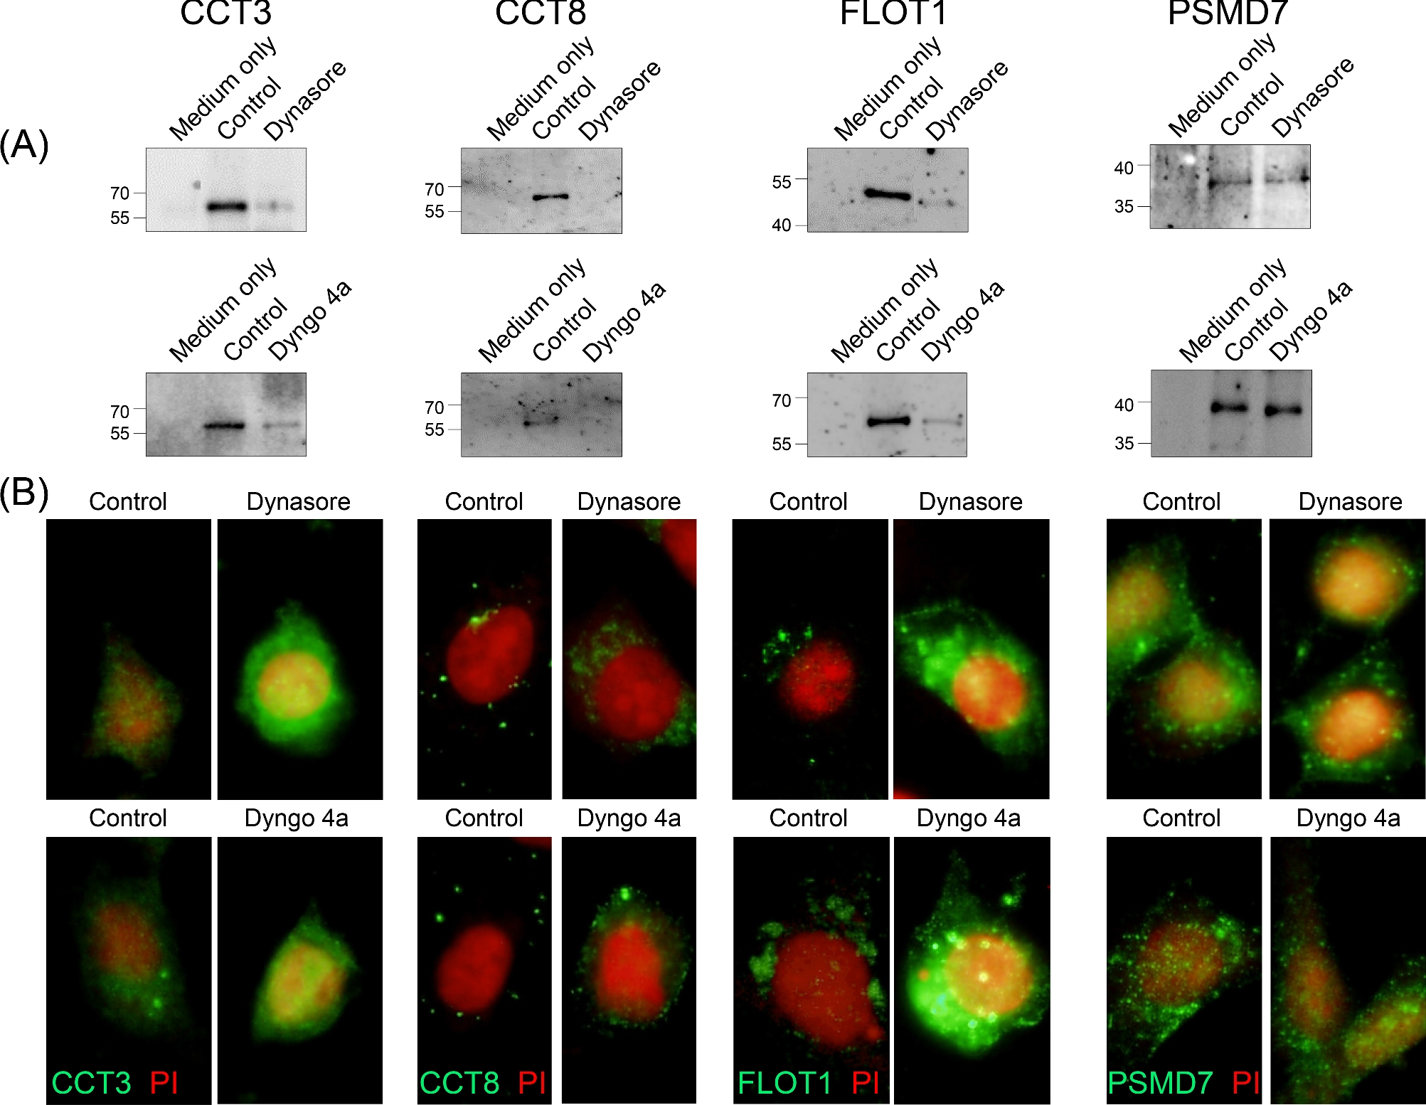
Figure 8. Dynamin inhibitors selectively modulate the secretion of proteins by cultured mouse mEcap18 cells. (A) ...
Notes:
Figure 8. Dynamin inhibitors selectively modulate the secretion of proteins by cultured mouse mEcap18 cells. (A) Immunoblotting of three representative epididymal secretory proteins: CCT3, CCT8, and FLOT1 confirmed a significant decrease in abundance within the medium following treatment of mEcap18 cells with either Dynasore or Dyngo-4a dynamin inhibitors. By contrast, the abundance of an alternative epididymal secretory protein, PSMD7, was not influenced by the presence of dynamin inhibitors. These blots also feature protein recovered from mEcap18 cells treated with the DMSO vehicle control (control) as well as an equivalent volume of cell-free medium (medium only). (B) Immunofluorescence detection of CCT3, CCT8, and FLOT1 within mEcap18 cells treated with Dynasore, Dyngo-4a, or the DMSO vehicle control (control) for 12 h. Substantially more CCT3, CCT8, and FLOT1 were detected in mEcap18 cells treated with Dynasore or Dyngo-4a compared to that of the vehicle controls. In contrast, the abundance of PSMD7 was not influenced by the presence of dynamin inhibitors. These experiments were replicated three times, and representative gels, immunofluorescence images, and immunoblots are presented.
Unless provided in the caption above, the following copyright applies to the content of this slide: © The Authors 2016. Published by Oxford University Press on behalf of Society for the Study of Reproduction. All rights reserved. For permissions, please journals.permissions@oup.com

