Slide 1
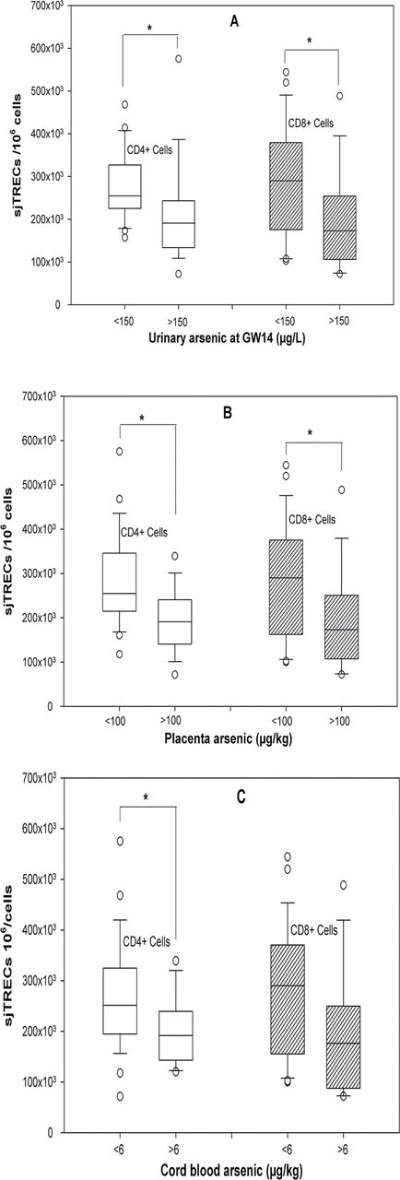
FIG. 2. In the 44 samples (A) distribution of sjTRECs levels of CD4⁺ and CD8⁺ cells between ...
Notes:
FIG. 2. In the 44 samples (A) distribution of sjTRECs levels of CD4+ and CD8+ cells between below (n = 24) and above (n = 18) cutoff (150 µg/l) of urinary arsenic at GW14. (B) Distribution of sjTRECs levels of CD4+ and CD8+ cells between below (n = 26) and above (n = 16) cutoff (100 µg/kg) of placenta arsenic. (C) Distribution of sjTRECs levels of CD4+ and CD8+ cells between below (n = 29) and above (n = 13) cutoff (6 µg/kg) of cord blood arsenic. Groups were compared using the Mann-Whitney U-test. * indicates p value < 0.05.
Unless provided in the caption above, the following copyright applies to the content of this slide: © The Author 2012. Published by Oxford University Press on behalf of the Society of Toxicology. All rights reserved. For permissions, please email: journals.permissions@oup.com

Slide 2
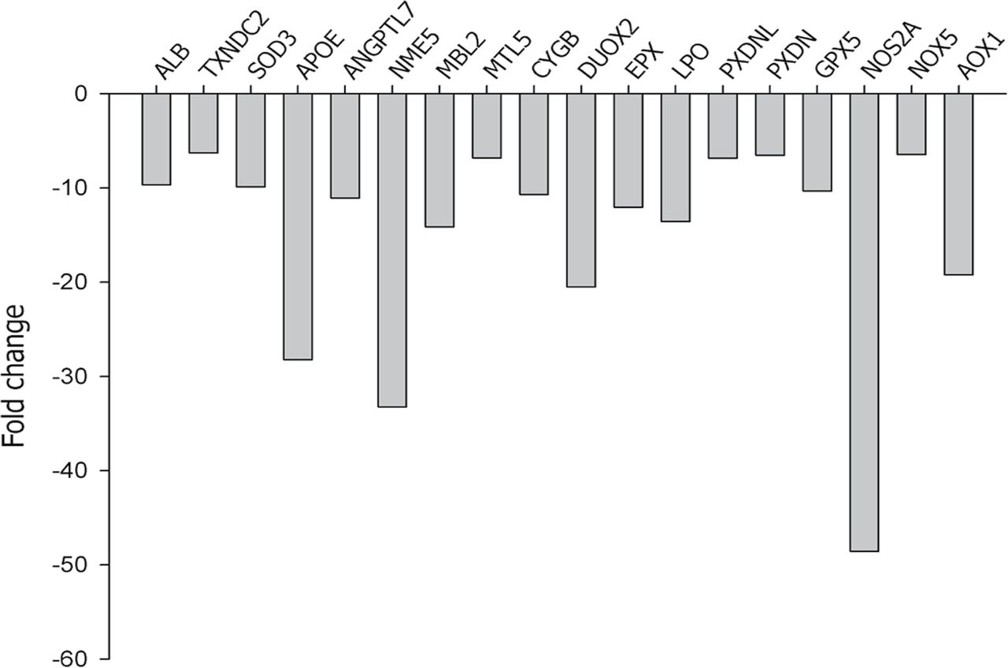
FIG. 3. Expression of genes involve in oxidative stress and antioxidant defense pathways in CBMC of six mothers (of ...
Notes:
FIG. 3. Expression of genes involve in oxidative stress and antioxidant defense pathways in CBMC of six mothers (of the 44 in the follow-up) with the highest cord blood arsenic concentrations (mean ± SD, 19.3±11.4 µg/kg) and in six mothers with the lowest cord blood arsenic concentrations (1.1±1.0 µg/kg).
Unless provided in the caption above, the following copyright applies to the content of this slide: © The Author 2012. Published by Oxford University Press on behalf of the Society of Toxicology. All rights reserved. For permissions, please email: journals.permissions@oup.com

Slide 3
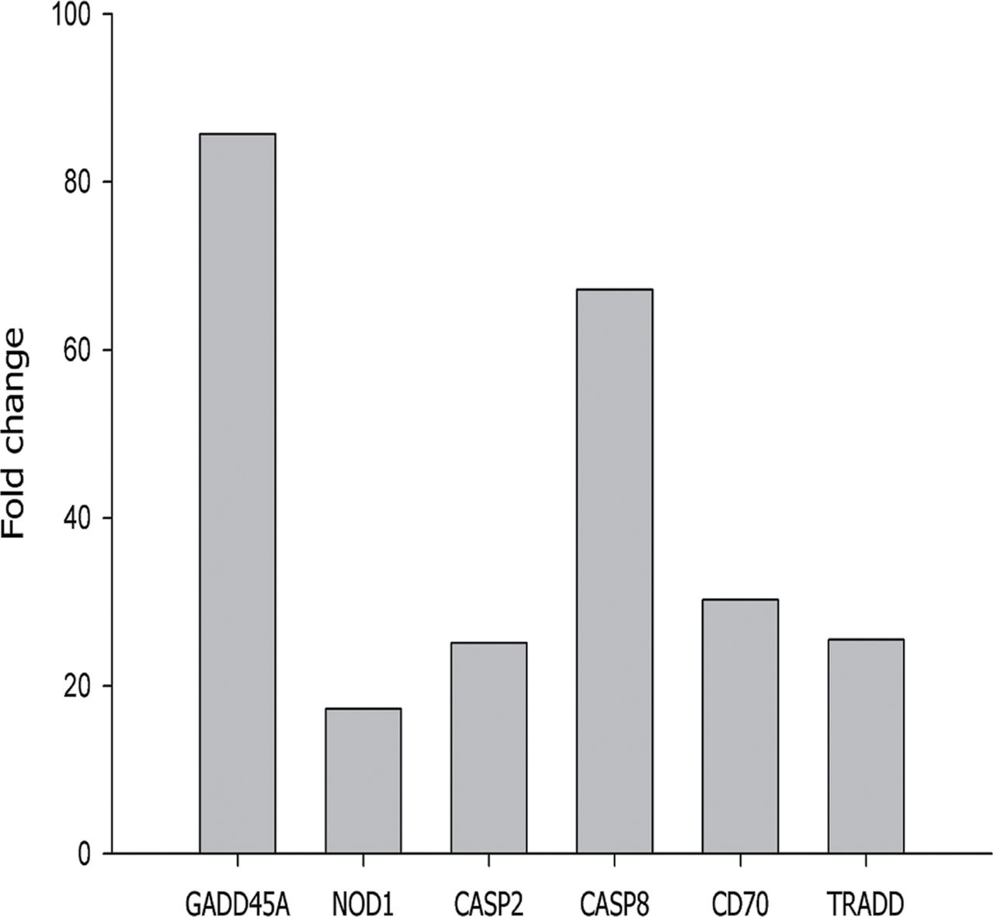
FIG. 4. Expression of genes involve in apoptosis pathways in CBMC of six mothers (of the 44 in the follow-up) with ...
Notes:
FIG. 4. Expression of genes involve in apoptosis pathways in CBMC of six mothers (of the 44 in the follow-up) with the highest cord blood arsenic concentrations (mean ± SD, 19.3±11.4 µg/kg) and in six mothers with the lowest cord blood arsenic concentrations (1.1±1.0 µg/kg).
Unless provided in the caption above, the following copyright applies to the content of this slide: © The Author 2012. Published by Oxford University Press on behalf of the Society of Toxicology. All rights reserved. For permissions, please email: journals.permissions@oup.com

Slide 4
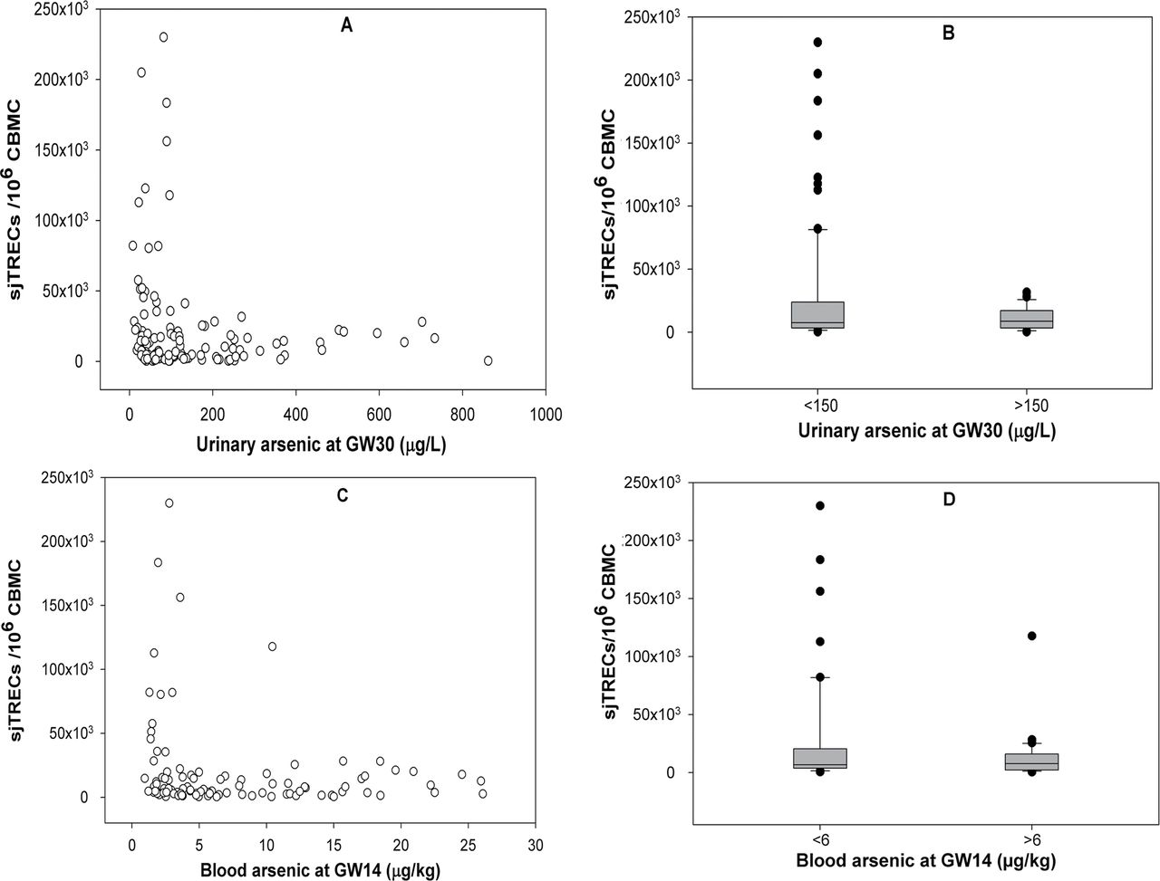
FIG. 1. (A) Association between urinary arsenic concentration at GW30 and cord blood sjTRECs. (B) Distribution of ...
Notes:
FIG. 1. (A) Association between urinary arsenic concentration at GW30 and cord blood sjTRECs. (B) Distribution of sjTRECs levels between below (n = 92) and above (n = 36) cutoff (150 µg/l) of urinary arsenic at GW30. (C) Association between blood arsenic concentration at GW14 and cord blood sjTRECs. (D) Distribution of sjTRECs levels between below (n = 58) and above (n = 40) cutoff (6 µg/kg) of blood arsenic at GW14. Groups were compared using the Mann-Whitney U-test.
Unless provided in the caption above, the following copyright applies to the content of this slide: © The Author 2012. Published by Oxford University Press on behalf of the Society of Toxicology. All rights reserved. For permissions, please email: journals.permissions@oup.com

