Slide 1
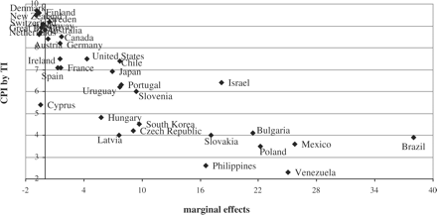
Figure 1 Relationship between the corruption perception rankings
Notes:
Figure 1 Relationship between the corruption perception rankings
Unless provided in the caption above, the following copyright applies to the content of this slide: © The Author 2010. Published by Oxford University Press on behalf of The World Association for Public Opinion Research. All rights reserved.

Slide 2
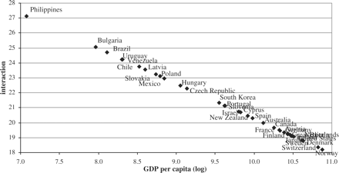
Figure 2 Interaction effect between GDP per capita and highest education (level 4)
Notes:
Figure 2 Interaction effect between GDP per capita and highest education (level 4)
Unless provided in the caption above, the following copyright applies to the content of this slide: © The Author 2010. Published by Oxford University Press on behalf of The World Association for Public Opinion Research. All rights reserved.

