Slide 1
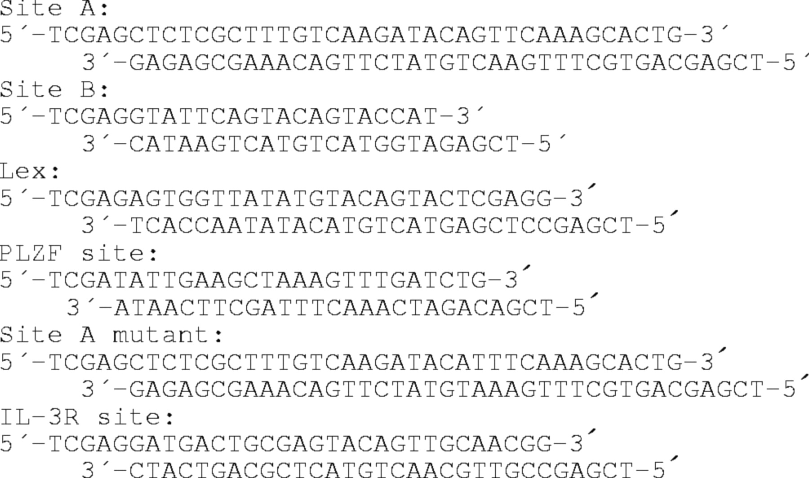
Figure 1 Comparison of PLZF binding sites. (A) The two PLZF binding sites (site A and site B) isolated from the CpG ...
Notes:
Figure 1 Comparison of PLZF binding sites. (A) The two PLZF binding sites (site A and site B) isolated from the CpG island library are aligned with the PLZF binding site identified in the lex operon (24), a sequence (IL-3R) that binds PLZF from the promoter of the murine IL-3Rα subunit and a PLZF site identified previously from a pool of random oligonucleotides (23). (B) Site B was labeled and used as a probe in an EMSA. Increasing quantities (10-, 100- and 1000-fold excess) of unlabeled site A, site B, lex, PLZF and site A mutant were added. The amount of probe bound in the presence of the unlabeled competitors is expressed as a percentage of the probe bound in the absence of competitor. (C) PLZF represses transcription through a sequence resembling site B. 293T cells were co-transfected with 0.1 μg of tk-Luc or 4×IL3R-tk-Luc and 0.25 or 0.5 μg of pSG5-PLZF. pSG5 expression vector was added for a total of 1 μg of DNA. Luciferase activity was measured 48 h after transfection and transfection efficiency normalized with a Renillin luciferase reporter. The data from a representative experiment is shown as the mean (±SD) of quadruplicate trials. (D) The SMRT co-repressor augments repression by PLZF. 293T cells were co-transfected with 0.05 μg of 4×IL3R-tk-Luc, a renilla internal control vector (5 ng), along with 0.4 μg of pCDNA-PLZF and 0.25 μg of CMV-SMRT as indicated. The average results (±SD) of four independent experiments are presented.
Unless provided in the caption above, the following copyright applies to the content of this slide: © 1999 Oxford University Press

Slide 2
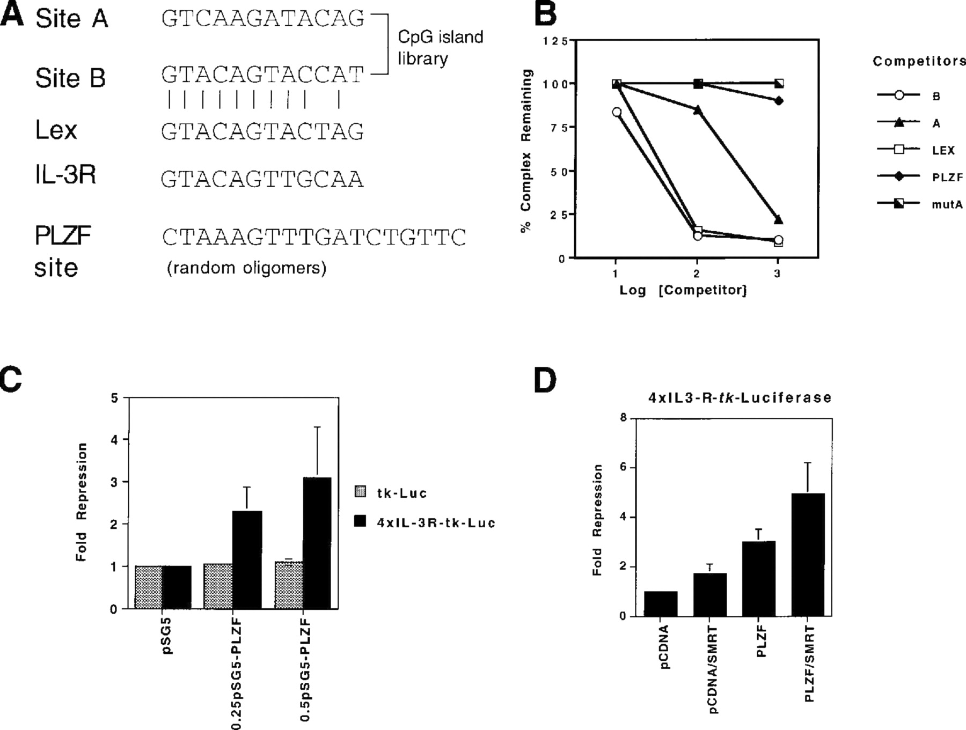
Figure 2 Determination of the size of PLZF DNA-protein complexes by pore exclusion limit analysis. (A) An EMSA was ...
Notes:
Figure 2 Determination of the size of PLZF DNA-protein complexes by pore exclusion limit analysis. (A) An EMSA was performed using radioactively labeled site A and nuclear extract from vector (lane 1), PLZF (lane 2) and (APOZ)PLZF (lane 3) transfected 293T cells. The reactions were separated on a 4–10% non-denaturing gradient gel alongside native protein molecular weight markers for 18 h at 4°C (31). (B) EMSA was also performed using site A and nuclear extract from vector (lane 1) and RARα/PLZF (lane 2) transfected 293T cells and separated through a 4–20% non-denaturing gradient gel.
Unless provided in the caption above, the following copyright applies to the content of this slide: © 1999 Oxford University Press

Slide 3
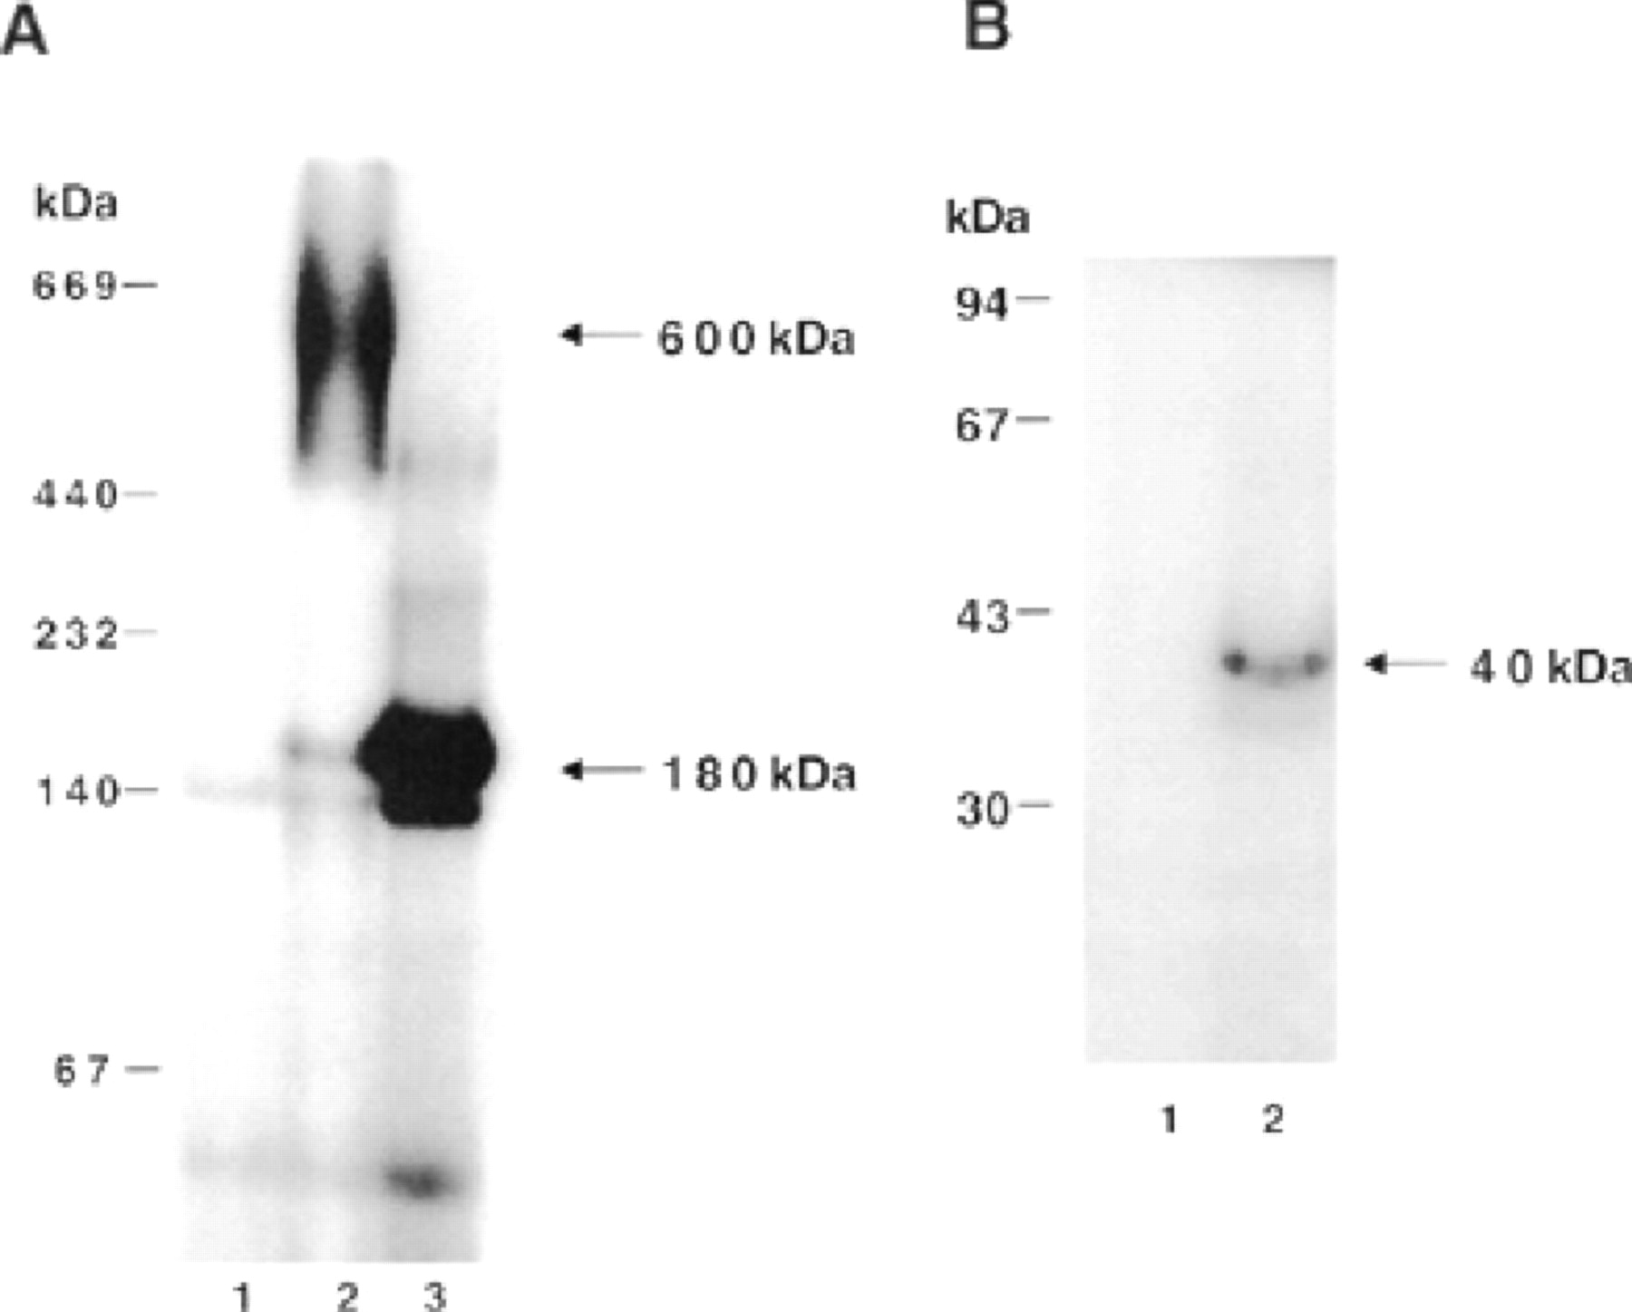
Figure 3 Effect of cdc2 antibodies on the PLZF-DNA and RARα/PLZF-DNA complexes. (A) An EMSA was performed using ...
Notes:
Figure 3 Effect of cdc2 antibodies on the PLZF-DNA and RARα/PLZF-DNA complexes. (A) An EMSA was performed using nuclear extract from vector or PLZF transfected COS-7 cells. Lane 1, probe alone; lane 2, site A plus nuclear extract from vector transfected cells. The remaining experiments contain nuclear extract from PLZF transfected cells with either no antibodies (lane 3), preimmune serum (lane 4), PLZF immune serum (lane 5), CDK antibody (lane 6), cdc2 antibody (lane 7), cyclin A antibody (lane 8) or cyclin E antibody (lane 9) added. (B) EMSA was performed using nuclear extract from the HEL cell line and the IL-3R site. Lane 1, probe alone. The other lanes contain extract from HEL cells with no antibody (lane 2) or antibodies to PLZF (lane 3), CDK2 (lane 4), cdc2 (lane 5) and cyclin A (lane 6). (C) EMSA was performed using site A and nuclear extract from vector and RARα/PLZF transfected COS-7 cells. Lane 1, site A plus nuclear extract from vector transfected cells. The remaining experiments contain nuclear extract from RARα/PLZF transfected cells with either no antibodies (lane 2) or antibodies to CDK2 (lane 3), cdc2 (lane 4), cyclin A (lane 5) or cyclin E (lane 6).
Unless provided in the caption above, the following copyright applies to the content of this slide: © 1999 Oxford University Press

Slide 4
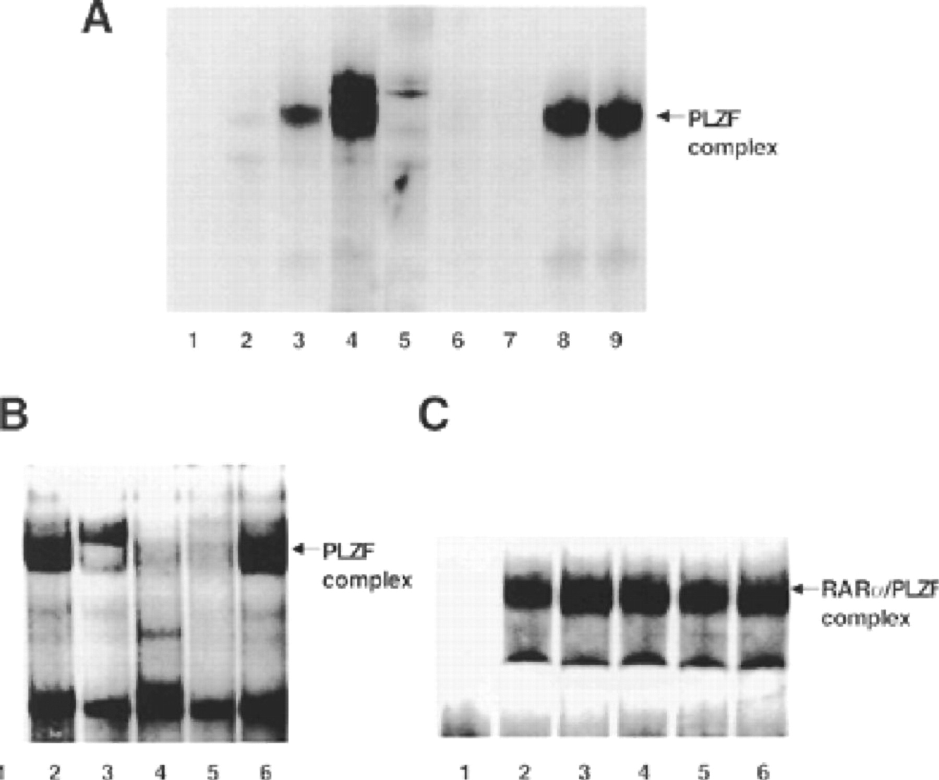
Figure 4 PLZF and cdc2 interact in vivo. (A) cdc2 co-immunoprecipitates with PLZF antibody. Proteins were ...
Notes:
Figure 4 PLZF and cdc2 interact in vivo. (A) cdc2 co-immunoprecipitates with PLZF antibody. Proteins were immunoprecipitated from vector, PLZF and (ΔPOZ)PLZF transfected 293T cells with PLZF antibody, followed by western analysis with cdc2 antibody. Lanes 1–3, cdc2 expression in the lysates. (B) PLZF co-immunoprecipitates with cdc2 antibody. Proteins were immunoprecipitated from vector and PLZF transfected 293T cells with cdc2 antibody and subjected to western analysis with a PLZF antibody. Lanes 1–2, lysate from the vector and PLZF transfected cells. (C) cdc2 is purified on a PLZF binding site. Site A or an oligonucleotide containing a single base pair mutation that abolishes PLZF binding that abolishes PLZF DNA binding were labeled with biotin, immobilized on streptavidin beads and incubated with nuclear extract from vector or PLZF transfected cells. The bound proteins were immunoblotted with a cdc2 antibody. (D) Endogenous PLZF and cdc2 interact. Proteins from HEL cells were immunoprecipitated with either gal4 or PLZF antibodies and immunoblotted with a cdc2 antibody.
Unless provided in the caption above, the following copyright applies to the content of this slide: © 1999 Oxford University Press

Slide 5
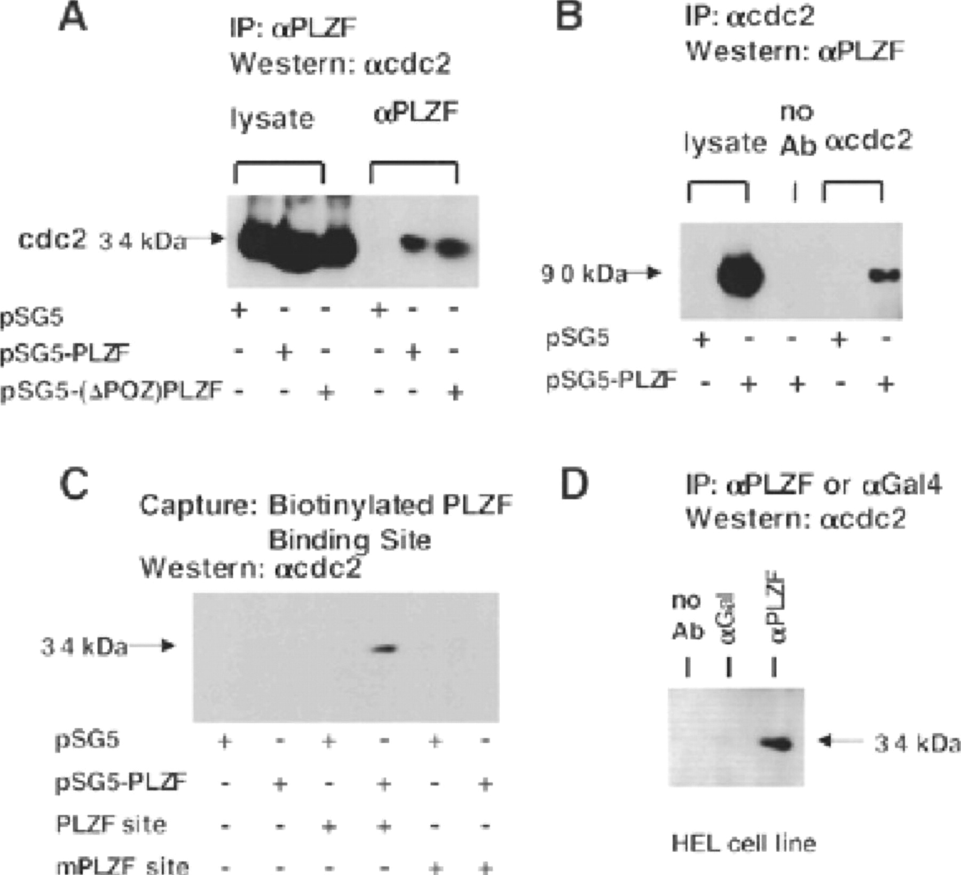
Figure 5 PLZF associates with an active kinase. (A) The amount of histone H1 kinase activity in the PLZF ...
Notes:
Figure 5 PLZF associates with an active kinase. (A) The amount of histone H1 kinase activity in the PLZF immunoprecipitates was quantitated using a cdc2 kinase assay, compared in immunoprecipitates from vector (lane 1) and PLZF (lane 2) transfected cells using PLZF antibody. The amount of kinase activity precipitated with cdc2 antibody is shown (lane 3). (B) PLZF is phos-phorylated by its associated kinase. Proteins immunoprecipitated from vector (lane 1) and PLZF (lane 2) transfected 293T cells with a PLZF monoclonal antibody were resuspended in a reaction containing [γ-32P]ATP. Phosphorylated proteins were detected by separation on a 12% SDS-polyacrylamide gel followed by autoradiography.
Unless provided in the caption above, the following copyright applies to the content of this slide: © 1999 Oxford University Press

Slide 6
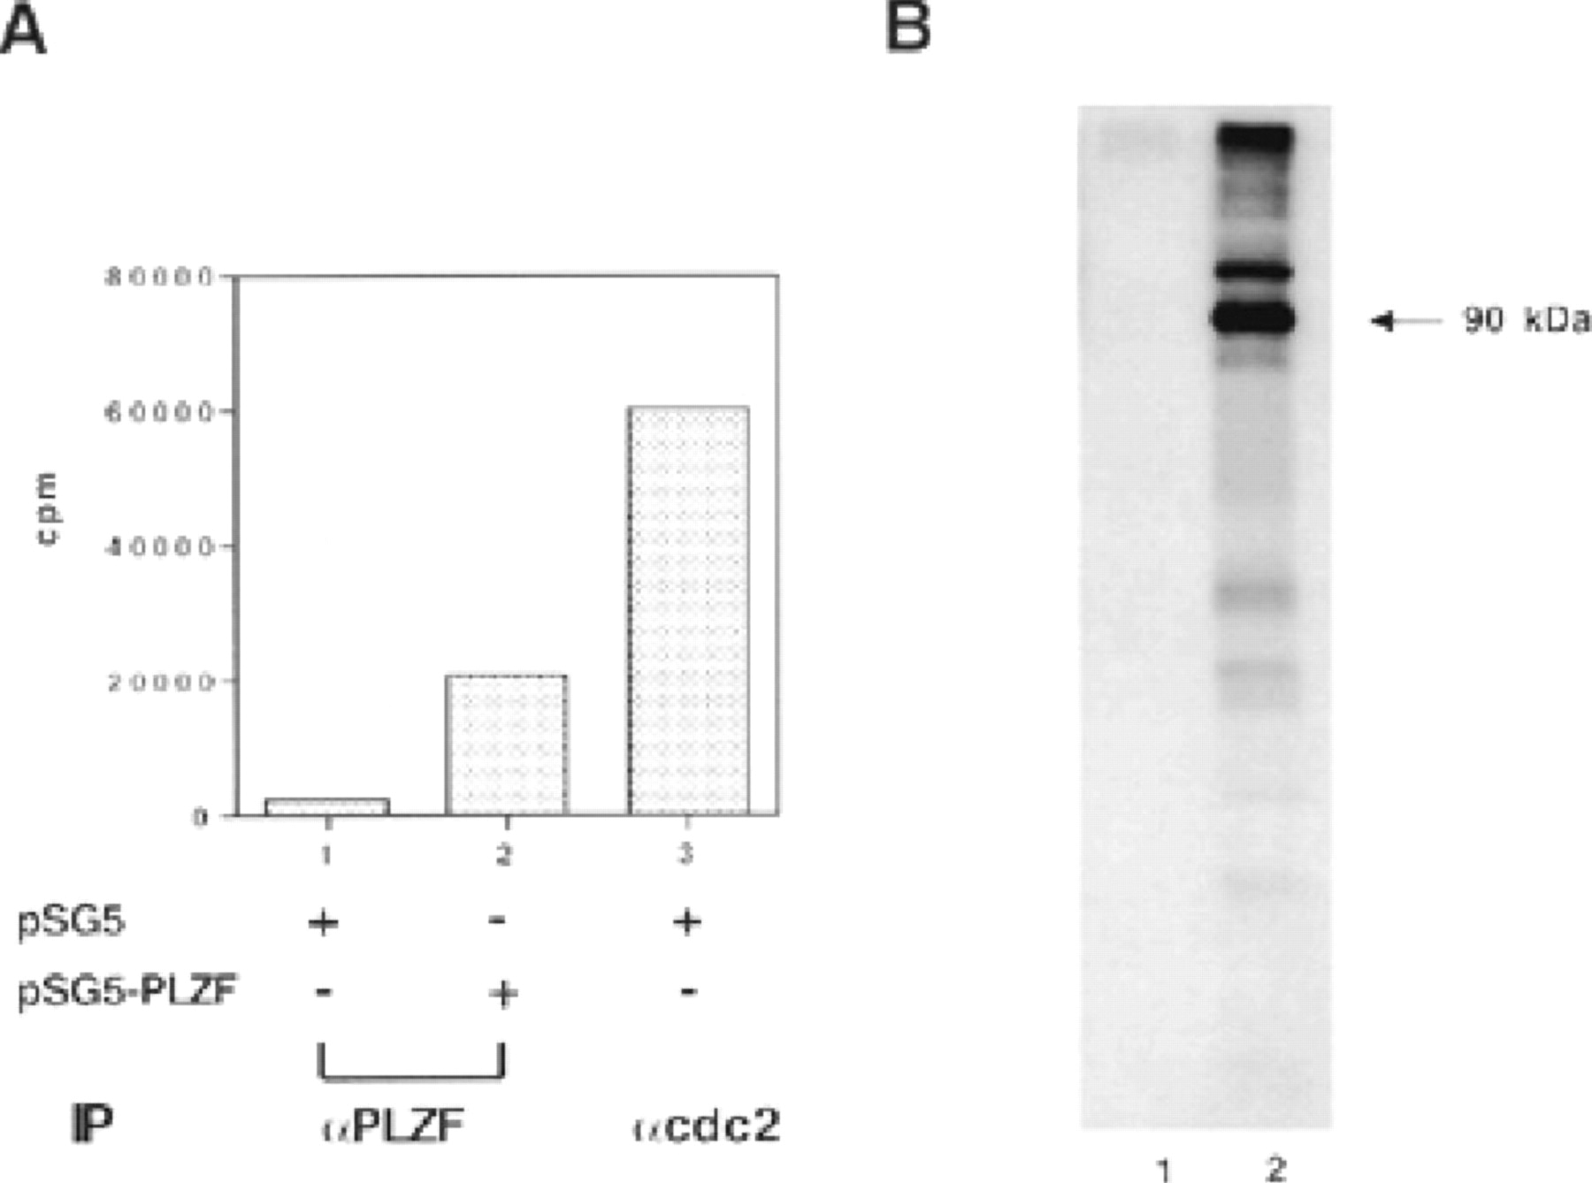
Figure 6 PLZF is a phosphoprotein. (A) PLZF-Flag was expressed in CV-1 cells and the cells were metabolically labeled ...
Notes:
Figure 6 PLZF is a phosphoprotein. (A) PLZF-Flag was expressed in CV-1 cells and the cells were metabolically labeled with [32P]orthophosphate. A 90 kDa protein corresponding to PLZF-Flag was immunoprecipitated with M2 monoclonal anti-Flag antibody. The labeled protein was excised from a polyacrylamide gel and eluted, then subjected to trypsin digestion and acid hydrolysis. The mixture of single amino acids and incompletely digested peptides was electrophoretically separated on a thin layer chromatography plate in two dimensions at pH 1.9 and pH 3.5, respectively, then compared to standards. (B) PLZF is phosphorylated by cyclin B/ cdc2. GST-PLZF was expressed in E.coli and purified on glutathione—agarose beads. The protein was incubated with [γ-32P]ATP with or without cyclin B/cdc2 kinase (2 U). The fusion protein was cleaved with Factor Xa and separated on a 12% SDS denaturing gel which was then dried for autoradiography. (C) The PLZF-DNA complex is more sensitive to the addition of phosphatase than the RARα/PLZF-DNA complex. In an EMSA, 0.001 and 0.003 U of potato acid phosphatase were added to the reaction mixtures and incubated on ice for 30 min before electrophoresis. In the second part of the figure, 0.003 U of potato acid phosphatase were added to extracts from vector, PLZF or (ΔPOZ)PLZF transfected 293T cells and incubated for 30 min on ice before electrophoresis on an SDS denaturing gel. Proteins were subjected to western blot analysis with a monoclonal PLZF antibody.
Unless provided in the caption above, the following copyright applies to the content of this slide: © 1999 Oxford University Press

