Slide 1
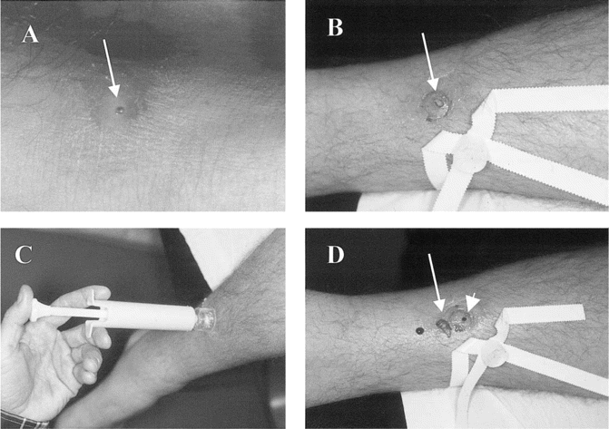
Figure 1 A, Photograph of presenting lesion with associated cellulitis. B, Failed extraction with suffocation and ...
Notes:
Figure 1 A, Photograph of presenting lesion with associated cellulitis. B, Failed extraction with suffocation and lateral pressure of lesion. The arrow denotes the posterior end of the maggot protruding through the central punctum. C and D, Application of a venom extractor results in rapid (<1 s) extraction of an intact and viable 1.5-cm larva. The arrowhead denotes the central punctum, with the intact maggot to the left (arrow).
Unless provided in the caption above, the following copyright applies to the content of this slide: © 2002 by the Infectious Diseases Society of America

