Slide 1
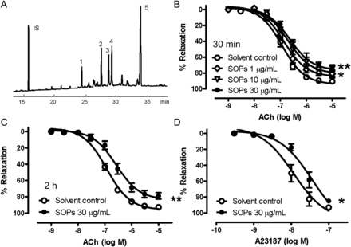
Figure 1 (A) GC spectrum of the main SOPs. IS, internal standard (5α-cholestane), 1: 7α-hydroxysitosterol, 2: ...
Notes:
Figure 1 (A) GC spectrum of the main SOPs. IS, internal standard (5α-cholestane), 1: 7α-hydroxysitosterol, 2: 7β-hydroxysitosterol, 3: 5,6β-epoxysitosterol, 4: 5,6α-epoxysitosterol, 5: 7-ketositosterol. (B) ACh-induced relaxation when the rat aortae were incubated with different concentrations of SOPs (1–30 μg/mL) for 30 min. SOPs attenuated ACh-induced relaxation in a concentration-dependent manner. (C) ACh-induced relaxation in the absence or presence of SOPs (30 µg/mL) for 2 h. Increasing the incubation time of SOPs from 30 min to 2 h did not further attenuate ACh-induced relaxation. (D) A23187-induced relaxation in the absence or presence of SOPs (30 µg/mL) for 30 min. SOPs attenuated A23187-induced relaxation. Values are mean ± SEM of five to nine experiments. *P < 0.05, **P < 0.01 vs. solvent control group.
Unless provided in the caption above, the following copyright applies to the content of this slide: Published on behalf of the European Society of Cardiology. All rights reserved. © The Author 2012. For permissions please email: journals.permissions@oup.com.

Slide 2
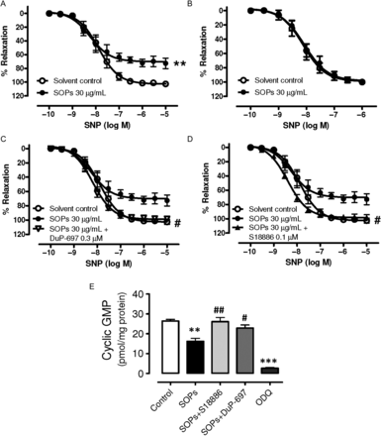
Figure 7 SNP-induced relaxation when (A) endothelium-intact or (B) endothelium-denuded rat aortae were incubated with ...
Notes:
Figure 7 SNP-induced relaxation when (A) endothelium-intact or (B) endothelium-denuded rat aortae were incubated with SOPs (30 µg/mL) for 30 min. SOPs attenuated SNP-induced relaxation only in the presence of endothelium. Values are mean ± SEM of four to six experiments. **P < 0.01 vs. control group. (C and D) The effect of (C) DuP-697 (0.3 µM) and (D) S18886 (0.1 µM) on SOPs-induced impairment on SNP-induced relaxations. DuP-697 or S18886 completely reversed the effects of SOPs, suggesting that SOPs acted through a COX-2- and TP receptor-mediated pathway. Values are mean ± SEM of four to six experiments. #P < 0.05 vs. SOPs group. (E) The inhibition effect of SOPs (30 μg/mL) on the production of cyclic GMP in endothelium-intact aortae. SOPs decreased cGMP production, and this effect was reversed by S18886 (0.1 μM) or DuP-697 (0.3 μM). Values are mean ± SEM of four to six experiments. **P < 0.01, ***P < 0.001 vs. solvent control group; #P < 0.05, ##P < 0.01 vs. SOPs group.
Unless provided in the caption above, the following copyright applies to the content of this slide: Published on behalf of the European Society of Cardiology. All rights reserved. © The Author 2012. For permissions please email: journals.permissions@oup.com.

Slide 3
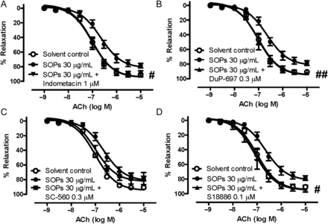
Figure 2 Effect of (A) indometacin (1 µM), (B) DuP-697 (0.3 µM), (C) SC-560 (0.3 µM), and (D) S18886 (0.1 µM) on ...
Notes:
Figure 2 Effect of (A) indometacin (1 µM), (B) DuP-697 (0.3 µM), (C) SC-560 (0.3 µM), and (D) S18886 (0.1 µM) on SOPs-induced impairment on ACh-induced relaxations. Indometacin, DuP-697, and S18886 completely reversed, whereas SC-560 partially reversed the effects of SOPs, suggesting that SOPs acted through a COX-2- and TP-receptor-mediated pathway. Values are mean ± SEM of 4–7 experiments. #P < 0.05, ##P < 0.01 vs. SOPs group.
Unless provided in the caption above, the following copyright applies to the content of this slide: Published on behalf of the European Society of Cardiology. All rights reserved. © The Author 2012. For permissions please email: journals.permissions@oup.com.

Slide 4
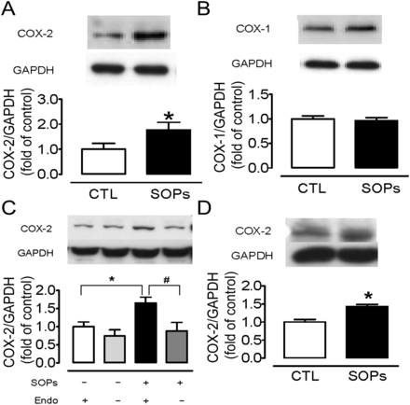
Figure 3 (A and B) Representative blots (upper panel) and Western blot analysis (lower panel) showing the effects of ...
Notes:
Figure 3 (A and B) Representative blots (upper panel) and Western blot analysis (lower panel) showing the effects of SOPs (30 µg/mL) treatment on the expression of (A) COX-2 and (B) COX-1 in endothelium-intact aortae. SOPs up-regulated COX-2 expression but did not affect COX-1 expression. Values are mean ± SEM of 6–12 experiments. *P < 0.05 vs. control group. (C) Representative blots (upper panel) and Western blot analysis (lower panel) showing the effects of SOPs (30 µg/mL) treatment on COX-2 expression in endothelium-intact and endothelium-denuded aortae. SOPs increased COX-2 expression only in endothelium-intact but not in endothelium-denuded aortae. Values are mean ± SEM of seven experiments. *P < 0.05 vs. endothelium-intact group without SOPs; #P < 0.05 vs. endothelium-denuded group with SOPs. (D) Representative blots (upper panel) and Western blot analysis (lower panel) showing the effects of SOPs (30 µg/mL) treatment on COX-2 expression in primary rat aortic endothelial cells. SOPs up-regulated COX-2 expression. Values are mean ± SEM of three experiments. *P < 0.05 vs. control group. GAPDH was used as the control loading protein. CTL, solvent control group.
Unless provided in the caption above, the following copyright applies to the content of this slide: Published on behalf of the European Society of Cardiology. All rights reserved. © The Author 2012. For permissions please email: journals.permissions@oup.com.

Slide 5
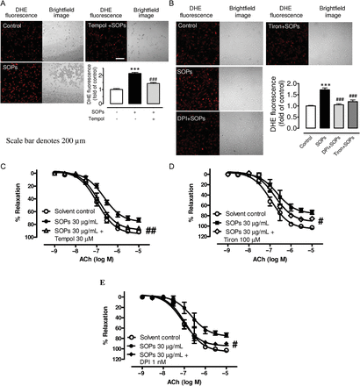
Figure 4 (A and B) DHE fluorescence was elevated with 15 min incubation of SOPs (30 μg/mL) and was reversed by the ROS ...
Notes:
Figure 4 (A and B) DHE fluorescence was elevated with 15 min incubation of SOPs (30 μg/mL) and was reversed by the ROS scavenger (A) tempol 30 µM, (B) DPI 1 nM, and tiron 100 µM in rat aortic endothelial cells. The results suggested that SOPs elevated the intracellular oxidative stress level. (C–E) Effect of (C) tempol, (D) tiron, and (E) DPI on SOPs-induced impairment on ACh-induced relaxations. Tempol completely reversed, whereas tiron partially reversed the effects of SOPs, suggesting that oxidative stress was involved in the SOPs-induced impairment of endothelium-dependent relaxation. In addition, DPI completely reversed the effects of SOPs, suggesting that the oxidative stress exerted by SOPs may originate from NADPH oxidase. Values are mean ± SEM of 3–12 experiments. #P < 0.05, ##P < 0.01 vs. SOPs group.
Unless provided in the caption above, the following copyright applies to the content of this slide: Published on behalf of the European Society of Cardiology. All rights reserved. © The Author 2012. For permissions please email: journals.permissions@oup.com.

Slide 6
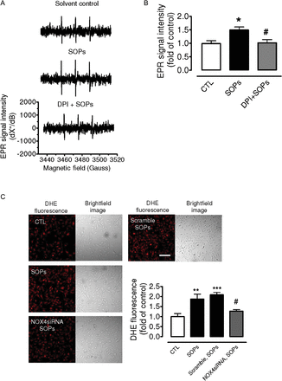
Figure 5 (A) Representative EPR spectrum of radicals detected by spin trap in rat aortic endothelial cells treated by ...
Notes:
Figure 5 (A) Representative EPR spectrum of radicals detected by spin trap in rat aortic endothelial cells treated by solvent, SOPs and DPI + SOPs; (B) Summarized data showing EPR signal intensity in rat aortic endothelial cells treated by solvent, SOPs and DPI + SOPs. SOPs increased the production of superoxide anions; this increase was reversed by DPI treatment, suggesting the SOPs increased NADPH oxidase-derived superoxide anions. Values are means ± SEM of four to five experiments. *P < 0.05 vs. solvent control group; #P < 0.05 vs. SOPs group. (C) Intracellular ROS was elevated after SOPs (30 μg/mL) treatment; this increase in ROS was reversed by knocking down of NOX4 expression by NOX4 siRNA. On the other hand, scramble siRNA did not reverse SOPs-induced increase in ROS. Values are mean ± SEM of five experiments. **P < 0.01, ***P < 0.001 vs. solvent control; #P < 0.05 vs. SOPs group.
Unless provided in the caption above, the following copyright applies to the content of this slide: Published on behalf of the European Society of Cardiology. All rights reserved. © The Author 2012. For permissions please email: journals.permissions@oup.com.

Slide 7
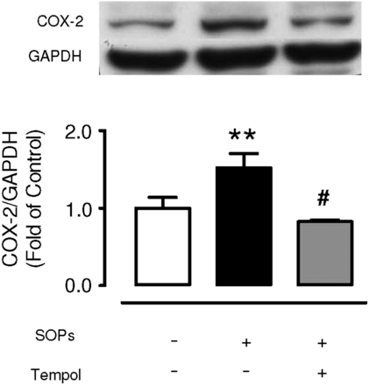
Figure 6 Representative blots (upper panel) and Western blot analysis (lower panel) showing the effect of tempol (30 ...
Notes:
Figure 6 Representative blots (upper panel) and Western blot analysis (lower panel) showing the effect of tempol (30 µM) treatment on SOPs (30 µg/mL)-induced COX-2 up-regulation in the endothelium-intact aorta. Tempol reversed the up-regulation of COX-2 induced by SOPs. GAPDH was used as the control loading protein. Values are mean ± SEM of 4–10 experiments. **P < 0.01 vs. control group; #P < 0.05 vs. SOPs group.
Unless provided in the caption above, the following copyright applies to the content of this slide: Published on behalf of the European Society of Cardiology. All rights reserved. © The Author 2012. For permissions please email: journals.permissions@oup.com.

Slide 8
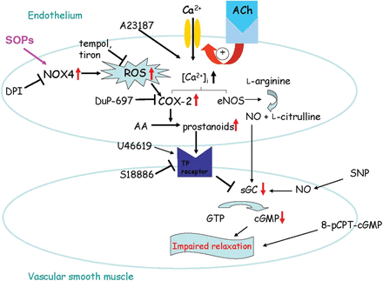
Figure 8 Schematic diagram showing how SOPs attenuate vasorelaxation in the rat aorta. The present study shows that ...
Notes:
Figure 8 Schematic diagram showing how SOPs attenuate vasorelaxation in the rat aorta. The present study shows that SOPs increase the production of ROS in the endothelium via a NOX4-sensitive pathway. The ROS would in turn increase the expression of COX-2, which is predicted to lead to an enhanced production of prostanoids. The prostanoids from the endothelium diffuse towards adjacent vascular smooth muscle cells, where they activate the TP receptors and attenuate the endothelium-dependent vasorelaxation by decreasing the activity of soluble guanylate cyclase and thereby decreasing the cGMP production.
Unless provided in the caption above, the following copyright applies to the content of this slide: Published on behalf of the European Society of Cardiology. All rights reserved. © The Author 2012. For permissions please email: journals.permissions@oup.com.

