Slide 1
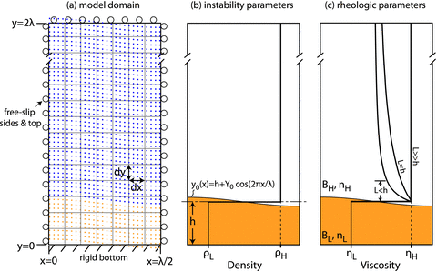
Figure 1 Schematic diagrams showing the initial model setup and parametrization. (a) Model domain, boundary ...
Notes:
Figure 1 Schematic diagrams showing the initial model setup and parametrization. (a) Model domain, boundary conditions, and initial particle layout. (b) Density structure and initial layer geometry. (c) Initial viscosity structure.
Unless provided in the caption above, the following copyright applies to the content of this slide: © The Authors Geophysical Journal International © 2012 RAS

Slide 2
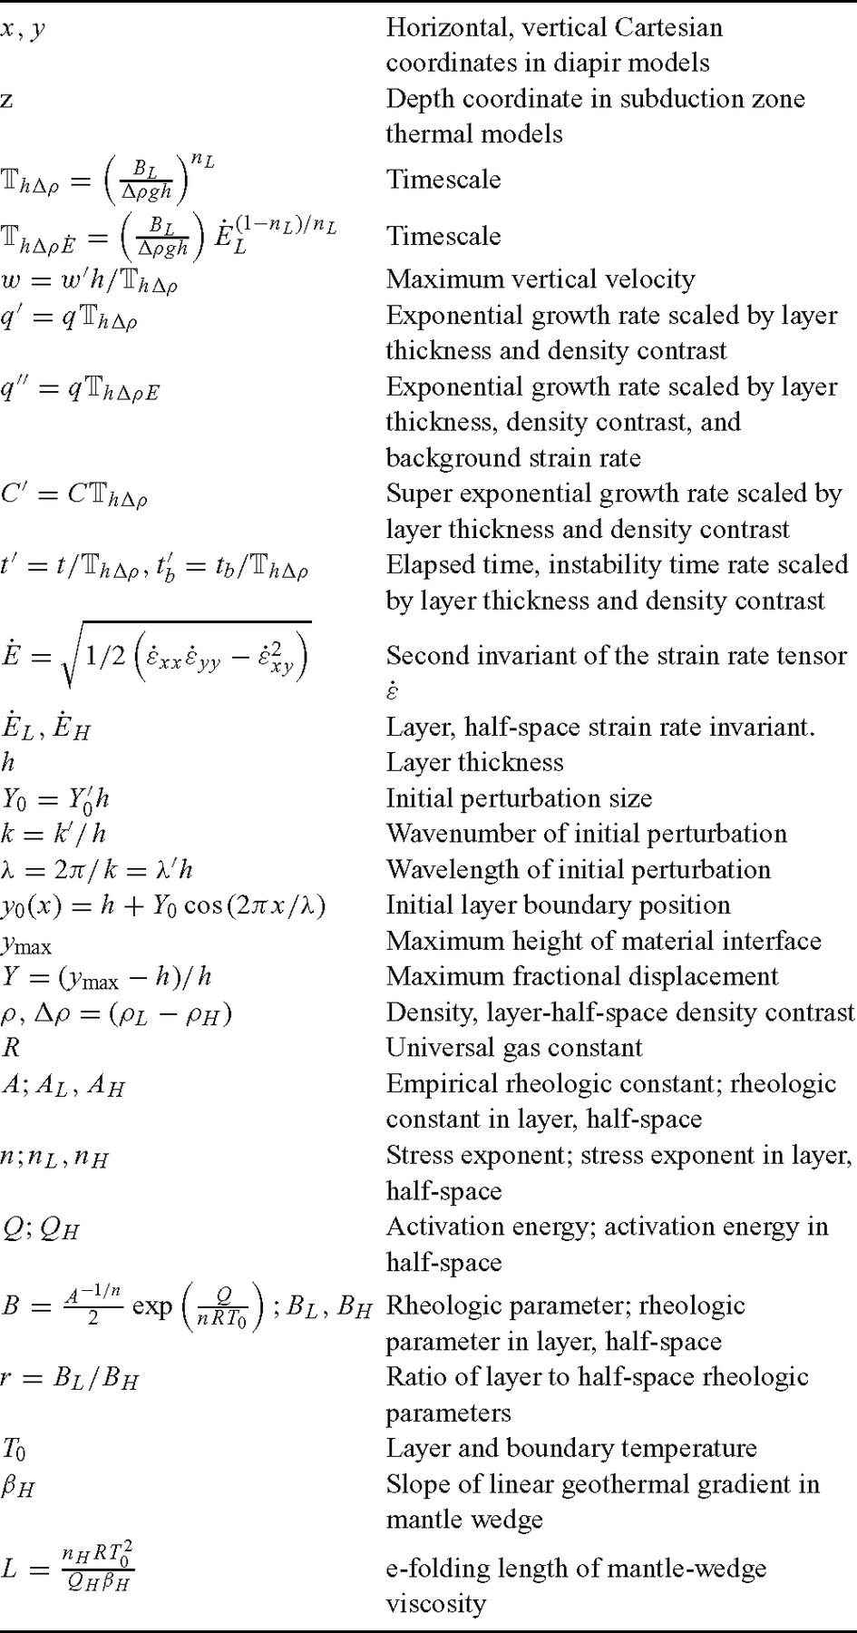
Table 1 Symbols.
Notes:
Table 1 Symbols.
Unless provided in the caption above, the following copyright applies to the content of this slide: © The Authors Geophysical Journal International © 2012 RAS

Slide 3
Table 2 Rheologic parameters.
Notes:
Table 2 Rheologic parameters.
Unless provided in the caption above, the following copyright applies to the content of this slide: © The Authors Geophysical Journal International © 2012 RAS

Slide 4
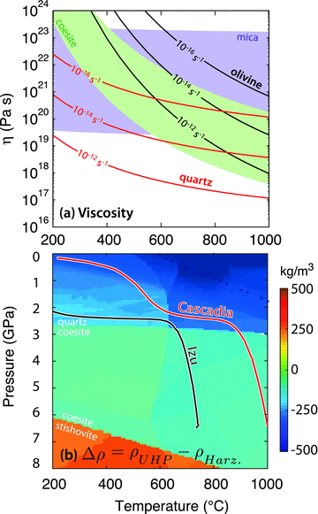
Figure 2 (a) Effective viscosity as a function of temperature for hydrous quartz (Hirth et al. 2001) and olivine ...
Notes:
Figure 2 (a) Effective viscosity as a function of temperature for hydrous quartz (Hirth et al. 2001) and olivine (Hirth & Kohlstedt 2003) at different strain rates. For comparison, shaded regions indicate the viscosity range of mica shist (strong T and dependent rheology of Shea & Kronenberg 1992) and dry coesite (Renner et al. 2001). In subduction zone thermal models, both slab-surface and mantle wedge temperatures and strain rates vary from ∼200 to ∼1000 °C and from ∼10−16 to ∼10−12 s−1, respectively. (b) Density contrast between UHP rocks (sediments) and harzburgite (mantle wedge) with 2 wt% H2O as a function of temperature and pressure (Behn et al. 2011). Lines show the pressure-temperature trajectory of the slab surface in the Cascadia (red) and Izu (black) subduction zone models of Wada & Wang (2009).
Unless provided in the caption above, the following copyright applies to the content of this slide: © The Authors Geophysical Journal International © 2012 RAS

Slide 5
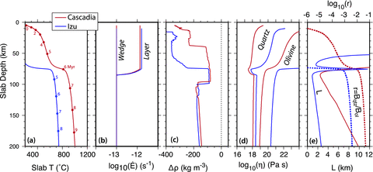
Figure 3 Key parameters controlling instability growth from models of the Cascadia (red) and Izu (blue) subduction ...
Notes:
Figure 3 Key parameters controlling instability growth from models of the Cascadia (red) and Izu (blue) subduction zones (Wada & Wang 2009) plotted as a function of slab depth. (a) Slab-surface temperature. Circles indicate increments of 1 Myr in subduction time from an arbitrary reference point. (b) Strain rate in the sediment layer and mantle wedge. (c) Density constrast of UHP rocks (sediments) and harzburgite (mantle wedge) (Behn et al. 2011). (d) Effective viscosity of quartz and olivine. (e) e-folding length scale for viscous decay in the mantle wedge (solid lines) and ratio of quartz-to-olivine rheologic parameters (dashed lines).
Unless provided in the caption above, the following copyright applies to the content of this slide: © The Authors Geophysical Journal International © 2012 RAS

Slide 6
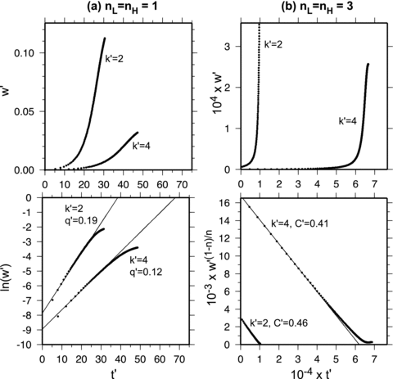
Figure 4 Plots of non-dimensionaled, maximum vertical velocity as function of non-dimensional time (top panels) in ...
Notes:
Figure 4 Plots of non-dimensionaled, maximum vertical velocity as function of non-dimensional time (top panels) in numerical models with (a) Newtonian and (b) non-Newtonian rheologies and different initial perturbation wavenumbers . In the Newtonian case, velocity increases exponentially and plotting ln versus (lower panel) produces a linear function (thin line). Similarly for the non-Newtonian case, velocity evolves according to a power law and can be linearized by plotting versus . In both cases, the slope of linearized velocities is proportional to the growth rate factor (i.e. or ).
Unless provided in the caption above, the following copyright applies to the content of this slide: © The Authors Geophysical Journal International © 2012 RAS

Slide 7
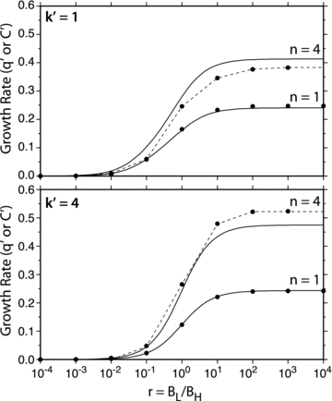
Figure 5 Comparison of non-dimensional growth rates plotted as a function of the ratio of rheologic parameters r found ...
Notes:
Figure 5 Comparison of non-dimensional growth rates plotted as a function of the ratio of rheologic parameters r found numerically (dots) and analytically (lines) for Newtonian (n= 1) and non-Newtonian (n= 4) rheologies and different initial perturbation wavenumbers ().
Unless provided in the caption above, the following copyright applies to the content of this slide: © The Authors Geophysical Journal International © 2012 RAS

Slide 8
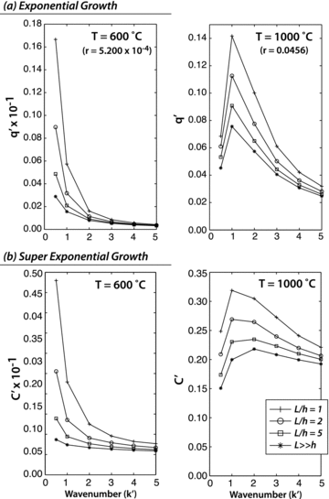
Figure 6 Numerically calculated growth rate factors as a function of wavenumber for quartz diapirs in an olivine ...
Notes:
Figure 6 Numerically calculated growth rate factors as a function of wavenumber for quartz diapirs in an olivine half-space with a homogenous layer temperature of 600 and 1000 °C for different length scales for viscous decay in the half-space (L/h). In (a), viscosities are held constant, and the diapirs grow exponentially. In (b), viscosities decay with increasing strain rate and diapir growth is super-exponential. If L/h is small, the half-space viscosity decays rapidly with distance from the layer boundary, while if L≫h, viscosity in the half-space is nearly homogenous. Changes in L/h have a much stronger effect at low temperatures where quartz is weak with respect to olivine (i.e. small r) than at higher temperatures where quartz and olivine viscosities are comparable.
Unless provided in the caption above, the following copyright applies to the content of this slide: © The Authors Geophysical Journal International © 2012 RAS

Slide 9
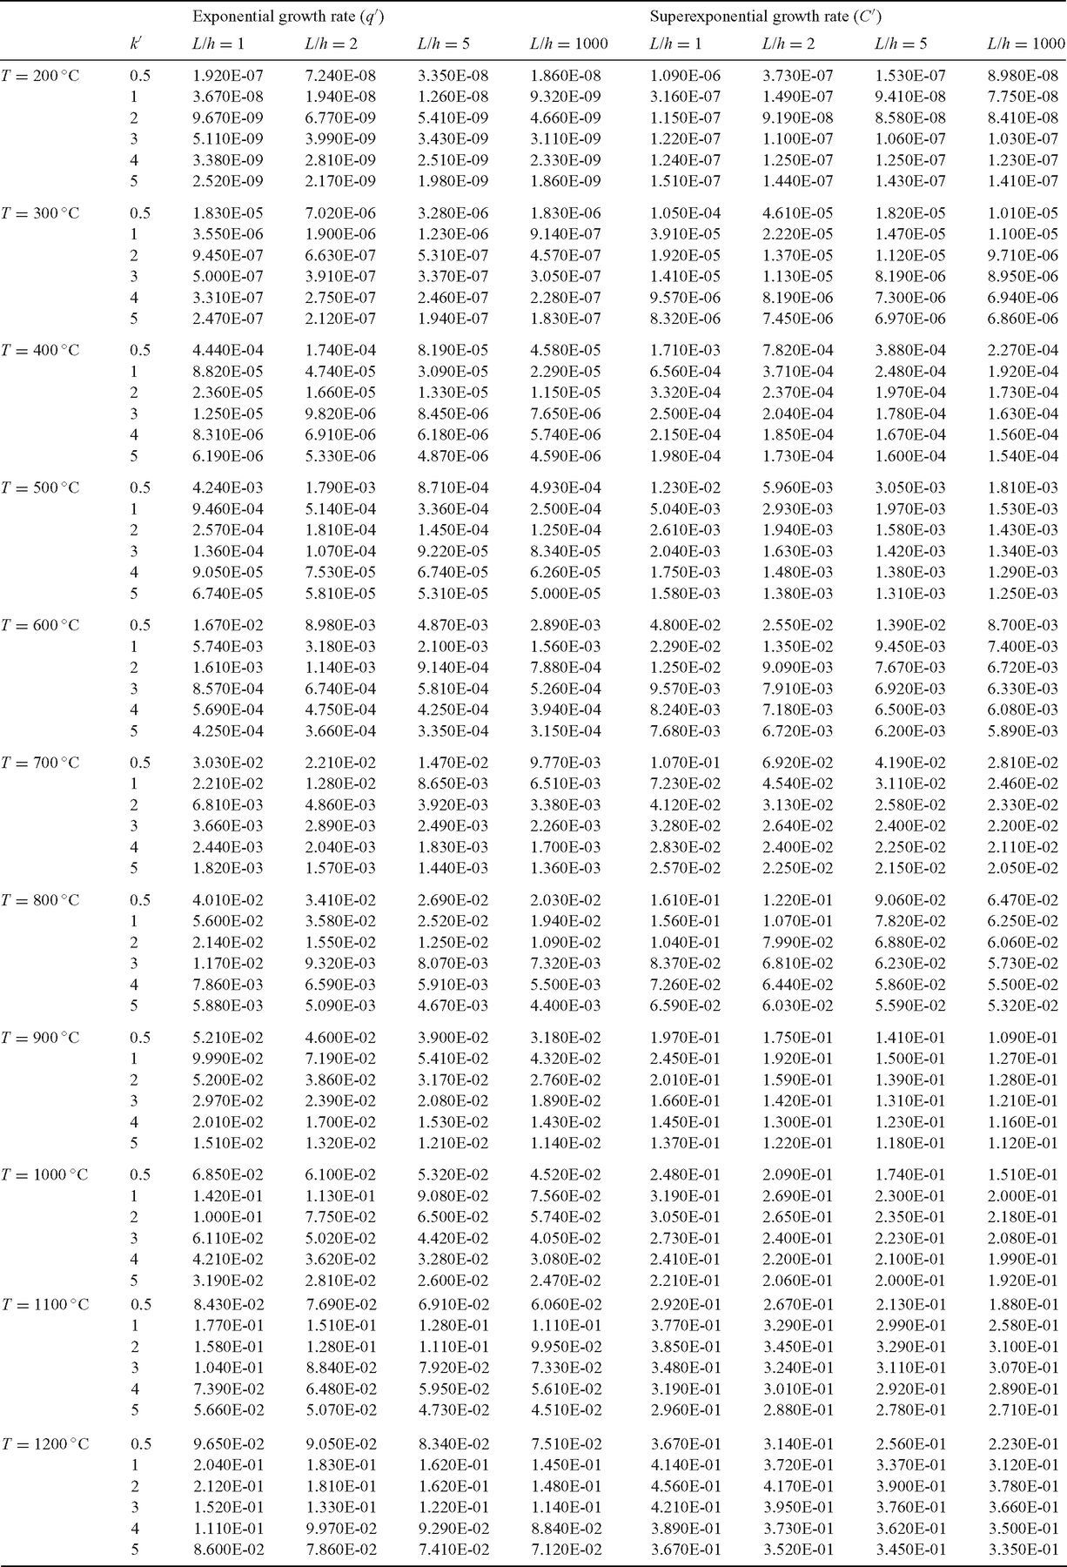
Table 3 Non-dimensional, exponential and superexponential growth rates for quartz diapirs in an olivine half-space ...
Notes:
Table 3 Non-dimensional, exponential and superexponential growth rates for quartz diapirs in an olivine half-space for various initial perturbationwavenumbers (k′). Models were run with fixed temperatures (T) and fixed relative length scales for viscous decay in the half-space (L/h).
Unless provided in the caption above, the following copyright applies to the content of this slide: © The Authors Geophysical Journal International © 2012 RAS

Slide 10
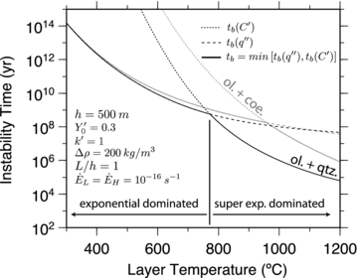
Figure 7 Example determination of diapir instability time. At low temperatures, diapirs grow fastest when Newtonian ...
Notes:
Figure 7 Example determination of diapir instability time. At low temperatures, diapirs grow fastest when Newtonian viscosities are calculated for a finite background strain rate ( s−1) (dashed line). At higher temperatures, diapirs grow faster when viscosities are non-Newtonian and decay with increasing local strain rates (dotted line). To determine an instability time as a function of temperature, we choose the minimum of these two curves (solid line). Instability times are shown for wet-quartz (black lines) and dry-coesite (grey lines) layers underlying a wet-olivine half-space.
Unless provided in the caption above, the following copyright applies to the content of this slide: © The Authors Geophysical Journal International © 2012 RAS

Slide 11
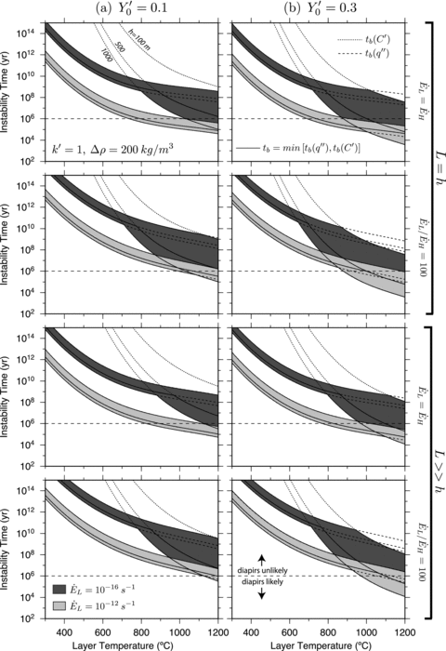
Figure 8 Scaled instability times as function of temperature for initial perturbation sizes of (a) 10 per cent and (b) ...
Notes:
Figure 8 Scaled instability times as function of temperature for initial perturbation sizes of (a) 10 per cent and (b) 30 per cent for different layer thicknesses, background strain rates and half-space viscous decay length scales. Shaded regions show the range of instability times calculated as in Fig. 7 for background strain rates of 10−16and 10−16 s−1. In most arcs, sediments are subducted in a few million years, and thus diapirs are only likely to form and detach from the slab when tb < O(106) yr.
Unless provided in the caption above, the following copyright applies to the content of this slide: © The Authors Geophysical Journal International © 2012 RAS

Slide 12
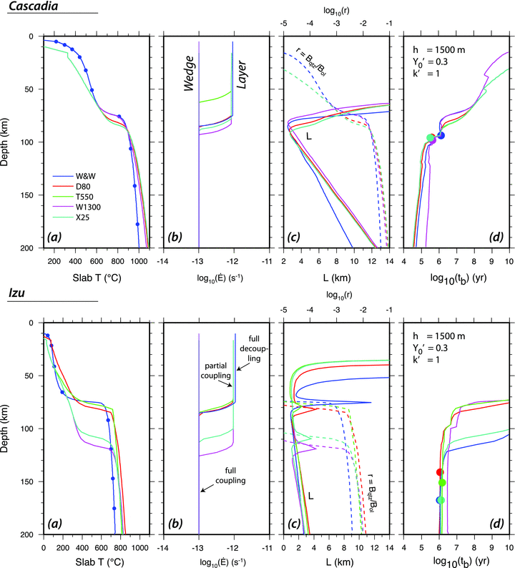
Figure 9 (a-c) Subset of the model parameters shown in Fig. 3. (d) Instability times scaled for conditions at depth ...
Notes:
Figure 9 (a-c) Subset of the model parameters shown in Fig. 3. (d) Instability times scaled for conditions at depth (lines) and depths for diapir detachment found by integrating these instability times (circles) for Cascadia (top) and Izu (bottom). W&W refers to models from Wada & Wang (2009) in which the decoupling/coupling transition is set to 80 km and the mantle-wedge temperature is allowed to evolve to steady state. Other models are from Syracuse et al. (2010) and have the following prescribed parameters: (D80) Depth of decoupling/coupling transition is set to 80 km. (T550) The decoupling/coupling transition occurs where the slab surface reaches the brittle/ductile transition at 550 °C. (W1300) The minimum temperature in the mantle wedge beneath the arc is held fixed at 1300 °C. (X25) The decoupling/coupling transition is placed 25 km from the arc. See references for additional model details.
Unless provided in the caption above, the following copyright applies to the content of this slide: © The Authors Geophysical Journal International © 2012 RAS

Slide 13
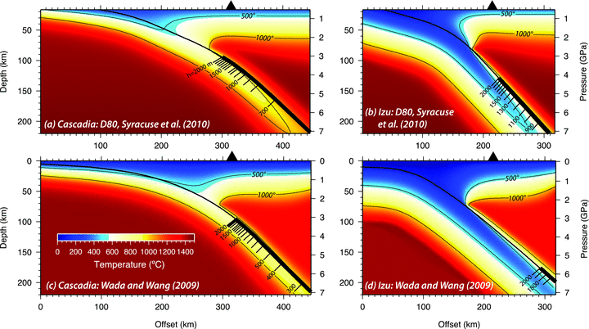
Figure 10 Locations of sediment diapir detachment in the D80 Syracuse et al. (2010) and the Wada & Wang (2009) models ...
Notes:
Figure 10 Locations of sediment diapir detachment in the D80 Syracuse et al. (2010) and the Wada & Wang (2009) models of the Cascadia and Izu subduction zones. Scale on slab surface indicates the location of diapir detachment for different layer thicknesses and a 30 per cent initial perturbation.
Unless provided in the caption above, the following copyright applies to the content of this slide: © The Authors Geophysical Journal International © 2012 RAS

Slide 14
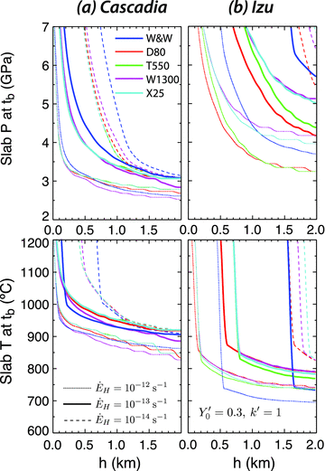
Figure 11 Slab-surface pressures (top) and temperatures (bottom) at the location of diapir detachment plotted as a ...
Notes:
Figure 11 Slab-surface pressures (top) and temperatures (bottom) at the location of diapir detachment plotted as a function of sediment layer thickness in thermal models for the (a) Cascadia and (b) Izu subduction zones. Values are for a 30 per cent initial perturbation with wavenumber . Colour coding is the same as in Fig. 9.
Unless provided in the caption above, the following copyright applies to the content of this slide: © The Authors Geophysical Journal International © 2012 RAS

Slide 15
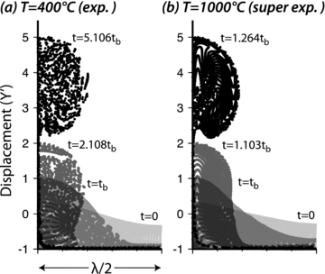
Figure 12 Snapshots of quartz diapirs in an olivine half-space for an initial perturbation wavenumber k′ and amplitude ...
Notes:
Figure 12 Snapshots of quartz diapirs in an olivine half-space for an initial perturbation wavenumber k′ and amplitude . In (a), viscosities are held constant but are calculated for a temperature of 400 °C and a background strain rate of 10−13 s−1, and growth is exponential. In (b), temperature is set to 1000 °C, viscosities are allowed to change with increasing local strain rates, and growth is superexponential.
Unless provided in the caption above, the following copyright applies to the content of this slide: © The Authors Geophysical Journal International © 2012 RAS

