Slide 1
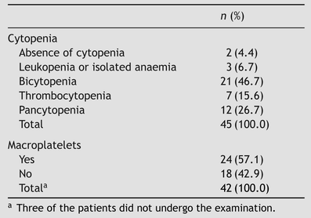
Table 1 Distribution of the patients according to type of cytopenia and occurrence or absence of macroplatelets.
Notes:
Table 1 Distribution of the patients according to type of cytopenia and occurrence or absence of macroplatelets.
Unless provided in the caption above, the following copyright applies to the content of this slide: © Royal Society of Tropical Medicine and Hygiene 2009

Slide 2
Table 2 Relationship between spleen longitudinal diameter and platelet count in 45 patients with hepatosplenic ...
Notes:
Table 2 Relationship between spleen longitudinal diameter and platelet count in 45 patients with hepatosplenic schistosomiasis.
Unless provided in the caption above, the following copyright applies to the content of this slide: © Royal Society of Tropical Medicine and Hygiene 2009

Slide 3
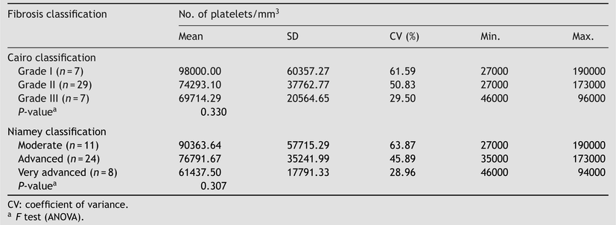
Table 3 Association between platelet count and fibrosis classification, by the Cairo and Niamey criteria, among 43 ...
Notes:
Table 3 Association between platelet count and fibrosis classification, by the Cairo and Niamey criteria, among 43 patients with hepatosplenic schistosomiasis.
Unless provided in the caption above, the following copyright applies to the content of this slide: © Royal Society of Tropical Medicine and Hygiene 2009

Slide 4
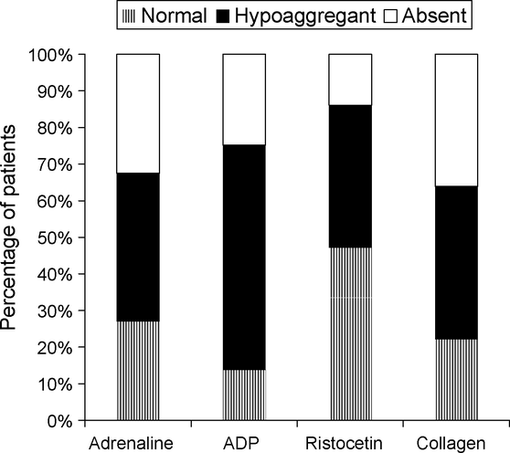
Figure 1 Evaluation of platelet aggregation among patients with hepatosplenic schistosomiasis mansoni. The graph shows ...
Notes:
Figure 1 Evaluation of platelet aggregation among patients with hepatosplenic schistosomiasis mansoni. The graph shows the percentage of patients with normal, hypoaggregant or absent clotting in the presence of different aggregating agents.
Unless provided in the caption above, the following copyright applies to the content of this slide: © Royal Society of Tropical Medicine and Hygiene 2009

Slide 5
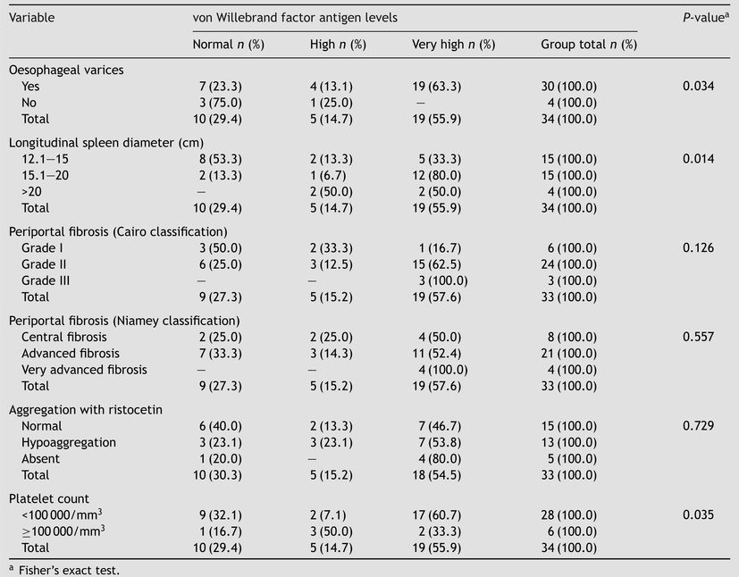
Table 4 Association of von Willebrand factor antigen levels with the presence of oesophageal varices, longitudinal ...
Notes:
Table 4 Association of von Willebrand factor antigen levels with the presence of oesophageal varices, longitudinal diameter of the spleen, degree of periportal fibrosis, aggregation with ristocetin and platelet counts among 34 patients with hepatosplenic schistosomiasis.
Unless provided in the caption above, the following copyright applies to the content of this slide: © Royal Society of Tropical Medicine and Hygiene 2009

