Slide 1
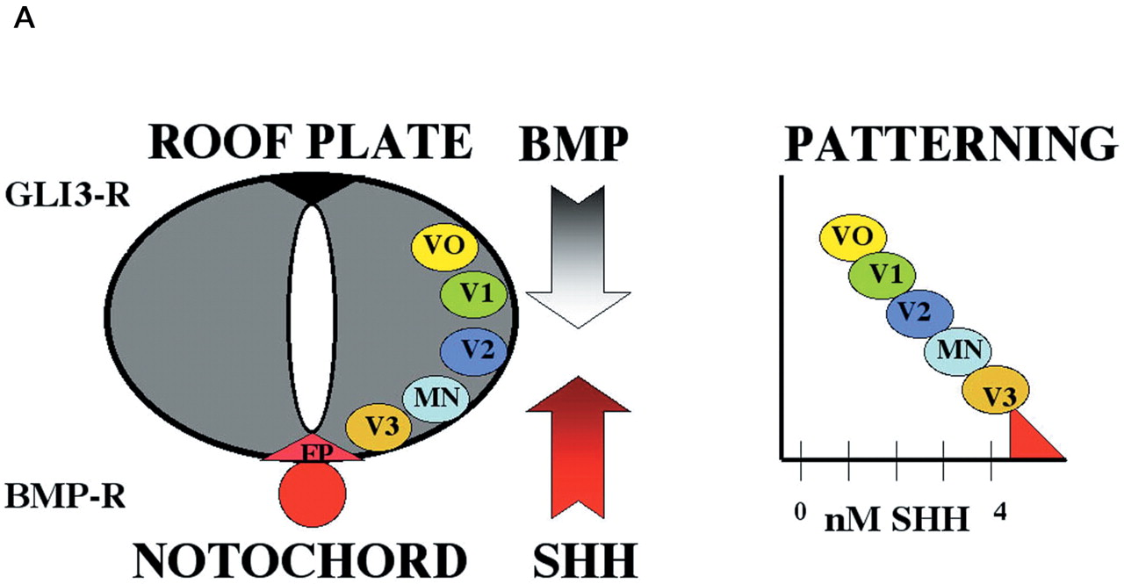
Figure 1. (A) A transverse section of the spinal chord identifies two principal signaling centers: (in red) ...
Notes:
Figure 1. (A) A transverse section of the spinal chord identifies two principal signaling centers: (in red) the notochord and floorplate are the source of Shh secretion that induces ventral patterning and form a gradient of activity (2–6) (red arrow; highest ventrally and decreasing towards the top); a similar gradient of BMP activity (gray arrow; highest in the roof plate) extends from the dorsal roof plate (41). Ventral motoneurons (MN) and interneurons (V0–V3) are specified by the combined actions of both gradients. The dorsal neural tube expresses the Gli3-repressor (Gli3-R), while the notochord is the source of BMP inhibitors (BMP-R). (B) A similar transverse section taken at the level of the presumptive forebrain reveals the proximity of the prechordal plate (PP) and the single eye field in the anterior neuroepithelium (adapted from 38). Both the PP and primitive foregut express Shh (red), although during pituitary development (18), Shh becomes excluded from Rathke's pouch (RP). We propose that in the immediate vicinity of Shh activity in the PP, GLI2 and GLI3 function as activators. ZIC2 (which is also associated with HPE) (see 39) may function as a co-factor with other GLI activators at more lateral positions.
Unless provided in the caption above, the following copyright applies to the content of this slide:

Slide 2
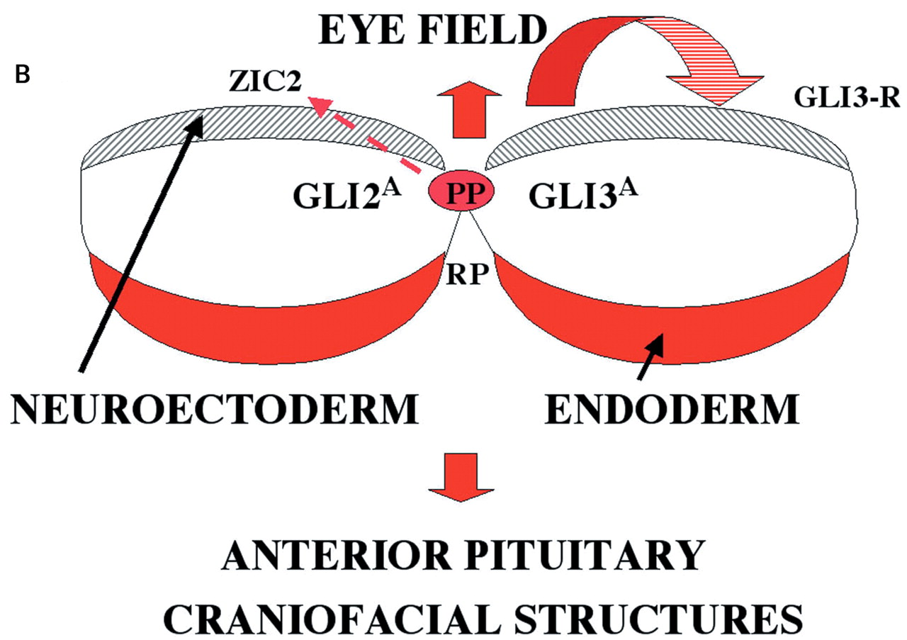
Figure 1. (A) A transverse section of the spinal chord identifies two principal signaling centers: (in red) ...
Notes:
Figure 1. (A) A transverse section of the spinal chord identifies two principal signaling centers: (in red) the notochord and floorplate are the source of Shh secretion that induces ventral patterning and form a gradient of activity (2–6) (red arrow; highest ventrally and decreasing towards the top); a similar gradient of BMP activity (gray arrow; highest in the roof plate) extends from the dorsal roof plate (41). Ventral motoneurons (MN) and interneurons (V0–V3) are specified by the combined actions of both gradients. The dorsal neural tube expresses the Gli3-repressor (Gli3-R), while the notochord is the source of BMP inhibitors (BMP-R). (B) A similar transverse section taken at the level of the presumptive forebrain reveals the proximity of the prechordal plate (PP) and the single eye field in the anterior neuroepithelium (adapted from 38). Both the PP and primitive foregut express Shh (red), although during pituitary development (18), Shh becomes excluded from Rathke's pouch (RP). We propose that in the immediate vicinity of Shh activity in the PP, GLI2 and GLI3 function as activators. ZIC2 (which is also associated with HPE) (see 39) may function as a co-factor with other GLI activators at more lateral positions.
Unless provided in the caption above, the following copyright applies to the content of this slide:

Slide 3
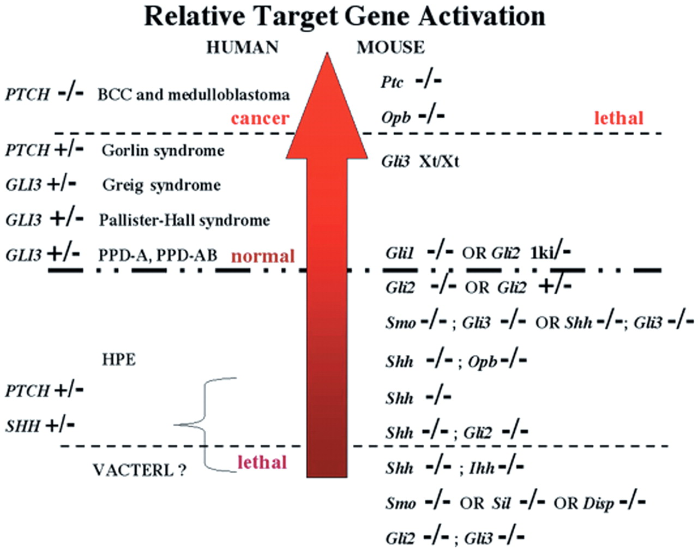
Figure 2. Genotypes of humans and mice are predicted to directly affect the activity of Hh-regulated genes. ...
Notes:
Figure 2. Genotypes of humans and mice are predicted to directly affect the activity of Hh-regulated genes. These genotypes can be ranked from those associated with the least expression (bottom) to the most active expression (red arrowhead). Most human disorders such as cancer, Gorlin, Greig or Pallister–Hall syndrome (99,103) are associated with above normal SHH activity owing to inactivation of the tumor suppressor, PTCH, or the repressor and/or activator functions of GLI3 (104,105). In contrast, HPE (39) (and possibly VACTERL, see 102) are often lethal malformations associated with a substantial decrease in target gene expression. An extensive array of murine models has been generated by several laboratories whose analysis has allowed direct verification of these changes in gene expression. At least five genotypes are lethal, probably due to failure of cardiac development (60). Note the shift toward more normal brain development when both Shh−/− (or its transducer smo−/−) is genetically combined with a simultaneous inactivation of the Gli3 (repressor≫activator) function (42), or Shh−/− in combination with the obligatory repressor Opb/Rab23 (66, see Table 1). Loss of Gli1 leads to essentially normal mouse development (86), while inactivation of Gli2 is nearly normal with an absent floorplate and minor ventral anomalies (82,83). We now understand that a combined action of Gli2-A and Gli3-A, and factors acting in parallel, is the principal mediator of Shh function (see Fig. 1B) (42,89).
Unless provided in the caption above, the following copyright applies to the content of this slide:

Slide 4
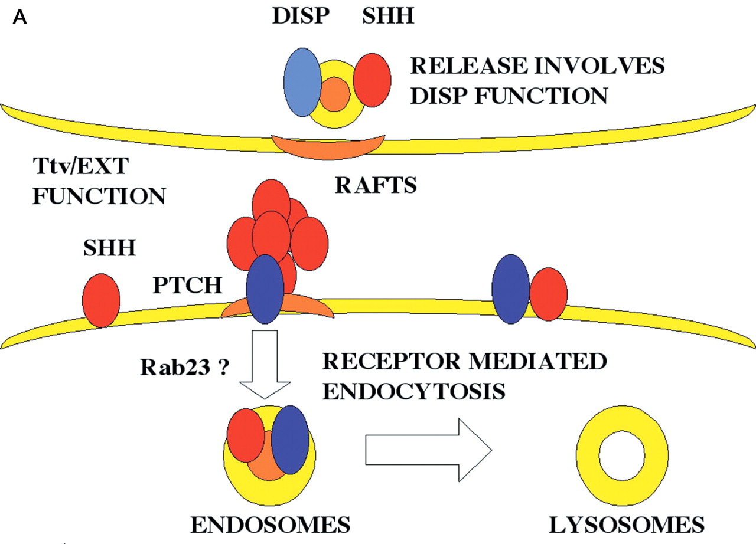
Figure 3. (A) A molecular symmetry is suggested between cells secreting SHH (red oval, top) and the ...
Notes:
Figure 3. (A) A molecular symmetry is suggested between cells secreting SHH (red oval, top) and the responding cells (bottom) based on the homology between the SHH-interacting, sterol-sensing domain (SSD) proteins DISP (light blue) and PTCH (dark blue). While Ptch, as well as Shh, are known to associate with sphingolipid and cholesterol-rich (orange) microdomains (144), this is not yet demonstrated for DISP. However, examination of its primary sequence suggests that DISP has a putative caveolin binding site within its SSD that may function in influencing the vesicle trafficking of the SHH morphogen. Heparin sulfate proteoglycans are suggested to be required matrix components that act to facilitate the movement of the Shh morphogen between cells. Note that binding of SHH (monomer or multimer) by PTCH leads to rapid internalization which(1) removes SHH from further action(s), and (2) also removes PTCH from any influence on SMOH (turquoise, not shown). (B) Once SMOH is relieved from its inhibition, it accumulates in the cell membrane in a hyper-phosphorylated state. How SMOH is effectively inhibited or its immediate downstream signal is not well known. As shown by the red arrows, SMOH activation leads to the accumulation of full-length activator forms of GLI transcription factors. In the absence of Hh signaling, a series of sequential kinases (PKA, GSK, CK1) promotes the cleavage of GLI factors to a repressor form. SU(FU) is thought to serve as a molecular bridge between GLI-R and a recently described repressor complex which inactivates chromatin domains in the vicinity of GLI transcription factor binding sites (73). In the basal (unstimulated) state, most of the GLI factors are associated with a multicomponent complex associated with cytoplasmic microtubules.
Unless provided in the caption above, the following copyright applies to the content of this slide:

Slide 5
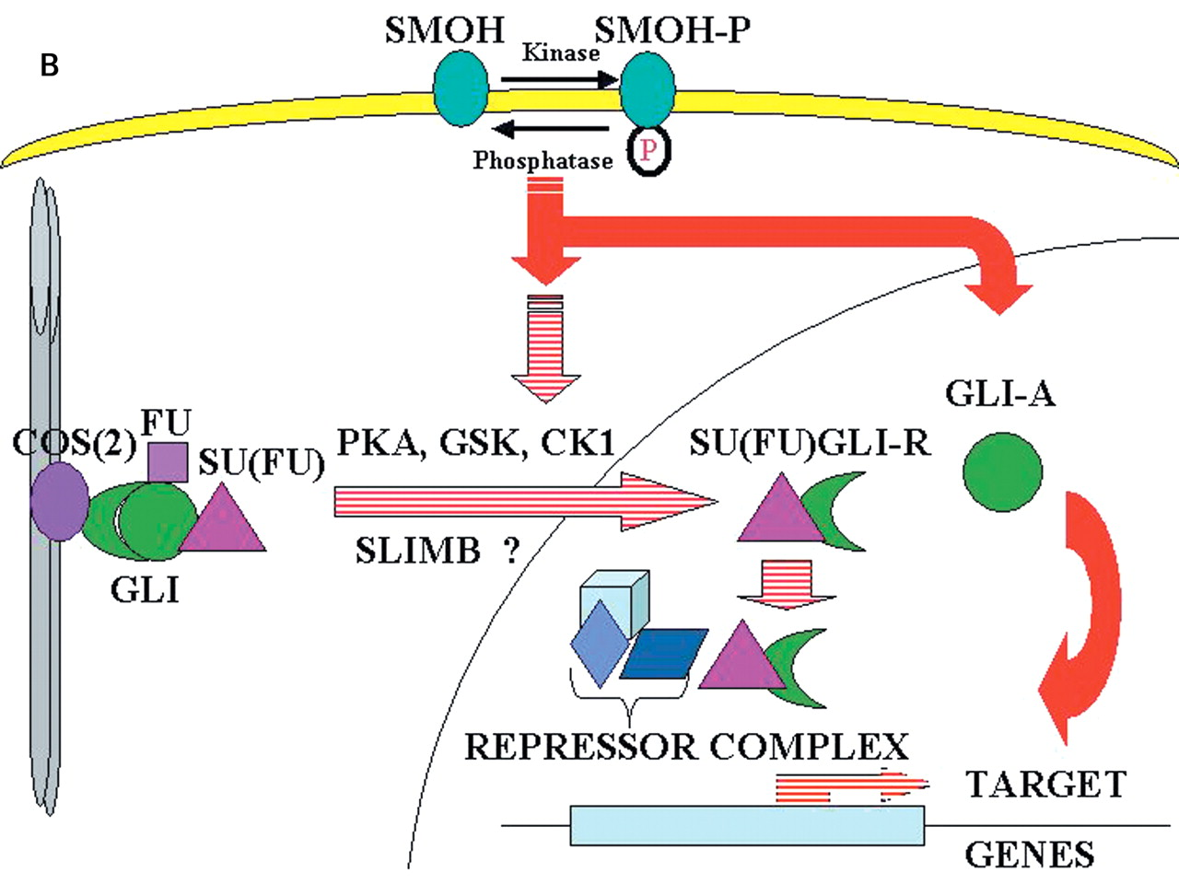
Figure 3. (A) A molecular symmetry is suggested between cells secreting SHH (red oval, top) and the ...
Notes:
Figure 3. (A) A molecular symmetry is suggested between cells secreting SHH (red oval, top) and the responding cells (bottom) based on the homology between the SHH-interacting, sterol-sensing domain (SSD) proteins DISP (light blue) and PTCH (dark blue). While Ptch, as well as Shh, are known to associate with sphingolipid and cholesterol-rich (orange) microdomains (144), this is not yet demonstrated for DISP. However, examination of its primary sequence suggests that DISP has a putative caveolin binding site within its SSD that may function in influencing the vesicle trafficking of the SHH morphogen. Heparin sulfate proteoglycans are suggested to be required matrix components that act to facilitate the movement of the Shh morphogen between cells. Note that binding of SHH (monomer or multimer) by PTCH leads to rapid internalization which(1) removes SHH from further action(s), and (2) also removes PTCH from any influence on SMOH (turquoise, not shown). (B) Once SMOH is relieved from its inhibition, it accumulates in the cell membrane in a hyper-phosphorylated state. How SMOH is effectively inhibited or its immediate downstream signal is not well known. As shown by the red arrows, SMOH activation leads to the accumulation of full-length activator forms of GLI transcription factors. In the absence of Hh signaling, a series of sequential kinases (PKA, GSK, CK1) promotes the cleavage of GLI factors to a repressor form. SU(FU) is thought to serve as a molecular bridge between GLI-R and a recently described repressor complex which inactivates chromatin domains in the vicinity of GLI transcription factor binding sites (73). In the basal (unstimulated) state, most of the GLI factors are associated with a multicomponent complex associated with cytoplasmic microtubules.
Unless provided in the caption above, the following copyright applies to the content of this slide:

Slide 6
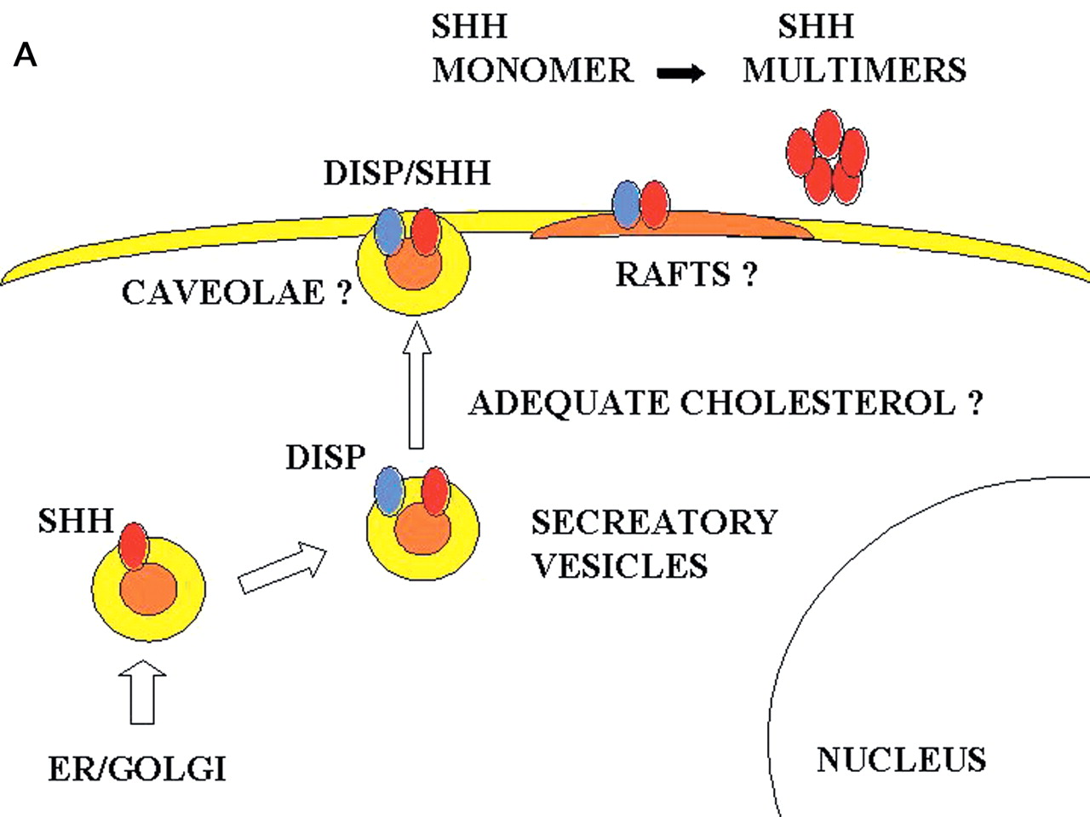
Figure 4. (A) A hypothetical model of SHH secretion postulates that adequate cholesterol (orange) can be a ...
Notes:
Figure 4. (A) A hypothetical model of SHH secretion postulates that adequate cholesterol (orange) can be a requirement for transport of SHH to the cell surface by influencing its association with the SSD-containing protein DISP (light blue). Cells secreting vertebrate Shh are known to accumulate immunoreative protein within the cell membrane, presumably due to the cholesterol moiety of Shh-Np. Cholesterol synthesis inhibitors do not affect the processing to the Shh-Np species, but might influence the trafficking to the cell membrane. (B) The mechanism(s) of inhibition of SMOH (turquoise) are poorly understood, but are likely to be multiple including: its translation, post-translational modification(s), vesicular trafficking between cellular compartments (influenced by Opb/Rab23 or cholesterol), its association with PTCH (inside and on the surface of cells), a balance between synthesis/degradation, as well as a hypothetical cholesterol requirement. In Drosophila, most of the Ptch protein in the steady state is associated with intracellular vesicles, and Hh signaling leads to a divergence in the distribution of Ptch and Smo. Similarly, in vertebrate cells, PTCH and SMOH appear to be co-localized in all compartments. Binding of the Hh ligand by PTCH leads to a sorting in late endosomes (149; see also 150), where PTCH/SHH complexes are degraded, and SMOH is diverted to the plasma membrane associated with signal transduction (red arrow).
Unless provided in the caption above, the following copyright applies to the content of this slide:

Slide 7
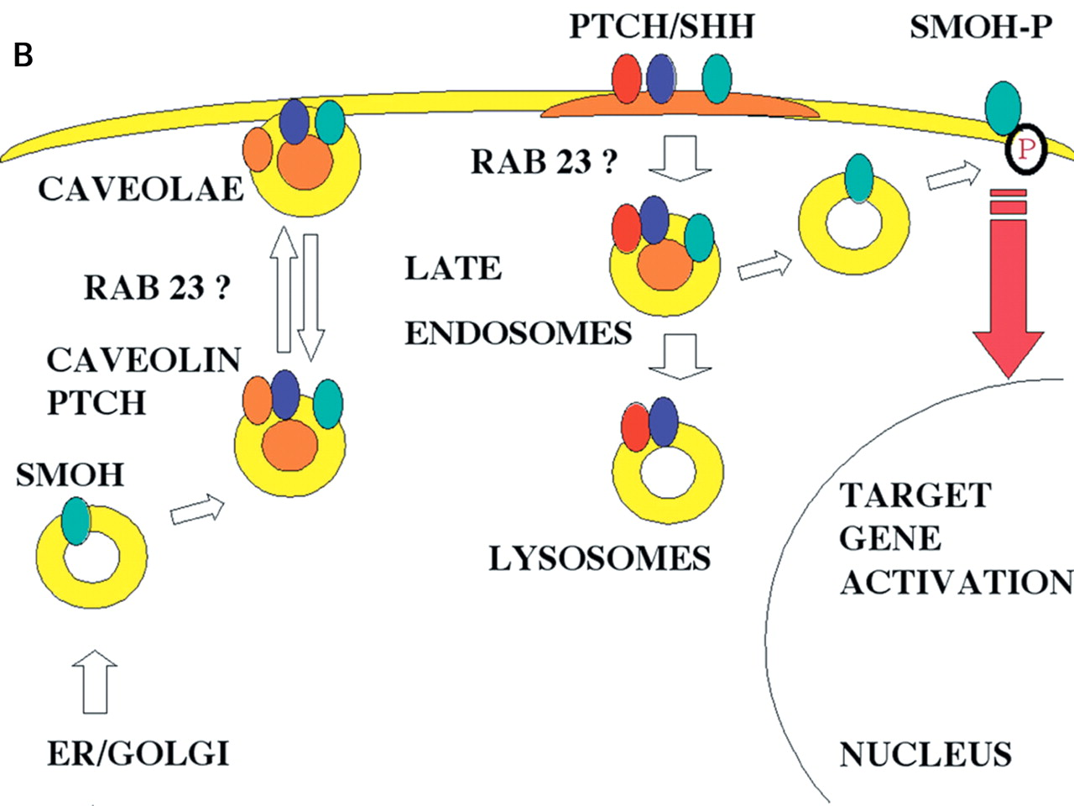
Figure 4. (A) A hypothetical model of SHH secretion postulates that adequate cholesterol (orange) can be a ...
Notes:
Figure 4. (A) A hypothetical model of SHH secretion postulates that adequate cholesterol (orange) can be a requirement for transport of SHH to the cell surface by influencing its association with the SSD-containing protein DISP (light blue). Cells secreting vertebrate Shh are known to accumulate immunoreative protein within the cell membrane, presumably due to the cholesterol moiety of Shh-Np. Cholesterol synthesis inhibitors do not affect the processing to the Shh-Np species, but might influence the trafficking to the cell membrane. (B) The mechanism(s) of inhibition of SMOH (turquoise) are poorly understood, but are likely to be multiple including: its translation, post-translational modification(s), vesicular trafficking between cellular compartments (influenced by Opb/Rab23 or cholesterol), its association with PTCH (inside and on the surface of cells), a balance between synthesis/degradation, as well as a hypothetical cholesterol requirement. In Drosophila, most of the Ptch protein in the steady state is associated with intracellular vesicles, and Hh signaling leads to a divergence in the distribution of Ptch and Smo. Similarly, in vertebrate cells, PTCH and SMOH appear to be co-localized in all compartments. Binding of the Hh ligand by PTCH leads to a sorting in late endosomes (149; see also 150), where PTCH/SHH complexes are degraded, and SMOH is diverted to the plasma membrane associated with signal transduction (red arrow).
Unless provided in the caption above, the following copyright applies to the content of this slide:

