Slide 1
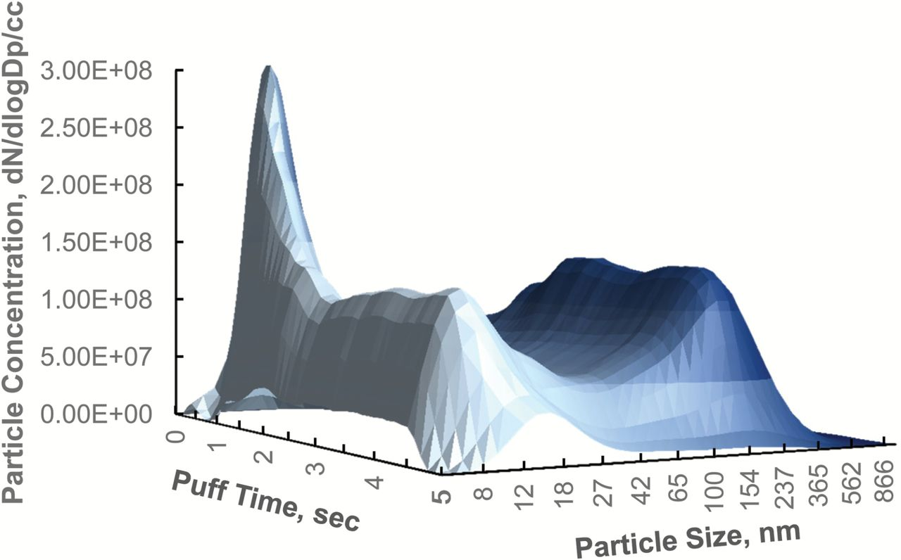
Figure 1. Aerosol size distribution, blu Classic Tobacco, 5-second puff, 15mL/s flow rate at low dilution (~1/30).
Notes:
Figure 1. Aerosol size distribution, blu Classic Tobacco, 5-second puff, 15mL/s flow rate at low dilution (~1/30).
Unless provided in the caption above, the following copyright applies to the content of this slide: © The Author 2016. Published by Oxford University Press on behalf of the Society for Research on Nicotine and Tobacco. All rights reserved. For permissions, please e-mail: journals.permissions@oup.com.

Slide 2
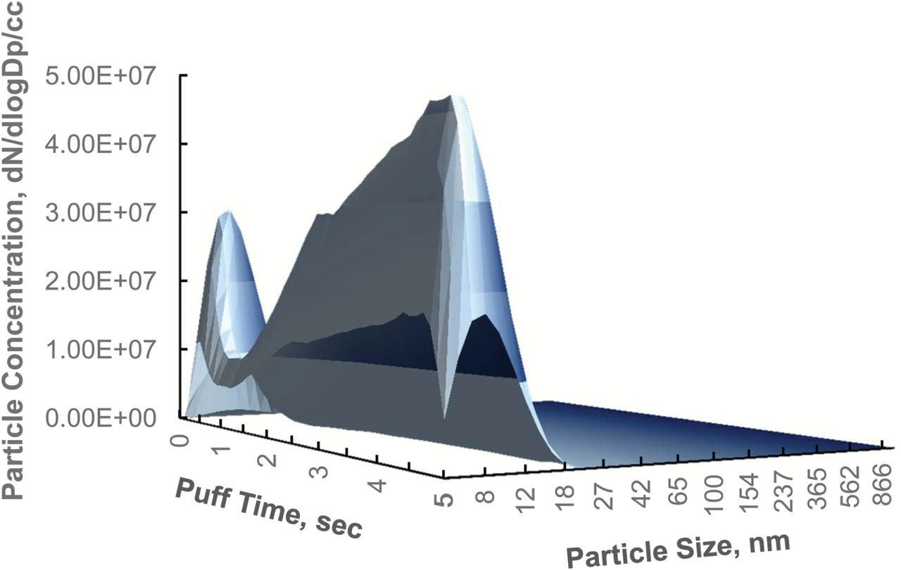
Figure 2. Aerosol size distribution, Joyetech (Tank-style), “Dry Puffing” Test, 5-second puff, 15mL/s flow rate at low ...
Notes:
Figure 2. Aerosol size distribution, Joyetech (Tank-style), “Dry Puffing” Test, 5-second puff, 15mL/s flow rate at low dilution (~1/30).
Unless provided in the caption above, the following copyright applies to the content of this slide: © The Author 2016. Published by Oxford University Press on behalf of the Society for Research on Nicotine and Tobacco. All rights reserved. For permissions, please e-mail: journals.permissions@oup.com.

Slide 3
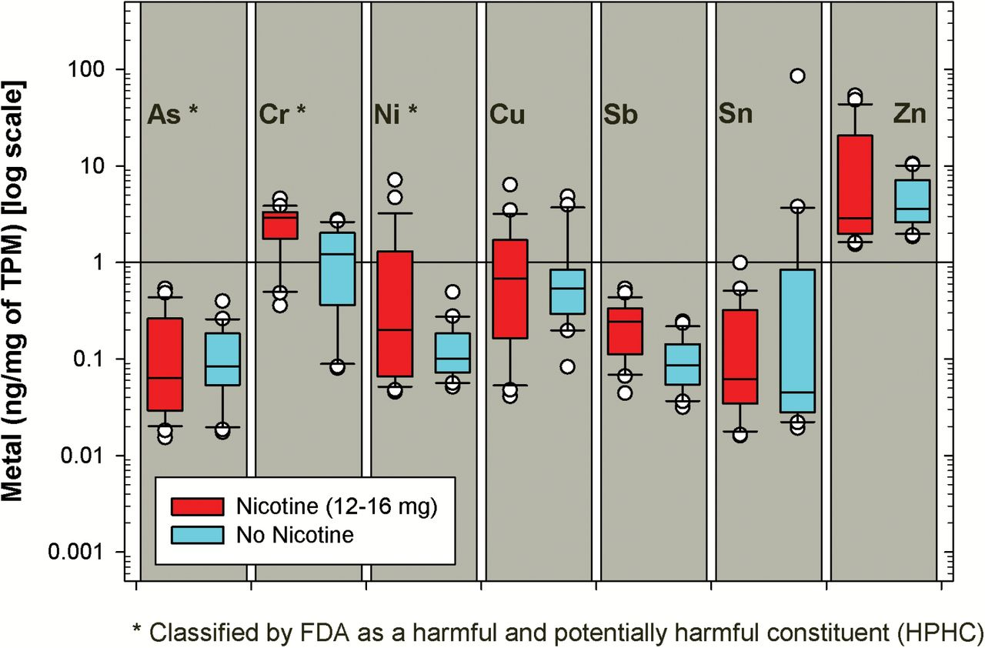
Figure 3. Metal levels in electronic cigarette aerosol.
Notes:
Figure 3. Metal levels in electronic cigarette aerosol.
Unless provided in the caption above, the following copyright applies to the content of this slide: © The Author 2016. Published by Oxford University Press on behalf of the Society for Research on Nicotine and Tobacco. All rights reserved. For permissions, please e-mail: journals.permissions@oup.com.

