Slide 1
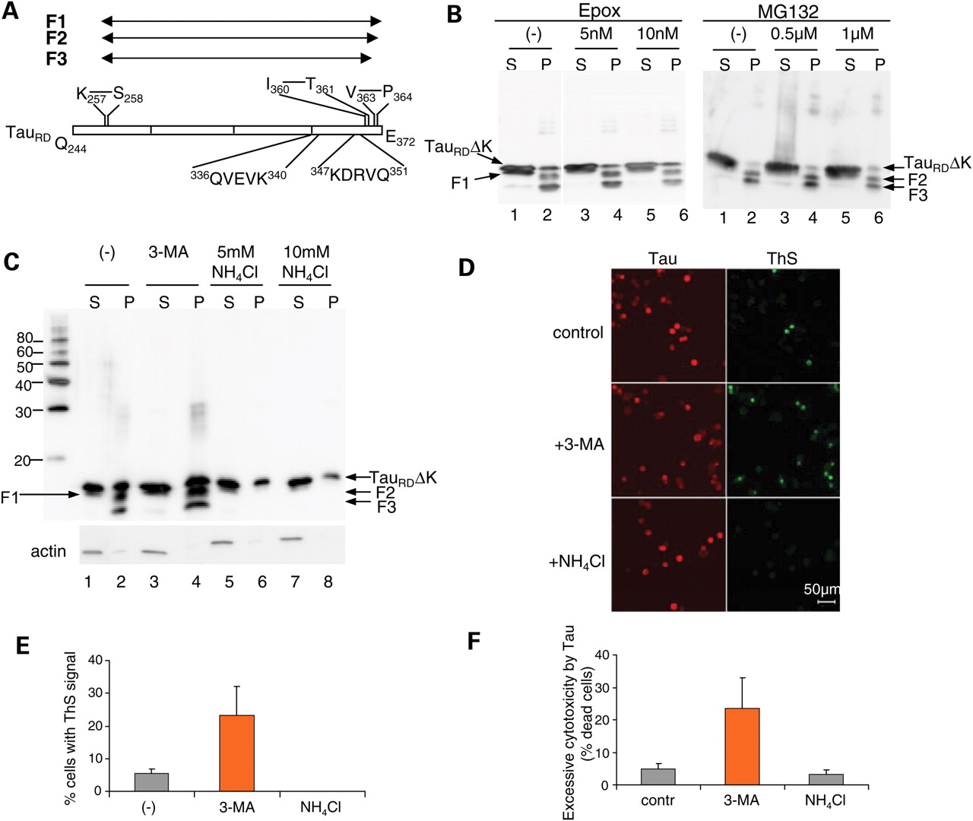
Figure 1. Effects of NH ₄ Cl and 3-MA on the cleavage, aggregation and cytotoxicity of Tau _{RD} ΔK ...
Notes:
Figure 1. Effects of NH 4 Cl and 3-MA on the cleavage, aggregation and cytotoxicity of Tau RD ΔK in N2a cells. ( A ) Diagram of Tau RD showing cleavage sites and CMA recognition motifs. Tau RD is first cleaved after K 257 to generate F1, then after V 363 to generate F2, and further after I 360 to produce F3. The two CMA recognition motifs are 336 QVEVK 340 and 347 KDRVQ 351 . ( B and C ) Blot analysis of effects of proteasomal inhibitors (epoxomicin or MG132) (B) or autophagy–lysosomal inhibitors (3-MA or NH 4 Cl) (C) on cleavage and oligomerization of Tau RD ΔK. N2a cells overexpressing Tau RD ΔK were treated with these inhibitors for 5 days. Lanes labeled P (=pellet) denote sarkosyl-insoluble Tau species, S (=supernatant) indicates soluble proteins. Note that NH 4 Cl but not 3-MA inhibits the cleavage and aggregation of Tau RD ΔK. ( D ) ThS staining showing the influence of 3-MA and NH 4 Cl on Tau aggregation. ( E ) Quantification of ThS positive cells, which increase ∼5-fold with 3-MA but not with NH 4 Cl. ( F ) Effects of NH 4 Cl and 3-MA on the cytotoxicity of Tau RD ΔK in N2a cells. The excessive cytotoxicity by Tau was obtained by subtracting cytotoxicity without Tau from cytotoxicity with Tau expression. Note that 3-MA but not NH 4 Cl aggravates Tau RD ΔK cytotoxicity.
Unless provided in the caption above, the following copyright applies to the content of this slide: © The Author 2009. Published by Oxford University Press. All rights reserved. For Permissions, please email: journals.permissions@oxfordjournals.org

Slide 2
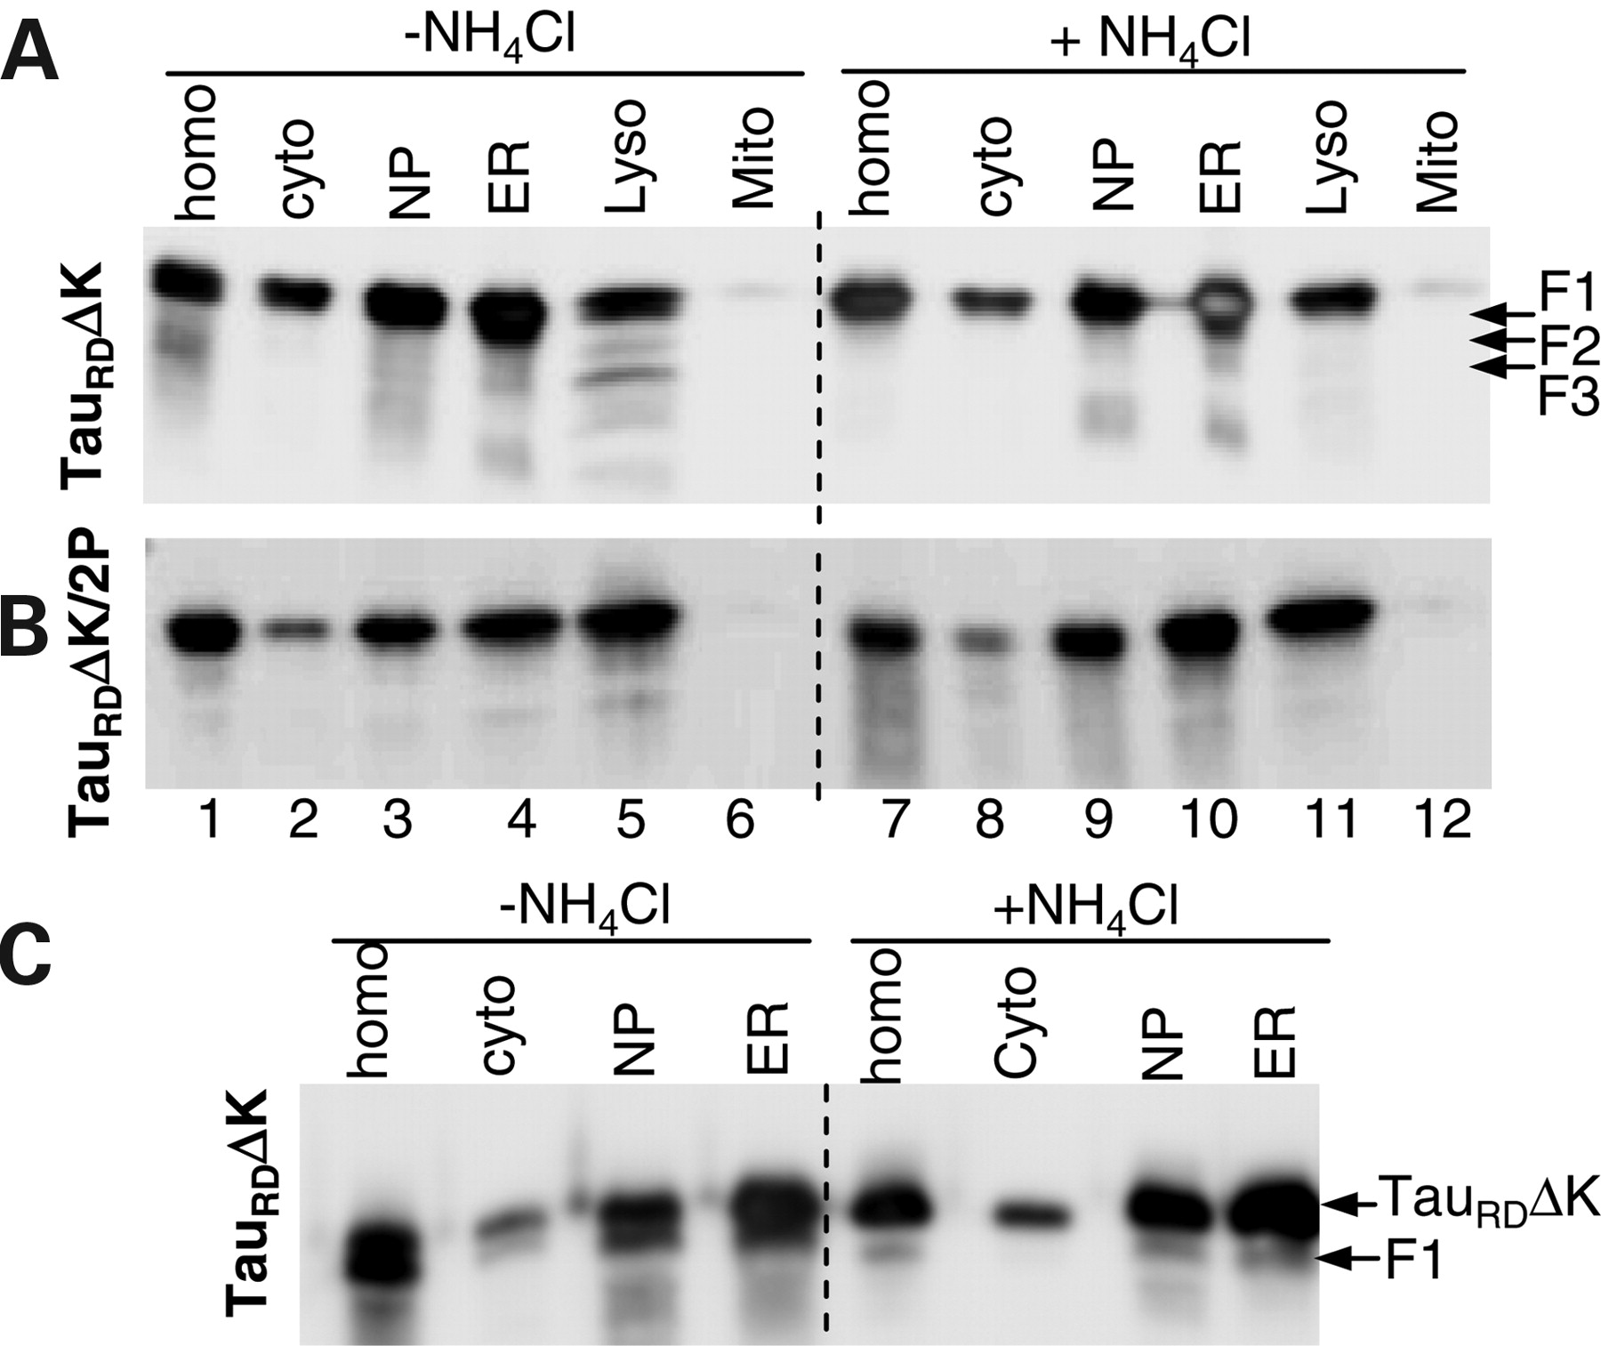
Figure 2. Distribution of Tau constructs in subcellular fractions of N2a cells. N2a cells induced to express Tau ...
Notes:
Figure 2. Distribution of Tau constructs in subcellular fractions of N2a cells. N2a cells induced to express Tau RD ΔK ( A and C ) or Tau RD ΔK/2P ( B ) were treated without or with NH 4 Cl for 5 days. The cell homogenates (homo) were fractionated into nuclear pellet (NP), containing nuclei and unbroken cells, cytosol (cyto), ER, mitochondria (Mito) and lysosomes (Lyso). To clearly distinguish the F1 band from the intact Tau RD ΔK band, the same samples but only half of the amount used in (A) were loaded in (C). Note that fragments F2 and F3 were only detected in the lysosomal fraction from N2a cells expressing Tau RD ΔK, whereas F1 can be detected in the cytosol or ER fractions.
Unless provided in the caption above, the following copyright applies to the content of this slide: © The Author 2009. Published by Oxford University Press. All rights reserved. For Permissions, please email: journals.permissions@oxfordjournals.org

Slide 3
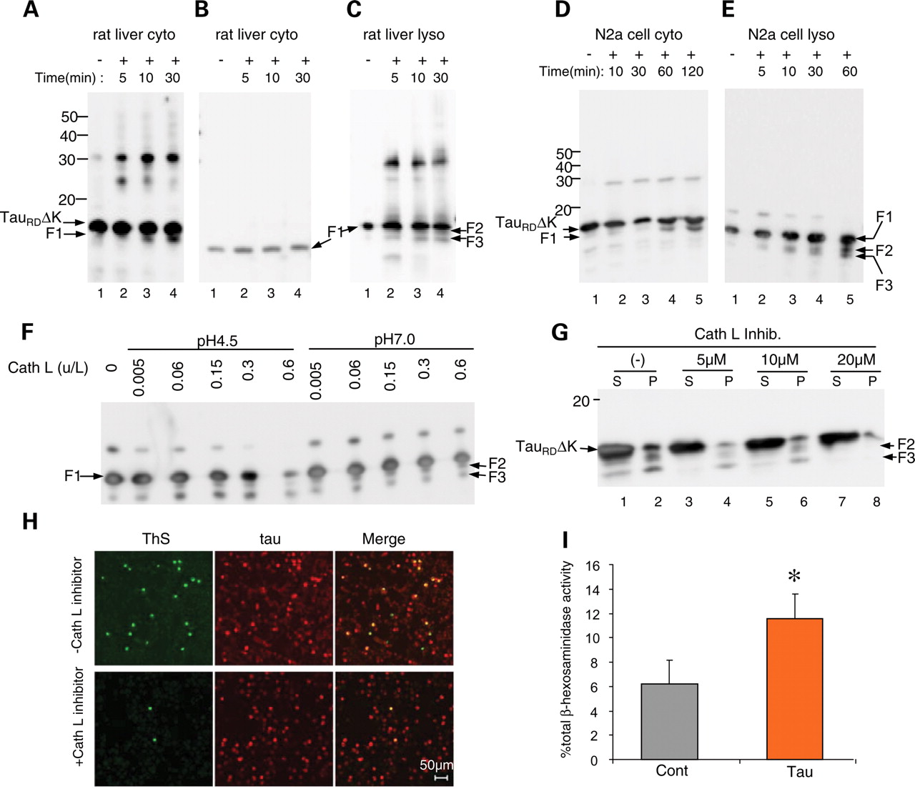
Figure 3. Cleavage of Tau constructs by cytosol, lysosomal matrix or cathepsin L and release of lysosomal hydrolase ...
Notes:
Figure 3. Cleavage of Tau constructs by cytosol, lysosomal matrix or cathepsin L and release of lysosomal hydrolase β-hexosaminidase into the cytosol of N2a cells caused by expression of Tau RD ΔK. ( A ) Tau RD ΔK incubated with cytosol fraction from rat liver. Note the appearance of fragment F1 (but not F2 or F3) and oligomeric aggregates (mostly dimers). ( B ) F1 incubated with cytosol fraction from rat liver. Note that there is no cleavage of F1. ( C ) F1 incubated with lysosomal matrix fraction from rat liver. Note cleavage of F1 to F2 and F3, as well as generation of oligomers (dimers and trimers). ( D ) Tau RD ΔK incubated with cytosol fraction from N2a cells. Note appearance of fragment F1 and oligomers. ( E ) F1 incubated with lysosomal fraction from N2a cells. Note fragmentation to F2 and F3. ( F ) Digestion of F1 by cathepsin L. Recombinant F1 (0.1 µg/µl) was incubated with 0.005, 0.06, 0.15, 0.3 or 0.6 U/l cathepsin L in 100 m m Na acetate pH 4.5 or 100 m m Tris–HCl pH 7.0 for 60 min. Note that fragments F2 and F3 (arrows) are generated by cathepsin L at both pH 7.0 and pH 4.5. ( G ) Cathepsin L inhibitor reduces generation of F2 and F3. N2a cells expressing Tau RD ΔK were treated with cathepsin L inhibitor for 3 days at concentrations up to 20 µ m . Lanes labeled P (=pellet) denote sarkosyl-insoluble Tau species, S (=supernatant) indicates soluble proteins. ( H ) Cathepsin L inhibition also inhibits aggregation of Tau. N2a cells expressing Tau RD ΔK were treated without or with cathepsin L inhibitor for 3 days. ThS staining reveals that inhibition of cathepsin L reduces Tau aggregation as well. ( I ) Expression of Tau RD ΔK causes the release of lysosomal hydrolase β-hexosaminidase. N2a cells expressing Tau RD ΔK were induced to express Tau for 2 days. The cytosolic distribution of β-hexosaminidase is expressed as the percentage of total β-hexosaminidase activity and is shown as mean ± SEM of four different experiments (* P < 0.05).
Unless provided in the caption above, the following copyright applies to the content of this slide: © The Author 2009. Published by Oxford University Press. All rights reserved. For Permissions, please email: journals.permissions@oxfordjournals.org

Slide 4
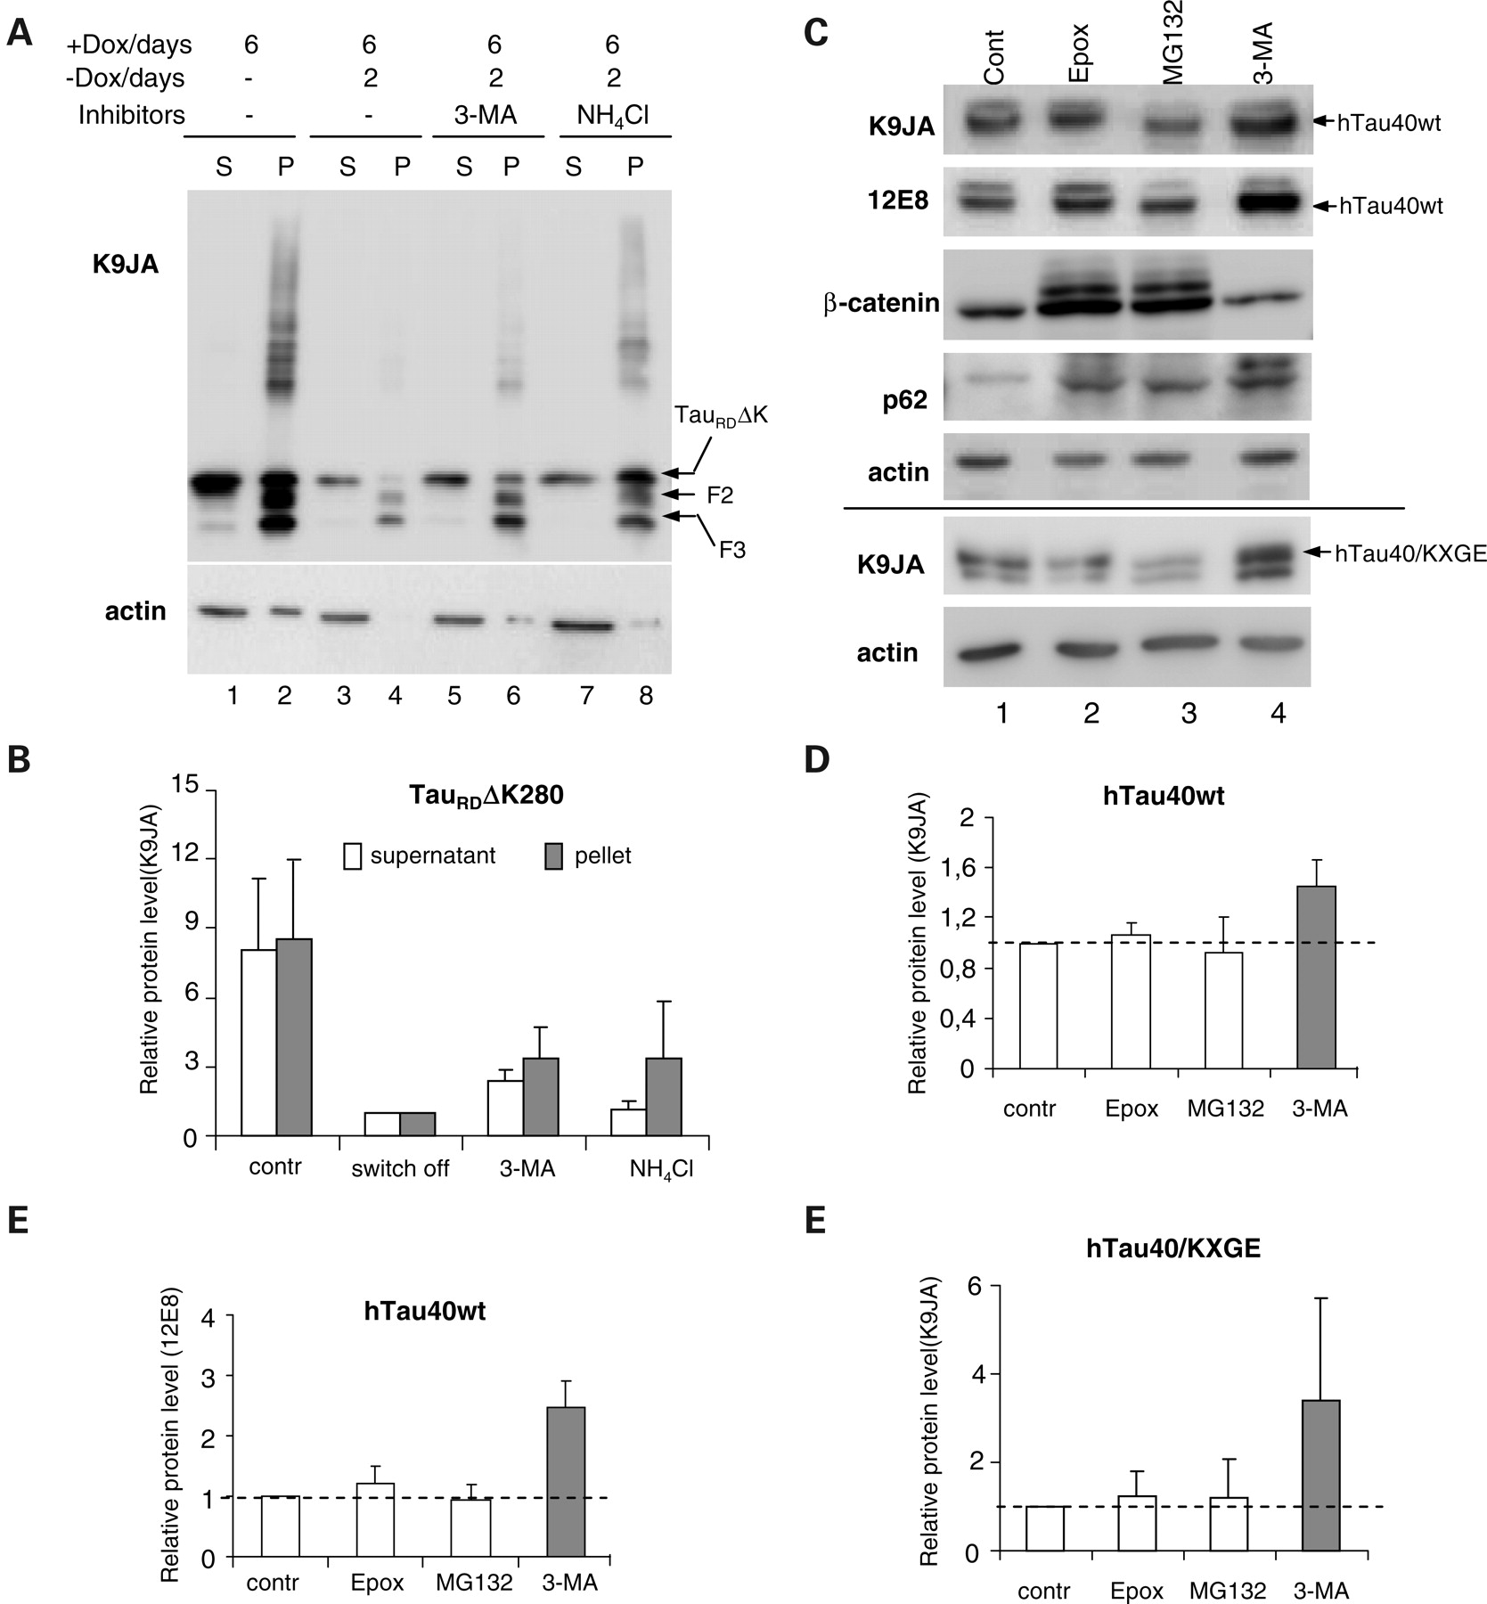
Figure 4. Degradation of Tau by macroautophagy. ( A ) Blot analysis of effects of inhibiting macroautophagy or ...
Notes:
Figure 4. Degradation of Tau by macroautophagy. ( A ) Blot analysis of effects of inhibiting macroautophagy or lysosomes on Tau clearance. N2a cells expressed Tau RD ΔK for 6 days, then expression was switched off and cells were treated with or without inhibitors for 2 days. Equal amounts of protein were loaded and checked against actin (A, lower panel). Lanes 1 and 2 show that expression of Tau RD ΔK generates aggregates in the pellet, fragmentation and a higher molecular weight smear. Stopping expression allows cells to clear most soluble Tau RD ΔK and aggregates (lane 4), but clearance is impaired if autophagy (3-MA, lane 6) or lysosomal proteases (NH 4 Cl, lane 8) are inhibited. ( B ) Quantification of effect of 3-MA and NH 4 Cl on Tau RD ΔK280 clearance. ( C ) Blot analysis of effects of inhibiting proteasome, macroautophagy or lysosomes on hTau40wt or hTau40/KXGE clearance. N2a cells expressed stably hTau40wt or transiently hTau40/KXGE were induced to express Tau for 2 days, then expression was switched off and cells were treated for 1 day with proteasome inhibitors (MG132 or epoxomicin) or 3-MA, or without inhibitor (control). Total Tau and Tau phosphorylated in the repeat domain(KXGS motifs) were determined with antibodies K9JA and 12E8. The level of β-catenin or p62 was measured to check the extent of the inhibition of the proteasomal or macroautophagy system. ( D – F ) Quantification of the effect of inhibitors on the clearance of hTau40wt (45% increase with 3-MA) (D), phospho-Tau (140% increase) (E) or hTau40/KXGE (240% increase) (F). Values are expressed as relative protein amount compared with the control (mean ± SE of three experiments). Inhibiting the proteasome has a minor effect, whereas inhibiting macroautophagy or lysosomes causes build-up of Tau. Note that Tau phosphorylated at KXGS motifs is a preferred target for macroautophagy (E, column 4).
Unless provided in the caption above, the following copyright applies to the content of this slide: © The Author 2009. Published by Oxford University Press. All rights reserved. For Permissions, please email: journals.permissions@oxfordjournals.org

Slide 5
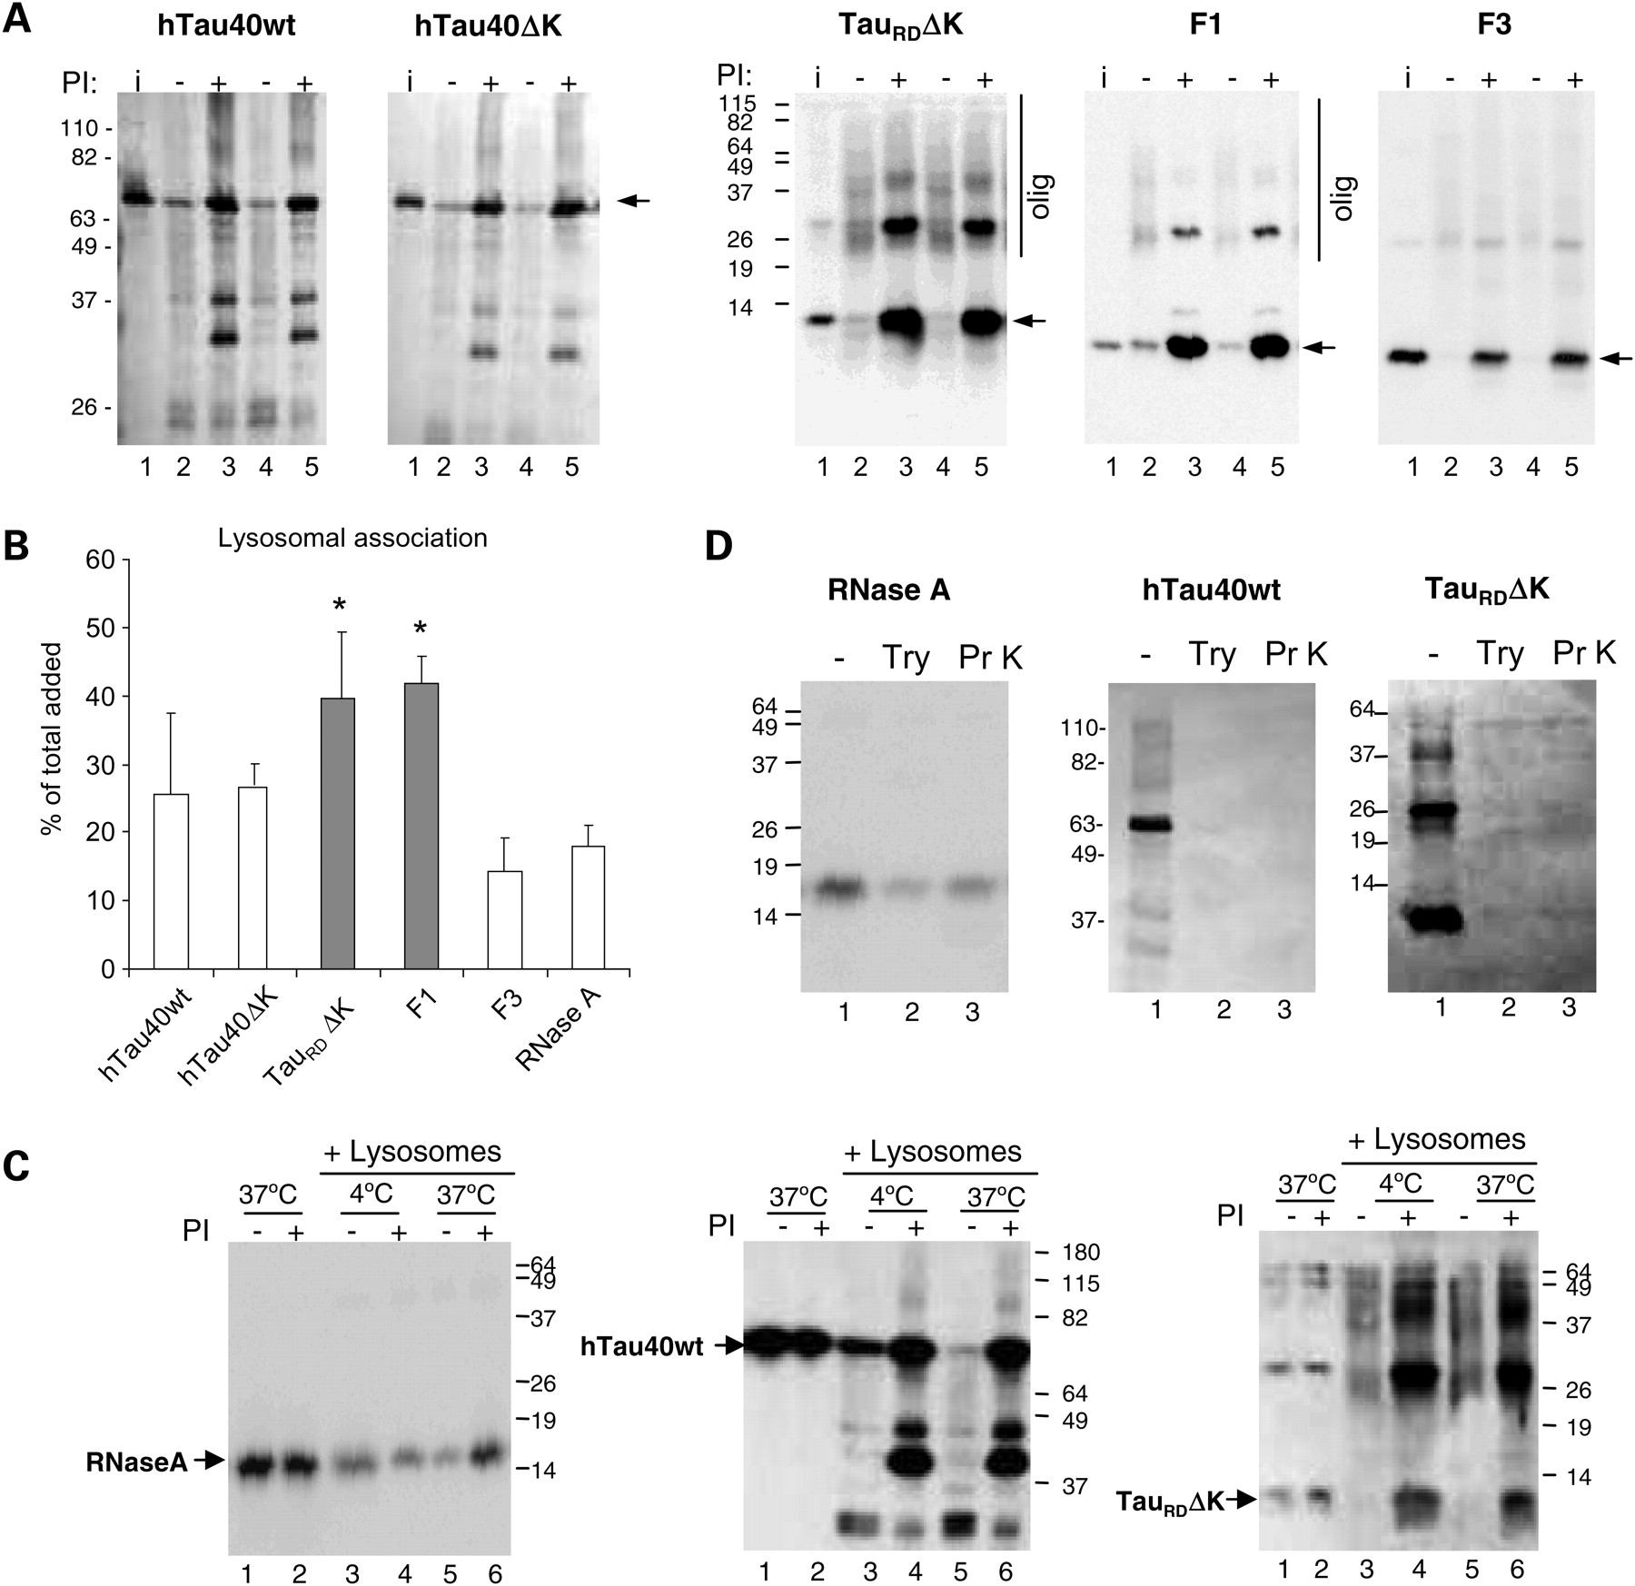
Figure 5. Association of different forms of Tau with isolated lysosomes. ( A ) Association of the indicated forms of ...
Notes:
Figure 5. Association of different forms of Tau with isolated lysosomes. ( A ) Association of the indicated forms of Tau (2 µg) with isolated lysosomes untreated or pre-treated with protease inhibitors (PI). Lanes 2–3, 4–5 show two independent incubations. Input (lane 1): 1/10 of total protein added to lysosomes. Arrows denote intact Tau constructs. Higher molecular weight forms of Tau (olig) can be detected for Tau RD ΔK and to a lesser extent for F1 (panels 3 and 4,). For hTau40wt and hTau40ΔK, with protease inhibitors, more intact Tau was detected (panels 1 and 2, lanes 3, 5). ( B ) Quantification of the amount of the indicated forms of Tau associated to lysosomes when incubated under the same conditions. Values are expressed as percentage of the total protein added to the reaction and are mean ± SEM of six different experiments (* P < 0.05). Binding of ribonuclease A (RNase A), under the same conditions is shown as reference. ( C ) Tau fails to translocate across the lysosomal membrane. Intact rat liver lysosomes treated or not with protease inhibitors were incubated with RNase A and the indicated forms of Tau at 4°C (lanes 3, 4) or 37°C (lanes 5, 6). Increase association at 37°C in the presence of protease inhibitors (indicative of lysosomal uptake) only occurred for RNase A. The similarity of Tau patterns at both temperatures shows that there is no uptake of Tau by CMA. Lanes 1 and 2 show the proteins incubated alone (1/10 of the total protein was added into the gel). ( D ) Lysosomal Tau is associated to the cytosolic side of the lysosomal membrane as determined by protease protection assay. Lysosomes previously treated with lysosomal protease inhibitors and incubated with the indicated proteins were recovered by centrifugation and resuspended in medium alone (−) or supplemented with trypsin (Try) or proteinase K (Pr K). Note that Tau is on the cytosolic side of the lysosomes because it is completely digested after protease treatment, whereas the fraction of RNase A translocated into lysosomes becomes protected from the exogenous proteases.
Unless provided in the caption above, the following copyright applies to the content of this slide: © The Author 2009. Published by Oxford University Press. All rights reserved. For Permissions, please email: journals.permissions@oxfordjournals.org

Slide 6
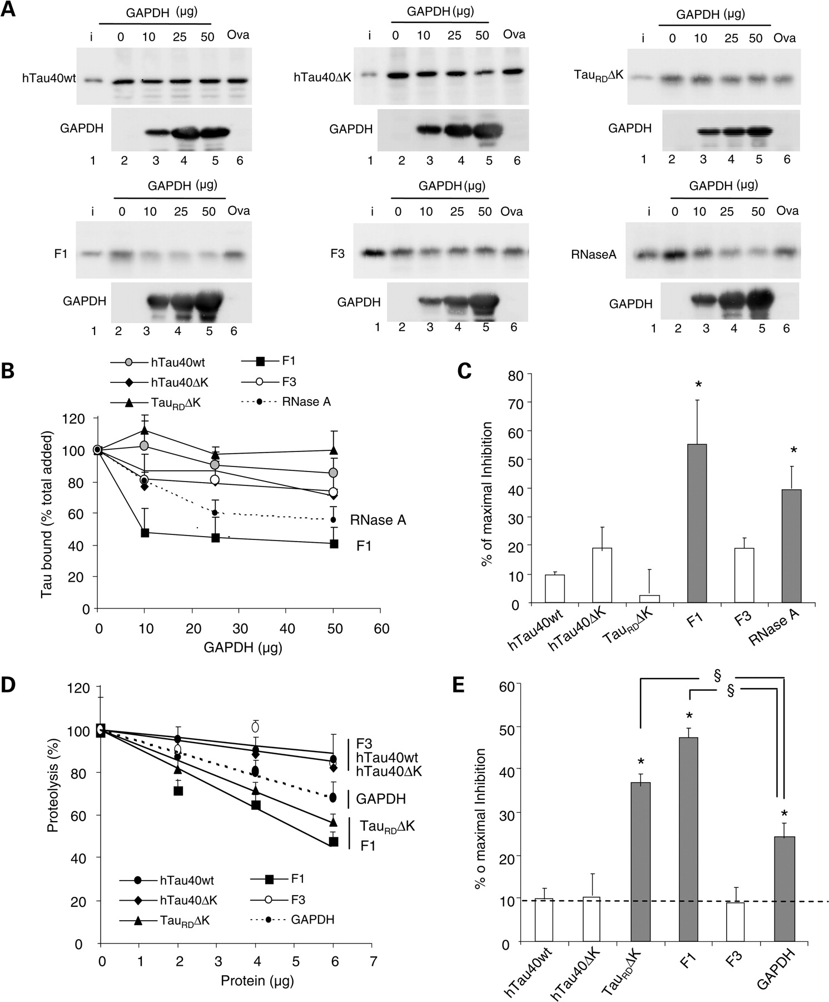
Figure 6. Competition of the lysosomal association of different forms of Tau by substrates of CMA. ( A ) Effects of ...
Notes:
Figure 6. Competition of the lysosomal association of different forms of Tau by substrates of CMA. ( A ) Effects of CMA substrate (GAPDH) and CMA non-substrate (ovalbumin) on binding and uptake of Tau by lysosomes. The different forms of Tau proteins (2 µg) and the indicated increasing concentrations of GAPDH or ovalbumin (Oval) were incubated with intact isolated lysosomes previously treated with protease inhibitors. Lane 1 shows 1/10 of the input (i) and insets show the amount of GAPDH associated with the lysosomal membranes. Only association of the F1 fragment and of RNase A (shown here as a positive control) could be competed by increasing concentrations of GAPDH, whereas ovalbumin did not modify lysosomal binding. ( B ) The percentage of the different Tau proteins and of RNase A bound to the lysosomal membrane in the presence of increasing concentrations of GAPDH was quantified in four experiments similar to the ones shown in (A). Values are mean ± SEM. ( C ) The maximal inhibition on Tau binding attained by GAPDH was calculated in four experiments similar to the ones shown in (A). Values are mean ± SEM (* P < 0.05). ( D and E ) Effect of different Tau proteins or GAPDH on the degradation of a pool of CMA substrates by intact lysosomes. Values expressed as % of proteolysis in the absence of Tau (D) or % of maximal inhibition of the degradation of the pool of proteins (E). Values are mean ± SEM of two experiments with triplicate samples. (* P < 0.05 compared with wild-type full-size Tau and § P < 0.05 compared with the inhibitory effect of GAPDH).
Unless provided in the caption above, the following copyright applies to the content of this slide: © The Author 2009. Published by Oxford University Press. All rights reserved. For Permissions, please email: journals.permissions@oxfordjournals.org

Slide 7
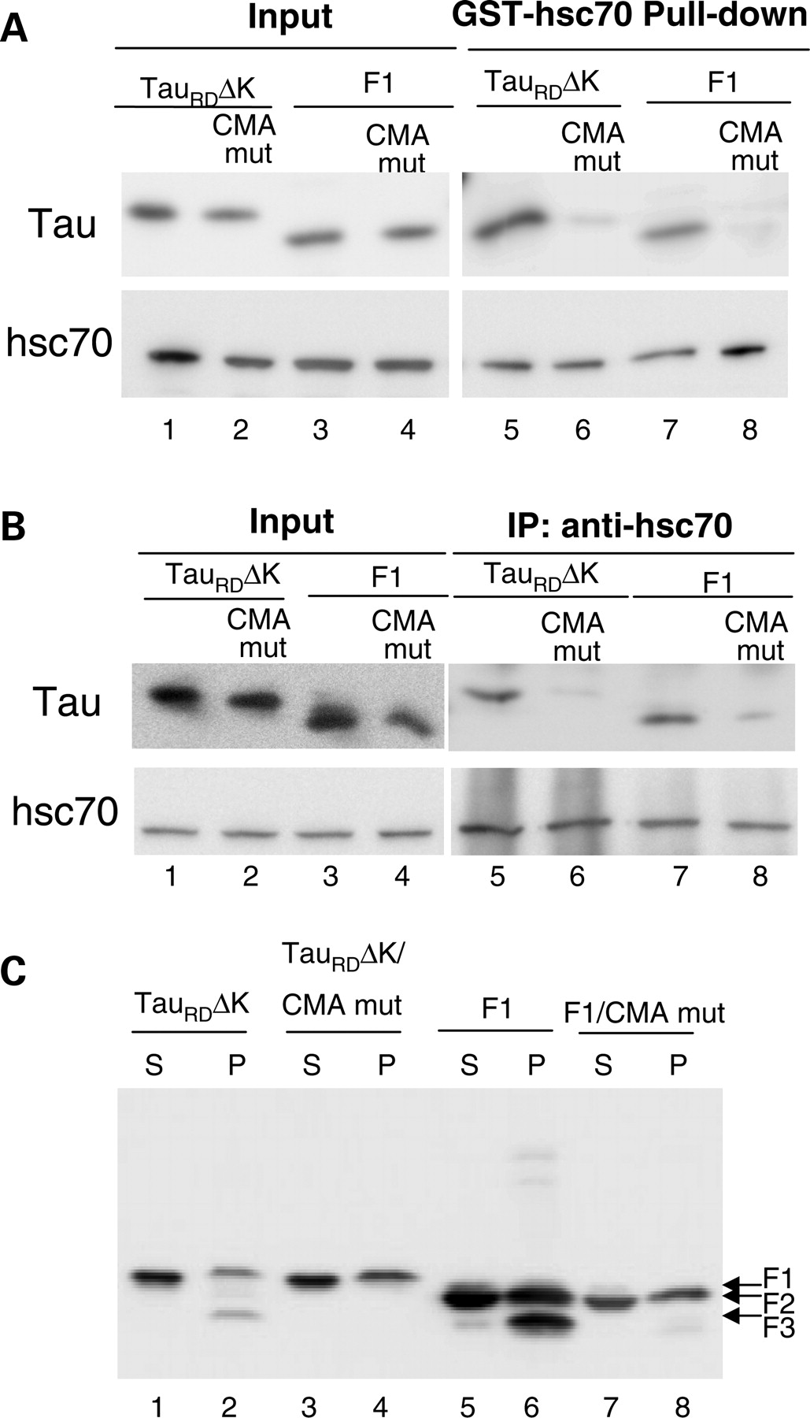
Figure 7. Effects of mutation of CMA motifs on the interaction of Tau constructs with hsc70 and Tau degradation. ( A ) ...
Notes:
Figure 7. Effects of mutation of CMA motifs on the interaction of Tau constructs with hsc70 and Tau degradation. ( A ) Interaction of recombinant Tau RD ΔK, Tau RD ΔK CMA mut (CMA recognition motifs mutated), F1 or F1 CMA mut with GST-hsc70 in vitro . Note that there is an interaction between hsc70 and Tau RD ΔK or F1 in vitro (lanes 5, 7) and the CMA motif mutations reduced this interaction (lanes 6, 8). ( B ) Interaction of Tau RD ΔK, Tau RD ΔK CMA mut, F1 or F1 CMA mut with endogenous hsc70 in N2a cells. There is a strong interaction between hsc70 and Tau RD ΔK as well as F1 in cells (lanes 5, 7), but reduced interaction between hsc70 and the Tau mutants (lanes 6, 8). ( C ) Mutation of the CMA motifs blocks Tau RD ΔK280 cleavage and the generation of F3 from F1. S and P denote supernatant and pellet of sarkosyl extraction, respectively. Note the absence of F3 in the pellet in lanes 4 and 8.
Unless provided in the caption above, the following copyright applies to the content of this slide: © The Author 2009. Published by Oxford University Press. All rights reserved. For Permissions, please email: journals.permissions@oxfordjournals.org

Slide 8
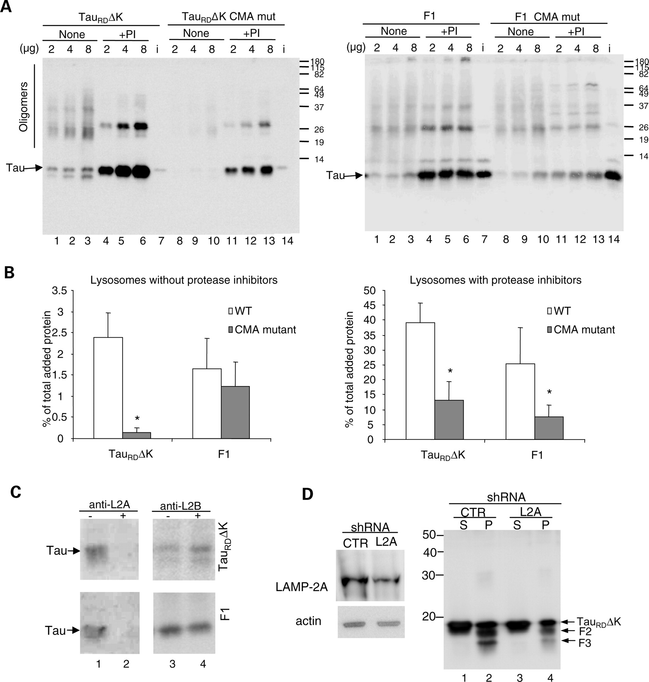
Figure 8. Effect of inhibition of CMA components on CMA uptake of Tau proteins. ( A ) Lysosomal association of Tau ...
Notes:
Figure 8. Effect of inhibition of CMA components on CMA uptake of Tau proteins. ( A ) Lysosomal association of Tau RD ΔK, F1 and its CMA mutants. Increasing concentrations of Tau proteins (as indicated) were incubated with freshly isolated intact lysosomes treated (+) or not (none) with protease inhibitors (PI). i=input (0.2 µg). ( B ) Quantification of lysosomal binding of the Tau proteins to untreated lysosomes (left) or lysosomes treated with protease inhibitors (right) calculated from three experiments as the ones shown in (A). Values are expressed as percentage of the total protein added and are given as mean ± SEM (* P < 0.05). ( C ) Effect of antibody blockage of lysosomal CMA components on the association of Tau proteins to lysosomes. The indicated Tau proteins were incubated with freshly isolated intact lysosomes pre-incubated or not with antibodies against LAMP-2A (anti-L2A) and LAMP-2B (anti-L2B). ( D ) Effects of knockdown of LAMP-2A on Tau RD ΔK280 fragmentation and aggregation. N2a cells infected with LAMP-2A (L2A) shRNA or control shRNA (CTR) lentivirus for 20 days were induced to express Tau RD ΔK280 for 3 days. Then sarkosyl extraction was used to separate soluble and insoluble Tau. Right panel, S and P denote sarkosyl supernatant and pellet, respectively. Left panel shows efficiency of knock-down for LAMP-2A. Actin was used as a loading control. Note: LAMP-2A shRNA knocks down the expression of LAMP-2A and reduces the generation of F2 and F3.
Unless provided in the caption above, the following copyright applies to the content of this slide: © The Author 2009. Published by Oxford University Press. All rights reserved. For Permissions, please email: journals.permissions@oxfordjournals.org

Slide 9
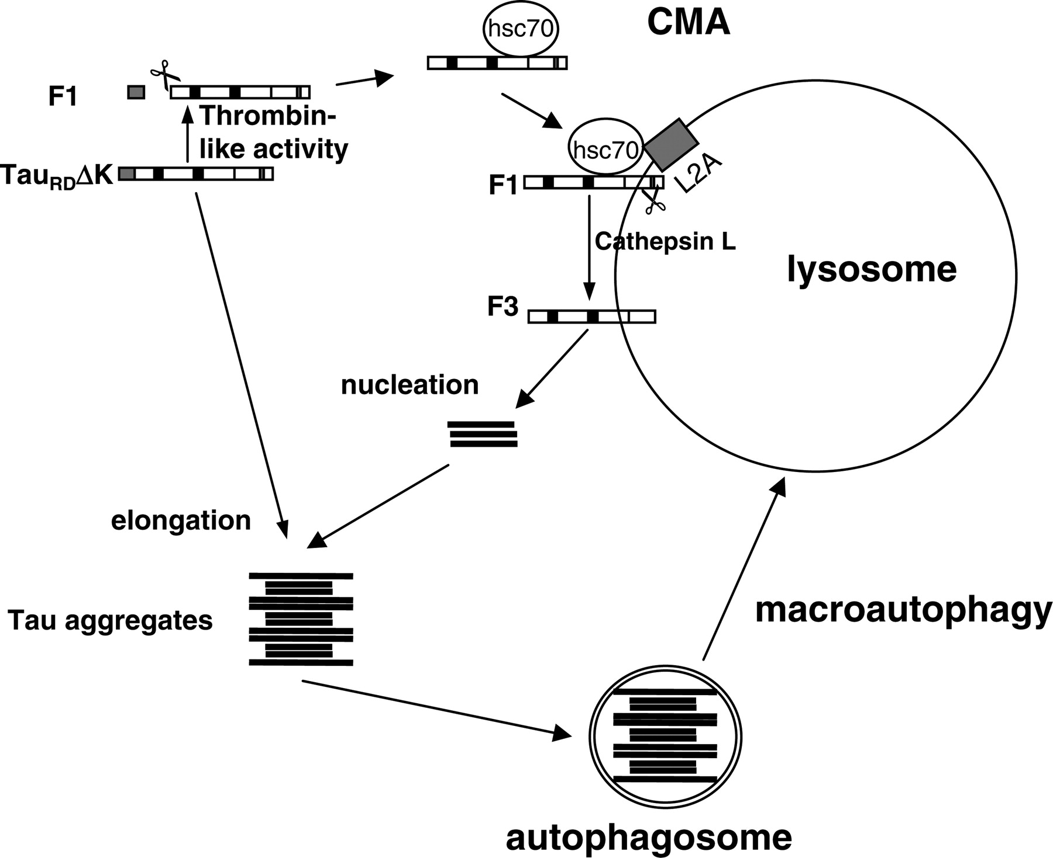
Figure 9. Model of fragmentation and degradation of Tau _{RD} ΔK by autophagy–lysosomal system. When Tau ...
Notes:
Figure 9. Model of fragmentation and degradation of Tau RD ΔK by autophagy–lysosomal system. When Tau RD ΔK is expressed in N2a cells, it becomes partially cleaved in the cytosol by a thrombin-like activity to generate F1. A fraction of F1 is delivered to lysosomes via CMA components (targeting through hsc70 and binding to the lysosomal membrane via LAMP-2A) where the C-terminal end is cleaved by cathepsin L to generate F2 and F3. These fragments are highly amyloidogenic, nucleate aggregation and induce the co-aggregation of intact Tau RD ΔK (or full-length Tau) in the cytosol. The aggregates can then be degraded through the macroautophagy pathway.
Unless provided in the caption above, the following copyright applies to the content of this slide: © The Author 2009. Published by Oxford University Press. All rights reserved. For Permissions, please email: journals.permissions@oxfordjournals.org

