Slide 1
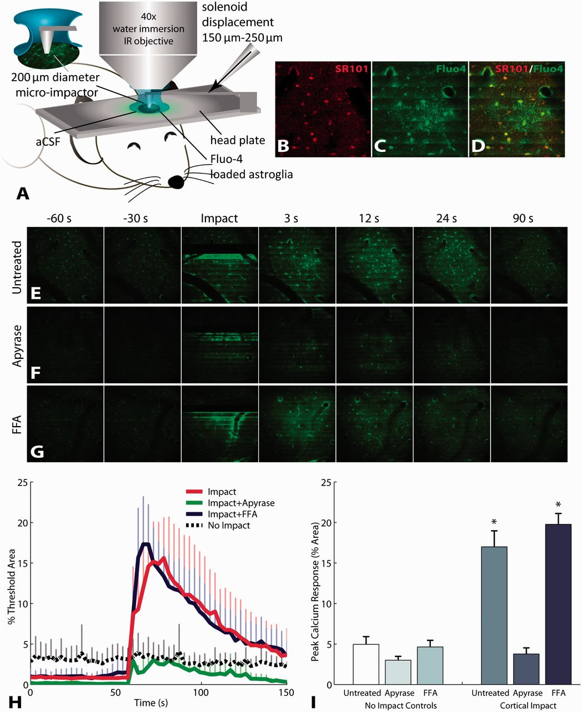
Figure 1 Mechanical impact to mouse cortex triggers astrocyte calcium waves in vivo that are mediated by purinergic ...
Notes:
Figure 1 Mechanical impact to mouse cortex triggers astrocyte calcium waves in vivo that are mediated by purinergic signalling. (A) Calcium activity in cortical astrocytes detected by two-photon in vivo imaging of Fluo-4 calcium indicator. Selective loading of Fluo-4 with the astrocyte specific indicator SR101 (B–D). Mechanical impact triggered calcium waves in astroglia (E and H). The extent of post-traumatic calcium waves, measured by the per cent area of increased Fluo-4 fluorescence, was attenuated by degrading ATP with apyrase (F, H and I), but was not changed by blocking gap junctions (G, H and I). Error bars denote standard error of the mean (SEM) from three (non-impact) to five (impact) animals per group. FFA = flufenamic acid.
Unless provided in the caption above, the following copyright applies to the content of this slide: © The Author (2013). Published by Oxford University Press on behalf of the Guarantors of Brain. All rights reserved. For Permissions, please email: journals.permissions@oup.com

Slide 2
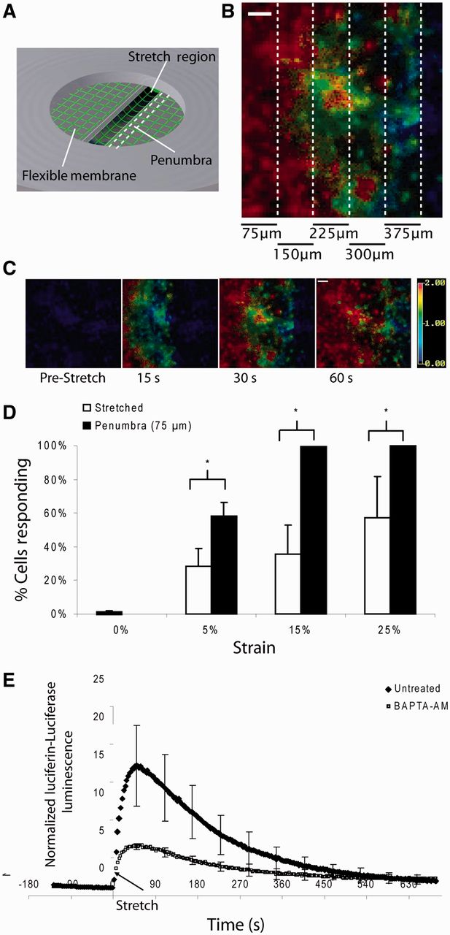
Figure 2 Mechanical stretch triggers intercellular calcium waves and ATP release in astrocytes in vitro. (A) Schematic ...
Notes:
Figure 2 Mechanical stretch triggers intercellular calcium waves and ATP release in astrocytes in vitro. (A) Schematic of stretch chamber where astrocytes grown on silicone elastic membranes (green grid) were stretched by a pulse of air pressure that deflects the membrane (2 × 18 mm2) through a slit in the chamber’s base. The mechanical penumbra is the region adjacent to the stretched region. (B) Fura-2-AM imaging revealed mechanically induced intercellular calcium waves propagate from the injury epicentre outward (C). Colorimetric scale bar represents Fura-2 ratio (340/380 nm). (D) A significantly greater proportion of astrocytes in the penumbra showed increases in intracellular calcium (>50% above baseline) than astrocytes directly in the stretched region (P < 0.05). (E) Imaging of luciferin–luciferase showed mechanical stretching induced ATP release within the first minute. This increase in intracellular calcium was significantly attenuated by BAPTA-AM, indicating that the ATP release was mediated by intracellular calcium. Error bars denote SEM from 4 to 33 stretch injuries per group. Scale bars = 50 μm.
Unless provided in the caption above, the following copyright applies to the content of this slide: © The Author (2013). Published by Oxford University Press on behalf of the Guarantors of Brain. All rights reserved. For Permissions, please email: journals.permissions@oup.com

Slide 3
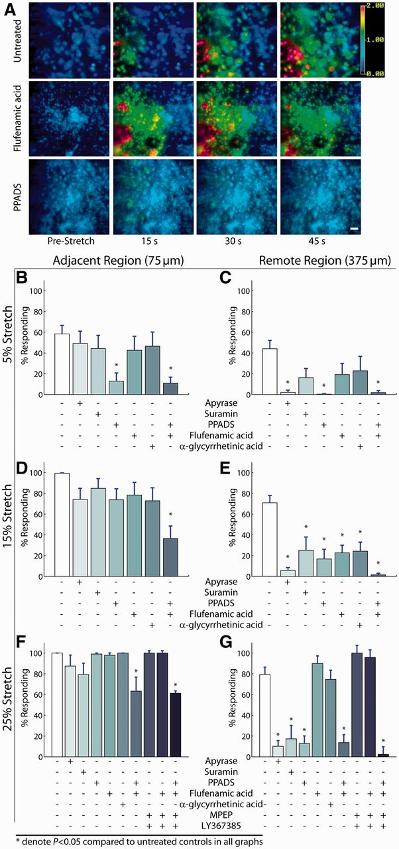
Figure 3 Purinergic signalling is a consistent mechanism of calcium-wave propagation at different injury severities. ...
Notes:
Figure 3 Purinergic signalling is a consistent mechanism of calcium-wave propagation at different injury severities. At the mildest level of mechanical trauma (5% peak stretch), propagation of calcium waves into the penumbra (A) was arrested from reaching the remote region (375 µm) by ATP degradation with apyrase or purinergic antagonism with PPADS but not by gap junction blockade (flufenamic acid and α-glycyrrhetinic acid) (A–C). At a more severe stretch (15% peak), P2 antagonism attenuated calcium waves in distant regions of the culture (375 µm from injury), and the combined inhibition of gap junctions with P2 receptors nearly abolished calcium waves in this remote region (D and E). At our most severe level of mechanical injury (25% peak stretch), purinergic antagonism reduced calcium waves in a region remote from the mechanically injured astrocytes (F and G), and a combined inhibition of purinergic receptors, gap junctions and metabotropic glutamate receptors completely blocked a calcium transient in the remote region (G). Error bars denote SEM from 8 to 24 stretch injuries per group.
Unless provided in the caption above, the following copyright applies to the content of this slide: © The Author (2013). Published by Oxford University Press on behalf of the Guarantors of Brain. All rights reserved. For Permissions, please email: journals.permissions@oup.com

Slide 4
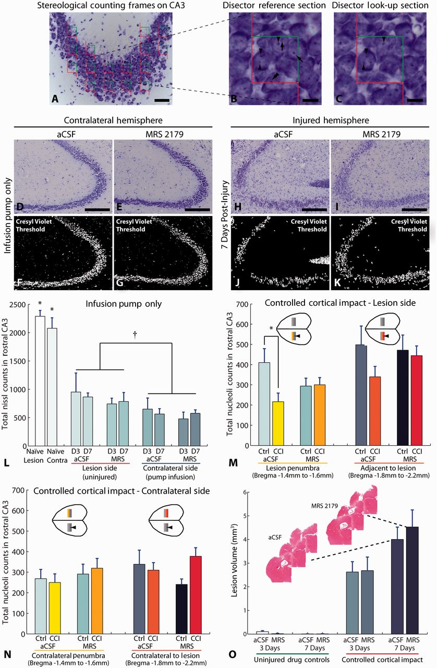
Figure 6 Antagonism of P2Y1 receptors improves hippocampal sparing after controlled cortical impact brain injury. ...
Notes:
Figure 6 Antagonism of P2Y1 receptors improves hippocampal sparing after controlled cortical impact brain injury. Stereological unbiased counting frames (30 × 30 µm2) arranged in a grid pattern (60 × 60 µm2) were randomly overlaid on the CA3 subregion of the hippocampus to count nucleoli stained with Cresyl violet (A; scale bar = 50 µm). The optical disector method (B and C; disector separation = 3 µm, scale bars = 10 µm) was used to determine the number of nucleoli (dense Nissl staining) in 3D. With unbiased counting frames, the objects of interest may touch the green acceptance lines (B and C) but are not counted if they touch the red forbidden lines (double arrowhead in B). Additionally, in the disector method, nucleoli are counted if they lay within the counting frame of the reference section (arrows B) without appearing in the look-up section (C). Nucleoli appearing in both optical sections (arrowheads B and C) are not counted. An estimate of the total counts in the volume is determined by scaling the counts made within the counting frames by the area fraction covered by these frames and the volume fraction sampled by the optical disector (disector thickness/measured tissue thickness). Implantation of the intraventricular cannula to deliver artificial CSF (aCSF) or MRS 2179 produced some loss in Cresyl violet staining for neurons in the CA3 pyramidal layer of uninjured animals, although CA3 appeared grossly intact (D and E; scale bars = 200 μm). Colour threshold images in F and G qualitatively illustrate slight loss of Cresyl violet staining between artificial CSF and MRS 2179 treated animals at 7 days because of the infusion alone without cortical impact. After controlled cortical impact (CCI), the CA3 subregion exhibits widespread loss of Cresyl violet staining (H and I; scale bars = 200 μm), further illustrated by colour threshold (J and K). In uninjured animals (artificial CSF n = 4 Day 3, n = 4 Day 7; MRS 2179 n = 4 Day 3, n = 5 Day 7), implantation of the cannula to infuse artificial CSF or MRS 2179 significantly reduced stereological counts of Cresyl violet-stained nucleoli in CA3 compared with completely untreated naïve control mice (n = 6 naïve, *P < 0.001 for all post hoc comparisons between naïve and the corresponding region in infusion pump control mice). Overall, the contralateral hemisphere where the cannula was implanted exhibited a greater loss in nucleoli counts compared with the uninjured lesion side (†P = 0.004). In these infusion control mice, there was no significant difference between days (P = 0.951) or infusion with artificial CSF versus MRS 2179 (P = 0.441). After controlled cortical impact, animals treated with artificial CSF (n = 17) exhibited a significant reduction in counts compared with artificial CSF infusion control mice in the lesion penumbra between bregma −1.4 and −1.6 mm (M; *P = 0.033). In contrast, in animals treated with MRS 2179 (n = 21), no additional nucleoli loss was observed in the penumbra (P = 0.929 MRS 2179 infusion control mice versus controlled cortical impact treated with MRS 2179, M). In the contralateral hemisphere, there was no statistically significant difference overall between groups (N). Note that counts are comparable within a given region in M and N, but the penumbra and region adjacent or contralateral to the lesion are not comparable with each other because the volume of tissue sampled and the geometry of the hippocampus are both different. Insets in M and N highlight regions shown on bar graphs along with the controlled cortical impact epicentre denoted by arrowheads (illustration is not to scale). (O) Lesion volumes in the cortex were not significantly different between animals treated with MRS 2179 and those treated with artificial CSF vehicle control. Lesion = lesion side in controlled cortical impact mice; Contra = contralateral side to controlled cortical impact lesion; Ctrl = pump infusion control mice without injury. Data are presented as mean ± SEM.
Unless provided in the caption above, the following copyright applies to the content of this slide: © The Author (2013). Published by Oxford University Press on behalf of the Guarantors of Brain. All rights reserved. For Permissions, please email: journals.permissions@oup.com

Slide 5
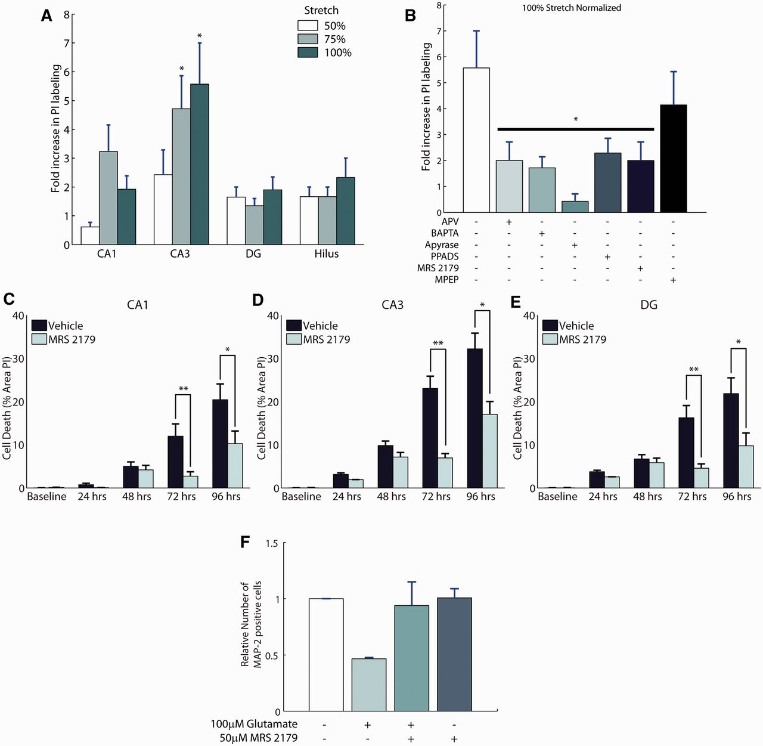
Figure 5 Purinergic antagonism is neuroprotective in stretch-injured hippocampal slices and excitotoxic insult. ...
Notes:
Figure 5 Purinergic antagonism is neuroprotective in stretch-injured hippocampal slices and excitotoxic insult. Organotypic slice cultures of the hippocampus were mechanically injured and evaluated for cell death using propidium iodide (PI) labelling 24 h after injury. Cell death was significantly increased in the CA3 subregion at the higher levels of mechanical injury (A; n = 21–28/group). Blocking astrocyte calcium signalling with BAPTA-AM reduced cell death in CA3, as did the broad-spectrum N-Methyl-d-aspartate receptor antagonist, (2R)-amino-5-phosphonovaleric acid (APV) (B; n = 7–22/group). The role of ATP in mediating the cell death after mechanical injury was significant, as apyrase treatment reduced cell death to a level similar to uninjured cultures. Antagonism of P2 receptors with PPADS, and specific antagonism of P2Y1 receptors with MRS 2179 showed equal efficacy in protecting against cell death in CA3 when applied before stretch-injury (B). Administration of MRS 2179 (30 μM) immediately after stretch to organotypic hippocampal slices (vehicle group 7.5 ± 3.6% stretch, n = 40; treated group 11.8 ± 4.6%, n = 44) was also neuroprotective (C–E). Application of 100 µM glutamate to mixed cultures of neurons and glia at 14 days in vitro results in excitotoxic cell death as evidenced by a loss of cells labelled with the neuronal marker MAP-2 (F; n = 3/group). Application of 50 µM MRS 2179 after glutamate stimulation protects neurons from excitotoxic cell death at 24 h. Data are presented as mean ± SEM. DG = dentate gyrus.
Unless provided in the caption above, the following copyright applies to the content of this slide: © The Author (2013). Published by Oxford University Press on behalf of the Guarantors of Brain. All rights reserved. For Permissions, please email: journals.permissions@oup.com

Slide 6
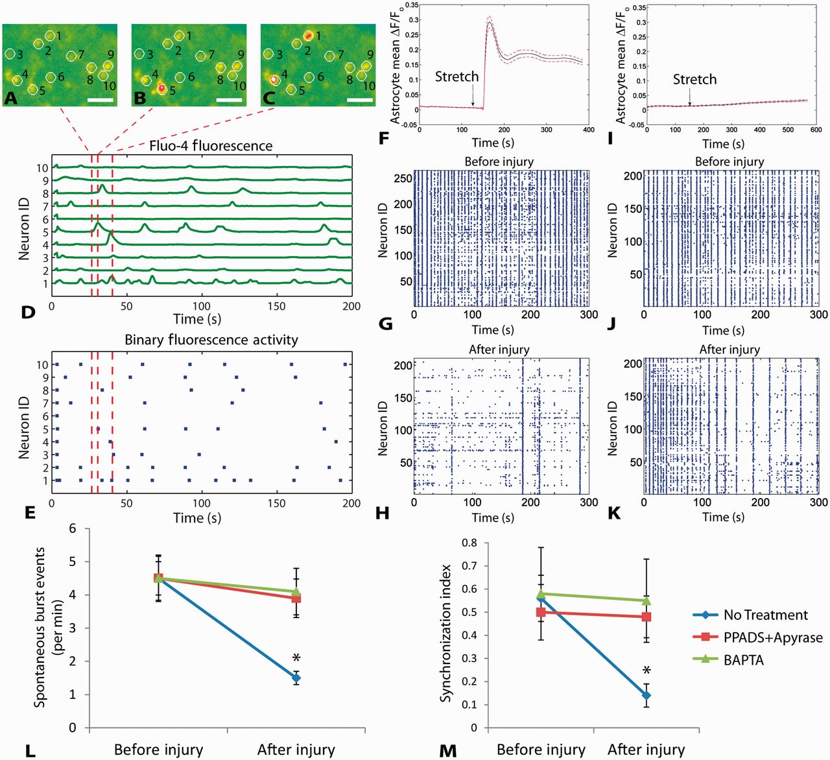
Figure 4 The activity of in vitro neuronal networks in the mechanical penumbra is influenced by intercellular waves in ...
Notes:
Figure 4 The activity of in vitro neuronal networks in the mechanical penumbra is influenced by intercellular waves in astrocytes and purinergic signalling. Mixed cultures of neurons and glia exhibited calcium oscillations detected with Fluo-4 imaging (A–C). (D) Normalized fluorescence traces show spontaneous calcium activity in the neurons numbered in A–C. (E) Fluorescence peaks (red lines in D) are converted into a binary raster to analyse network activity. Calcium oscillations correspond to electrical activity (Supplementary Fig. 1). Mechanical injury triggered a calcium transient in astrocytes of the mechanical penumbra within 30 s of injury (F). Spontaneous activity in neurons located in the mechanical penumbra decreased after injury (G before injury versus H–recording period beginning 80 s after injury when calcium wave has passed through). Pretreating mixed cultures with BAPTA-AM or a combination of PPADS and apyrase blocked the calcium wave from propagating into the mechanical penumbra (I) and reduced post-traumatic changes in neural activity patterns (J versus K). Both spontaneous burst events and the synchronized activity were decreased in the penumbra after injury, and these changes were blocked with PPADS + apyrase or BAPTA-AM treatment (L and M). Scale bars: A–C = 25 µm. Error bars in L and M = SEM from n = 4/group.
Unless provided in the caption above, the following copyright applies to the content of this slide: © The Author (2013). Published by Oxford University Press on behalf of the Guarantors of Brain. All rights reserved. For Permissions, please email: journals.permissions@oup.com

Slide 7
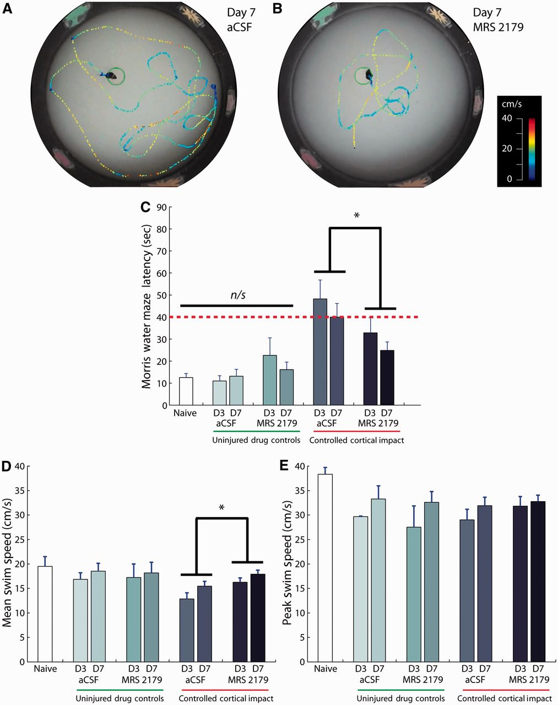
Figure 7 Antagonism of P2Y1 receptors reduced post-traumatic learning deficits after controlled cortical impact brain ...
Notes:
Figure 7 Antagonism of P2Y1 receptors reduced post-traumatic learning deficits after controlled cortical impact brain injury. Escape latency from Morris water maze indicates spatial learning ability of mice where a longer escape time is indicative of learning deficits (compare A and B; dotted contours indicate swim path, colour indicates speed). (C) Bar graphs show escape latency after controlled cortical impact (*P = 0.019). (D) Average swim speed showed a significant improvement with MRS 2179 treatment compared with artificial CSF (aCSF) infusion (*P = 0.015). (E) Peak swim speed was not different among treatment groups (artificial CSF, MRS 2179) at any time point after injury. Data are presented as mean ± SEM from n = 8 naïve; n = 11 artificial CSF uninjured; n = 10 MRS uninjured; n = 11 artificial CSF Day 3 controlled cortical impact; n = 13 artificial CSF Day 7 controlled cortical impact; n = 12 MRS Day 3 controlled cortical impact; n = 15 MRS Day 7 controlled cortical impact. D3 = Day 3; D7 = Day 7.
Unless provided in the caption above, the following copyright applies to the content of this slide: © The Author (2013). Published by Oxford University Press on behalf of the Guarantors of Brain. All rights reserved. For Permissions, please email: journals.permissions@oup.com

