Slide 1
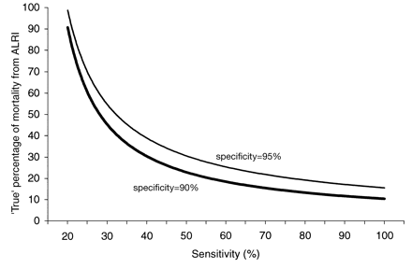
Figure 1 Proportion of overall mortality caused by ALRI assuming that 19% was attributed to ALRI by post-mortem ...
Notes:
Figure 1 Proportion of overall mortality caused by ALRI assuming that 19% was attributed to ALRI by post-mortem questionnaire. The curves are shown for different levels of sensitivity and specificity of post-mortem questionnaires.
Unless provided in the caption above, the following copyright applies to the content of this slide: © International Epidemiological Association 2003

