Slide 1
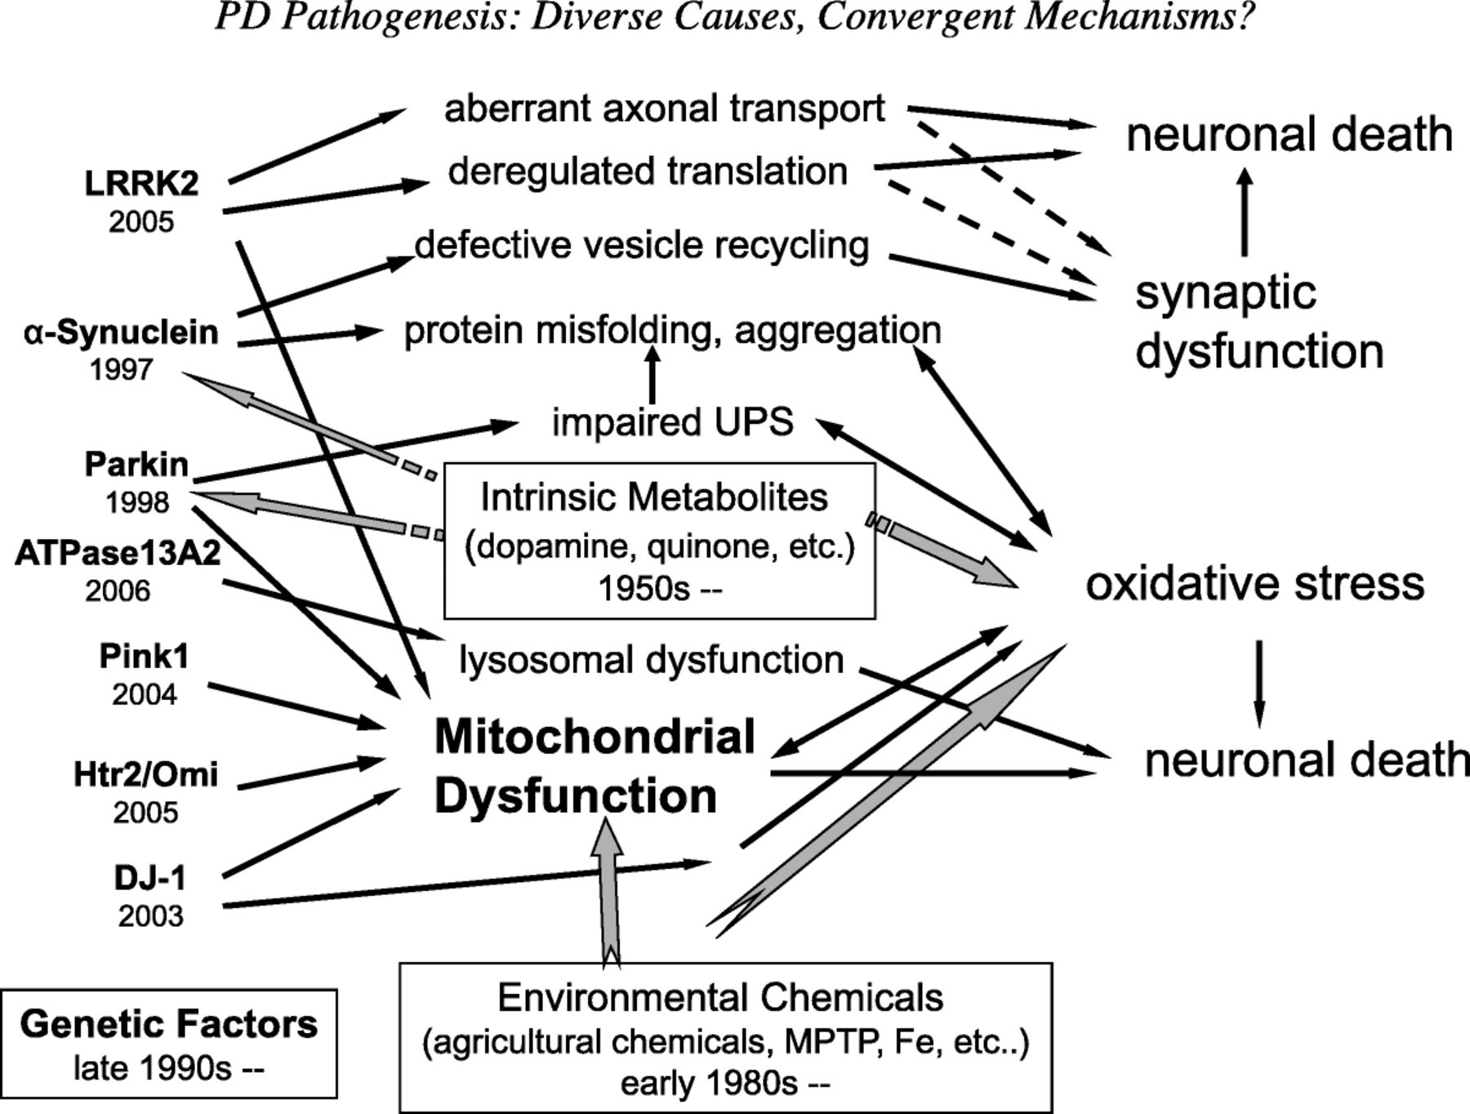
FIGURE 1. Multiple causes and convergent pathways leading to Parkinson disease (PD). A combination of environmental ...
Notes:
FIGURE 1. Multiple causes and convergent pathways leading to Parkinson disease (PD). A combination of environmental factors, intrinsic cellular metabolic properties, and susceptible genetic alleles may contribute to the pathogenesis of PD. Environmental risk factors were first disclosed in the early 1980s, and most are linked to mitochondrial dysfunction and oxidative stress. Mutant genetic alleles that lead to familial PD have been identified since the late 1990s. Cellular functions of these PD-associated genes seem to be diverse and range from translation regulation, protein processing, cytoskeletal transport, vesicle trafficking, lysosomal integrity, and mitochondrial function. Tissue-specific metabolites such as dopamine and its derivatives might interfere with the activity of some of the gene products and produce intrinsic free radical species. Despite the diversity, mitochondria continue to be the center of these processes, but the primary causes of mitochondrial dysfunction are largely unknown. Arrows indicate the genetic factors, environmental or endogenous toxins, and the pathways involved. Dashed arrows indicate possible connections for which direct experimental evidence has not yet been provided. UPS, ubiquitin-proteasome system.
Unless provided in the caption above, the following copyright applies to the content of this slide: Copyright © 2009 by the American Association of Neuropathologists, Inc.

Slide 2
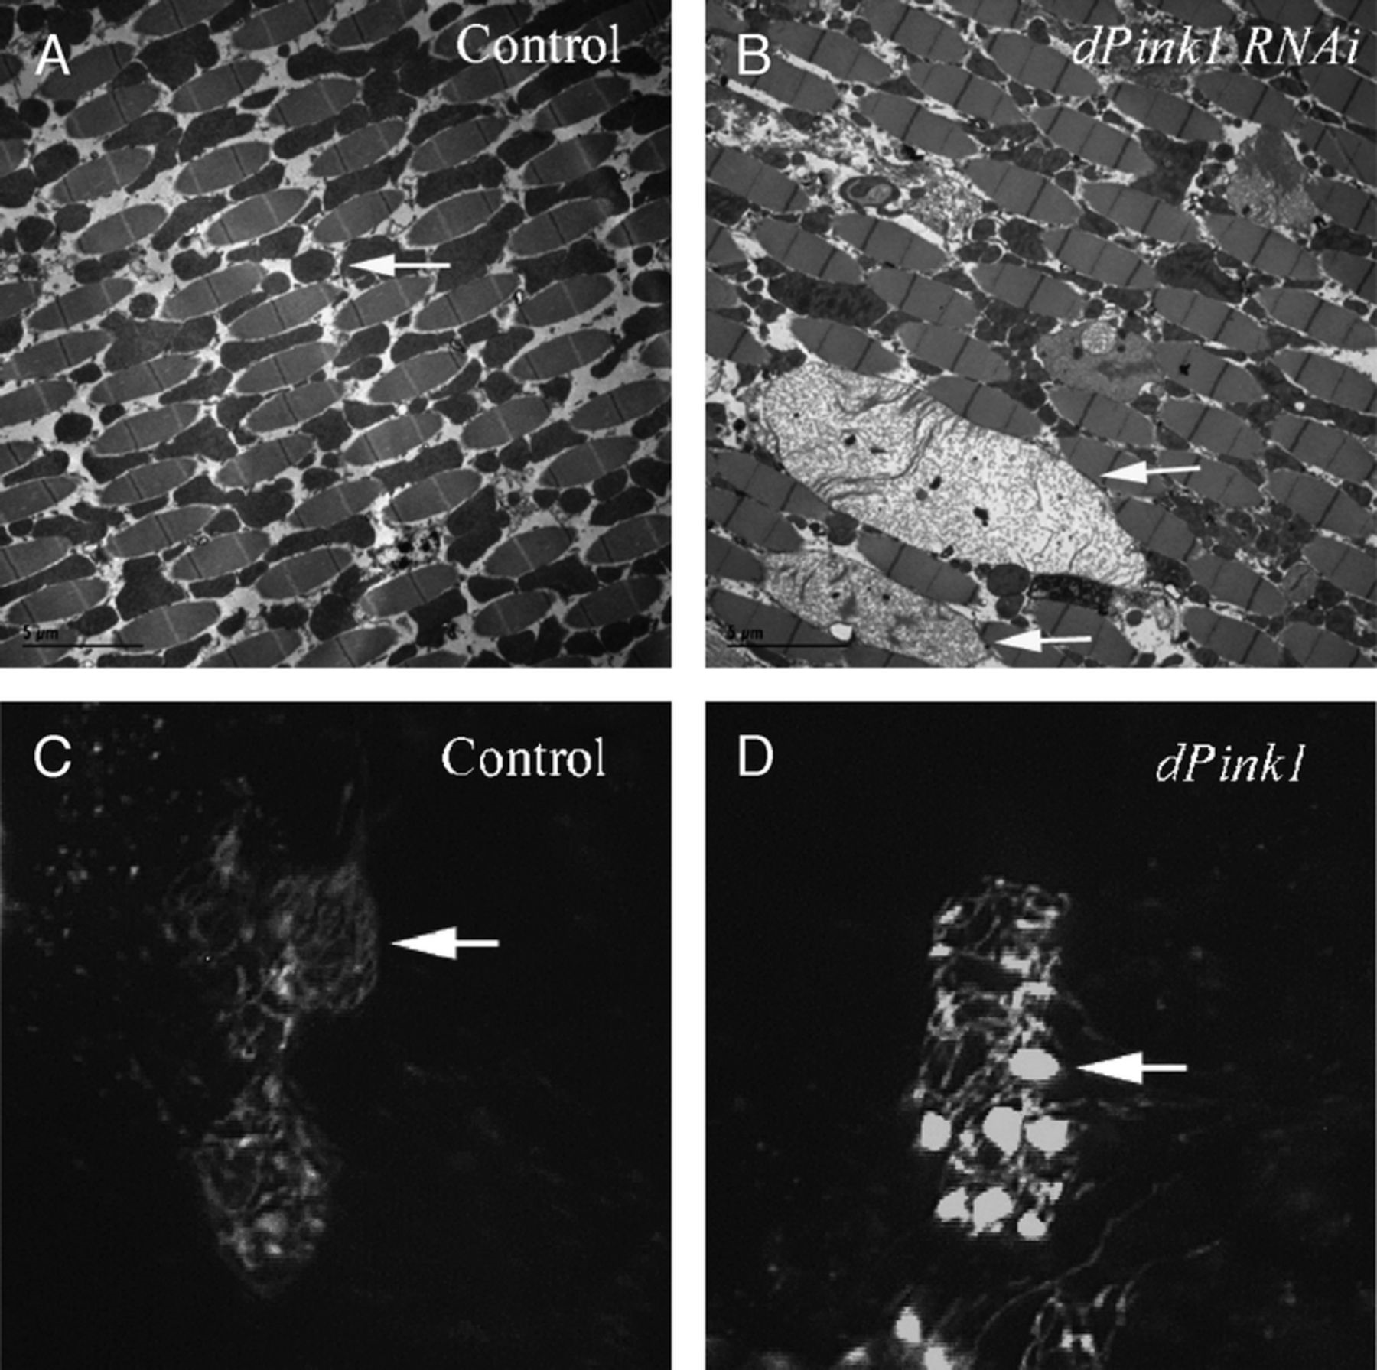
FIGURE 2. Abnormal mitochondrial morphology caused by inhibition of Pink1 function in Drosophila indirect flight muscle ...
Notes:
FIGURE 2. Abnormal mitochondrial morphology caused by inhibition of Pink1 function in Drosophila indirect flight muscle and dopaminergic (DA) neurons. (A, B) Electron microscopy images show indirect flight muscle from wild-type control (A) and dPink1 RNAi (B) animals. The white arrows indicate the electron dense mitochondria in wild-type muscle (A) and swollen mitochondria in dPink1 RNAi muscle (B). (C, D) Expression of a mitochondrial targeted mito-GFP reporter in DA neurons of control (C) and dPink1-mutant (D) animals. White arrows indicate the normal tubular mitochondrial network on control (C) and the aggregated mitochondria in dPink1 mutant (D). Images adopted from Yang et al (31, 34), Copyright, National Academy of Sciences.
Unless provided in the caption above, the following copyright applies to the content of this slide: Copyright © 2009 by the American Association of Neuropathologists, Inc.

Slide 3
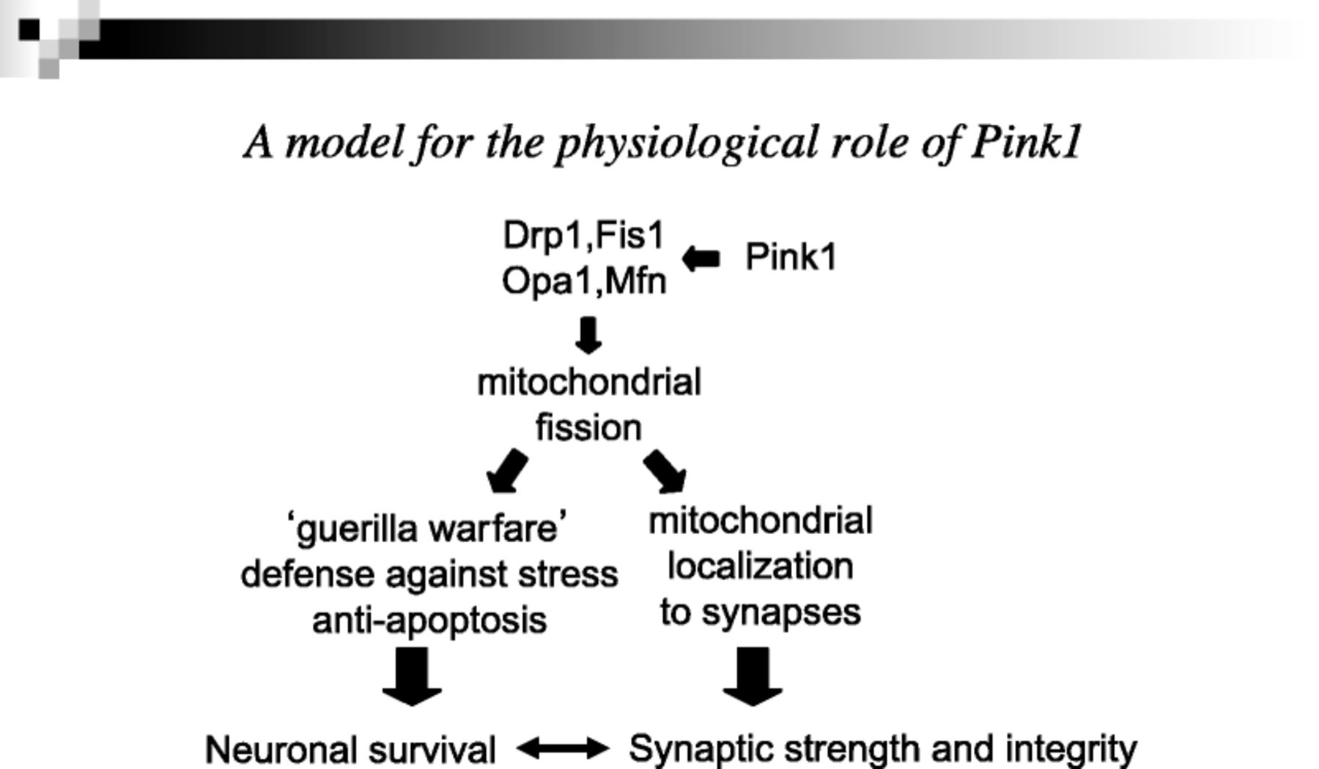
FIGURE 3. A model for the physiological role of Pink1. Pink1 and possibly Parkin may directly promote mitochondrial ...
Notes:
FIGURE 3. A model for the physiological role of Pink1. Pink1 and possibly Parkin may directly promote mitochondrial fissionby interacting with the mitochondrial fission and fusion machinery. Mitochondrial fission would facilitate the localization of mitochondria to the engaged synapses and regulate synaptic strength and integrity. In parallel, fission could be deemed as guerilla warfare that mitochondria adopt to protect against stress and preserve mitochondrial genome and integrity, thus promoting neuron survival. The double-headed arrow indicates that synaptic integrity and strength might affect neuronal survival in general; genes normally involved in neuronal survival control may also perform nonapoptotic functions to preserve synaptic integrity and function.
Unless provided in the caption above, the following copyright applies to the content of this slide: Copyright © 2009 by the American Association of Neuropathologists, Inc.

