Slide 1
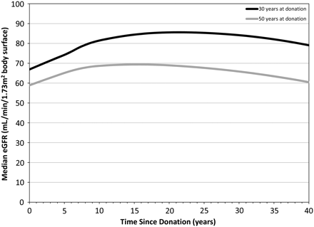
Fig. 1 Illustrations of typical development curves for estimated eGFR following nephrectomy for 30-year-old kidney ...
Notes:
Fig. 1 Illustrations of typical development curves for estimated eGFR following nephrectomy for 30-year-old kidney donors (black) and 50-year-old kidney donors (grey), respectively. Development curves were determined by special multivariable regression analysis.
Unless provided in the caption above, the following copyright applies to the content of this slide: © The Author 2011. Published by Oxford University Press on behalf of ERA-EDTA. All rights reserved. For Permissions, please e-mail: journals.permissions@oup.com

Slide 2
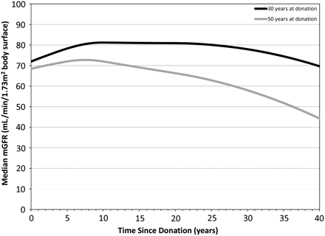
Fig. 2 Illustrations of typical development curves for measured mGFR following nephrectomy for 30-year old kidney ...
Notes:
Fig. 2 Illustrations of typical development curves for measured mGFR following nephrectomy for 30-year old kidney donors (black) and 50-year old kidney donors (grey), respectively. Development curves were determined by special multivariable regression analysis.
Unless provided in the caption above, the following copyright applies to the content of this slide: © The Author 2011. Published by Oxford University Press on behalf of ERA-EDTA. All rights reserved. For Permissions, please e-mail: journals.permissions@oup.com

