Slide 1
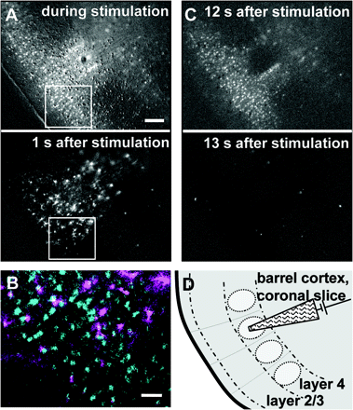
Figure 1. Astrocytes selectively respond to stimulation of input into a barrel column, but not to spontaneous neuronal ...
Notes:
Figure 1. Astrocytes selectively respond to stimulation of input into a barrel column, but not to spontaneous neuronal activity in layer 2/3. Subtraction images showing a recording in a slice obtained from a p9 mouse brain under 488 nm illumination. Time points are indicated in each image. Images are background subtracted and highlight reacting cells. (A) Focal electrical stimulation in layer IV leads to an increase in Ca2+ in neurons along the barrel and horizontally across barrel structures in layer 2/3. This response is followed by an astrocytic Ca2+ signal restricted to the stimulated barrel. Bar = 100 μm. (B) Overlay of the regions indicated in (A). The neuronal signal during stimulation (blue) does not overlap with the astrocytic signal appearing 1 s delayed (violet). Note, that astrocytic signaling stops at barrel borders. Bar = 30 μm. (C) Spontaneous neuronal network activity in layer 2/3 is not followed by a Ca2+ signal in astrocytes. (D) Cartoon illustrating the barrel borders, the orientation of the slice as observed in bright-field optics (as shown in Fig. 2A) and the position of the stimulation pipette.
Unless provided in the caption above, the following copyright applies to the content of this slide: © The Author 2008. Published by Oxford University Press. All rights reserved. For permissions, please e-mail: journals.permissions@oxfordjournals.org

Slide 2
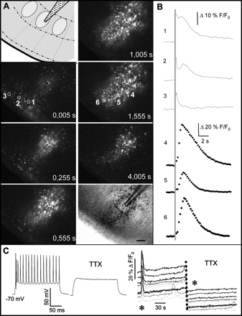
Figure 2. In the barrel cortex, stimulation in layer IV leads to subsequent Ca²⁺ increases in neurons and ...
Notes:
Figure 2. In the barrel cortex, stimulation in layer IV leads to subsequent Ca2+ increases in neurons and astrocytes. (A) The cartoon illustrates the orientation of the slice and the location of the stimulation pipette. The fluorescence images show consecutive subtraction images highlighting reacting cells in response to a focal electrical stimulation in layer IV in a slice obtained from a P9 mouse brain, recording frequency 4 Hz. To better visualize reacting cells, pixel values of the previous image were subtracted from each image. The resulting images are shown. Increases in fluorescence are displayed by increases in brightness. The time after onset of stimulation is indicated in each image. Immediately after stimulation a population of cells (neurons) reacts with a fast, small Ca2+ signal. A second population (astrocytes) exhibits Ca2+ peaks around 1 s after stimulation. Note that this reaction is restricted to the stimulated barrel column. The last image displays an overlay of all reacting cells (black) with the bright-field image of the slice. Bar = 100 μm. (B) Ca2+ traces from the regions marked in (A). Traces 1 to 3 are examples for neuronal cells reacting fast and with a small amplitude, traces 4–6 for astrocytes reacting delayed with larger amplitudes. The dotted line indicates the onset of stimulation (4 V, 100 Hz, 300 ms). Note the difference in the scale for cells 1–3 and 4–6. To obtain Ca2+ intensities from single cells the tool “AOI analysis in a t-stack” (http://www.mediacy.com/index.aspx?page=ViewSolution&solid=960) was used. (C) Left: Current clamp responses from a pyramidal neuron in layer 2/3. Forty picoamperes were injected. Firing of action potentials is completely blocked in the presence of 1 μM TTX. Right: Ca2+ responses are also blocked by TTX. Asterisks indicate the time point of stimulation.
Unless provided in the caption above, the following copyright applies to the content of this slide: © The Author 2008. Published by Oxford University Press. All rights reserved. For permissions, please e-mail: journals.permissions@oxfordjournals.org

Slide 3
Figure 3. Evoked neuronal Ca²⁺ signals in layer 2/3 are glutamatergic. (A) upper image: spontaneous neuronal ...
Notes:
Figure 3. Evoked neuronal Ca2+ signals in layer 2/3 are glutamatergic. (A) upper image: spontaneous neuronal Ca2+ signals in layer 2/3. Bright areas show the cell population with rises in intracellular Ca2+ concentration. The cartoon illustrates the orientation of the slice and the location of the stimulation pipette. During stimulation in layer 2/3 using the same stimulus as in layer 4, neurons in layer 2/3 across several barrel exhibit a Ca2+ signal. One second after the simulation astrocytic Ca2+ signals are only observed in the barrel column where the stimulation pipette is placed, but not following the neuronal activation across barrel columns in layer 2/3 (all image presented are background subtracted). (B) In the presence of CNQX, the stimulation-induced response in the neuronal population in layer 2/3 was reduced to 22.5% of the control (SEM 13.0; n = 11 slices, P < 0.005 paired Student's t-test). To obtain these values, fluorescence images were analyzed after background subtraction. An area of interest (region of interest) was selected covering layer 2/3 outside the stimulated column containing reacting neurons only. From the data obtained, F/F0 values were calculated (F0 was defined as the average of the 15 values determined before stimulation).
Unless provided in the caption above, the following copyright applies to the content of this slide: © The Author 2008. Published by Oxford University Press. All rights reserved. For permissions, please e-mail: journals.permissions@oxfordjournals.org

Slide 4
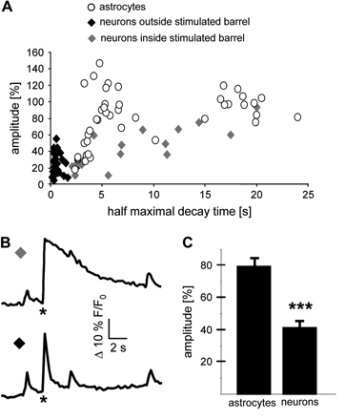
Figure 4. Ca²⁺ signals were analyzed with respect to amplitude and to the decay time τ. A) Decay times were ...
Notes:
Figure 4. Ca2+ signals were analyzed with respect to amplitude and to the decay time τ. A) Decay times were analyzed by determining the time from the maximal peak amplitude to the half-maximal amplitude of the Ca2+ signal. The averaged decay time for Ca2+ signals recorded from astrocytes (open circles) was 8.8 s and for signals recorded from neurons it was 3.3 s (black and gray diamonds). For neurons, 2 different patterns were observed: with a τ shorter than 2 s (black diamonds) and clearly longer (gray diamonds). The latter ones only occur within the stimulated barrel, while the shorter decay times occur outside the stimulated barrel and mostly in layer 2/3. (B) Example traces for the 2 different neuronal Ca2+ signals in a slice from a p9 mouse brain. Asterisks indicate electrical stimulation. Peaks before and after the stimulation occurred spontaneously. (C) Astrocytes show a Ca2+ signal with an average increase in amplitude of 80% (SEM = 4.9), neurons with an increase of 41% (SEM = 3.9; unpaired t-test P < 0.005). Data from 4 independent experiments with a total of 103 cells were analyzed.
Unless provided in the caption above, the following copyright applies to the content of this slide: © The Author 2008. Published by Oxford University Press. All rights reserved. For permissions, please e-mail: journals.permissions@oxfordjournals.org

Slide 5
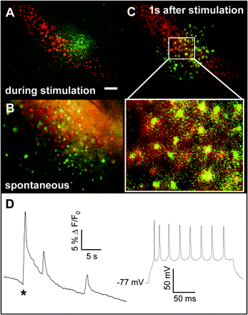
Figure 5. Astrocytes were identified by Sulforhodamine 101 staining, neurons by patch-clamp recordings. (A–C) A slice ...
Notes:
Figure 5. Astrocytes were identified by Sulforhodamine 101 staining, neurons by patch-clamp recordings. (A–C) A slice obtained from a p10 mouse brain was costained with Fluo4-AM (green) and Sulforhodamine 101 (SR101, red), which selectively labels astrocytes. Cells reacting during stimulation (A, green) are not astrocytes, since no overlap with the SR101 staining is observed. Also when synchronous, spontaneous Ca2+ activity in large cell populations occurred, this signal never overlapped with the SR101 staining (B, red). Cells reacting 1 s after stimulation show a clear overlap with the SR101 staining (red), indicating that they are astrocytes (C). Bar = 100 μm. (D) Magnification of the area outlined in (C). Note the yellow appearance of cells due to overlap of the Fluo4 signal (green) with SR101 (red). Bar = 25 μm. (D) Cells in layer 2/3 in- and outside the stimulated barrel with the typical fast, weak fluorescence signal were selected for patch-clamp recordings. Left: Ca2+ trace of a representative cell selected for recording. Note that after the peak due to stimulation (asterisk) also spontaneous Ca2+ increases occur. Right: Current clamp recording from the same cell. By injecting current steps trains of action potentials could be elicited. Action potentials could be recorded in all cells with a membrane potential more negative than −20 mV (n = 9).
Unless provided in the caption above, the following copyright applies to the content of this slide: © The Author 2008. Published by Oxford University Press. All rights reserved. For permissions, please e-mail: journals.permissions@oxfordjournals.org

Slide 6
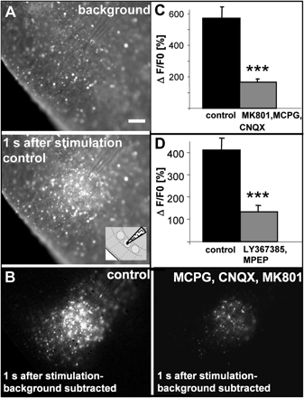
Figure 6. The astrocyte response is sensitive to glutamate receptor antagonists. (A) Images showing the surface of a ...
Notes:
Figure 6. The astrocyte response is sensitive to glutamate receptor antagonists. (A) Images showing the surface of a Fluo4-stained brain slice (mouse p12) illuminated at 488 nm before (first image) and 1 s after the stimulation (second image) under control conditions. Bright cells show increases in intracellular Ca2+ concentration. The cartoon illustrates the orientation of the slice and the location of the stimulation pipette. Bar = 100 μm. (B) Subtraction of the images described in A displaying the astrocyte reaction in a brain slice under control conditions (left image). After application of a cocktail of S-MCPG, CNQX, and MK801 the response is drastically reduced to cells reacting only in the close proximity to the stimulation pipette (right image, different set of experiments). (C) In 5 slices fluorescence intensities were determined as described in Figure 3. The F/F0 values were calculated from the whole observation area 2 s after the stimulation when the neuronal signal had already declined. After application of S-MCPG, CNQX, and MK801, the average increase was reduced to 29.8% (SEM 3.1; P < 0.005 paired Student's t-test) compared to control. (D) Similar to (C) the reduction of the astrocyte signal by the metabotropic glutamate antagonists LY367385 and MPEP was determined. In 8 slices the Ca2+ signal after application of the blockers was reduced to 33.2% (SEM 6.2; P < 0.005 paired Student's t-test).
Unless provided in the caption above, the following copyright applies to the content of this slide: © The Author 2008. Published by Oxford University Press. All rights reserved. For permissions, please e-mail: journals.permissions@oxfordjournals.org

Slide 7
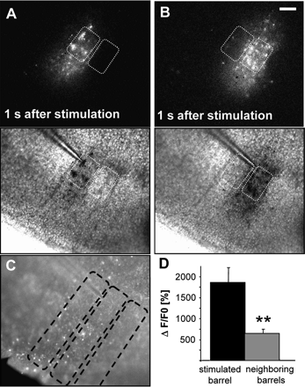
Figure 7. Stimulation close to the septum is followed by Ca²⁺ signals in astrocytes confined to the ...
Notes:
Figure 7. Stimulation close to the septum is followed by Ca2+ signals in astrocytes confined to the corresponding barrel column. (A, B) A stimulation pipette with a small tip opening (2–3 MOhm) was used to stimulate close to the septum, but still within one (A) and, alternatively within the neighboring barrel (B). The upper images show the astrocytic Ca2+ signals 1 s after stimulation (background shown in (C) was subtracted, responding cells in white). The barrels in layer 4 are outlined by dotted white lines. The lower images show an overlay of the bright-field image with the location of the pipette and the responding astrocytes now shown in black. The barrels are outlined by dotted white lines. Note that the responding astrocytes are located selectively within a single barrel column following stimulation of the respective barrel even when the stimulation pipette is located very close to the septum. Bar = 100 μm. (C) Image showing the background fluorescence before stimulation for the experiment shown in (A, B). The slice was stained with Fluo4-AM and illuminated at 488 nm. Superimposed are the regions of interest (ROIs) used for the analysis described in (D). (D) Average fluorescence increases in stimulated barrel columns (n = 21) were compared with the neighboring, unstimulated barrel columns (n = 41) using the same procedure as described for Figure 3. The ROIs used for the analysis are depicted in (C). The intensity in stimulated barrel columns was 2.9-fold higher in average than in unstimulated, neighboring barrel columns (P < 0.01 unpaired Student's t-test).
Unless provided in the caption above, the following copyright applies to the content of this slide: © The Author 2008. Published by Oxford University Press. All rights reserved. For permissions, please e-mail: journals.permissions@oxfordjournals.org

Slide 8
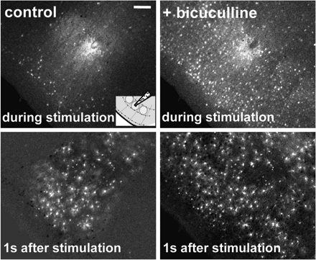
Figure 8. Blockade of GABA_{A} receptors affects both the neuronal and the astrocytic signaling. Displayed are ...
Notes:
Figure 8. Blockade of GABAA receptors affects both the neuronal and the astrocytic signaling. Displayed are consecutive images of a control reaction (left) and after application of the GABAA receptor antagonist bicuculline (right). The cartoon in the inset shows the orientation of the slice and the location of the stimulation pipette. Bicuculline application leads to an enhanced neuronal response during stimulation (upper right image). Also, the following astrocytic response is no longer restricted to a barrel in the presence of bicuculline (lower right image, n = 6). Bar = 100 μm.
Unless provided in the caption above, the following copyright applies to the content of this slide: © The Author 2008. Published by Oxford University Press. All rights reserved. For permissions, please e-mail: journals.permissions@oxfordjournals.org

Slide 9
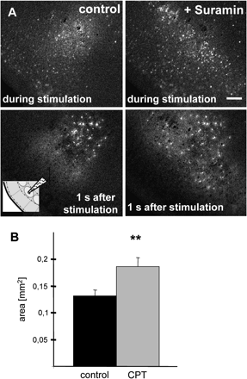
Figure 9. Interfering with purinergic signaling relieves the restriction of the astrocyte reaction to barrel borders. ...
Notes:
Figure 9. Interfering with purinergic signaling relieves the restriction of the astrocyte reaction to barrel borders. (A) Suramin application leads to a spread of the Ca2+ signal in both astrocytes and neurons across barrel borders. When compared to control, in the presence of suramin astrocytes and neurons also respond in neighboring barrels. Upper images show the neuronal reaction during the stimulation, lower images the astrocyte reaction 1 s after the stimulation (after background subtraction, reacting cells in white). Bar = 100 μm. The cartoon in the inset shows the orientation of the slice and the location of the stimulation pipette. (B) Histogram displaying the total area containing reacting astrocytes under control conditions and after application of CPT (4 μM), an A1 adenosine receptor antagonist. Blockade of A1 receptors also leads to a broadening of the signal. The area containing reacting astrocytes increased by 42% (0.13 mm2, SEM 0.011) to 0.18 (SEM 0.017); P < 0.01 paired t-test, n = 6 slices).
Unless provided in the caption above, the following copyright applies to the content of this slide: © The Author 2008. Published by Oxford University Press. All rights reserved. For permissions, please e-mail: journals.permissions@oxfordjournals.org

