Slide 1
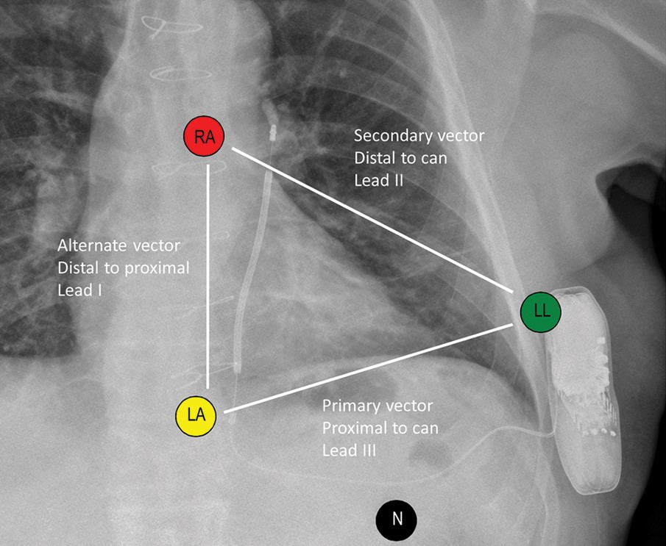
Figure 1 Subcutaneous ICD components, sensing vectors, and surface ECG lead positions. RA, right arm; LA, left arm; ...
Notes:
Figure 1 Subcutaneous ICD components, sensing vectors, and surface ECG lead positions. RA, right arm; LA, left arm; LL, left leg; N, neutral.
Unless provided in the caption above, the following copyright applies to the content of this slide: Published on behalf of the European Society of Cardiology. All rights reserved. © The Author 2013. For permissions please email: journals.permissions@oup.com.

Slide 2
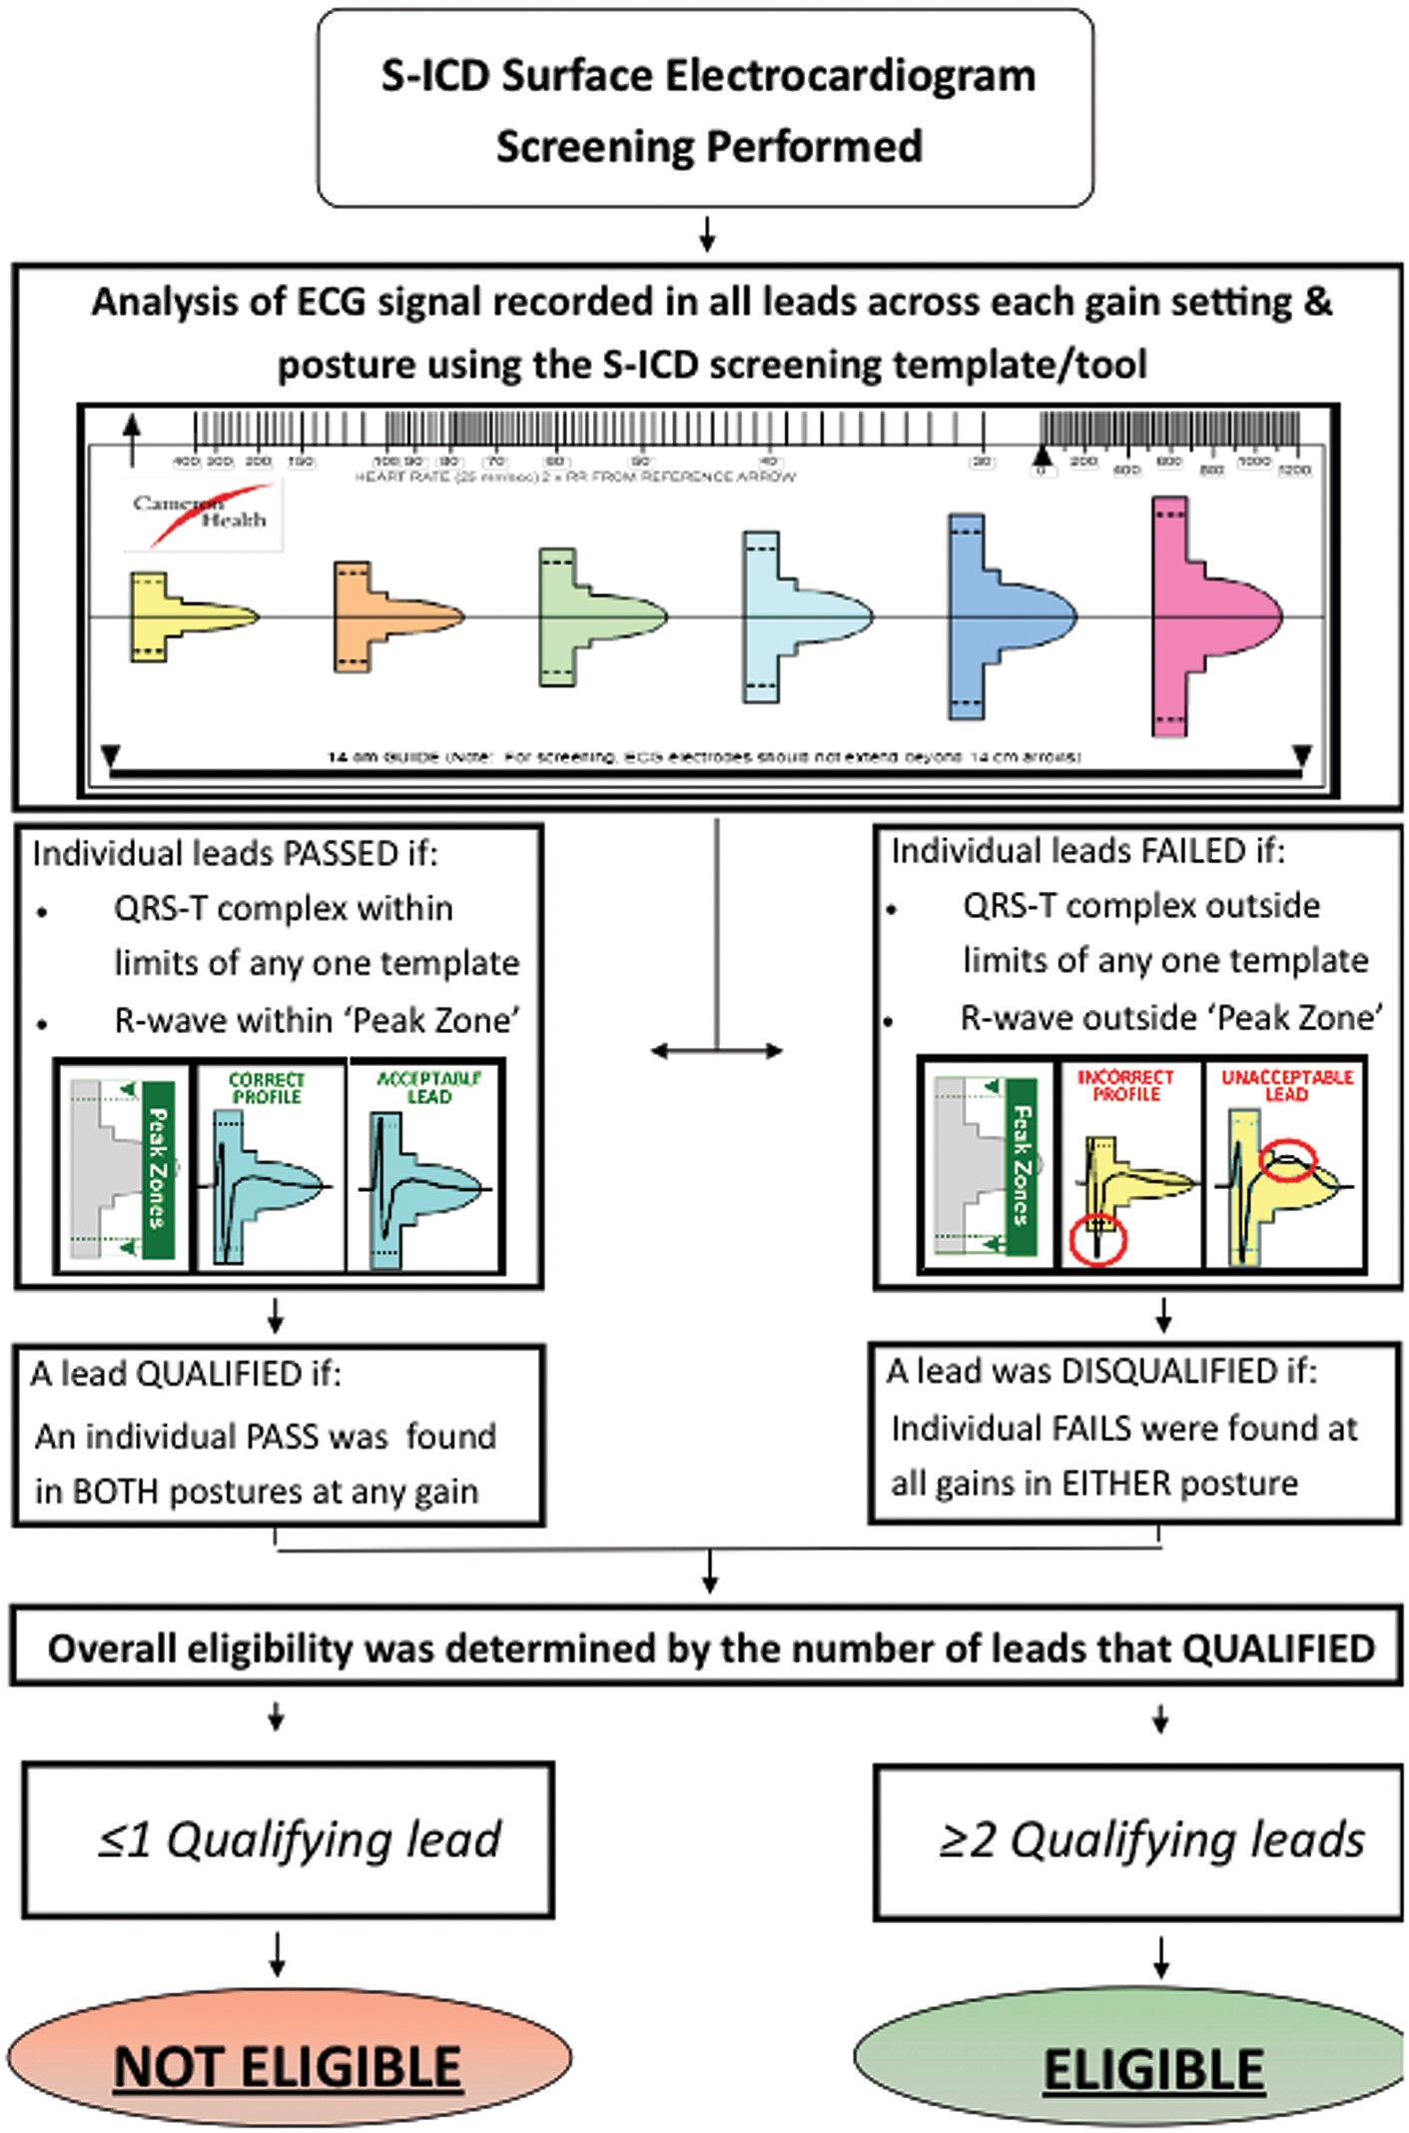
Figure 2 Flowchart showing the surface ECG screening template and process used to determine eligibility for S-ICD ...
Notes:
Figure 2 Flowchart showing the surface ECG screening template and process used to determine eligibility for S-ICD implantation.
Unless provided in the caption above, the following copyright applies to the content of this slide: Published on behalf of the European Society of Cardiology. All rights reserved. © The Author 2013. For permissions please email: journals.permissions@oup.com.

Slide 3
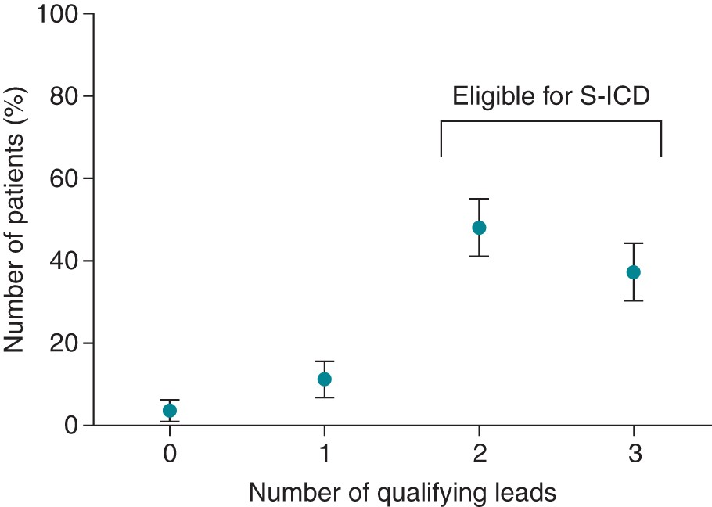
Figure 3 Proportion of patients with zero, one, two, and three ECG leads that satisfy the surface ECG screening ...
Notes:
Figure 3 Proportion of patients with zero, one, two, and three ECG leads that satisfy the surface ECG screening template. The errors bars represent 95% CIs.
Unless provided in the caption above, the following copyright applies to the content of this slide: Published on behalf of the European Society of Cardiology. All rights reserved. © The Author 2013. For permissions please email: journals.permissions@oup.com.

