Slide 1
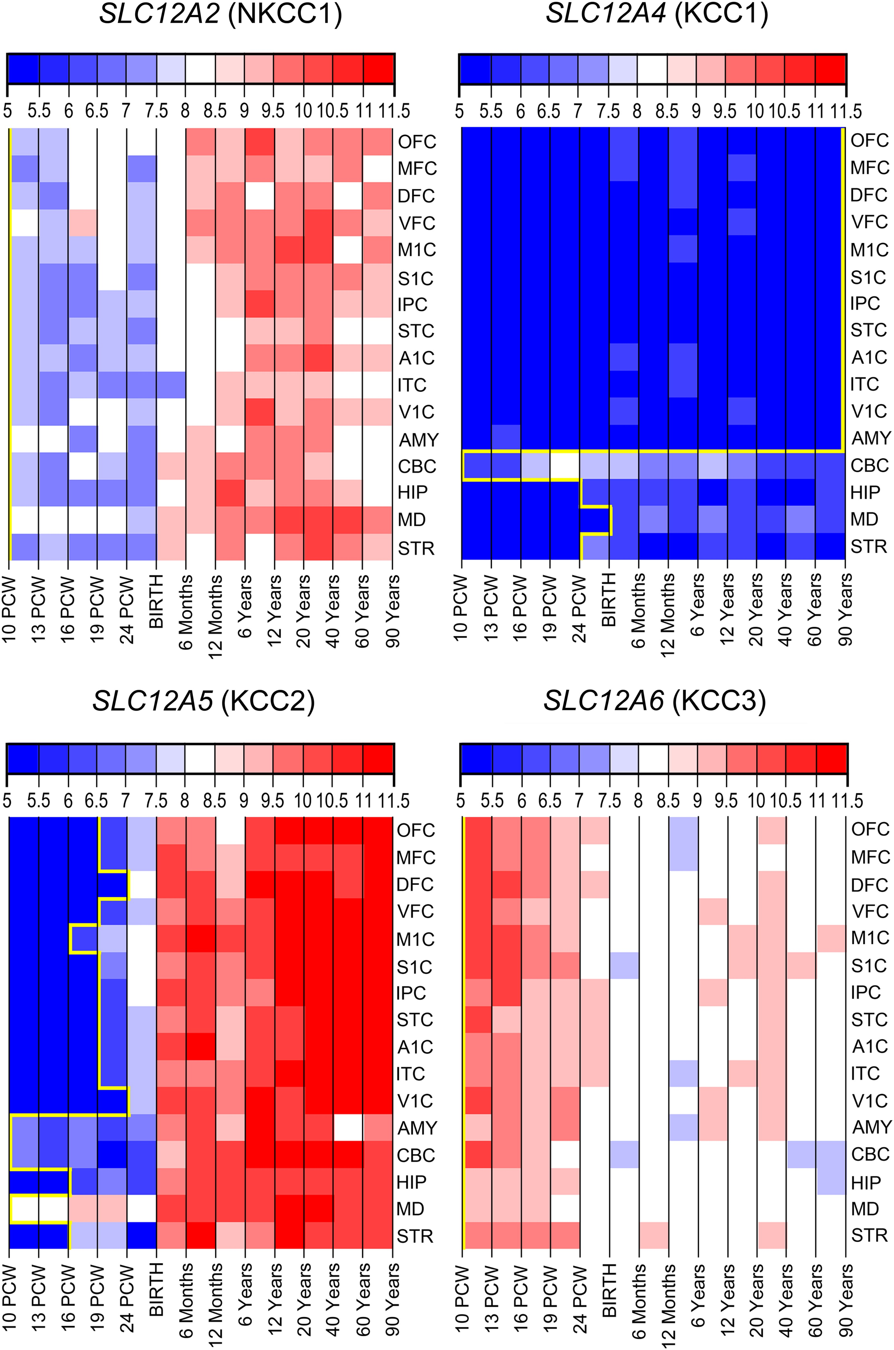
Figure 1. Spatiotemporal expression patterns of SLC12A family in the human brain. The microarray expression data were ...
Notes:
Figure 1. Spatiotemporal expression patterns of SLC12A family in the human brain. The microarray expression data were analyzed for all 9 members of the SLC12 family in 16 brain regions and at 13 different developmental periods (see Supplementary Table 1). Five CCCs (SLC12A1 [encoding NKCC2], SLC12A3 [NCC], SLC12A7 [KCC4], SLC12A9 [CIP1], SLC12A8 [CCC9]) were not expressed in the human brain in any region or at any period (Supplementary Fig. 1). Remaining 4 CCCs (SLC12A2 [NKCC1], SLC12A4-6 [KCC1-3]) exhibited diverse spatiotemporal patterns of expression. NKCC1 and KCC3 were expressed in all regions at all periods, whereas KCC1 and KCC2 had specific patterns of expression (for details, see text). Yellow line represents border between expressed (right) and unexpressed (left) samples. Note that in the majority of neocortical regions, the onset of KCC2 expression occurs between 19 and 24 PCW.
Unless provided in the caption above, the following copyright applies to the content of this slide: © The Author 2015. Published by Oxford University Press. All rights reserved. For Permissions, please e-mail: journals.permissions@oup.com

Slide 2
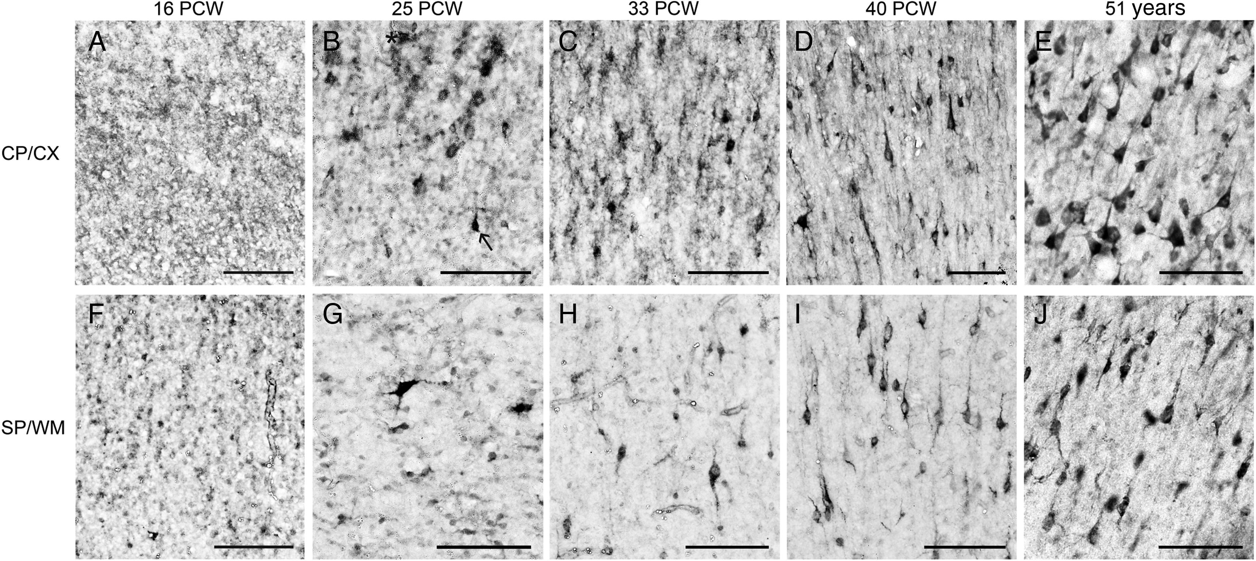
Figure 2. Developmental expression pattern of KCC2 immunoreactivity in the neocortex. At 16 PCW, no KCC2-immunoreactive ...
Notes:
Figure 2. Developmental expression pattern of KCC2 immunoreactivity in the neocortex. At 16 PCW, no KCC2-immunoreactive (KCC2-ir) neurons were observed either in cortical plate (A) or subplate (F). KCC2-ir was present in the neocortex from 25 PCW onwards in both the cortical plate (B) and the subplate (G). KCC2-ir neurons at 33 PCW (C, H), 40 PCW (D, I), and 51 years (E, J). KCC2-ir was also present in the adult subcortical white matter interstitial neurons (H). Note the difference between KCC2-ir neuron (arrow in B) and staining artifact (asterisk in B). Bar = 100 µm.
Unless provided in the caption above, the following copyright applies to the content of this slide: © The Author 2015. Published by Oxford University Press. All rights reserved. For Permissions, please e-mail: journals.permissions@oup.com

Slide 3
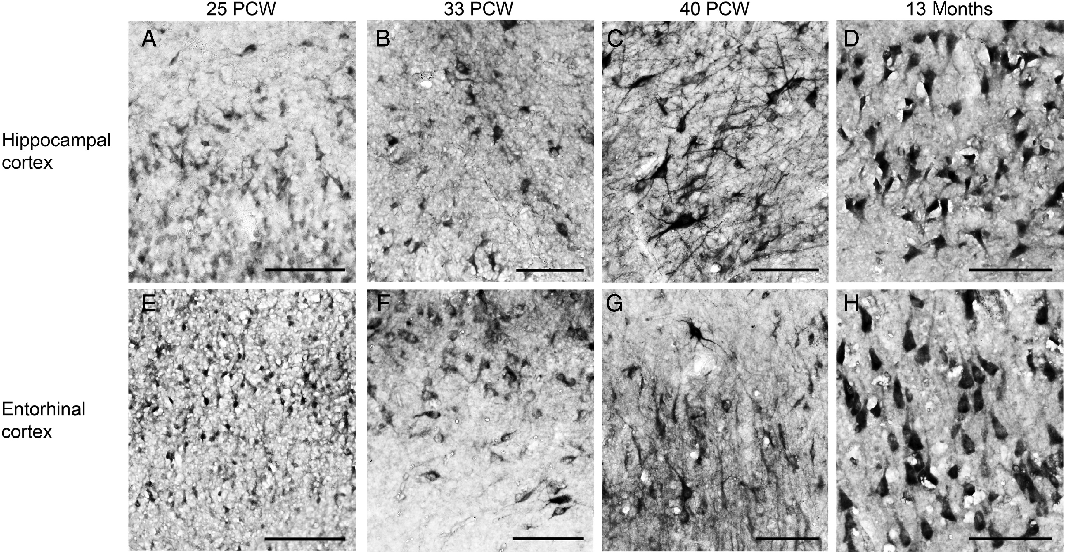
Figure 3. Developmental expression pattern of KCC2 immunoreactivity in the hippocampus and the entorhinal cortex. ...
Notes:
Figure 3. Developmental expression pattern of KCC2 immunoreactivity in the hippocampus and the entorhinal cortex. KCC2-ir neurons were observed in the hippocampus (stratum pyramidale) and the entorhinal cortex (layer 3–5) at 25 PCW (A, E), 33 PCW (B, F), 40 PCW (C, G) and 13 months (D, H). Bar = 100 µm.
Unless provided in the caption above, the following copyright applies to the content of this slide: © The Author 2015. Published by Oxford University Press. All rights reserved. For Permissions, please e-mail: journals.permissions@oup.com

Slide 4
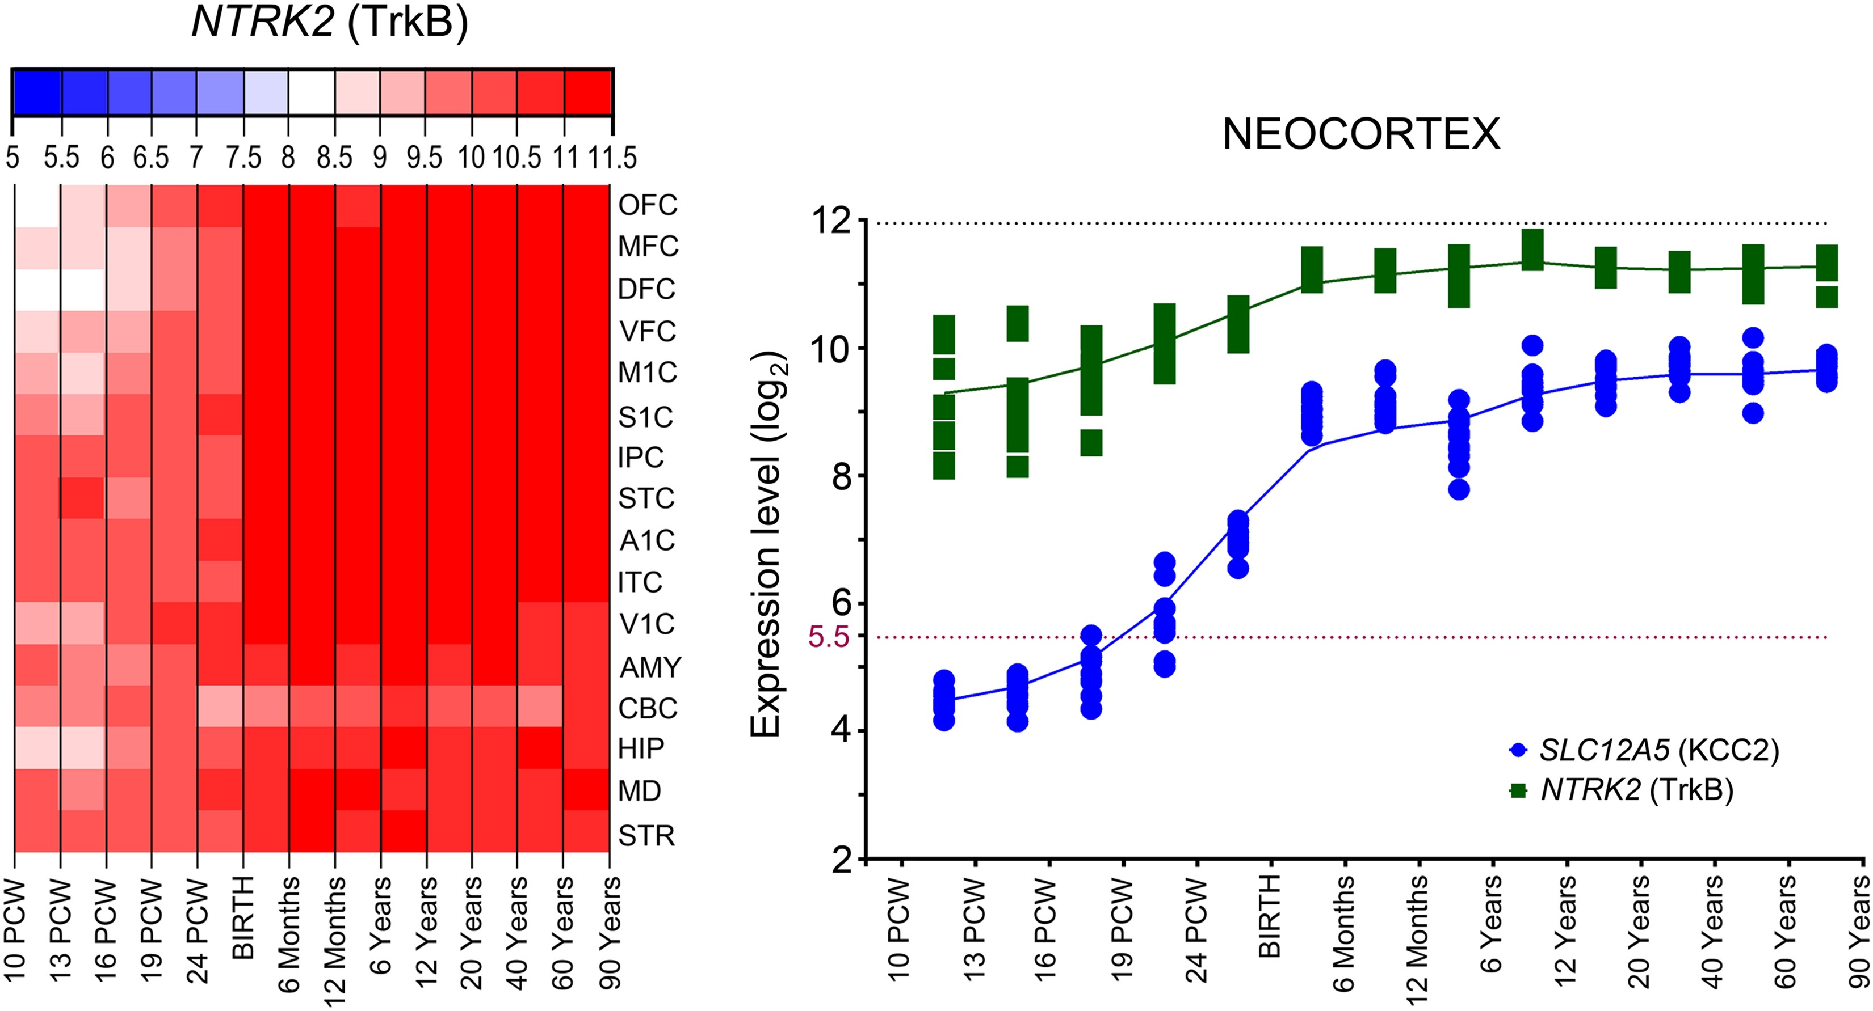
Figure 4. Spatiotemporal expression patterns of NTRK2 in the human brain. The microarray expression data were analyzed ...
Notes:
Figure 4. Spatiotemporal expression patterns of NTRK2 in the human brain. The microarray expression data were analyzed for NTRK2 (encoding TrkB) in 16 brain regions and at 13 different developmental periods (see Supplementary Table 1). NTRK2 is expressed in all examined regions from 10 PCW. Note that expression pattern of NTRK2 follows upregulation of KCC2 expression in the neocortex.
Unless provided in the caption above, the following copyright applies to the content of this slide: © The Author 2015. Published by Oxford University Press. All rights reserved. For Permissions, please e-mail: journals.permissions@oup.com

Slide 5
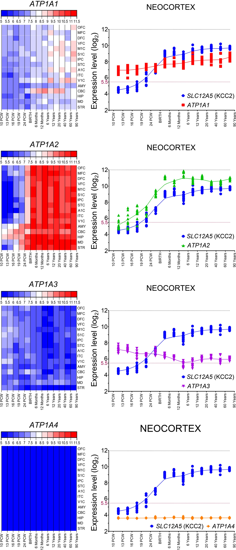
Figure 5. Spatiotemporal expression patterns of ATP1A1-4 in the human brain. The microarray expression data were ...
Notes:
Figure 5. Spatiotemporal expression patterns of ATP1A1-4 in the human brain. The microarray expression data were analyzed for all 4 ATP1A (encoding Na-K ATPase α-subunits 1–4) family members in 16 brain regions and at 13 different developmental periods (see Supplementary Table 1). Three members of the family (ATP1A1-3) are expressed in the human brain, whereas ATP1A4 is not expressed in the human brain at any period. ATP1A1 starts to be expressed from 10 PCW throughout entire lifespan in all analyzed regions. ATP1A2 and ATP1A3 have opposite expression patterns. Expression pattern of ATP1A2 closely follows the expression pattern of SLC12A5 (cf. Fig. 1), whereas ATP1A3 has the opposite expression pattern (higher prenatal and lower postnatal level of expression).
Unless provided in the caption above, the following copyright applies to the content of this slide: © The Author 2015. Published by Oxford University Press. All rights reserved. For Permissions, please e-mail: journals.permissions@oup.com

Slide 6
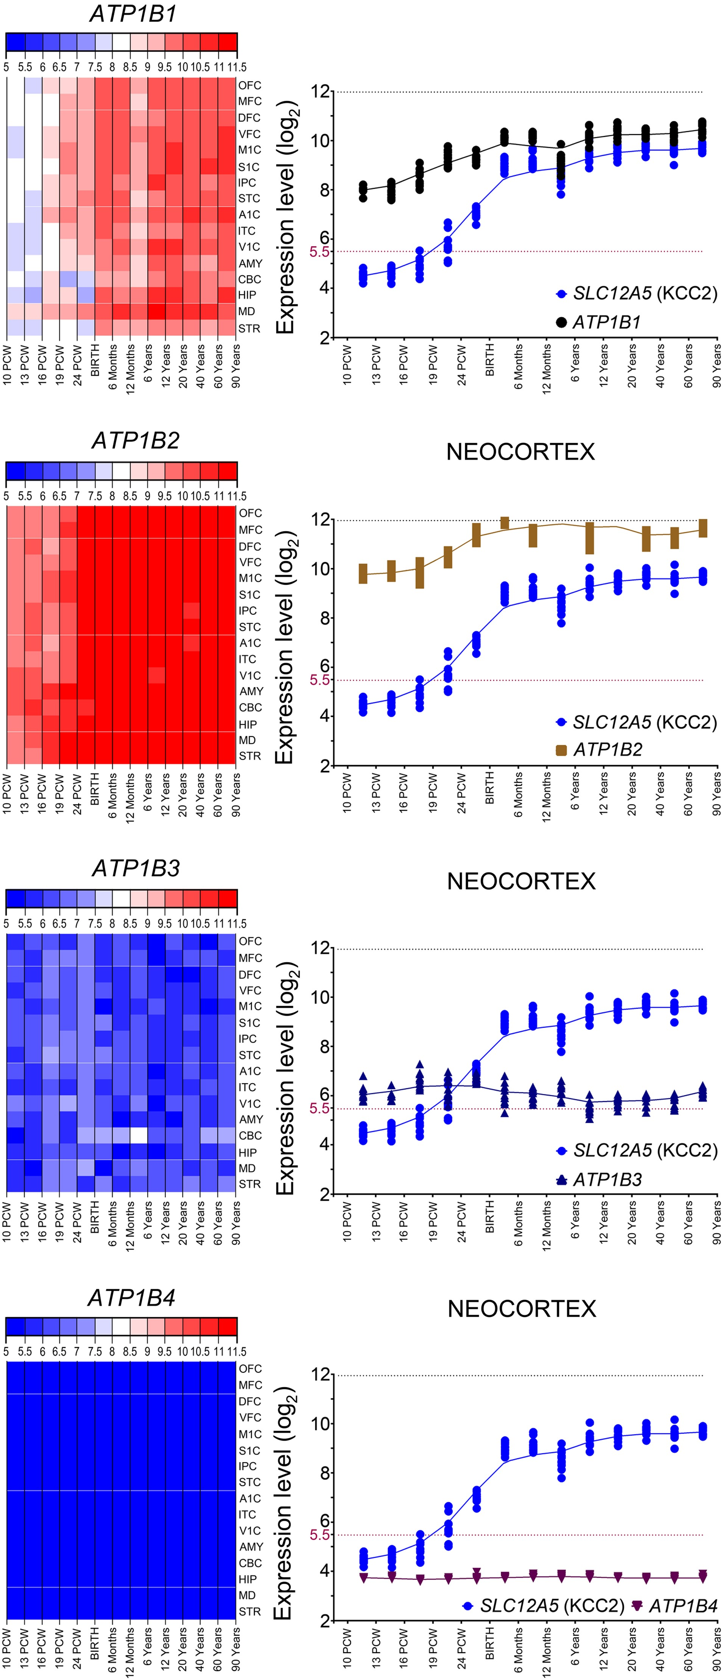
Figure 6. Spatiotemporal expression patterns of ATP1B1-4 in the human brain. The microarray expression data were ...
Notes:
Figure 6. Spatiotemporal expression patterns of ATP1B1-4 in the human brain. The microarray expression data were analyzed for all 4 ATP1B (encoding Na-K ATPase β subunits 1–4) family members in 16 brain regions and at 13 different developmental periods (see Supplementary Table 1). Three members of the family (ATP1B1-3) are expressed in the human brain, whereas ATP1B4 is not expressed in the human brain at any period. ATP1B1 and ATP1B2 exhibit similar expression pattern as SLC12A5, whereas ATP1B3 exhibits similar expression pattern as ATP1A3 (higher prenatal and lower postnatal level of expression).
Unless provided in the caption above, the following copyright applies to the content of this slide: © The Author 2015. Published by Oxford University Press. All rights reserved. For Permissions, please e-mail: journals.permissions@oup.com

Slide 7
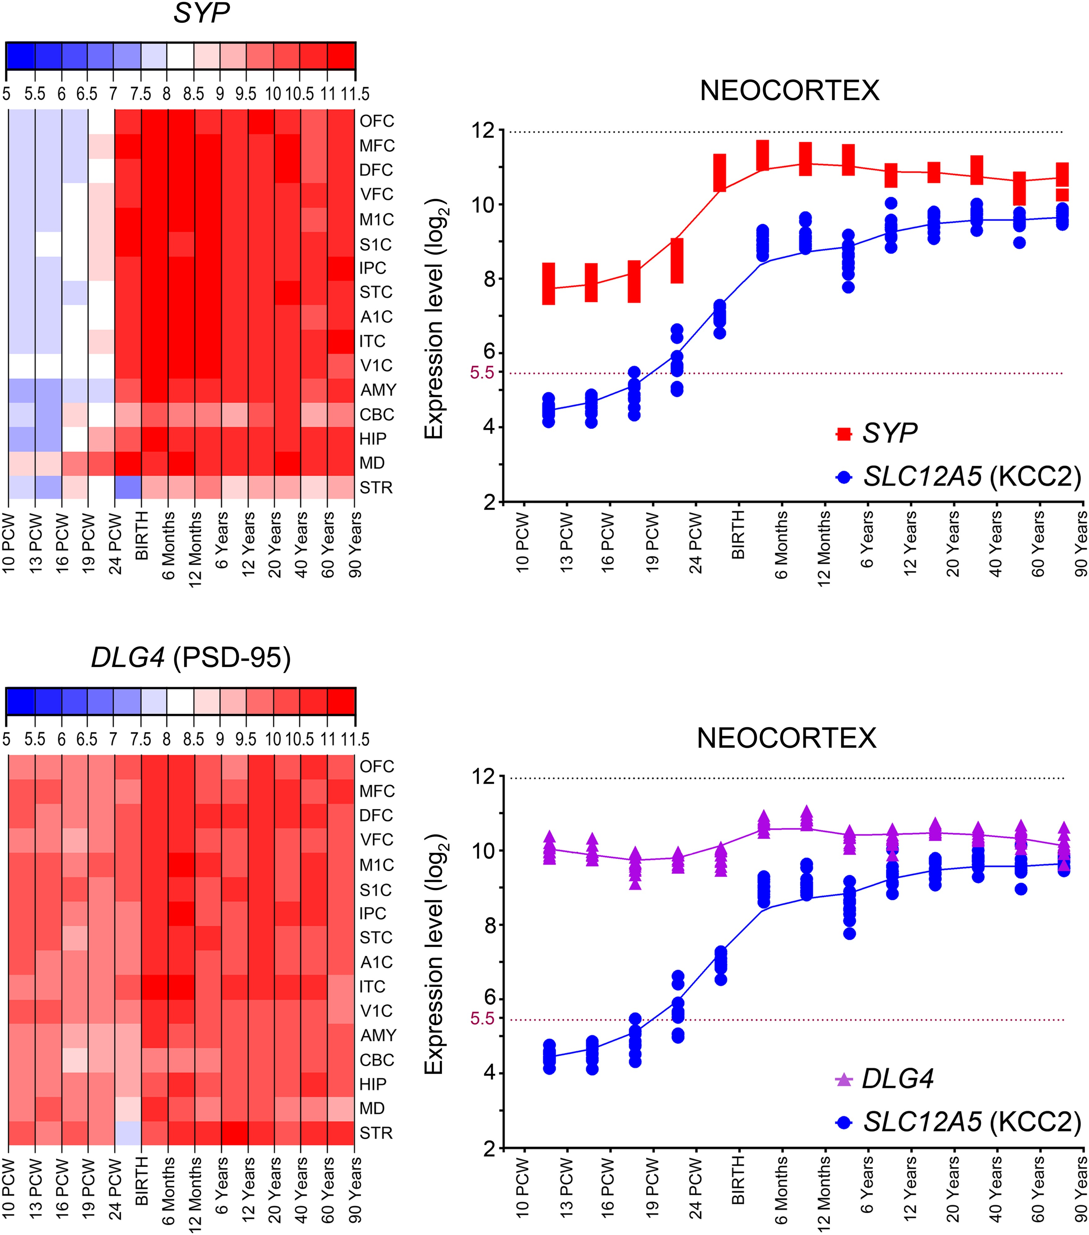
Figure 7. Spatiotemporal expression patterns of SYP and DLG4 in the human brain. The microarray expression data were ...
Notes:
Figure 7. Spatiotemporal expression patterns of SYP and DLG4 in the human brain. The microarray expression data were analyzed for SYP (encoding synaptophysin) and DLG4 (encoding PSD-95) in 16 brain regions and at 13 different developmental periods (see Supplementary Table 1). SYP and DLG4 are expressed in all examined regions from 10 PCW. Note that expression pattern of SYP follows upregulation of KCC2 expression in the neocortex. DLG4 is expressed at high levels throughout the development; however, it undergoes upregulation which correlates with the SLC12A5 upregulation.
Unless provided in the caption above, the following copyright applies to the content of this slide: © The Author 2015. Published by Oxford University Press. All rights reserved. For Permissions, please e-mail: journals.permissions@oup.com

Slide 8
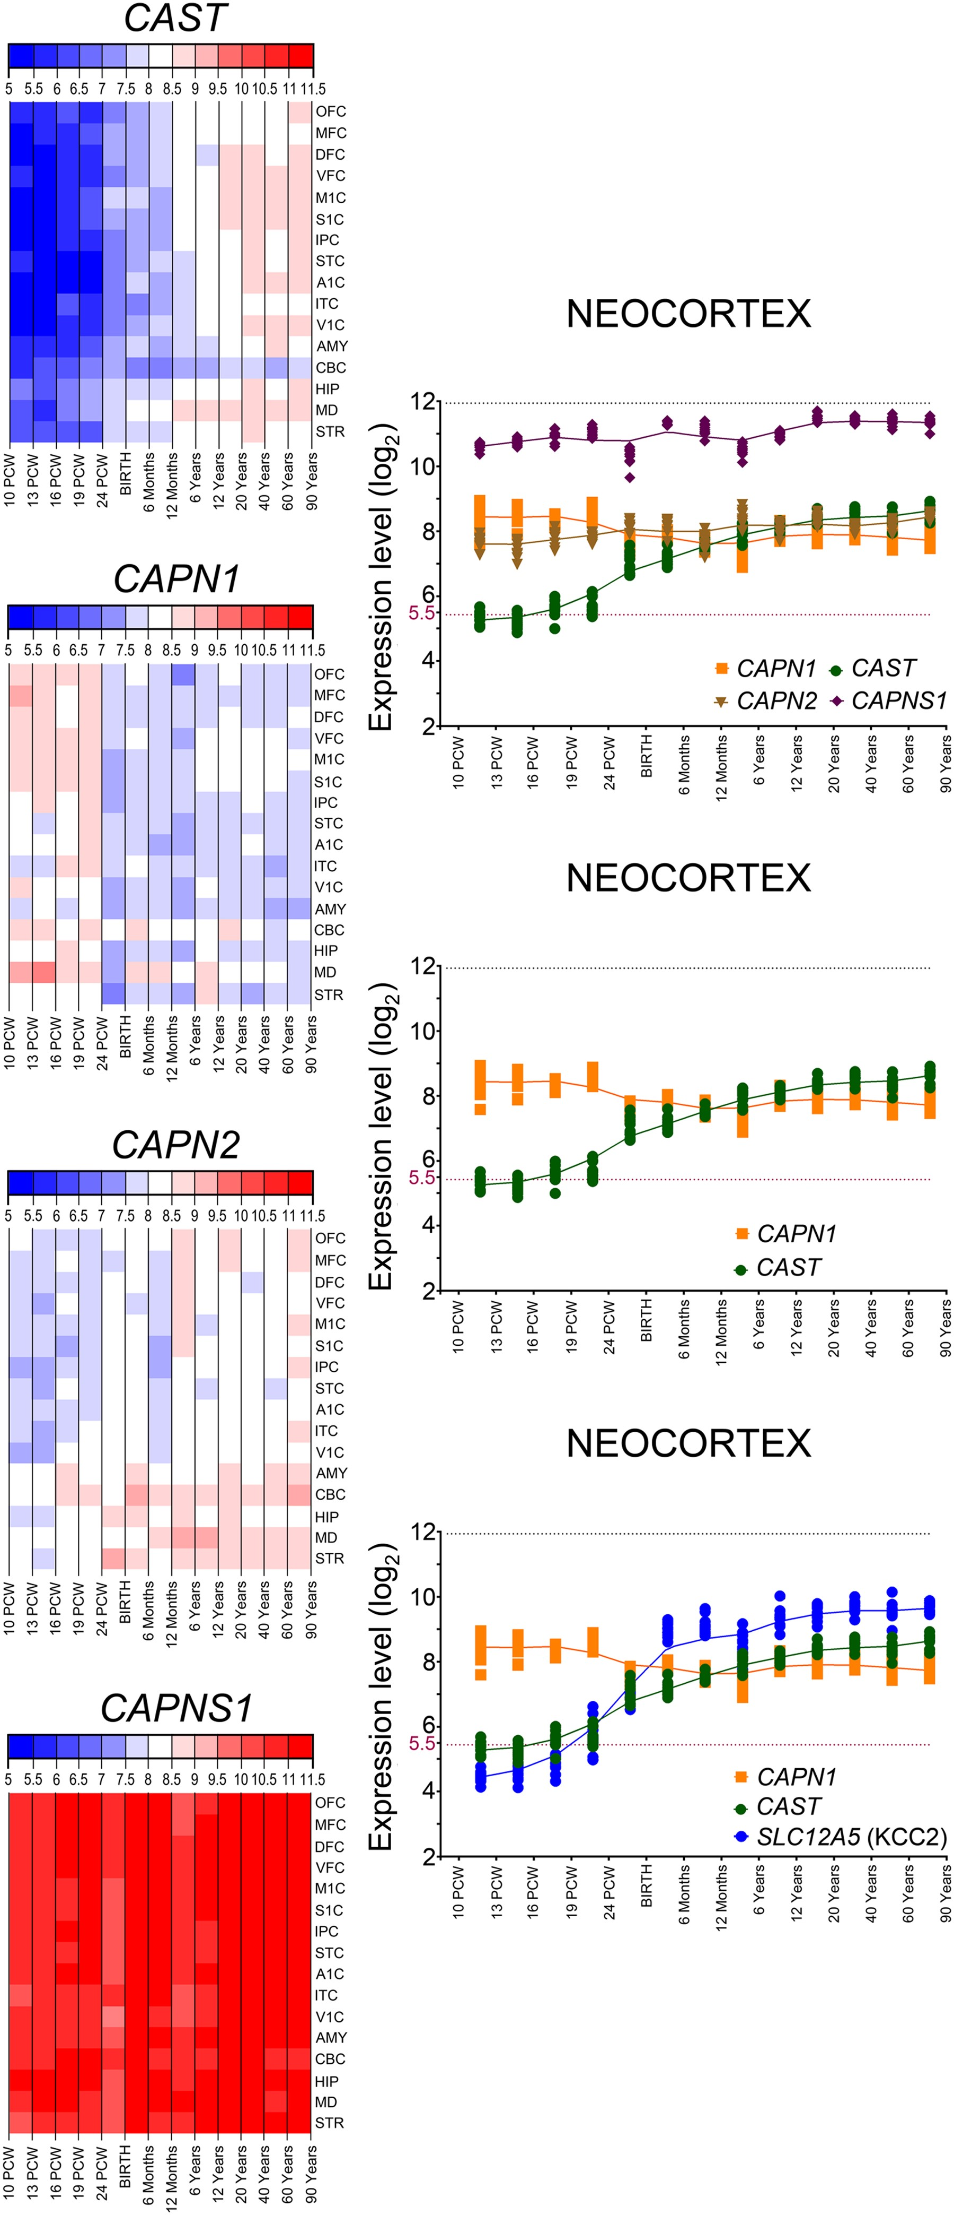
Figure 8. Spatiotemporal expression patterns of CAST, CAPN1, CAPN2 and CAPNS1 in the human brain. The microarray ...
Notes:
Figure 8. Spatiotemporal expression patterns of CAST, CAPN1, CAPN2 and CAPNS1 in the human brain. The microarray expression data were analyzed for CAST (encoding calpastatin), CAPN1 (encoding large subunit of calpain 1), CAPN2 (encoding large subunit of calpain 2) and CAPNS1 (encoding small subunit of calpains 1–2) in 16 brain regions and at 13 different developmental periods (see Supplementary Table 1). CAPN1 and CAPN2 are expressed continuously throughout entire lifespan with CAPN1 exhibiting higher prenatal and CAPN2 higher postnatal levels of expression. Note that CAST exhibits very low expression levels especially during the prenatal period and is upregulated in the postnatal period. CAPNS1 is expressed at high levels throughout entire lifespan.
Unless provided in the caption above, the following copyright applies to the content of this slide: © The Author 2015. Published by Oxford University Press. All rights reserved. For Permissions, please e-mail: journals.permissions@oup.com

