Slide 1
Figure 1. Variation in age-at-onset of PD Age-at-onset distribution in NGRC subjects shows nearly 80 years of variation ...
Notes:
Figure 1. Variation in age-at-onset of PD Age-at-onset distribution in NGRC subjects shows nearly 80 years of variation in both familial and non-familial PD. The tails (age at onset ≤20 or ≥89 years) were excluded from analyses.
Unless provided in the caption above, the following copyright applies to the content of this slide: © The Author 2016. Published by Oxford University Press.This is an Open Access article distributed under the terms of the Creative Commons Attribution Non-Commercial License (http://creativecommons.org/licenses/by-nc/4.0/), which permits non-commercial re-use, distribution, and reproduction in any medium, provided the original work is properly cited. For commercial re-use, please contact journals.permissions@oup.com

Slide 2
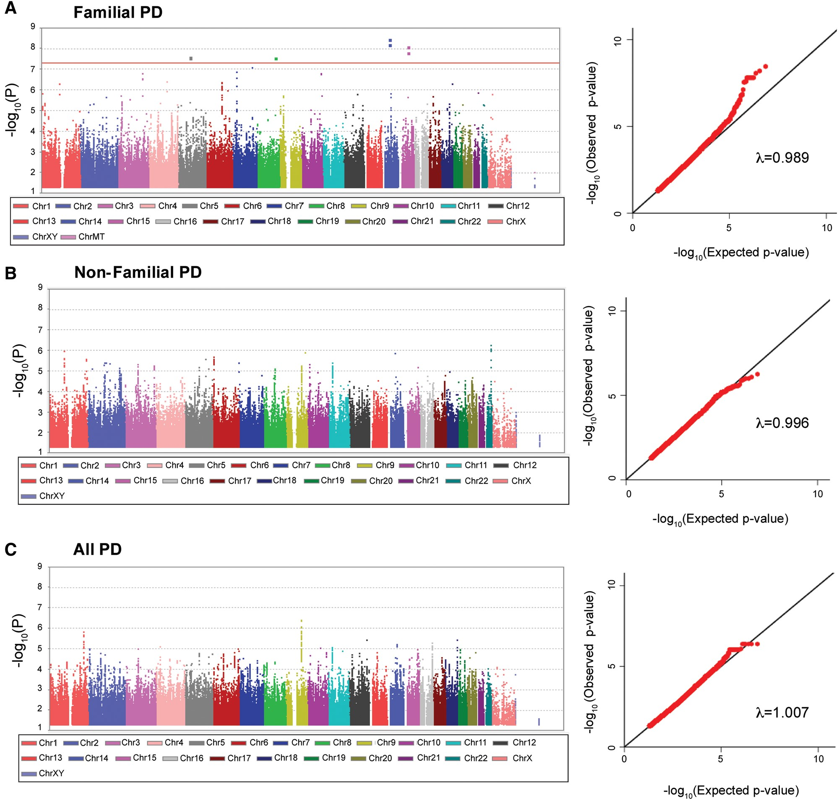
Figure 2. GWAS. Left panel: Manhattan Plots. Using Cox regression, four signals achieved P < 5E-8 in familial PD (A). ...
Notes:
Figure 2. GWAS. Left panel: Manhattan Plots. Using Cox regression, four signals achieved P < 5E-8 in familial PD (A). No signals were detected in non-familial PD (B) or in all PD (C). SNPs with P ≥ 0.05 are not plotted. Right panel: QQ plots. The observed P-values were consistent with the expected distributions and did not appear to be inflated (λfamilial=0.989, λnon-familial=0.996, λall-PD=1.007).
Unless provided in the caption above, the following copyright applies to the content of this slide: © The Author 2016. Published by Oxford University Press.This is an Open Access article distributed under the terms of the Creative Commons Attribution Non-Commercial License (http://creativecommons.org/licenses/by-nc/4.0/), which permits non-commercial re-use, distribution, and reproduction in any medium, provided the original work is properly cited. For commercial re-use, please contact journals.permissions@oup.com

Slide 3
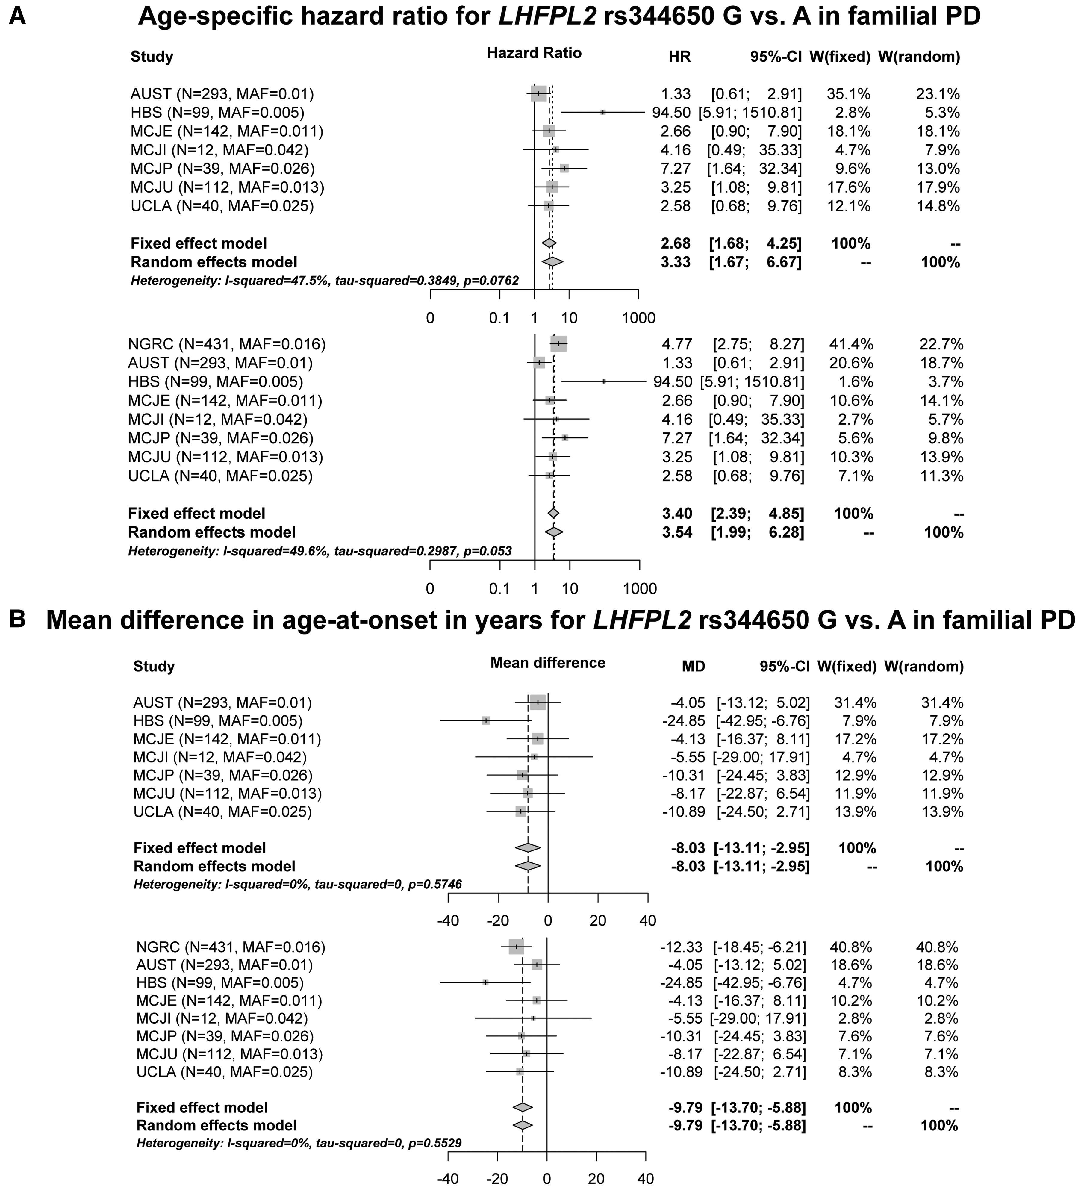
Figure 3. Replication results for rs344650 in LHFPL2 in familial PD. In the replication datasets, excluding NGRC ...
Notes:
Figure 3. Replication results for rs344650 in LHFPL2 in familial PD. In the replication datasets, excluding NGRC dataset (GWAS), the rs344650_G allele was associated with more than two-fold higher age-specific hazard ratio (HR) and approximately 8 years earlier onset than rs344650_A allele. (A). HR were generated using Cox regression, with Firth’s Penalized correction for datasets with 6 or fewer observations. The forest plot depicts the HR with SE for each dataset individually, and combined using Fixed and Random Effects meta-analysis. (B) Mean differences in age-at-onset were calculated using linear regression. Additive models were used (estimates are per allele). Each panel shows the replication datasets only on top, followed by NGRC plus replication datasets. W: weight of each dataset in meta-analysis under fixed or random effects model.
Unless provided in the caption above, the following copyright applies to the content of this slide: © The Author 2016. Published by Oxford University Press.This is an Open Access article distributed under the terms of the Creative Commons Attribution Non-Commercial License (http://creativecommons.org/licenses/by-nc/4.0/), which permits non-commercial re-use, distribution, and reproduction in any medium, provided the original work is properly cited. For commercial re-use, please contact journals.permissions@oup.com

Slide 4
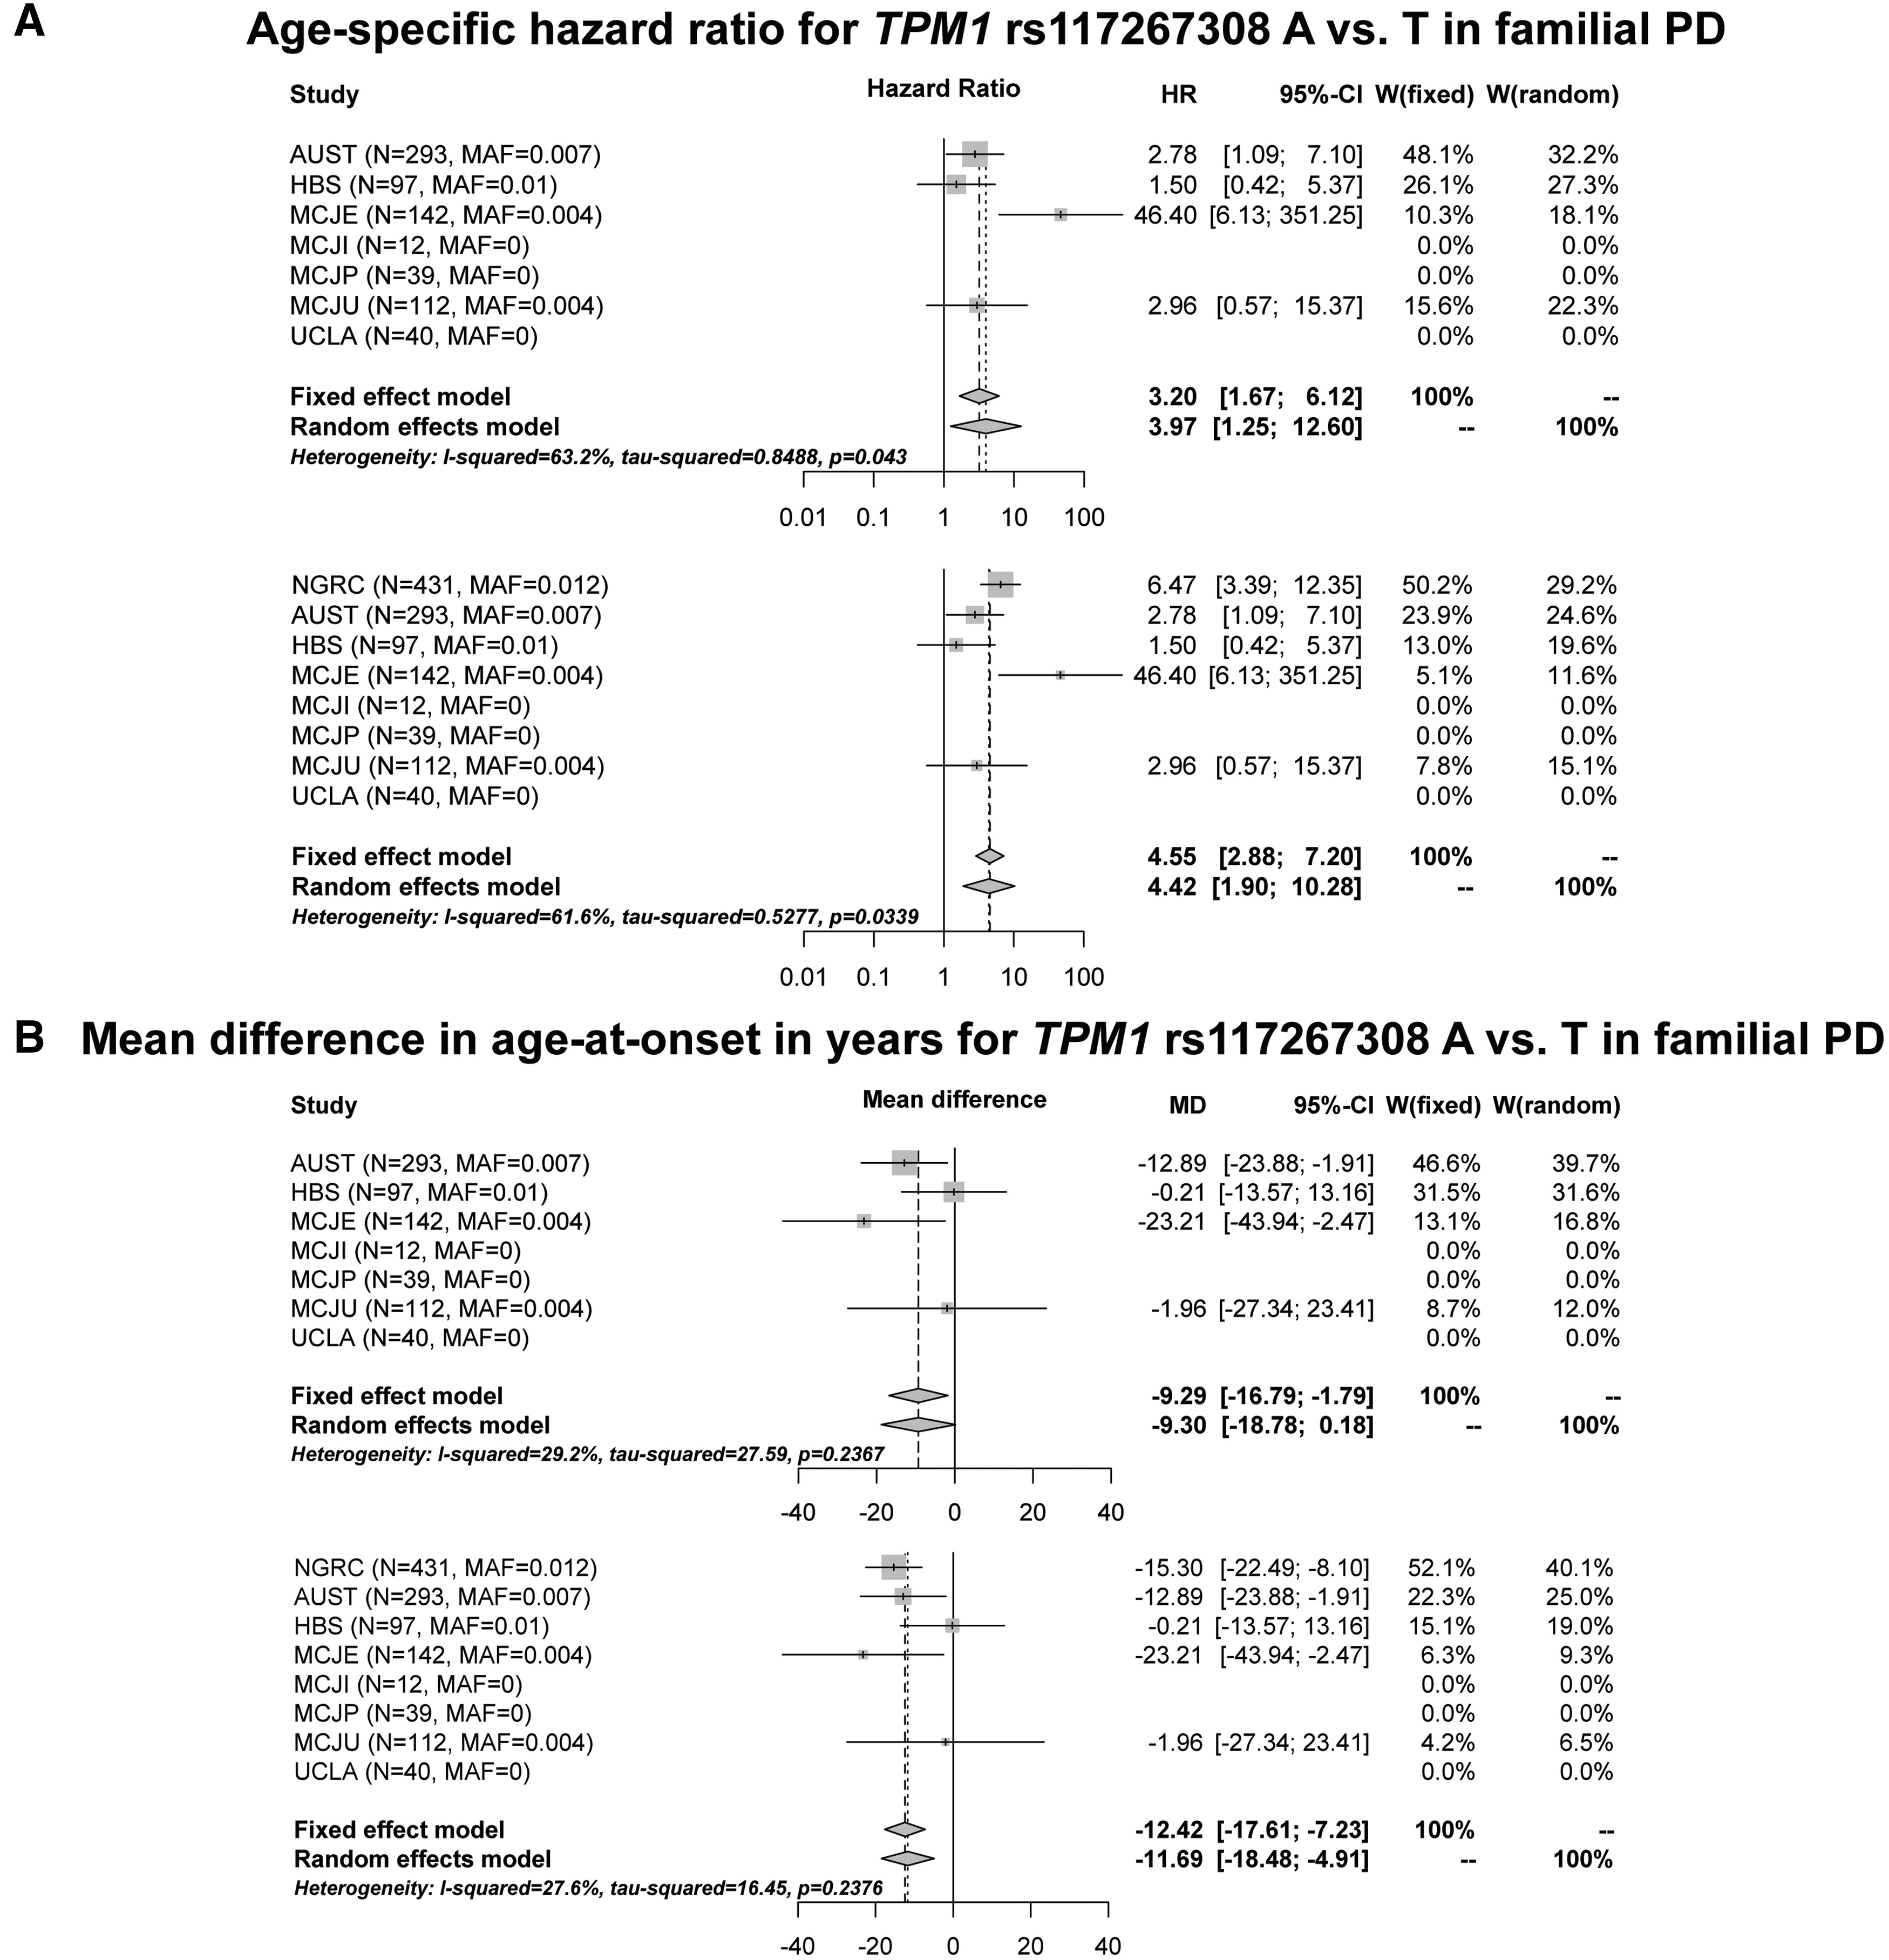
Figure 4. Replication results for rs117267308 in TPM1 in familial PD. In the replication datasets, excluding NGRC ...
Notes:
Figure 4. Replication results for rs117267308 in TPM1 in familial PD. In the replication datasets, excluding NGRC dataset (GWAS), the rs117267308_A allele was associated with more than three-fold higher age-specific hazard ratio (HR) and approximately 9 years earlier onset than rs117267308_T allele. (A) HR were generated using Cox regression, with Firth’s Penalized correction for datasets with 6 or fewer observations. The forest plot depicts the HR with SE for each dataset individually, and combined using Fixed and Random Effects meta-analysis. (B) Mean differences in age-at-onset were calculated using linear regression. Additive models were used (estimates are per allele). Each panel shows the replication datasets only on top, followed by NGRC plus replication datasets. W: weight of each dataset in meta-analysis under fixed or random effects model.
Unless provided in the caption above, the following copyright applies to the content of this slide: © The Author 2016. Published by Oxford University Press.This is an Open Access article distributed under the terms of the Creative Commons Attribution Non-Commercial License (http://creativecommons.org/licenses/by-nc/4.0/), which permits non-commercial re-use, distribution, and reproduction in any medium, provided the original work is properly cited. For commercial re-use, please contact journals.permissions@oup.com

Slide 5
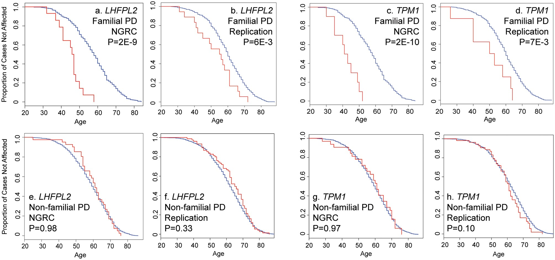
Figure 5. Kaplan-Meier plots of age-at-onset for LHFPL2 (rs344650) and TPM1 (rs117267308). Familial PD (A–D): LHFPL2 ...
Notes:
Figure 5. Kaplan-Meier plots of age-at-onset for LHFPL2 (rs344650) and TPM1 (rs117267308). Familial PD (A–D): LHFPL2 genotype and TPM1 genotype show markedly significant effects on age-at-onset of familial PD. Non-familial PD (E–H): Age at onset distributions did not vary by LHFPL2 genotype or by TPM1 genotype in non-familial PD. Kaplan-Meier survival curves are plots of age-specific cumulative probability of survival without disease. Here, survival is defined as not yet being affected with PD, the event is onset of PD, and the time of event is age-at-onset. Patients are divided by genotype (presence vs. absence of the minor allele), and cumulative disease-free survival is plotted for each group. Red: individuals with the minor allele. Blue: individuals without the minor allele.
Unless provided in the caption above, the following copyright applies to the content of this slide: © The Author 2016. Published by Oxford University Press.This is an Open Access article distributed under the terms of the Creative Commons Attribution Non-Commercial License (http://creativecommons.org/licenses/by-nc/4.0/), which permits non-commercial re-use, distribution, and reproduction in any medium, provided the original work is properly cited. For commercial re-use, please contact journals.permissions@oup.com

Slide 6
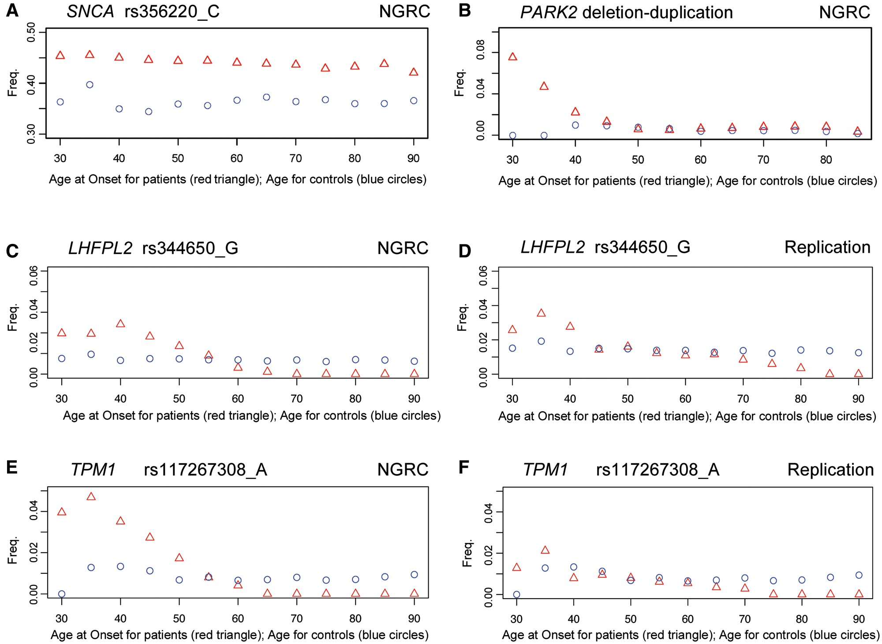
Figure 6. Moving average plots (MAP). Minor allele frequencies are plotted in a moving-average window across the age ...
Notes:
Figure 6. Moving average plots (MAP). Minor allele frequencies are plotted in a moving-average window across the age spectrum in NGRC controls (blue) and as a function of age-at-onset in patients (red). For the description of the MAP method see (38). Data are shown for the LHFPL2 rs344650_G allele and the TPM1 rs117267308_A allele, as well as for two well-established PD loci for the purpose of demonstration: SNCA rs356220, which is associated with risk in all PD (A), and PARK2 deletion/duplication, which is associated with risk of early-onset PD. (B) The MAP of SNCA rs356220 demonstrates the expected pattern for a variant that is associated with increased risk ubiquitously: allele frequency is higher in patients and parallels the control frequency, always staying higher, with no variation with age or age-at-onset. The plot for PARK2 is the signature pattern for variants that are associated with the risk of early-onset disease: allele frequency in patients is the highest in early-onset cases and decreases with increasing age-at-onset until it reaches the control frequency when it stops declining and remains superimposed on controls. LHFPL2 rs344650 has the signature pattern for an age-at-onset modifier in familial PD (C,D): accelerated onset in rs344650_G carriers causes the allele frequency to be highest in early-onset cases, decrease with increasing ages-at-onset, cross the control frequency and continue to drop below the control frequency – yet overall, rs344650_G frequency in all patients is the same as in controls. TPM1 rs117267308 exhibited a similar pattern consistent with an age-at onset modifier in familial PD (E,F).
Unless provided in the caption above, the following copyright applies to the content of this slide: © The Author 2016. Published by Oxford University Press.This is an Open Access article distributed under the terms of the Creative Commons Attribution Non-Commercial License (http://creativecommons.org/licenses/by-nc/4.0/), which permits non-commercial re-use, distribution, and reproduction in any medium, provided the original work is properly cited. For commercial re-use, please contact journals.permissions@oup.com

Slide 7
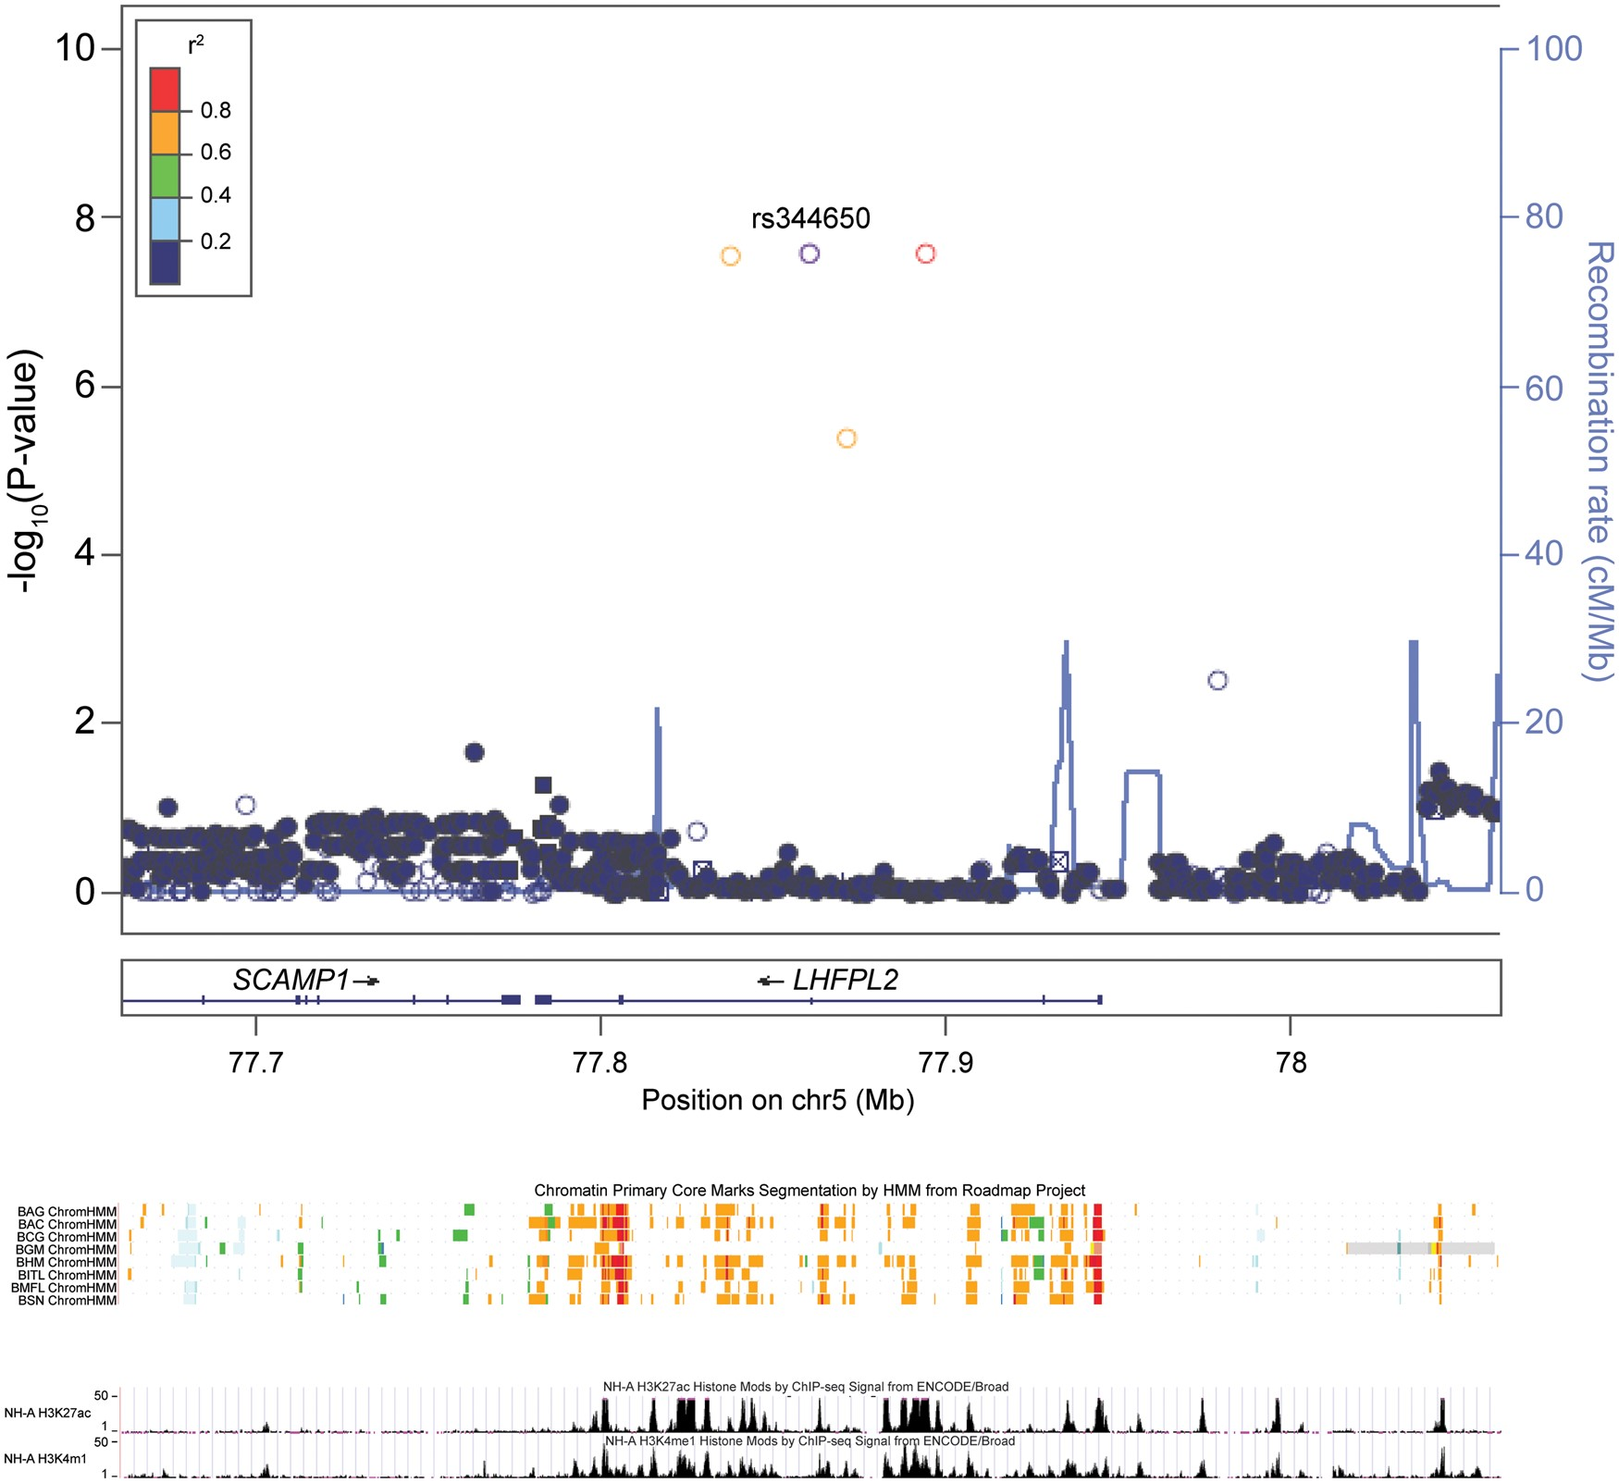
Figure 7. Alignment of LHFPL2 variants with regulatory markers. Shown is a 400 kb segment of DNA surrounding the ...
Notes:
Figure 7. Alignment of LHFPL2 variants with regulatory markers. Shown is a 400 kb segment of DNA surrounding the variants that associate with age-at-onset of PD in the LHFPL2 region (rs344650 ± 200kb; chr5: 77,660,608–78,060,608, genome build 37). The box on top was generated using LocusZoom and shows the SNPs with their associated P-values (left Y-axis) and their positions on the chromosome (X-axis). rs344650 is shown in purple. LD (r2) was calculated in relation to rs344650. The colors denote the strength of LD. The top four SNPs shown in purple, red, and orange are all in the same intron. The next section is from the Roadmap Epigenomics Project and shows regulatory marks (orange=enhancers and red=transcription start sites) predicted by ChromHMM, with each line representing a different brain tissue that was analyzed (BAG=brain angular gyrus; BAC=brain anterior caudate; BCG=brain cingulate gyrus; BGM=brain germinal matrix; BHM=brain hippocampus middle; BITL=brain inferior temporal lobe; BMFL=brain mid frontal lobe; BSN=brain substantia nigra). The bottom panel is from ENCODE and shows histone acetylation and methylation marks (black) in brain cells (NH-A cell line).
Unless provided in the caption above, the following copyright applies to the content of this slide: © The Author 2016. Published by Oxford University Press.This is an Open Access article distributed under the terms of the Creative Commons Attribution Non-Commercial License (http://creativecommons.org/licenses/by-nc/4.0/), which permits non-commercial re-use, distribution, and reproduction in any medium, provided the original work is properly cited. For commercial re-use, please contact journals.permissions@oup.com

Slide 8
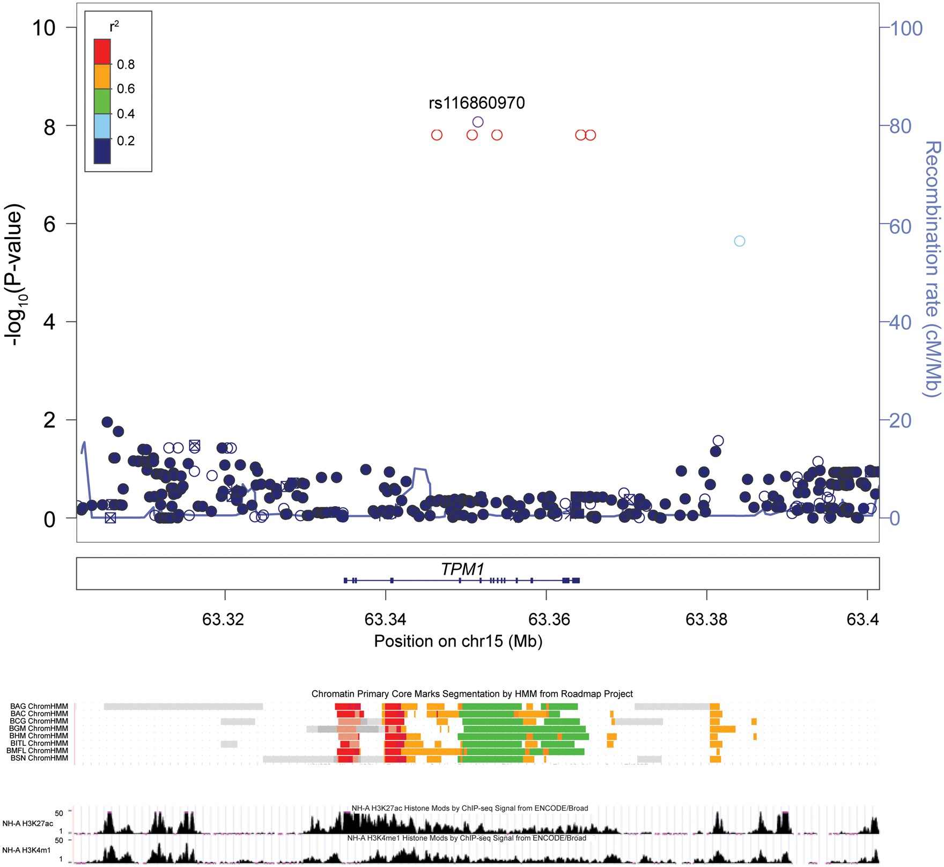
Figure 8. Alignment of TPM1 variants with regulatory markers. Shown is a 100 kb segment of DNA surrounding the variants ...
Notes:
Figure 8. Alignment of TPM1 variants with regulatory markers. Shown is a 100 kb segment of DNA surrounding the variants that associate with age-at-onset of PD in the TPM1 region (rs116860970 ± 50kb; chr15: 63,301,500–63,401,500, genome build 37). The box on top was generated using LocusZoom and shows the SNPs with their associated P-values (left Y-axis) and their positions on the chromosome (X-axis). rs116860970 is shown in purple. LD (r2) was calculated in relation to rs116860970. The colors denote the strength of LD. The top SNPs shown in purple and red span from Intron 3 to 3’ of TPM1. The next section is from the Roadmap Epigenomics Project and shows regulatory marks (orange=enhancers, red=transcription start sites, and green=transcribed regions) predicted by ChromHMM, with each line representing a different brain tissue that was analyzed (BAG=brain angular gyrus; BAC=brain anterior caudate; BCG=brain cingulate gyrus; BGM=brain germinal matrix; BHM=brain hippocampus middle; BITL=brain inferior temporal lobe; BMFL=brain mid frontal lobe; BSN=brain substantia nigra). The bottom panel is from ENCODE and shows histone acetylation and methylation marks (black) in brain cells (NH-A cell line).
Unless provided in the caption above, the following copyright applies to the content of this slide: © The Author 2016. Published by Oxford University Press.This is an Open Access article distributed under the terms of the Creative Commons Attribution Non-Commercial License (http://creativecommons.org/licenses/by-nc/4.0/), which permits non-commercial re-use, distribution, and reproduction in any medium, provided the original work is properly cited. For commercial re-use, please contact journals.permissions@oup.com

