Slide 1
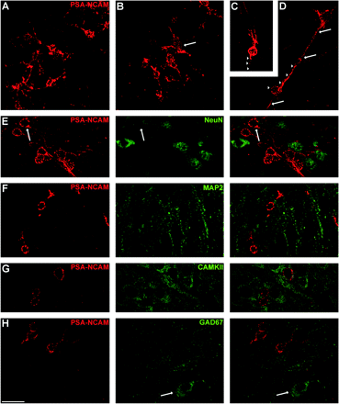
Figure 1. Confocal microscopic analysis of PSA-NCAM immunoreactive cells in the paleocortex layer II. (A) PSA-NCAM ...
Notes:
Figure 1. Confocal microscopic analysis of PSA-NCAM immunoreactive cells in the paleocortex layer II. (A) PSA-NCAM immunohistochemistry in the piriform cortex layer II. Note the high density of tangled cells. (B) PSA-NCAM immunohistochemistry in the entorhinal cortex layer II. A semilunar–pyramidal transition neuron can be observed (arrow) among the abundant smaller tangled cells. (C) Example of a PSA-NCAM immunolabeled semilunar cell displaying a basal process resembling an axon (arrowhead). (D) Detail of an inverted pyramidal PSA-NCAM immunoreactive cell. Note its single process directed to layer III (arrows), to which another PSA-NCAM expressing cell is attached (arrowheads). (E) Most PSA-NCAM immunoreactive tangled cells lack NeuN expression in their nuclei. However, some of these cells display faint NeuN expression in their nuclei (arrow). (F) PSA-NCAM expressing cells lacking MAP2 expression in their somata and dendrites. (G) PSA-NCAM expressing cells lacking CAMKII expression. (H) PSA-NCAM expressing cells lacking GAD67 expression in their somata. Note a GAD67 positive cell (arrow) which lacks PSA-NCAM expression. All the images in this figure are taken from unique confocal planes, except (C) and (D), which are 2D projections of reconstructions of 3 consecutive confocal planes located 1 μm apart. Scale bar: 20 μm. NeuN: neuronal nuclear antigen; MAP2: microtubule associated protein2; CAMKII: Ca2+/calmodulin dependent protein kinase II.
Unless provided in the caption above, the following copyright applies to the content of this slide: © The Author 2008. Published by Oxford University Press. All rights reserved. For permissions, please e-mail: journals.permissions@oxfordjournals.org

Slide 2
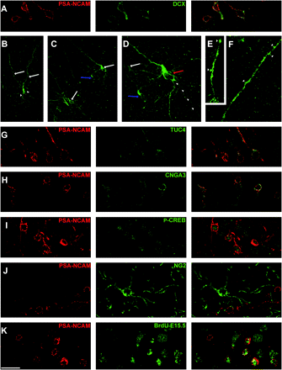
Figure 2. Confocal microscopic analysis of PSA-NCAM immunoreactive cells in the paleocortex layer II. (A) Cells ...
Notes:
Figure 2. Confocal microscopic analysis of PSA-NCAM immunoreactive cells in the paleocortex layer II. (A) Cells coexpressing PSA-NCAM and DCX. (B–F) DCX expressing cells in the paleocortex layer II. (B) Typical semilunar–pyramidal transitional neuron. Observe the 2 apical dendrites (arrows) and the presence of a basal dendritic tree (arrowheads). (C) A couple of semilunar–pyramidal transition neurons (white arrows) in entorhinal cortex layer II. The blue arrow points to a tangled cell showing some characteristics of a semilunar neuron, such as the presence of 2 apical dendrites. (D) Detailed view of the cells shown on the right side of Fig. 3C. Note the presence of thick basal processes resembling dendrites and a thin process resembling an axon (arrowheads). Two typical tangled cells can be observed, one of them closely apposed to the semilunar–pyramidal transition neuron (red arrow) and the other located in the left margin of the figure (white arrow). (E, F) Entorhinal cortex layer I. High magnification view of dendritic processes from semilunar–pyramidal transition neurons. Observe the presence of several swellings, and protrusions resembling dendritic spines (arrowheads). (G) PSA-NCAM/TUC-4 immunoreactive cells. (H) Cells coexpressing PSA-NCAM and CNGA-3. (I) PSA-NCAM expressing cells displaying p-CREB expression in their nuclei. (J) Double PSA-NCAM/NG2 immunohistochemistry. Observe the absence of NG2 immunoreactivity in PSA-NCAM expressing cells. Some NG2 expressing processes can be observed in close apposition to PSA-NCAM expressing cell somata. (K) PSA-NCAM expressing cells containing BrdU immunoreactive nuclei in the piriform cortex of an adult rat injected with BrdU at E15.5. (B), (C), (D), (E), and (F) are 2D projections of reconstructions of 3 (B–D) or 2 (A, B) focal planes located 1 μm apart. Scale bar: 20 μm for (A–D) and (G–J). 10 μm for (E) and (F). DCX: doublecortin (C-18); TUC-4 (TOAD64 [Turned On After Division]/Ulip/CRMP); p-CREB: phospho-CREB (Ser133).
Unless provided in the caption above, the following copyright applies to the content of this slide: © The Author 2008. Published by Oxford University Press. All rights reserved. For permissions, please e-mail: journals.permissions@oxfordjournals.org

Slide 3
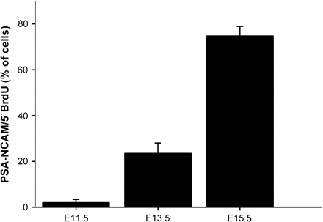
Figure 3. Graph representing the percentage of PSA-NCAM/5′BrdU double-labeled cells in the adult rats which received ...
Notes:
Figure 3. Graph representing the percentage of PSA-NCAM/5′BrdU double-labeled cells in the adult rats which received BrdU at E11.5, E13.5, and E15.5, respectively.
Unless provided in the caption above, the following copyright applies to the content of this slide: © The Author 2008. Published by Oxford University Press. All rights reserved. For permissions, please e-mail: journals.permissions@oxfordjournals.org

Slide 4
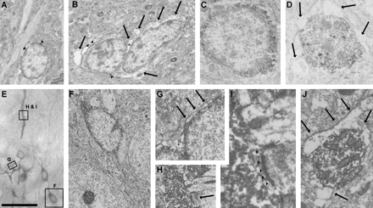
Figure 4. Electron micrographs of PSA-NCAM– (A, B), TUC-4– (C, D), and CNGA-3–immunolabeled cells (E–I) of the ...
Notes:
Figure 4. Electron micrographs of PSA-NCAM– (A, B), TUC-4– (C, D), and CNGA-3–immunolabeled cells (E–I) of the paleocortex layer II. (A, B) Somata of PSA-NCAM expressing cells. The couple of cells in panel B are intimately associated. PSA-NCAM immunoreactivity is especially abundant in certain regions associated with the plasma membrane (arrowheads). Note the presence of clear structures surrounding the labeled somata (arrows), corresponding to astroglial lamellae and swellings of the extracellular space (asterisk). Several heterochromatin clumps can be observed inside the nuclei of the labeled cells. (C) Soma of a TUC-4 expressing cell showing an intensely labeled cytoplasm and a nucleus displaying abundant heterochromatin. (D) Transversal section of a proximal process from a TUC-4 expressing cell. Some mitochondria and cisternae can be observed inside the immunoreactive cytoplasm. Note that this process is also surrounded by clear structures resembling astroglial lamellae (arrows). (E) View of the resin-embedded section from which the ultrathin sections shown in (F–I; squared areas) were obtained. (F) CNGA-3 immunoreactive cell surrounded by 2 unlabeled somata, probably corresponding to pyramidal neurons. (G) Detail of a couple of closely apposed tangled cells, in which the 2 nuclei, as well as the labeled cytoplasms, can be discerned. Note the presence of a swelling of the extracellular space (asterisk) and an astroglial lamella located closely to the plasma membrane (arrows). (H) Asymmetric synaptic contact (arrow) onto a CNGA-3 immunoreactive dendrite in layer I, corresponding to a semilunar–pyramidal transition neuron. (I) Detailed view of the synaptic contact (arrowheads) shown in (H). (J) Transversal section of a proximal process from a CNGA-3 immunoreactive cell surrounded by astroglial lamellae (arrows). Scale bar: 5 μm for (A), (B), and (F); 2.5 μm for (C) and (G); 1 μm for (D); 50 μm for (E); 1.5 μm for (H), 0.37 μm for (I) and (J). TUC-4 (TOAD64 [Turned On After Division]/Ulip/CRMP).
Unless provided in the caption above, the following copyright applies to the content of this slide: © The Author 2008. Published by Oxford University Press. All rights reserved. For permissions, please e-mail: journals.permissions@oxfordjournals.org

Slide 5
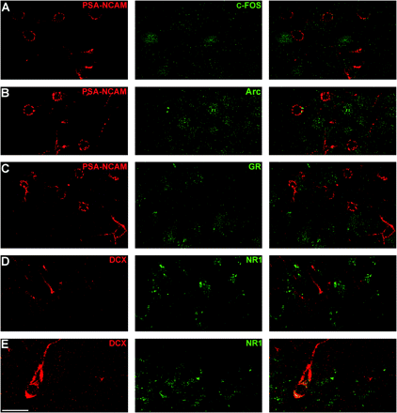
Figure 5. Confocal microscopic analysis of different markers on PSA-NCAM and DCX expressing cells in the paleocortex ...
Notes:
Figure 5. Confocal microscopic analysis of different markers on PSA-NCAM and DCX expressing cells in the paleocortex layer II. (A) PSA-NCAM expressing cells lacking c-Fos expression in their nuclei. (B) PSA-NCAM expressing cells lacking Arc expression in their nuclei. (C) PSA-NCAM immunoreactive cells lacking GR expression in their nuclei. (D) DCX expressing tangled cell lacking NR1 expression. (E) DCX expressing semilunar neuron expressing NR1 in its somata and proximal apical dendrite. All photographs in this figure correspond to single optical sections taken from z-stacks. Scale bar: 20 μm. Arc: activity-regulated cytoskeleton-associated protein.
Unless provided in the caption above, the following copyright applies to the content of this slide: © The Author 2008. Published by Oxford University Press. All rights reserved. For permissions, please e-mail: journals.permissions@oxfordjournals.org

