Slide 1
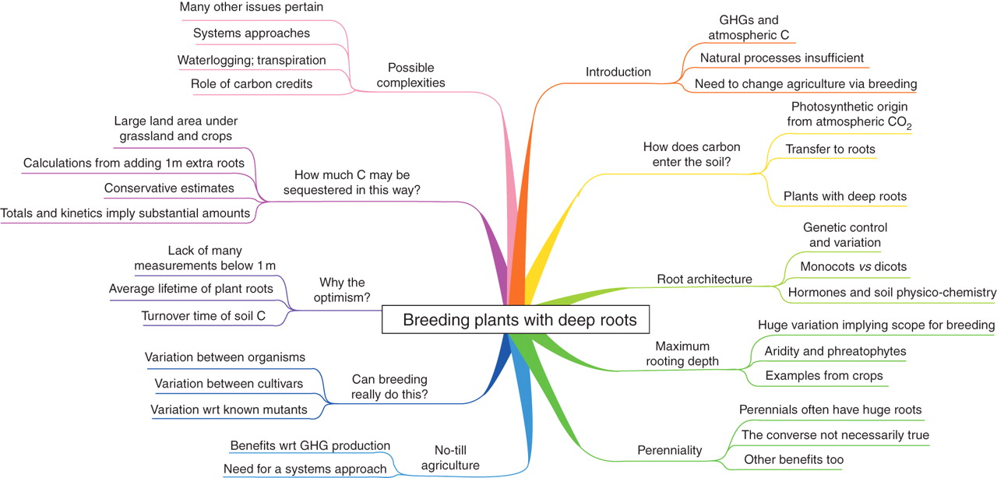
Fig 1. A mind map (Buzan, 2002) summarizing the content of this review. To interpret this, start at the top and read ...
Notes:
Fig 1. A mind map (Buzan, 2002) summarizing the content of this review. To interpret this, start at the top and read clockwise.
Unless provided in the caption above, the following copyright applies to the content of this slide: © The Author 2011. Published by Oxford University Press on behalf of the Annals of Botany Company. All rights reserved. For Permissions, please email: journals.permissions@oup.com

Slide 2
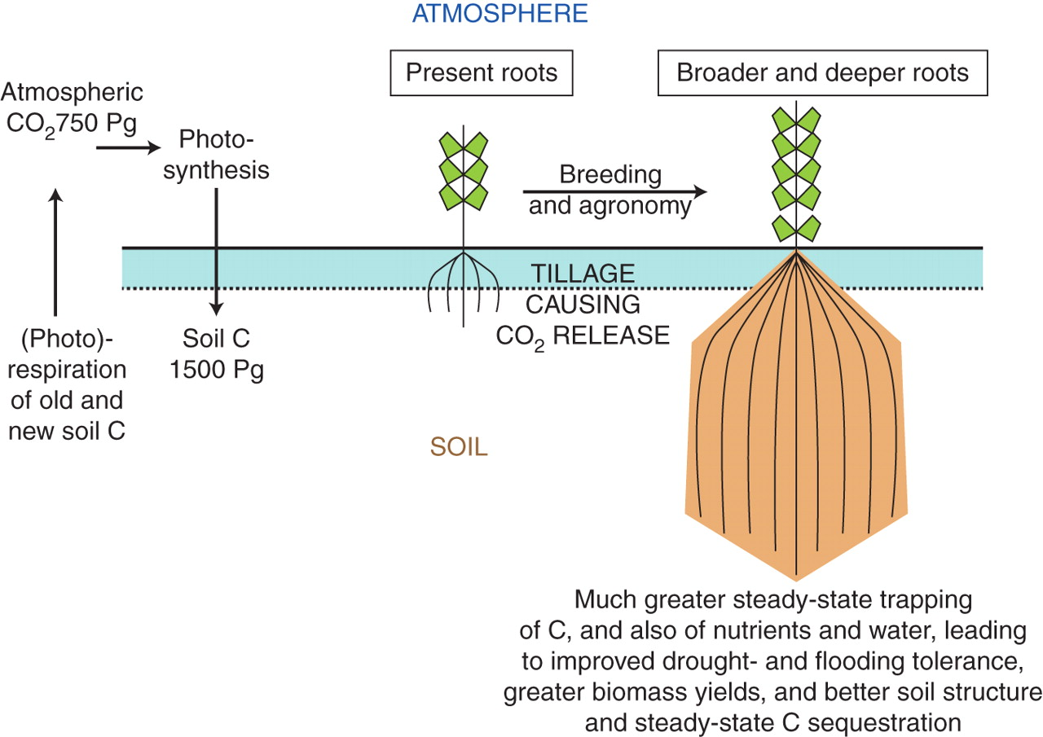
Fig. 2. Cartoon illustration of the potential for the improvement of agricultural and ecological traits by breeding ...
Notes:
Fig. 2. Cartoon illustration of the potential for the improvement of agricultural and ecological traits by breeding crop plants with large root systems. The root morphologies are to be considered as illustrative only, and all details of bidirectional fluxes to and from litter and the many soil carbon pools (and including leaching and erosion) are omitted for clarity. For a summary of the various terms used to describe the most important carbon fluxes and stocks see, for example, Chapin et al. (2006) and Smith et al. (2010b).
Unless provided in the caption above, the following copyright applies to the content of this slide: © The Author 2011. Published by Oxford University Press on behalf of the Annals of Botany Company. All rights reserved. For Permissions, please email: journals.permissions@oup.com

