Slide 1
Figure 1. (A) Activation of a direct (e.g., monosynaptic) pathway projecting from premotor cortex (PMC) onto CSN ...
Notes:
Figure 1. (A) Activation of a direct (e.g., monosynaptic) pathway projecting from premotor cortex (PMC) onto CSN situated in primary motor cortex (M1) by AP-TMS, resulting in short onset latency MEPs. In contrast, short latency MEPs induced by PA-TMS are thought to result from trans-synaptic activation of CSN within M1 (modified from Lemon 2008). (B) Longer onset latencies following AP-TMS might be due to the stimulation of indirect (e.g., polysynaptic) pathways from PMC onto CSNs. Individual recruitment may arise from preactivation-dependent differences in excitability between direct and indirect pathways.
Unless provided in the caption above, the following copyright applies to the content of this slide: © The Author 2014. Published by Oxford University Press. All rights reserved. For Permissions, please e-mail: journals.permissions@oup.com

Slide 2
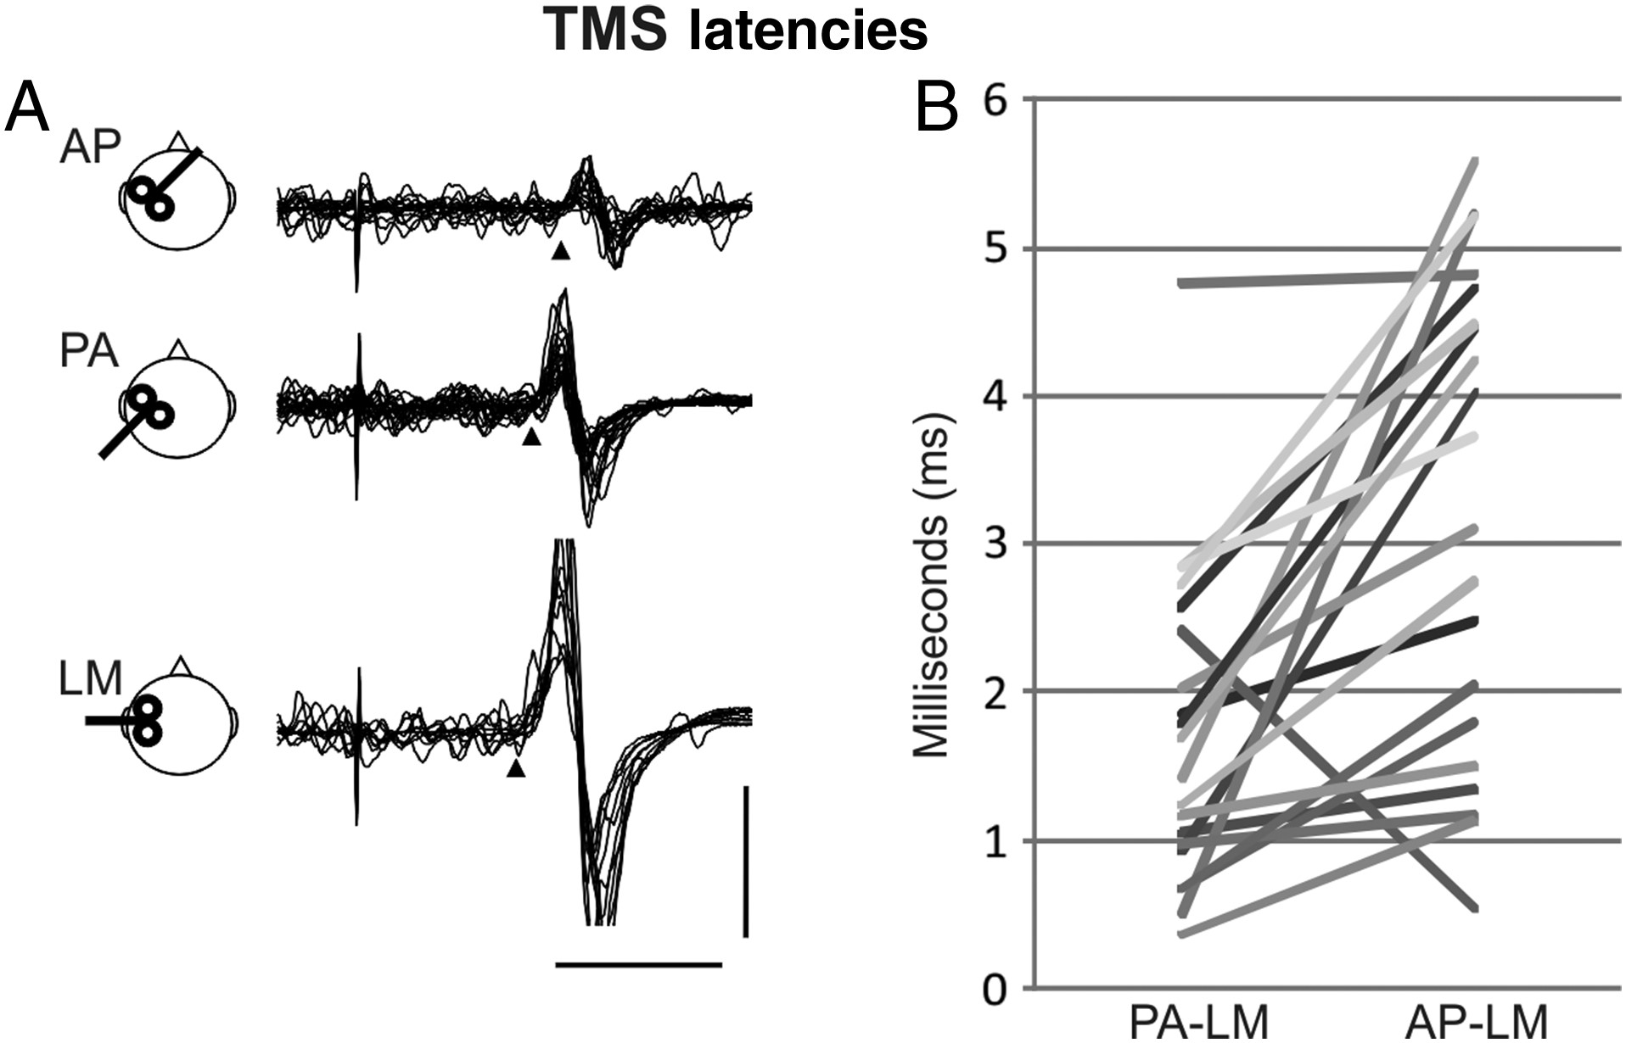
Figure 2. (A) Schematic representation of coil orientations and typical example of MEPs during constant contraction of ...
Notes:
Figure 2. (A) Schematic representation of coil orientations and typical example of MEPs during constant contraction of the TMS target muscle (FDI). Arrow indicates the timing of TMS and arrow head indicates the onset of MEPs. Calibration bars, 1 mV, 20 ms. (B) Group results of TMS PA-LM and AP-LM latency differences from 20 subjects.
Unless provided in the caption above, the following copyright applies to the content of this slide: © The Author 2014. Published by Oxford University Press. All rights reserved. For Permissions, please e-mail: journals.permissions@oup.com

Slide 3
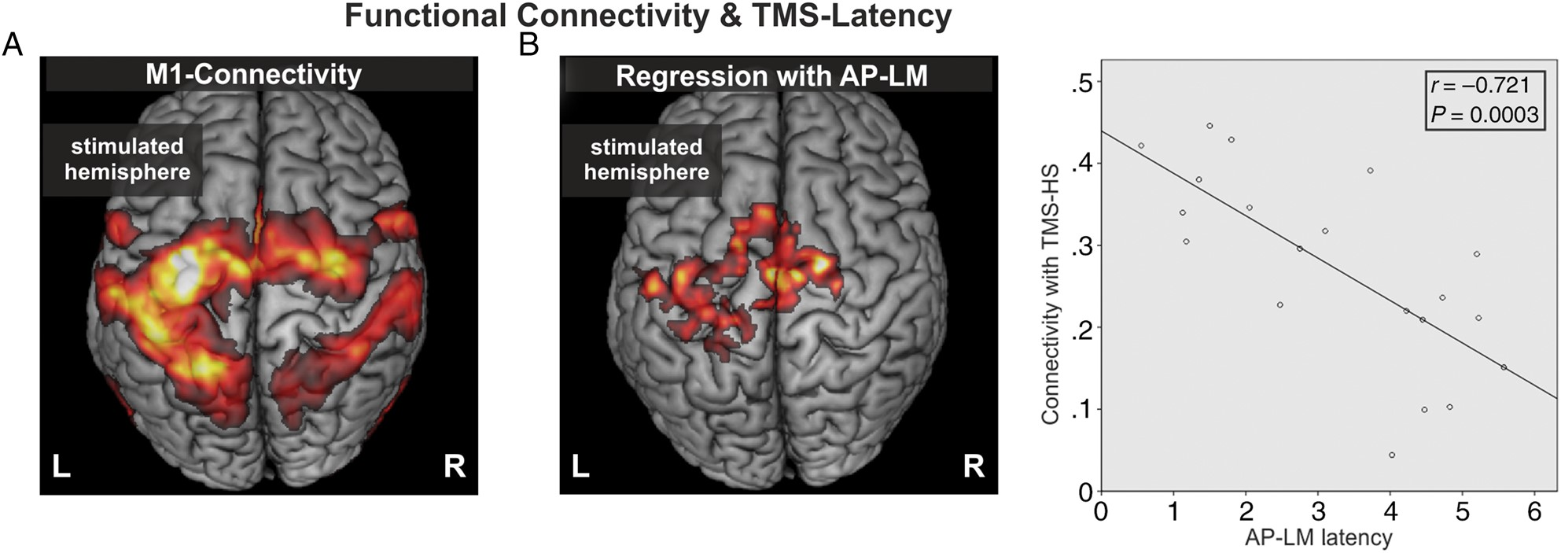
Figure 3. (A) Group functional connectivity of M1 (TMS hotspot) during constant thumb–index-contraction (at 5% maximal ...
Notes:
Figure 3. (A) Group functional connectivity of M1 (TMS hotspot) during constant thumb–index-contraction (at 5% maximal force involving activation of the FDI muscle; P < 0.05, FWE cluster-level corrected). (B) Negative correlation of AP-LM latency and M1-connectivity. Marked areas featured strong M1-connectivity in subjects with short AP-LM latencies (P < 0.05, FWE cluster-level corrected). The scatterplot shows the significant correlation between M1-connectivity and AP-LM latency obtained from the cluster in (B).
Unless provided in the caption above, the following copyright applies to the content of this slide: © The Author 2014. Published by Oxford University Press. All rights reserved. For Permissions, please e-mail: journals.permissions@oup.com

