Slide 1
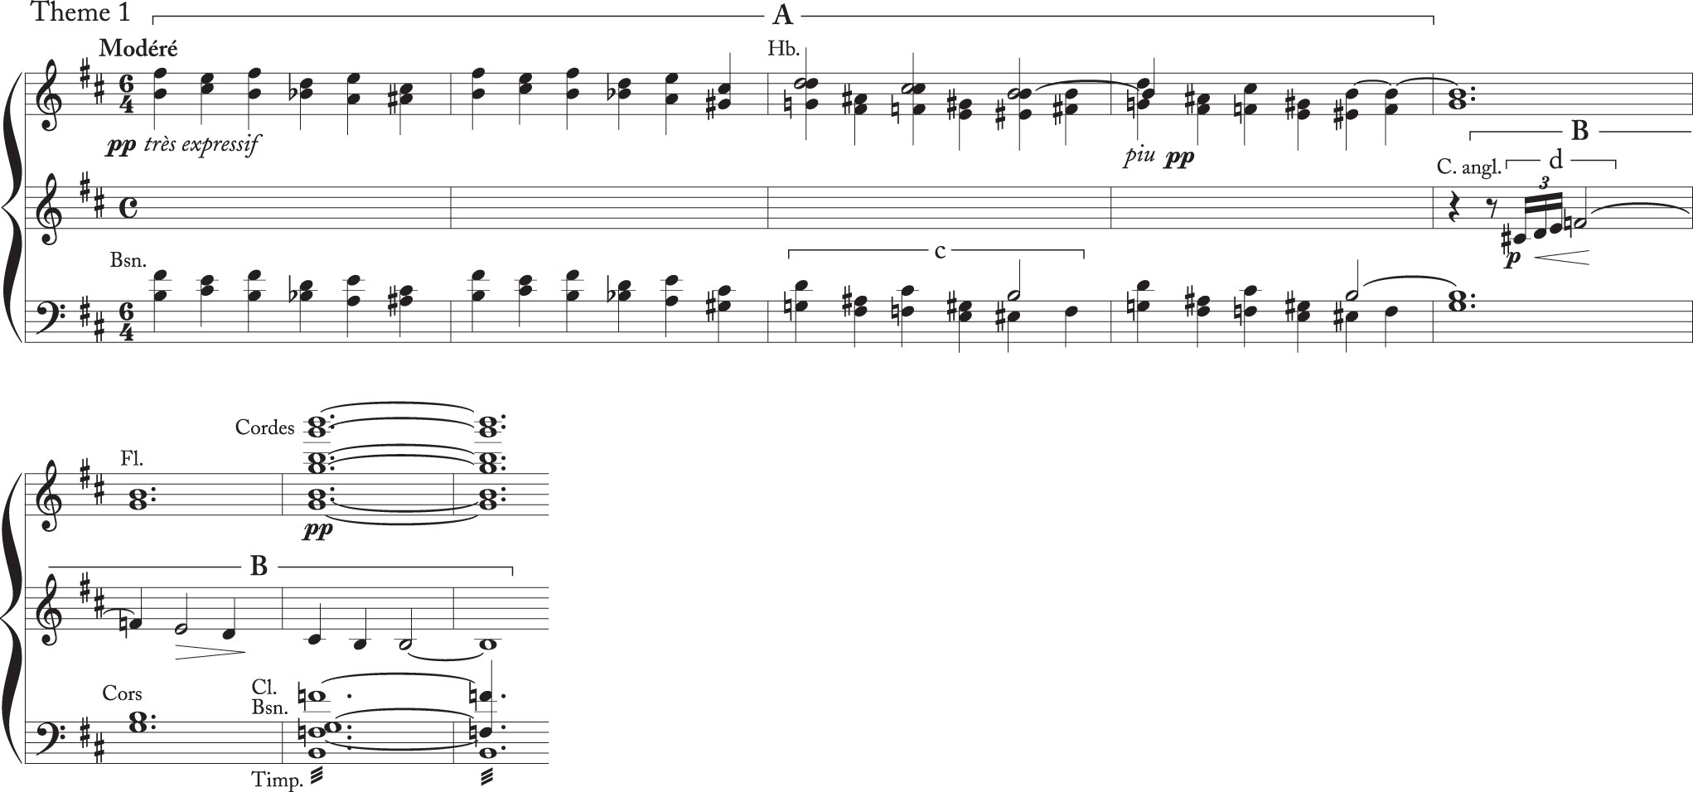
Example 1. Claude Debussy, Nocturnes I. “Nuages,” mm. 1–8. Reduction as it appears in Marnold (1902a, 69).
Notes:
Example 1. Claude Debussy, Nocturnes I. “Nuages,” mm. 1–8. Reduction as it appears in Marnold (1902a, 69).
Unless provided in the caption above, the following copyright applies to the content of this slide: © The Author 2016. Published by Oxford University Press on behalf of The Society for Music Theory. All rights reserved. For permissions, please e-mail: journals.permissions@oup.com

