Slide 1
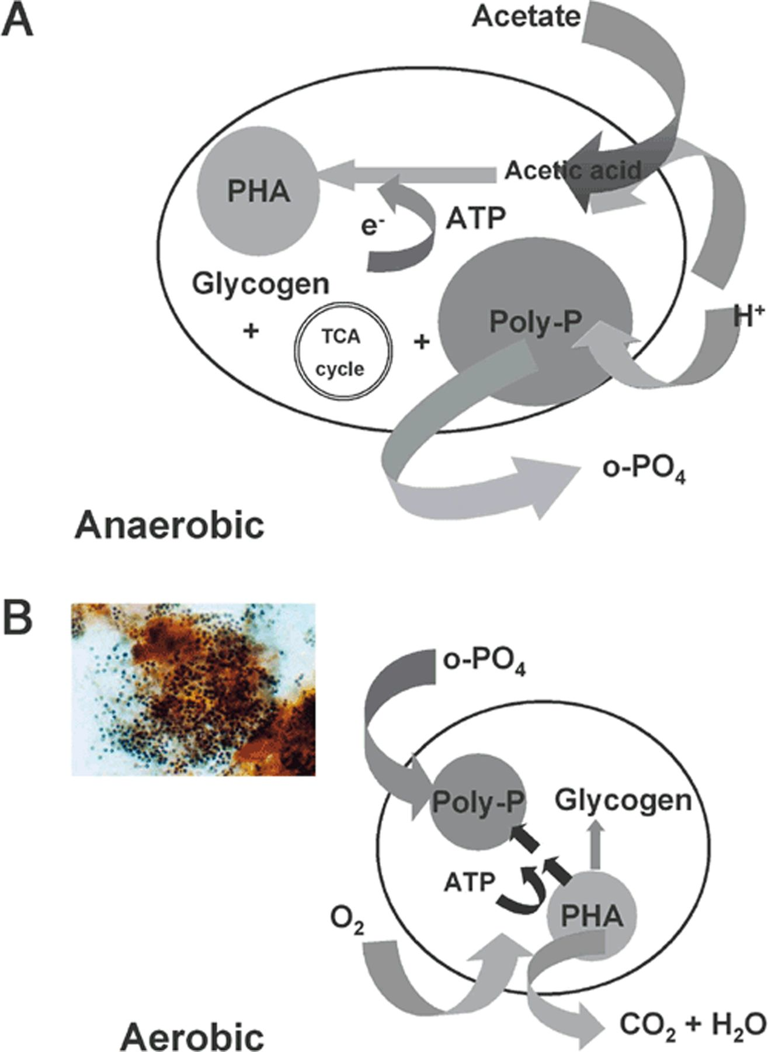
Figure 1 A summary of the major features of the biochemical models for EBPR. The changes thought to take place during ...
Notes:
Figure 1 A summary of the major features of the biochemical models for EBPR. The changes thought to take place during the aerobic and anaerobic stages are shown. The insert shows the characteristic microscopic appearance of the biomass taken from the aerobic zone, with clustered cells staining black with the Neisser stain for polyP.
Unless provided in the caption above, the following copyright applies to the content of this slide: © 2003 Federation of European Microbiological Societies.

Slide 2
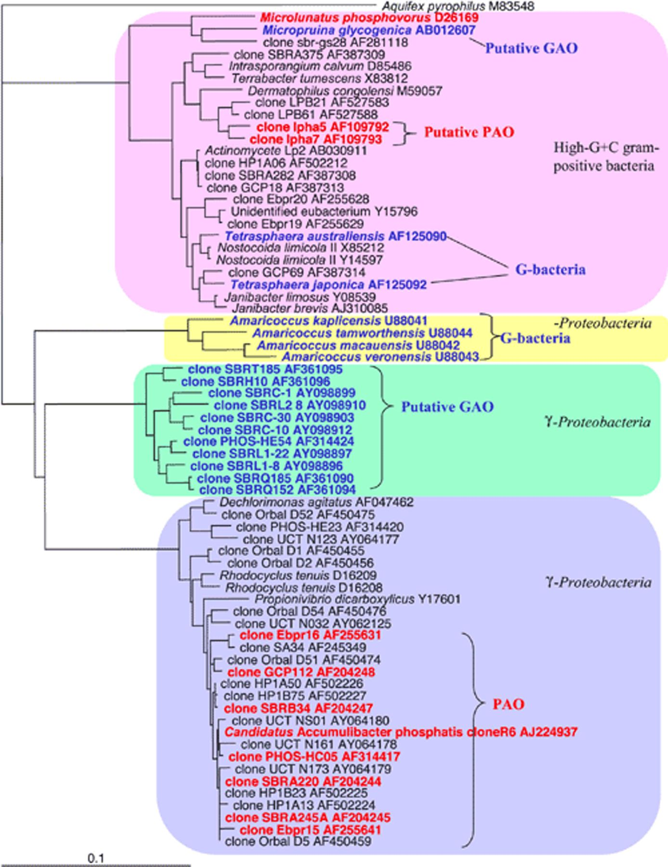
Figure 2 A tree showing the phylogenetic relationships among the putative PAO and ‘G-Bacteria’/GAO. This is based on ...
Notes:
Figure 2 A tree showing the phylogenetic relationships among the putative PAO and ‘G-Bacteria’/GAO. This is based on that given in [26]. Only sequences of more than 1400 bp are included. Red: putative PAO, Blue: ‘G-Bacteria’/GAO.
Unless provided in the caption above, the following copyright applies to the content of this slide: © 2003 Federation of European Microbiological Societies.

Slide 3
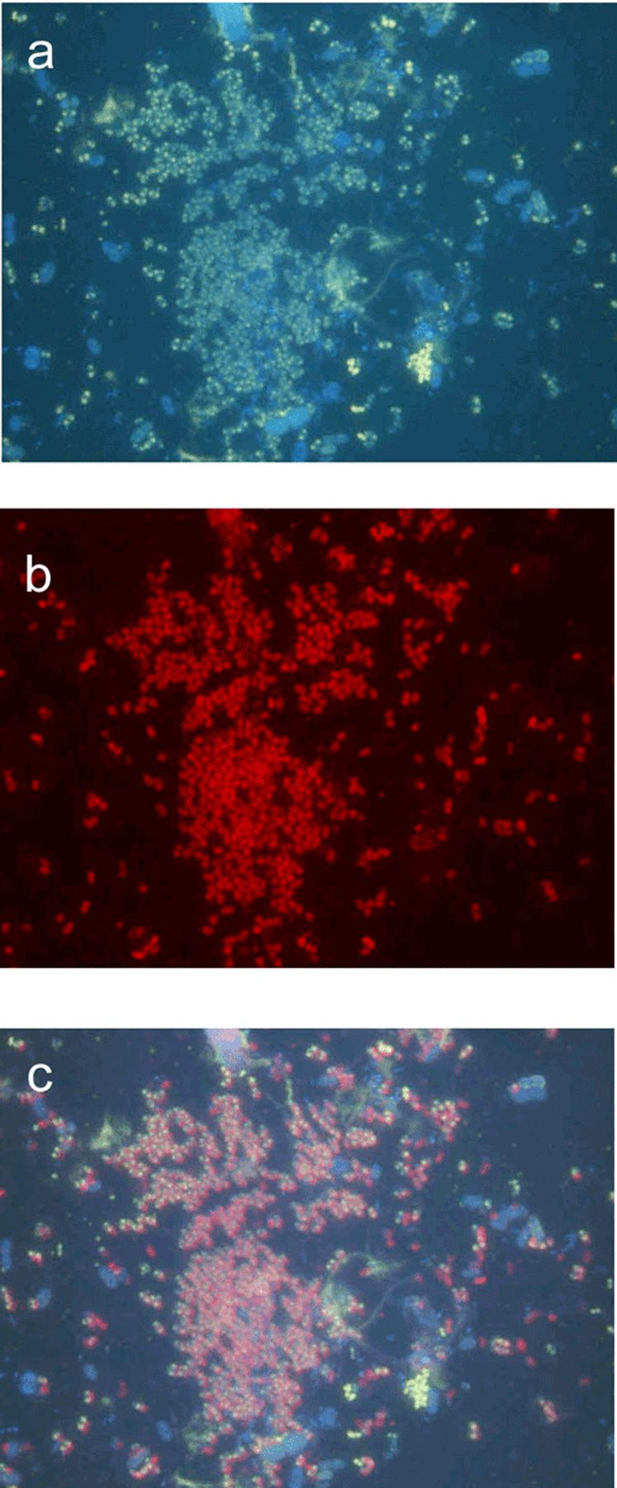
Figure 3 Fluorescence micrographs of EBPR biomass showing typically clustered cells staining positive with DAPI for ...
Notes:
Figure 3 Fluorescence micrographs of EBPR biomass showing typically clustered cells staining positive with DAPI for polyP (a), the same cells fluorescing with the PAO462 FISH probe for Rhodocyclus-related organisms (b), and a composite of the two (c) showing that the cells fluorescing with this probe are those containing polyP.
Unless provided in the caption above, the following copyright applies to the content of this slide: © 2003 Federation of European Microbiological Societies.

Slide 4
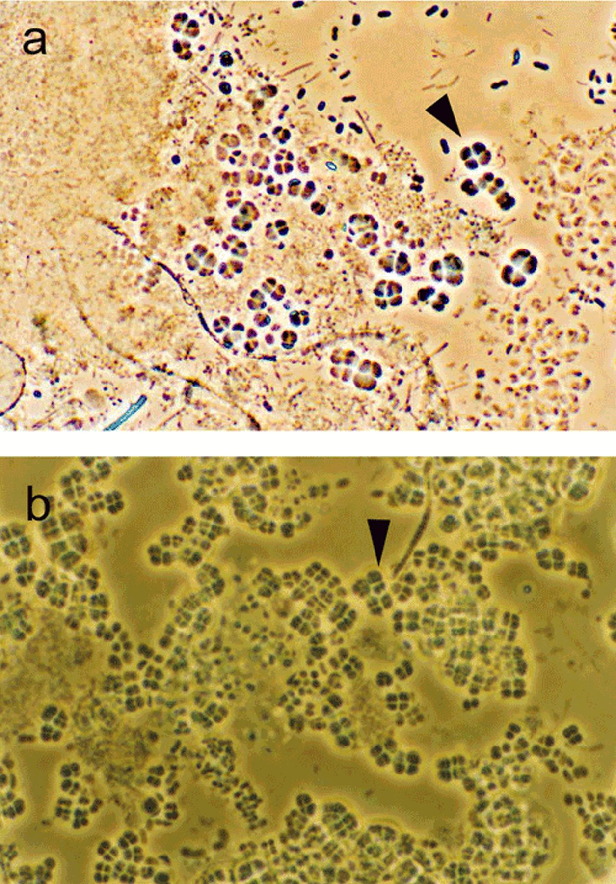
Figure 4 Light micrographs of the microscopic appearance typical of ‘G-Bacteria’/GAO in EBPR systems. a: Individual ...
Notes:
Figure 4 Light micrographs of the microscopic appearance typical of ‘G-Bacteria’/GAO in EBPR systems. a: Individual tetrads of cocci. b: Tetrads arranged in sheets.
Unless provided in the caption above, the following copyright applies to the content of this slide: © 2003 Federation of European Microbiological Societies.

