Slide 1
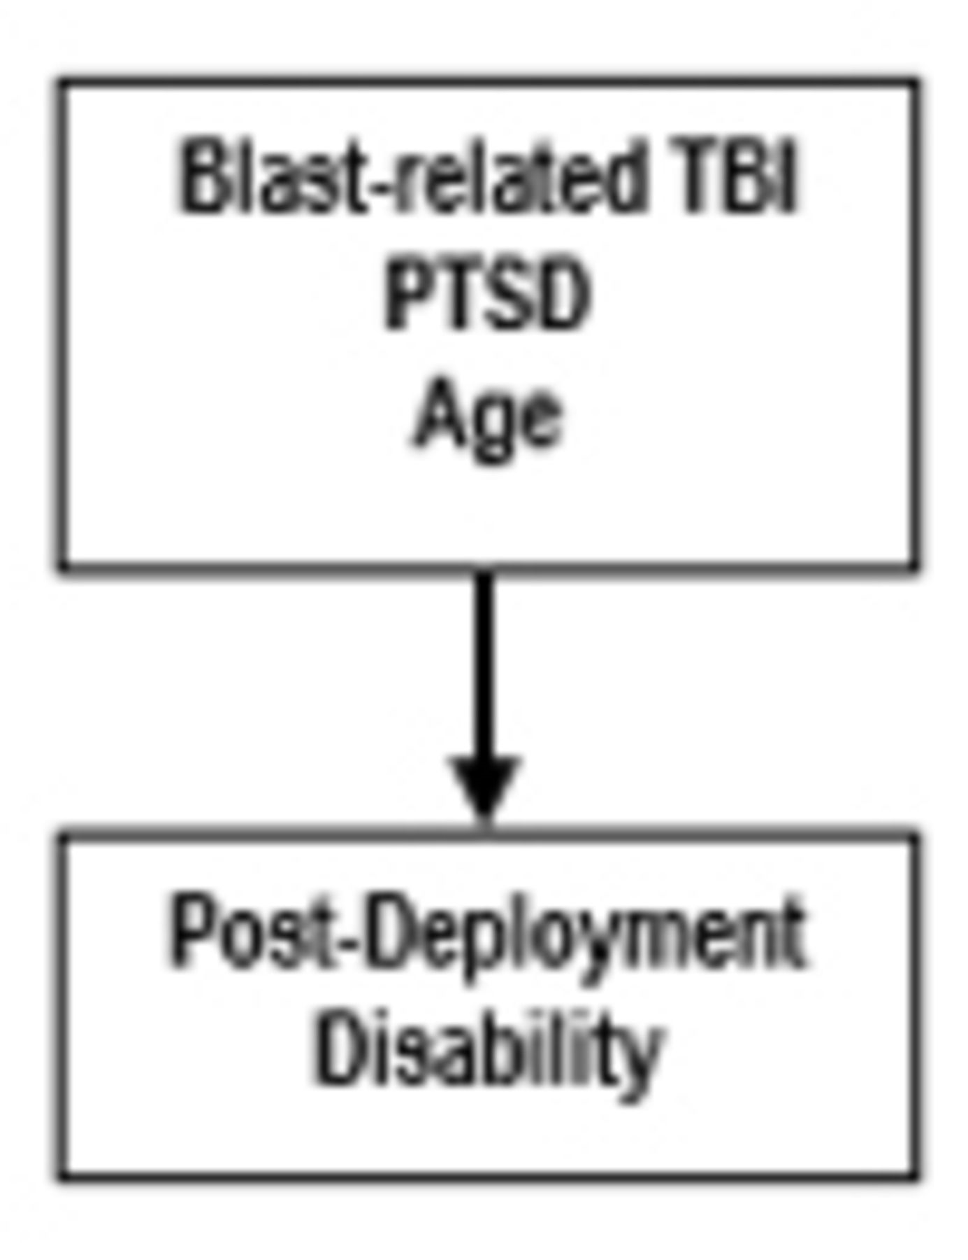
In the first such study to be conducted, Mac Donald et al. assess US military personnel 0–7 days after ...
Notes:
In the first such study to be conducted, Mac Donald et al. assess US military personnel 0–7 days after blast-related concussion in Afghanistan and 6–12 months later in the United States. Military personnel who remain on duty after concussion frequently show poor outcomes, driven largely by impaired mental health.
Unless provided in the caption above, the following copyright applies to the content of this slide: © The Author (2015). Published by Oxford University Press on behalf of the Guarantors of Brain. All rights reserved. For Permissions, please email: journals.permissions@oup.com

Slide 2
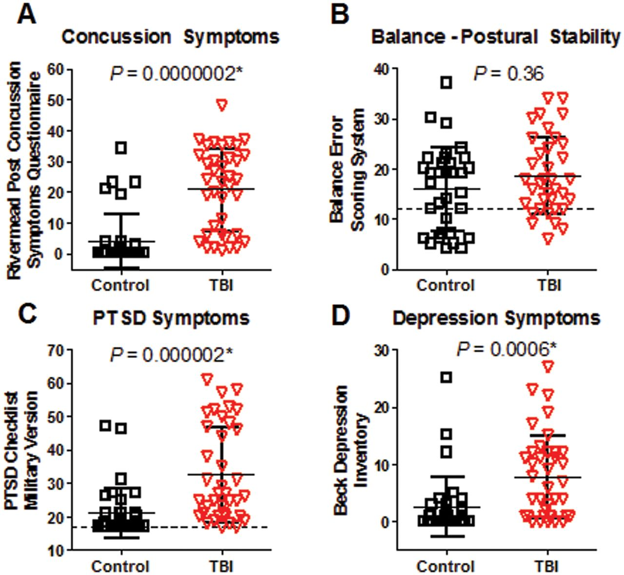
Figure 1 Initial clinical assessments indicate more severe concussion, PTSD and depression symptoms in TBI patients ...
Notes:
Figure 1 Initial clinical assessments indicate more severe concussion, PTSD and depression symptoms in TBI patients versus controls. (A) Rivermead Post-Concussion Symptoms Questionnaire (Max 64). (B) Balance Error Scoring System (Max 60), an assessment of balance and postural stability. Dashed line indicates average score of normal performance by college varsity athletes. (C) PCL-M (Max 85). Dashed line indicates minimum score of 17 on questionnaire. (D) Beck Depression Inventory (Max 63). Uncorrected P-values reported. *Significance after Bonferroni correction for multiple comparisons at *P < 0.05/4 = 0.0125.
Unless provided in the caption above, the following copyright applies to the content of this slide: © The Author (2015). Published by Oxford University Press on behalf of the Guarantors of Brain. All rights reserved. For Permissions, please email: journals.permissions@oup.com

Slide 3
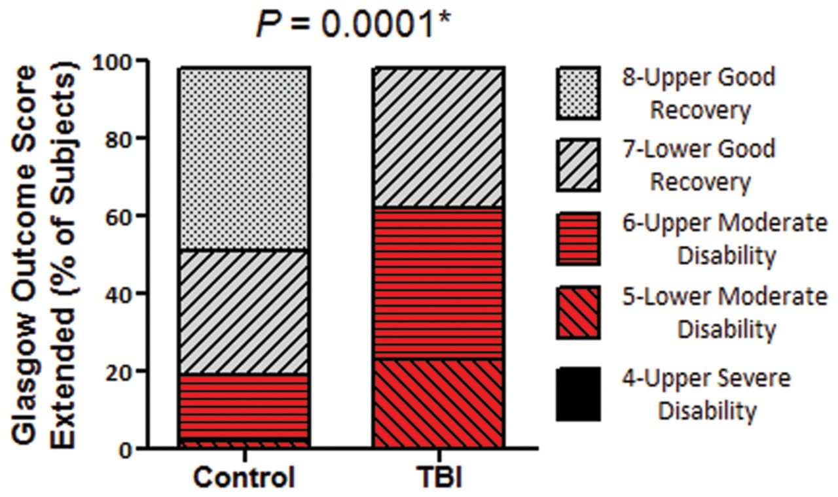
Figure 2 Global measure of outcome 6–12 months after enrolment indicate worse outcomes in TBI subjects versus ...
Notes:
Figure 2 Global measure of outcome 6–12 months after enrolment indicate worse outcomes in TBI subjects versus controls. *Mann-Whitney U-test.
Unless provided in the caption above, the following copyright applies to the content of this slide: © The Author (2015). Published by Oxford University Press on behalf of the Guarantors of Brain. All rights reserved. For Permissions, please email: journals.permissions@oup.com

Slide 4
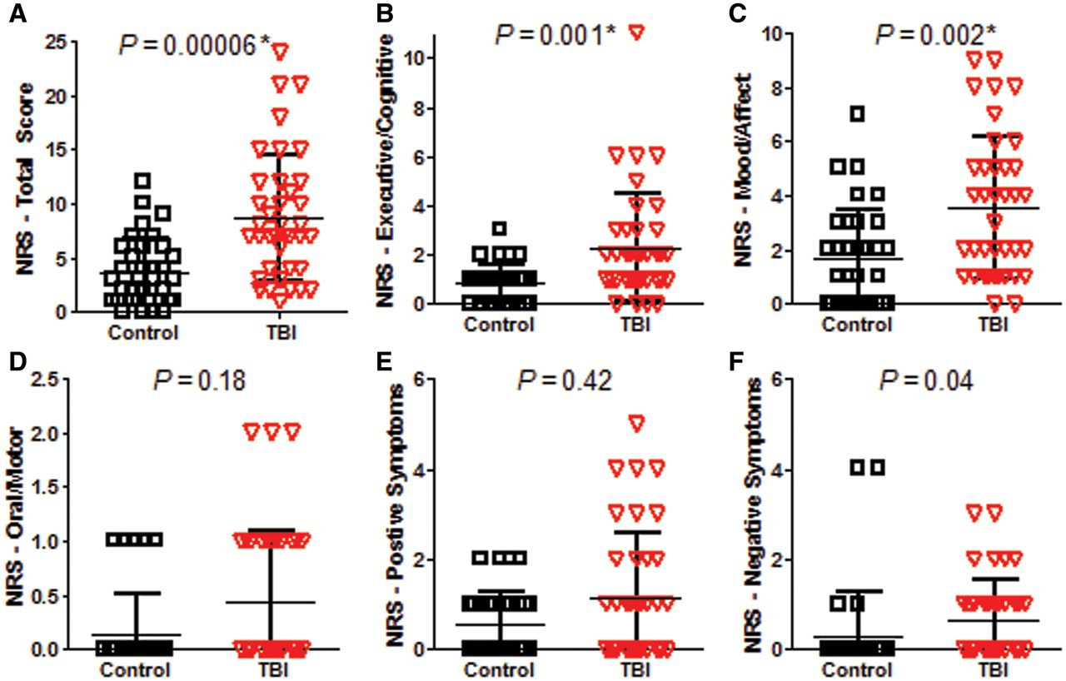
Figure 3 Neurobehavioural outcome indicates worse outcomes in TBI subjects versus controls. (A) Total Neurobehavioural ...
Notes:
Figure 3 Neurobehavioural outcome indicates worse outcomes in TBI subjects versus controls. (A) Total Neurobehavioural Rating Scale (NRS) Total Score (Max 87). (B) Executive/cognitive domain (Max 24). (C) Mood/affect domain (Max 15). (D) Oral/motor domain (Max 12). (E) Positive symptoms domain (Max 21). (F) Negative symptoms domain (Max 12). Higher scores on all of the measures indicate worse impairment. Uncorrected P-values reported. *Significance after Bonferroni correction for multiple comparisons at *P < 0.05/6 = 0.0083.
Unless provided in the caption above, the following copyright applies to the content of this slide: © The Author (2015). Published by Oxford University Press on behalf of the Guarantors of Brain. All rights reserved. For Permissions, please email: journals.permissions@oup.com

Slide 5
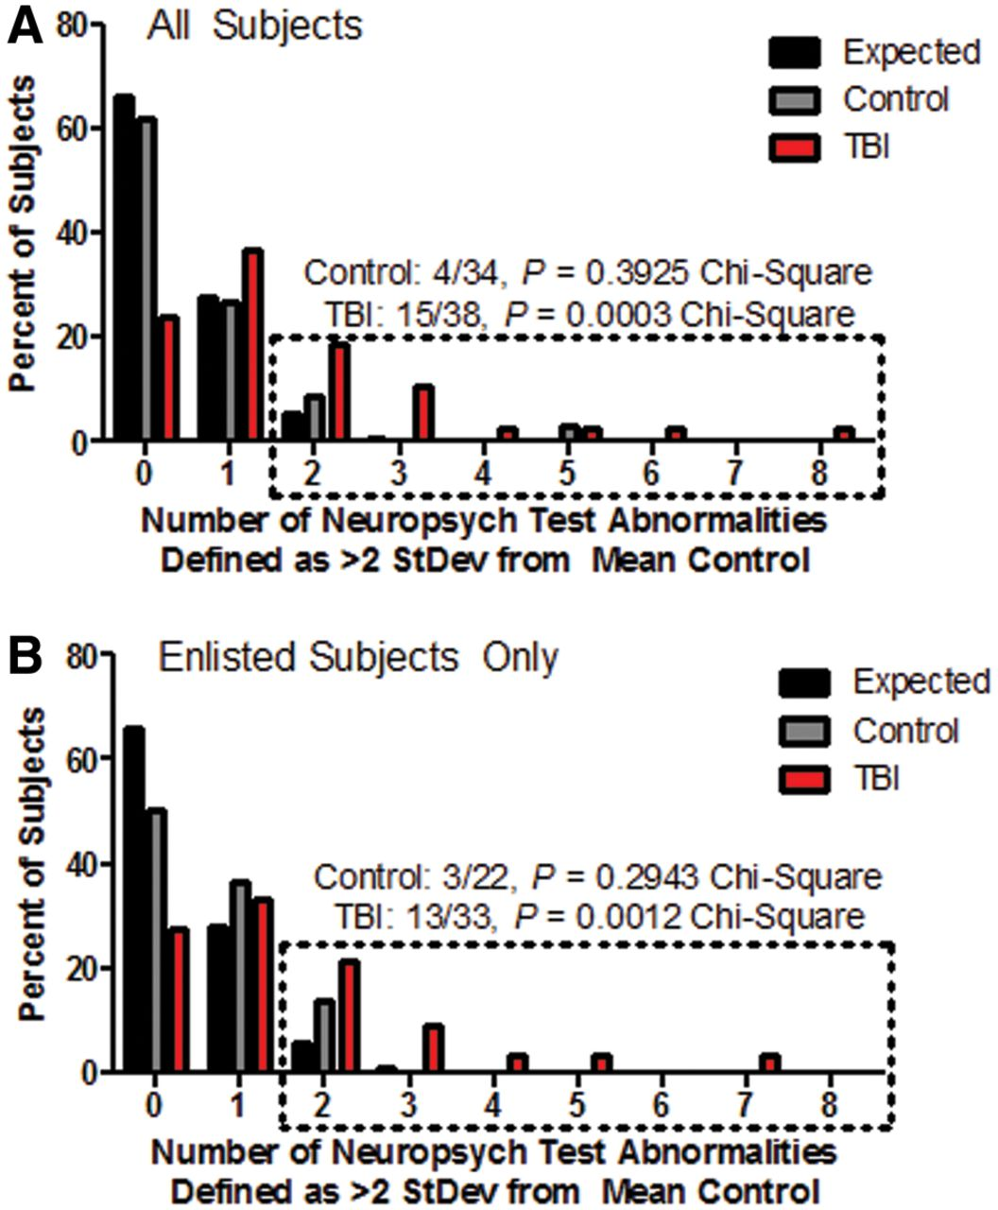
Figure 4 Larger numbers of TBI subjects than controls with two or more neuropsychological performance abnormalities at ...
Notes:
Figure 4 Larger numbers of TBI subjects than controls with two or more neuropsychological performance abnormalities at follow-up. (A) All subjects. (B) Enlisted subjects only. The number of subjects with neuropsychological test abnormalities are displayed by group in comparison to what would be expected by chance (black bars). Per cent of subjects is displayed to account for the differences in the number of subjects in each group. Dotted box indicates the group of subjects who had poor performance on two or more of the 18 neuropsychological assessments. Poor performance is defined as a score that is >2 SD away from the mean of the control group in the direction of worse performance. P-value calculated using the chi-square test by group in comparison to the expected distribution for that group size.
Unless provided in the caption above, the following copyright applies to the content of this slide: © The Author (2015). Published by Oxford University Press on behalf of the Guarantors of Brain. All rights reserved. For Permissions, please email: journals.permissions@oup.com

Slide 6
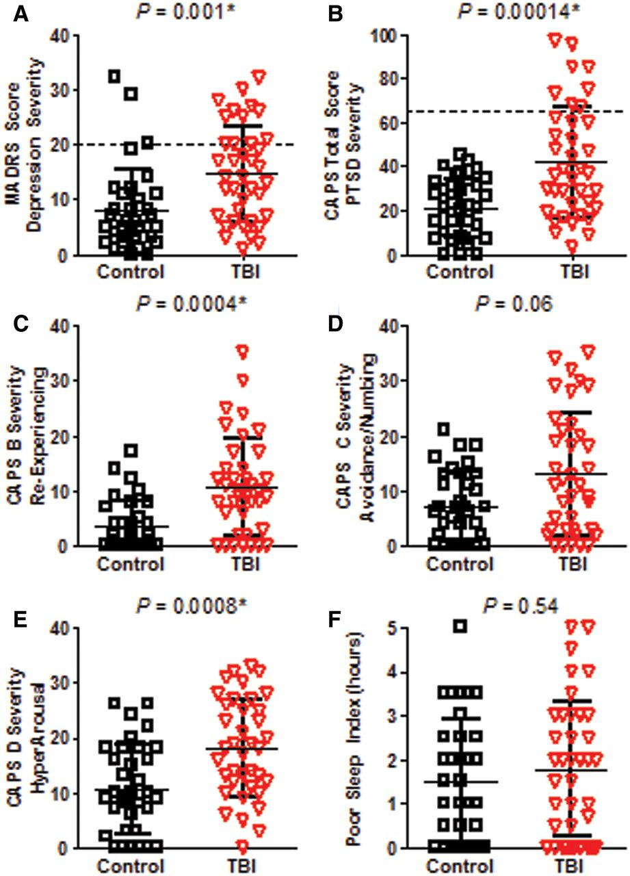
Figure 5 Greater depression and PTSD severity in TBI subjects versus controls at follow-up. (A) Depression severity ...
Notes:
Figure 5 Greater depression and PTSD severity in TBI subjects versus controls at follow-up. (A) Depression severity assessed by the MADRS (Max 60). Dashed line indicates cut-off for moderate to severe symptoms (Snaith et al., 1986). (B) PTSD severity assessed by the CAPS for DSM IV (Max 136). Dashed line indicates cut-off for moderate to severe symptoms (Weathers et al., 2001). (C) CAPS B Severity–Re-experiencing (Max 40). (D) CAPS C Severity–Avoidance and Numbing (Max 56). (E) CAPS D Severity–Increased Arousal and hypervigilance (Max 40). (F) Poor sleep index, taken from CAPS D1, defined as the self-reported number of desired hours of sleep minus the number of hours reported. Higher scores on all of the measures indicate worse impairment. Uncorrected P-values reported. *Significance after Bonferroni correction for multiple comparisons for the three CAPS subdomains at P < 0.05/3 = 0.0167.
Unless provided in the caption above, the following copyright applies to the content of this slide: © The Author (2015). Published by Oxford University Press on behalf of the Guarantors of Brain. All rights reserved. For Permissions, please email: journals.permissions@oup.com

Slide 7
Figure 6 Modest correlations observed between acute and chronic measures of depression, PTSD and Neuropsychological ...
Notes:
Figure 6 Modest correlations observed between acute and chronic measures of depression, PTSD and Neuropsychological Test Performance-Reaction Time. (A) Very modest correlations for both control and TBI subjects were observed between the self-report symptom checklist for depression collected 0–7 days post-injury and a structured interview administered by trained research staff at 6–12 month follow-up. (B) Similar modest correlations were observed for controls and TBI subjects comparing acute self-report to chronic structured interview data for PTSD symptoms. (C) Metrics of reaction time collected as part of the neuropsychological examination in both the acute (ANAM procedural reaction time) and chronic phase (Conners’ Continuous Performance Test II reaction time) significantly correlated in TBI subjects but not in controls using the Bonferonni corrected criterion of P < 0.05/6 = 0.0083.
Unless provided in the caption above, the following copyright applies to the content of this slide: © The Author (2015). Published by Oxford University Press on behalf of the Guarantors of Brain. All rights reserved. For Permissions, please email: journals.permissions@oup.com

Slide 8
Figure 7 Logistic regression models predict global outcome moderately based on acute data and strongly based on ...
Notes:
Figure 7 Logistic regression models predict global outcome moderately based on acute data and strongly based on chronic data. (A) Receiver-operator curve for best fit model of overall disability defined as the dichotomized GOS-E of 7 or 8 (good outcome), and ≤6 (disabled) using acute clinical data. The best model included the PCL-M, group distinction of control versus TBI, and age. (B) Receiver-operator curve for model of overall disability using chronic clinical data. The best fit model consisted of the CAPS for DSM IV, MADRS, Combat Exposure Scale and Age. This model showed improvement over the acute data best fit model. (C) Receiver-operator curve for best fit model of overall disability using both acute and chronic clinical data. The model consisted of PCL-M, CAPS for DSM IV, MADRS, Combat Exposure Scale and age.
Unless provided in the caption above, the following copyright applies to the content of this slide: © The Author (2015). Published by Oxford University Press on behalf of the Guarantors of Brain. All rights reserved. For Permissions, please email: journals.permissions@oup.com

