Slide 1
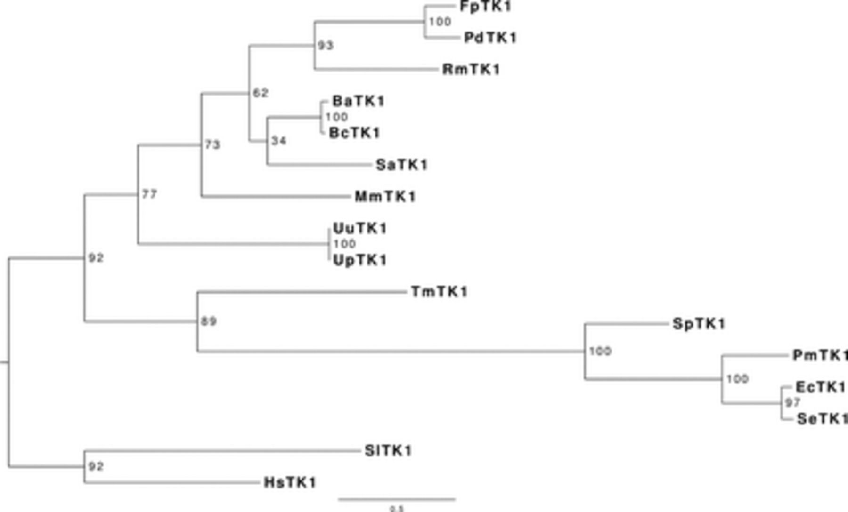
Phylogenetic tree of the TK1-like kinases from Gram-negative bacteria Polaribacter sp. MED 152 (PdTK1) and ...
Notes:
Phylogenetic tree of the TK1-like kinases from Gram-negative bacteria Polaribacter sp. MED 152 (PdTK1) and Flavobacterium psychrophilum JIP02/86 (FpTK1) together with previously biochemically characterized TK1s. The following bacterial, plant, and human TK1s were used in the analysis: BaTK1 — Bacillus anthracis TK1 (YP_031418.1), BcTK1 — Bacillus cereus TK1 (NP_834992.), EcTK1 — Escherichia coli TK1 (NP_415754.1), HsTK1 — Homo sapiens TK1 (AAH07986.1), MmTK1 — Mycoplasma mycoides TK1 (CAC85214.1), PmTK1 — Pasteurella multocida TK1 (NP_246173.1), RmTK1 — Rhodothermus marinus TK1 (ACY49479.1), SeTK1 — Salmonella enterica TK1 (NP_455750.1), SlTK1 — Solanum lycopersicum TK1 (AAQ08180), SaTK1 — Staphylococcus aureus TK1 (BD37699.1), SpTK1 — Streptococcus pyogenes TK1 (ABO07417.1), TmTK1 — Thermotoga maritima TK1 (Q9WYN2.1), UpTK1 — Ureaplasma parvum TK1 (NP_078433.1),and UuTK1 — Ureaplasma urealyticum TK1 (Q9PPP5.1). Note that TK1s from both Gram-negative bacteria (FpTK1 and PdTK1) group together with TK1s from Gram-positive bacteria, while some TK1s from Gram-negative bacteria, including EcTK1, PmTK1, SeTK1, SpTK1, and TmTK1, form a separate group. Bootstrap values for each node are shown.
Unless provided in the caption above, the following copyright applies to the content of this slide: © 2012 Federation of European Microbiological Societies. Published by Blackwell Publishing Ltd. All rights reserved

Slide 2
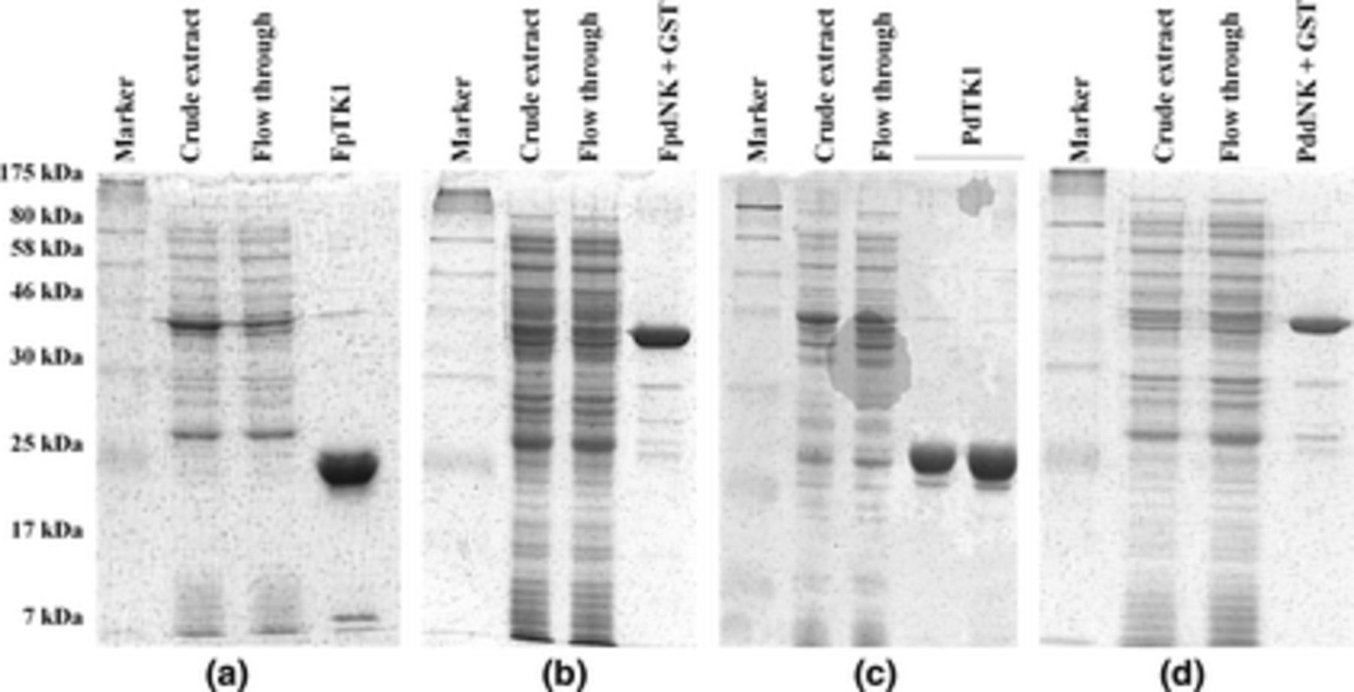
Coomassie-stained SDS-PAGE gels of purified recombinant dNKs. (a) Flavobacterium psychrophilum JIP02/86 TK1 ...
Notes:
Coomassie-stained SDS-PAGE gels of purified recombinant dNKs. (a) Flavobacterium psychrophilum JIP02/86 TK1 (FpTK1). Lane 1, protein marker (BioLabs); lane 2, crude extract; lane 3, flow-through; lane 4, pure FpTK1. (b) F. psychrophilum JIP02/86 dNK (FpdNK). Lane 1, protein marker (BioLabs); lane 2, crude extract; lane 3, flow-through; lane 4, pure FpdNK + GST (uncleaved fusion protein with bound GST tag). (c) Polaribacter sp. MED152 TK1 (PdTK1). Lane 1, protein marker (BioLabs); lane 2, crude extract; lane 3,flow-through; lanes 4 and 5, pure PdTK1. (d) Polaribacter sp. MED152 dNK (PddNK). Lane 1, protein marker (BioLabs); lane 2, crude extract; lane 3, flow-through; lane 4, pure PddNK + GST (uncleaved fusion protein with bound GST tag).
Unless provided in the caption above, the following copyright applies to the content of this slide: © 2012 Federation of European Microbiological Societies. Published by Blackwell Publishing Ltd. All rights reserved

Slide 3
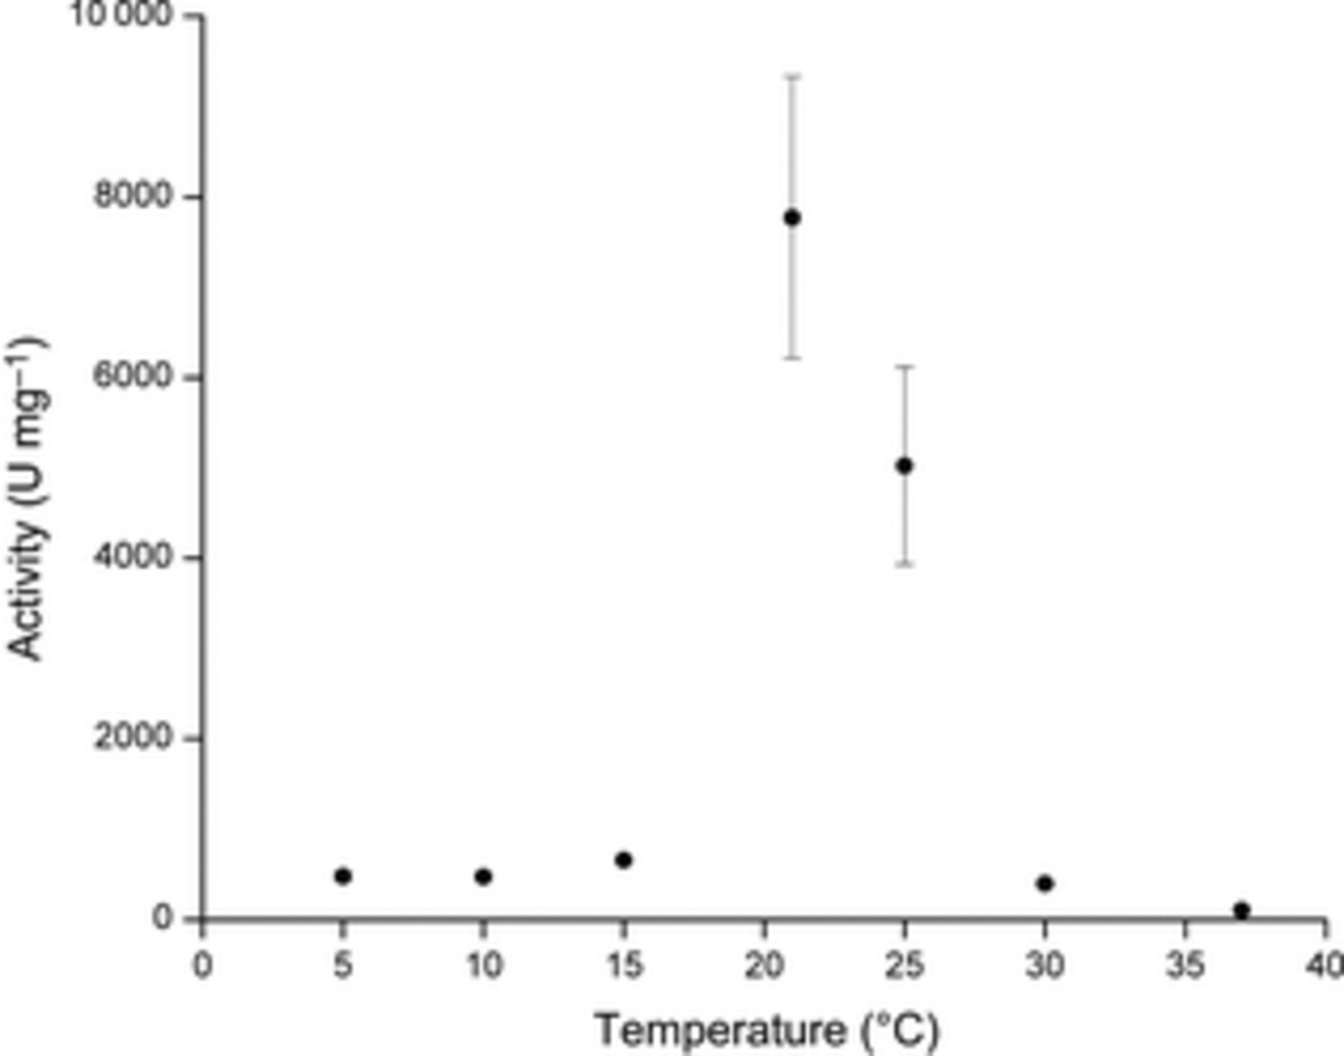
Polaribacter sp. MED152 TK1 (PdTK1) activity as a function of temperature. Radio-assays were performed at 5, ...
Notes:
Polaribacter sp. MED152 TK1 (PdTK1) activity as a function of temperature. Radio-assays were performed at 5, 10, 15, 21, 25, 30, and 37 °C with 500 µM 3H-dT as substrate. All measurements were taken four times, except at 30 and 37 °C (three times). The shown activities represent the average ± standard deviation.
Unless provided in the caption above, the following copyright applies to the content of this slide: © 2012 Federation of European Microbiological Societies. Published by Blackwell Publishing Ltd. All rights reserved

