Slide 1
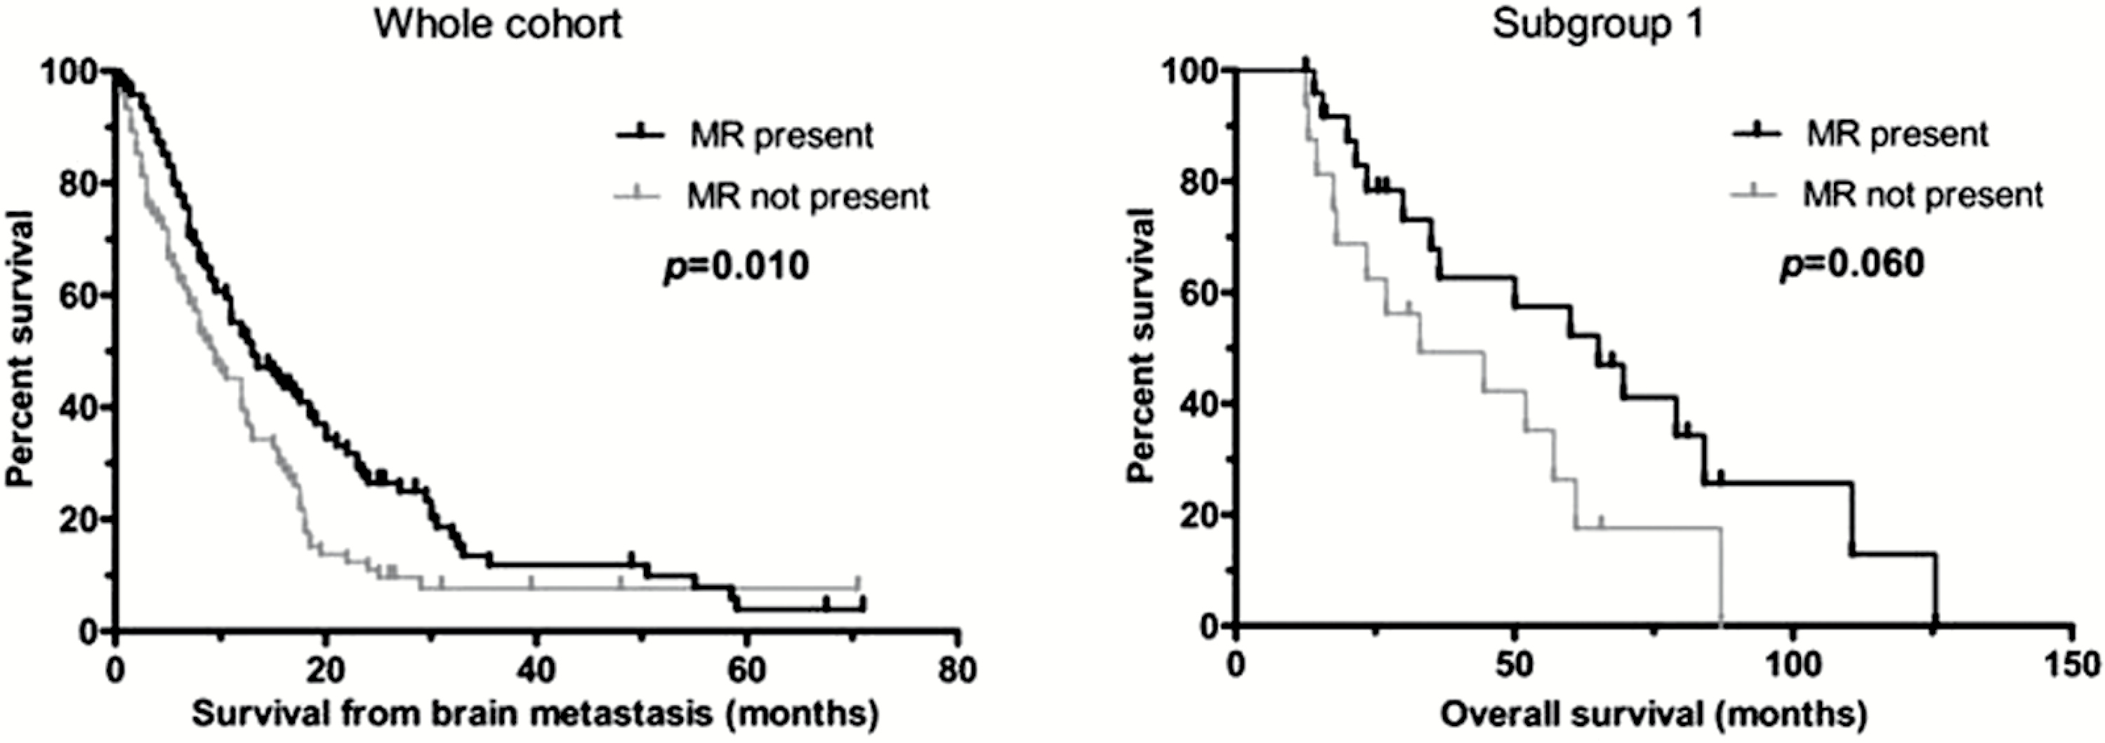
Fig. 1 Kaplan–Meier analysis. The presence of mononuclear ring (MR) around the brain metastasis of lung ...
Notes:
Fig. 1 Kaplan–Meier analysis. The presence of mononuclear ring (MR) around the brain metastasis of lung adenocarcinoma is associated with better survival after brain metastasis surgery. The presence of MR is also associated with a tendency for better OS in patients with solitary brain metastasis who underwent primary tumor resection (subgroup 1).
Unless provided in the caption above, the following copyright applies to the content of this slide: © The Author(s) 2017. Published by Oxford University Press on behalf of the Society for Neuro-Oncology. All rights reserved. For permissions, please e-mail: journals.permissions@oup.com

Slide 2
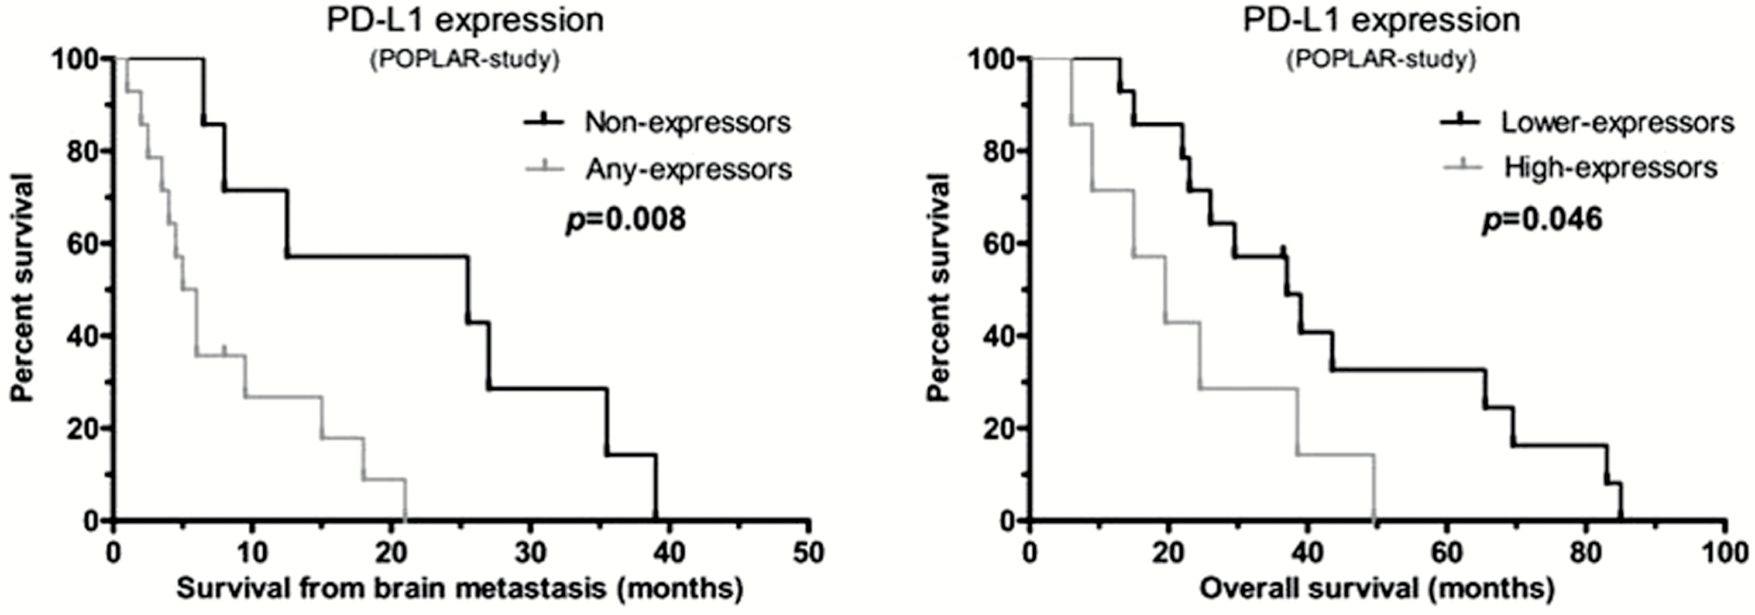
Fig. 2 Kaplan–Meier analysis of the different PD-L1 expressor groups used in the POPLAR study. Among patients who ...
Notes:
Fig. 2 Kaplan–Meier analysis of the different PD-L1 expressor groups used in the POPLAR study. Among patients who underwent primary tumor resection and had multiple brain metastases (subgroup 2), “non-expressors” showed better survival after brain metastasis surgery compared with the “any-expressors”; and “lower-expressors” showed better OS compared with the “high-expressors.”
Unless provided in the caption above, the following copyright applies to the content of this slide: © The Author(s) 2017. Published by Oxford University Press on behalf of the Society for Neuro-Oncology. All rights reserved. For permissions, please e-mail: journals.permissions@oup.com

