Slide 1
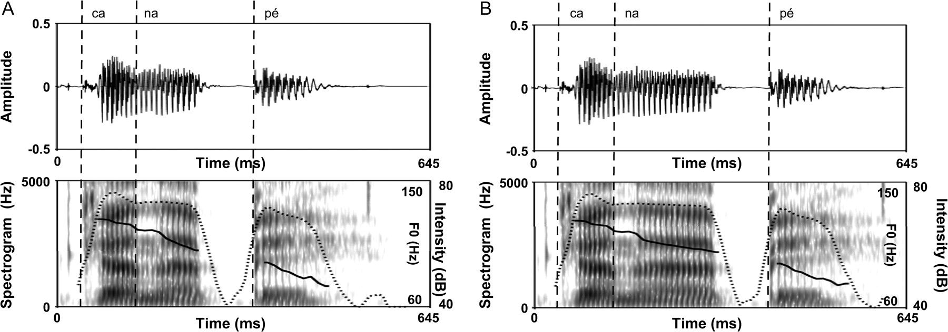
Figure 1. (A) Original version of the word “canapé.” (B) Time-stretched version of the word “canapé.” On both panels, ...
Notes:
Figure 1. (A) Original version of the word “canapé.” (B) Time-stretched version of the word “canapé.” On both panels, the waveform is represented on the top part; the spectrogram (gray scale), the F0 (solid line), and the intensity (dashed line) are represented on the bottom part.
Unless provided in the caption above, the following copyright applies to the content of this slide: © The Author 2007. Published by Oxford University Press. All rights reserved. For permissions, please e-mail: journals.permissions@oxfordjournals.org

Slide 2
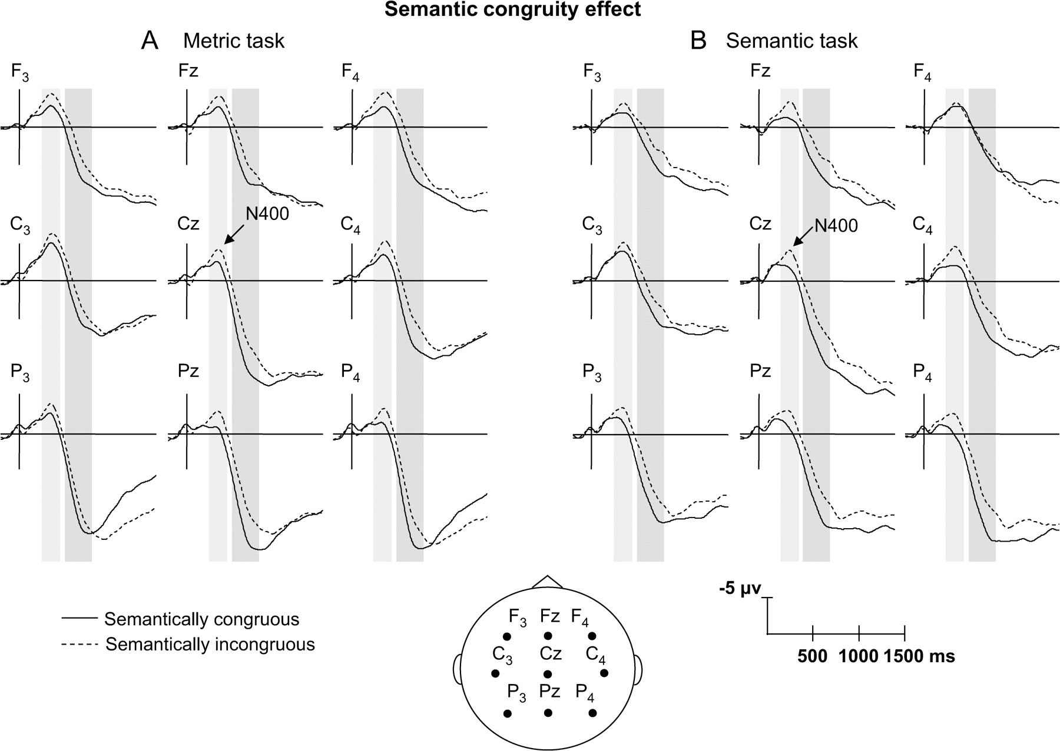
Figure 2. Averaged electrophysiological data time locked to the onset of semantically congruous (solid line) or ...
Notes:
Figure 2. Averaged electrophysiological data time locked to the onset of semantically congruous (solid line) or semantically incongruous (dashed line) final words, in the metric (A) and semantic tasks (B). Selected traces from 9 electrodes are presented. The latency ranges within which statistical analyses revealed significant effects are shown in gray (250- to 450-ms and 500- to 800-ms latency ranges). In this figure, as in the following ones, the amplitude (in microvolts) is plotted on the ordinate (negative up) and the time (in milliseconds) is on the abscissa.
Unless provided in the caption above, the following copyright applies to the content of this slide: © The Author 2007. Published by Oxford University Press. All rights reserved. For permissions, please e-mail: journals.permissions@oxfordjournals.org

Slide 3
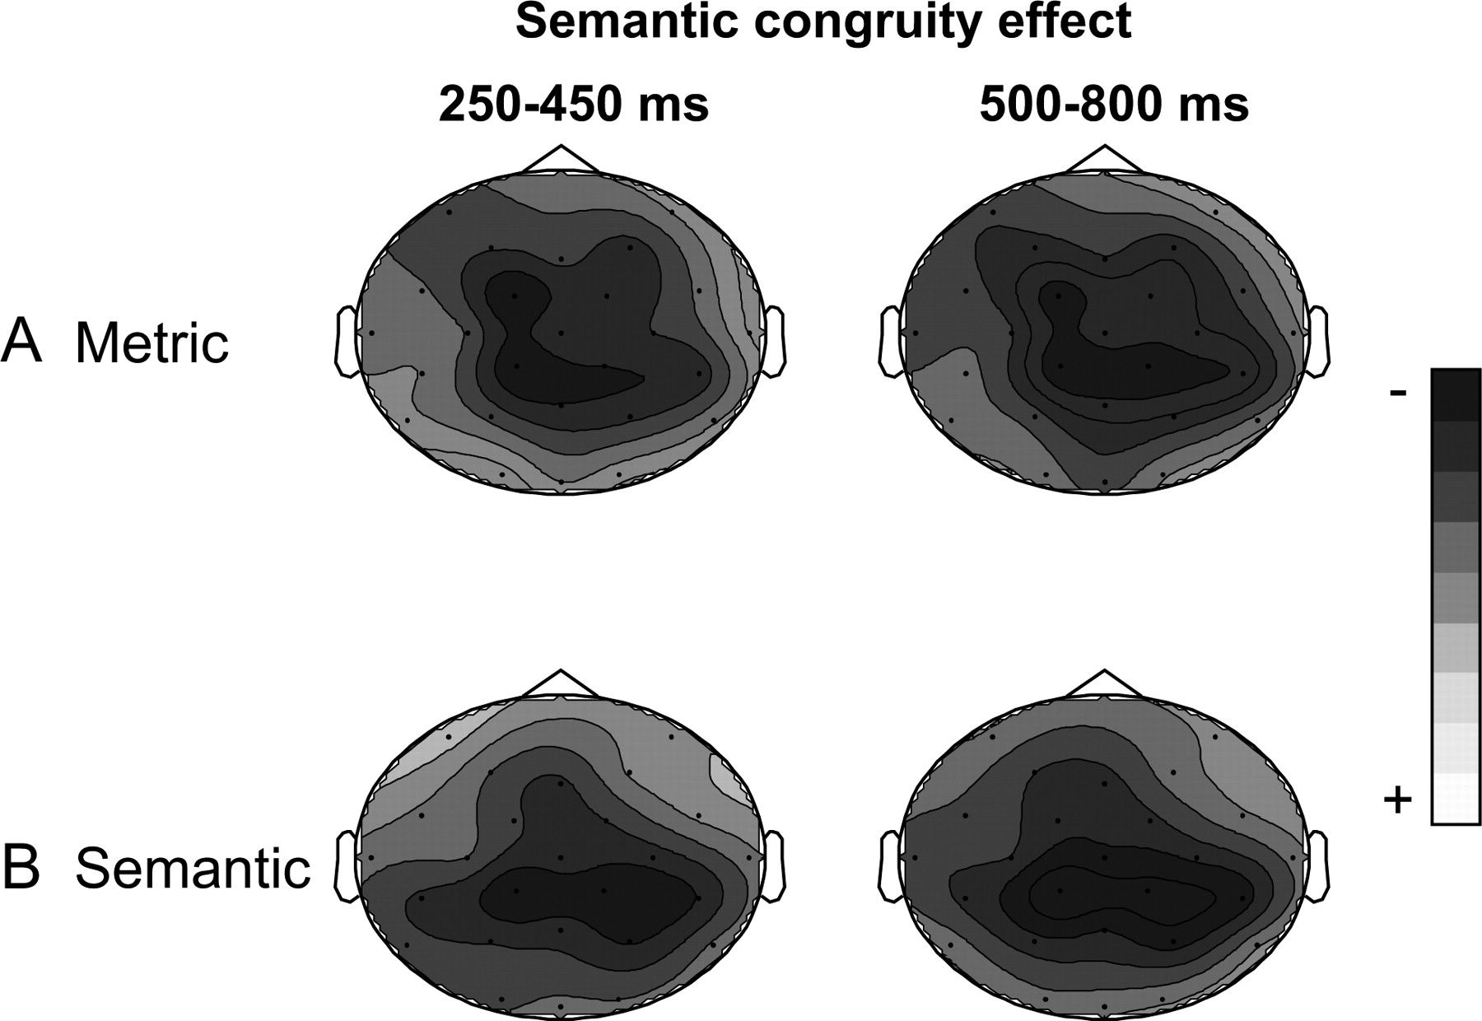
Figure 3. Topographic maps of the semantic congruity effect in the metric (A) and semantic tasks (B). Mean amplitude ...
Notes:
Figure 3. Topographic maps of the semantic congruity effect in the metric (A) and semantic tasks (B). Mean amplitude differences between semantically incongruous and congruous words in the 250- to 450-ms and 500- to 800-ms latency ranges.
Unless provided in the caption above, the following copyright applies to the content of this slide: © The Author 2007. Published by Oxford University Press. All rights reserved. For permissions, please e-mail: journals.permissions@oxfordjournals.org

Slide 4
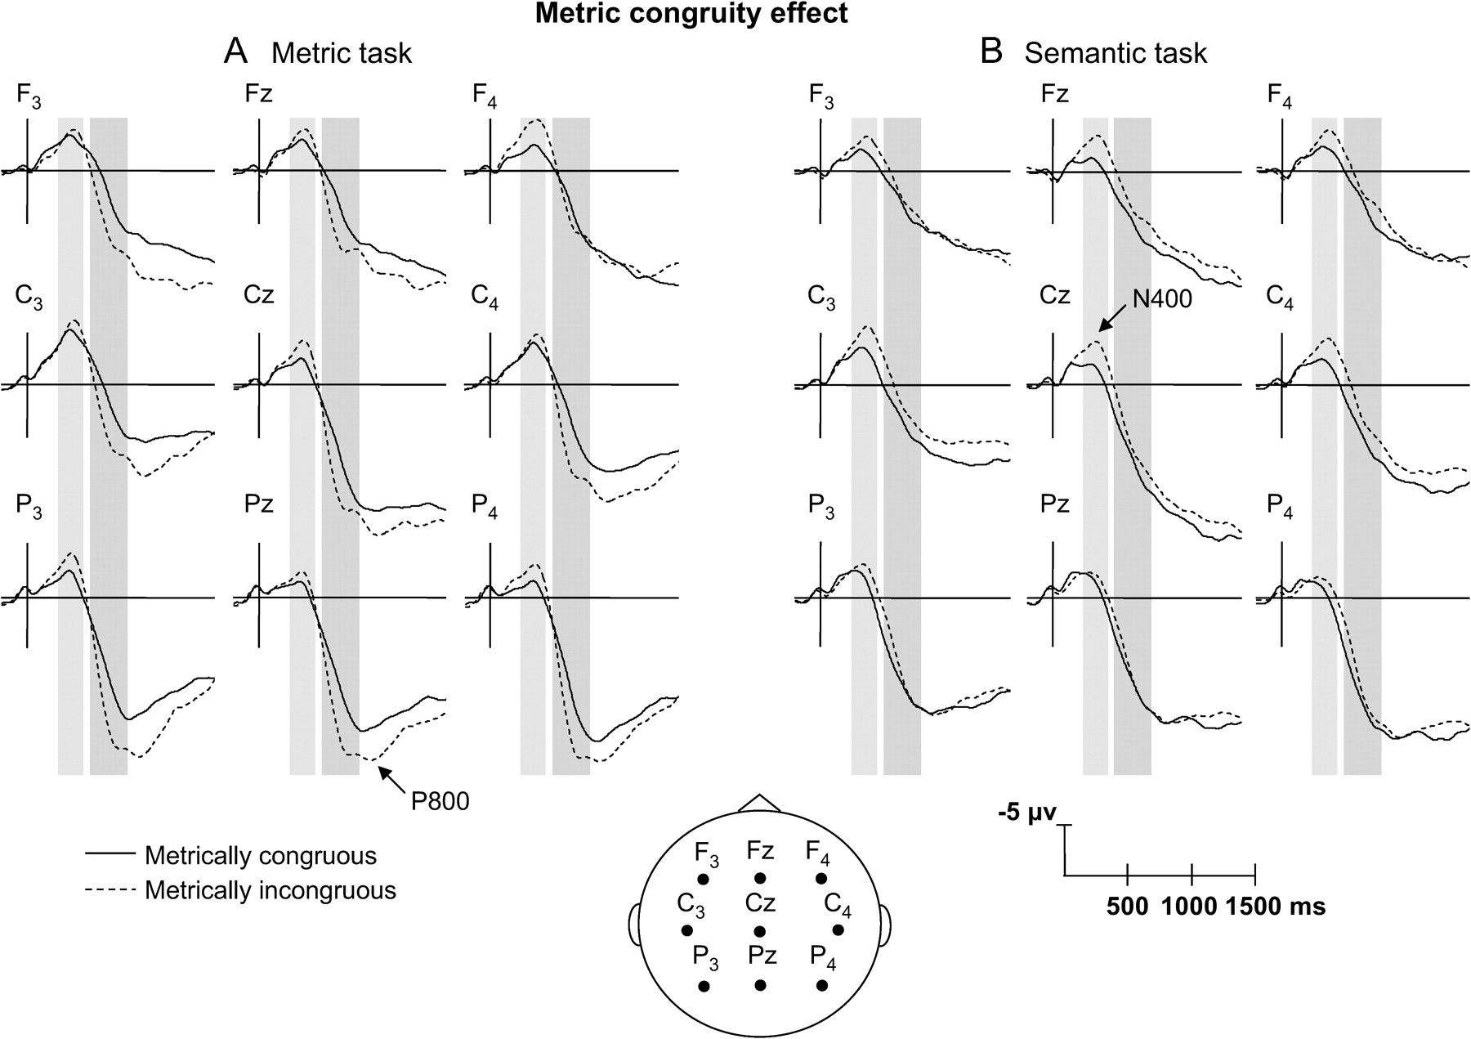
Figure 4. Averaged electrophysiological data time locked to the onset of metrically congruous (solid line) or ...
Notes:
Figure 4. Averaged electrophysiological data time locked to the onset of metrically congruous (solid line) or metrically incongruous (dashed line) final words, in the metric (A) and semantic tasks (B).
Unless provided in the caption above, the following copyright applies to the content of this slide: © The Author 2007. Published by Oxford University Press. All rights reserved. For permissions, please e-mail: journals.permissions@oxfordjournals.org

Slide 5
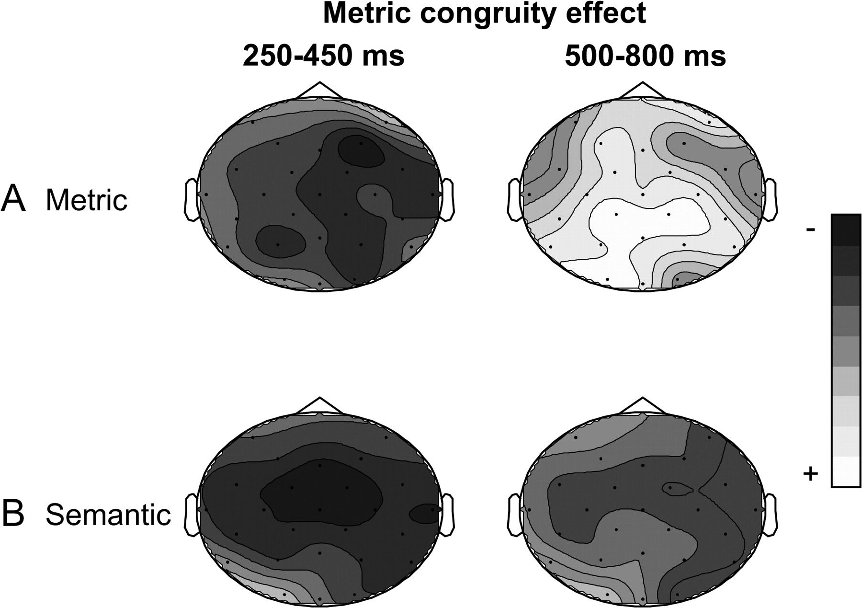
Figure 5. Topographic maps of the metric incongruity effect in the metric (A) and semantic tasks (B). Mean amplitude ...
Notes:
Figure 5. Topographic maps of the metric incongruity effect in the metric (A) and semantic tasks (B). Mean amplitude difference between metrically incongruous and metrically congruous words in the 250- to 450-ms and 500- to 800-ms latency ranges.
Unless provided in the caption above, the following copyright applies to the content of this slide: © The Author 2007. Published by Oxford University Press. All rights reserved. For permissions, please e-mail: journals.permissions@oxfordjournals.org

