Slide 1
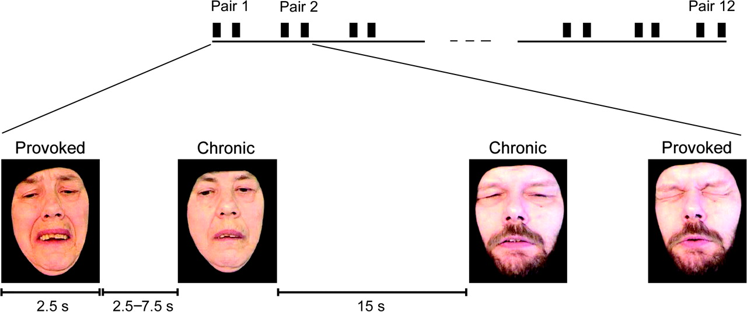
Figure 1 An example of the sequence of the pain face stimuli. Altogether 12 provoked pain photos (3 from each of the 4 ...
Notes:
Figure 1 An example of the sequence of the pain face stimuli. Altogether 12 provoked pain photos (3 from each of the 4 patients) and 12 chronic pain photos (similarly 3 from each of the 4 patients) of the same patient were shown in pairs, each consisting of 2 photos of the same patient. Each photo was displayed for 2.5 s. The intrapair-interval varied between 2.5 and 7.5 s, and the interpair-interval was 15 s.
Unless provided in the caption above, the following copyright applies to the content of this slide: © The Author 2006. Published by Oxford University Press. All rights reserved. For permissions, please e-mail: journals.permissions@oxfordjournals.org

Slide 2
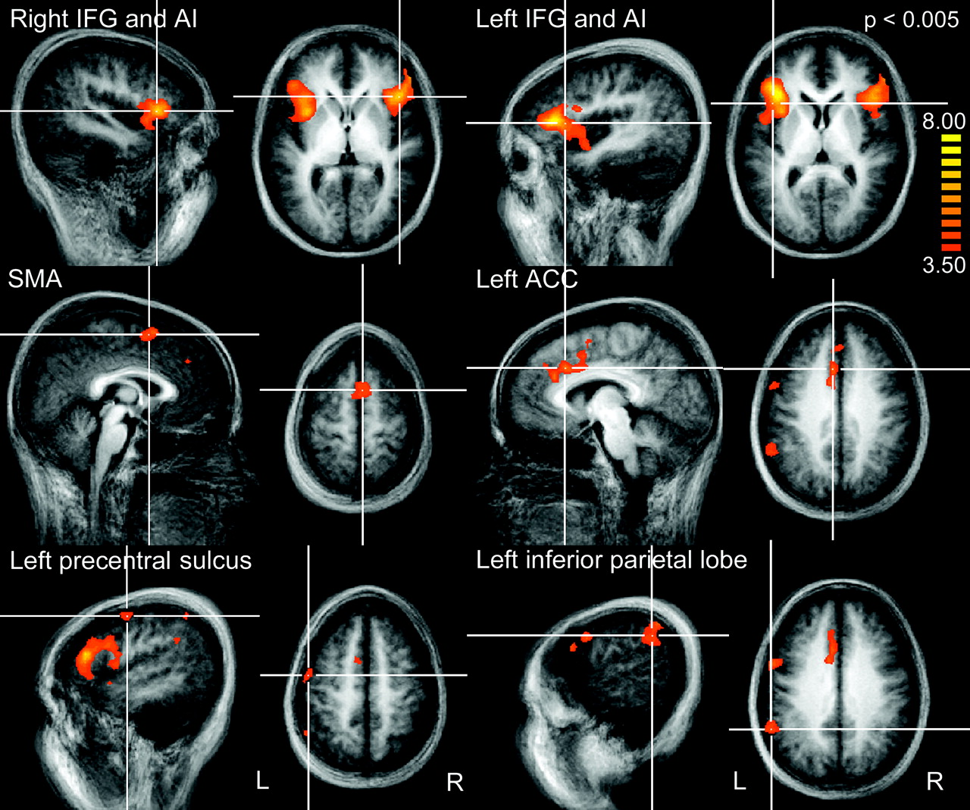
Figure 2 Statistical maps in the provoked pain − chronic pain contrast superimposed on the averaged structural MR ...
Notes:
Figure 2 Statistical maps in the provoked pain − chronic pain contrast superimposed on the averaged structural MR image of all 12 subjects. The colored areas indicate statistically significant activations at P < 0.005, and the color bar indicates the t-value scale.
Unless provided in the caption above, the following copyright applies to the content of this slide: © The Author 2006. Published by Oxford University Press. All rights reserved. For permissions, please e-mail: journals.permissions@oxfordjournals.org

Slide 3
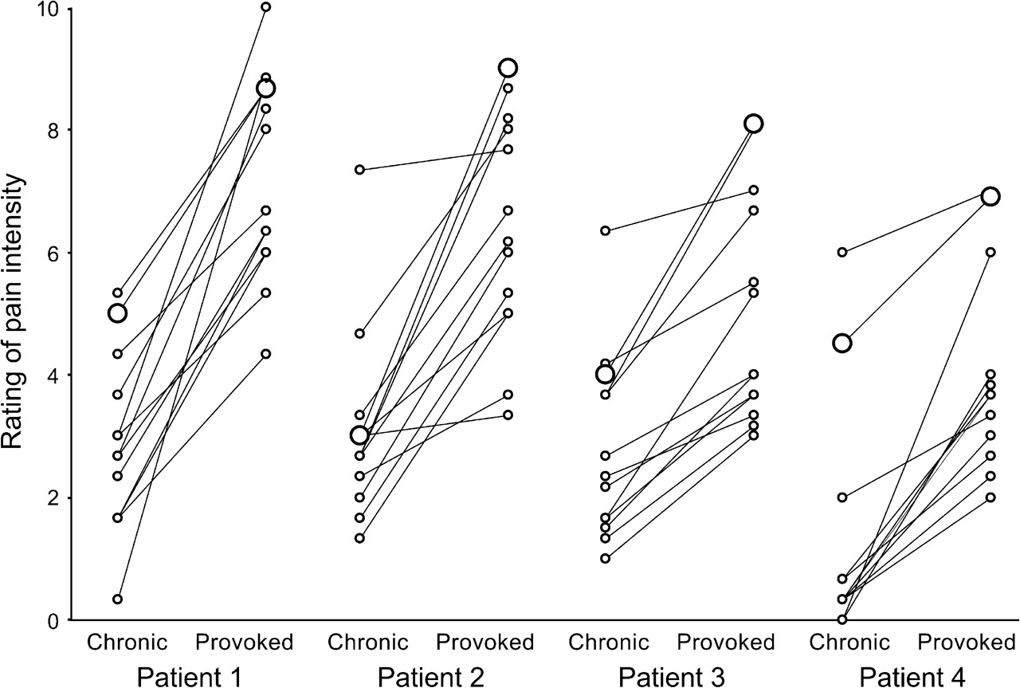
Figure 3 Individual estimates of pain intensity by the 12 subjects participating in the neuroimaging experiment. The ...
Notes:
Figure 3 Individual estimates of pain intensity by the 12 subjects participating in the neuroimaging experiment. The subjects evaluated the chronic and provoked pain photos of patients 1–4: smaller circles represent average evaluations of 3 photos of the same situation. The patients' own ratings of average pain intensity during pain provocation and rest periods are indicated by larger circles.
Unless provided in the caption above, the following copyright applies to the content of this slide: © The Author 2006. Published by Oxford University Press. All rights reserved. For permissions, please e-mail: journals.permissions@oxfordjournals.org

Slide 4
Figure 4 Brain areas where the BOLD response correlated with the subjects' estimates of observed pain intensity. The ...
Notes:
Figure 4 Brain areas where the BOLD response correlated with the subjects' estimates of observed pain intensity. The statistically significantly activated areas are the left ACC (Talairach x, y, z coordinates for center of gravity −9, 23, 43), the left IPL (−58, −58, 28), and the bilateral AI (−37, 12, −7 and 37, 17, −4). The locations of the axial slices are shown on the left, and the color bar indicates the t-value. All statistical maps are superimposed on group averages (n = 12) of structural images.
Unless provided in the caption above, the following copyright applies to the content of this slide: © The Author 2006. Published by Oxford University Press. All rights reserved. For permissions, please e-mail: journals.permissions@oxfordjournals.org

Slide 5
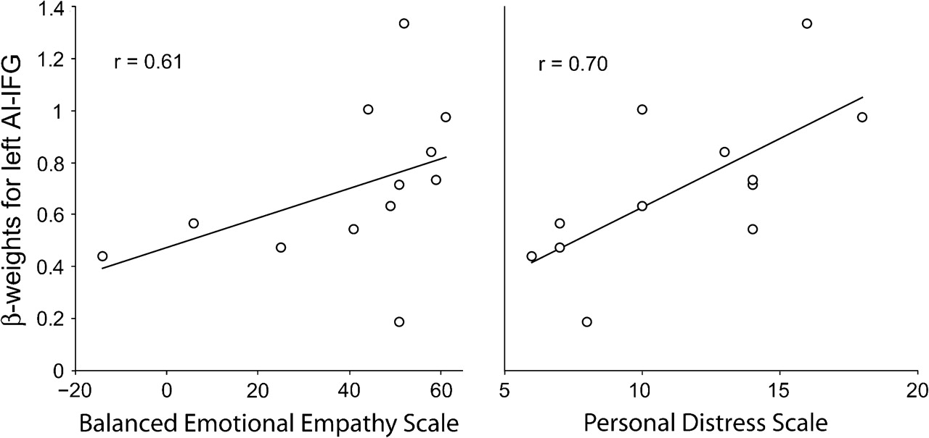
Figure 5 Activation strengths as β-weights in the left AI-IFG region (see Fig. 2) during provoked pain faces presented ...
Notes:
Figure 5 Activation strengths as β-weights in the left AI-IFG region (see Fig. 2) during provoked pain faces presented as a function of the individual scores in personal distress scale (right) and BEES (left). The lines represent the linear best fits. The correlation coefficients for both scales differed from zero at P < 0.05 (see Table 2).
Unless provided in the caption above, the following copyright applies to the content of this slide: © The Author 2006. Published by Oxford University Press. All rights reserved. For permissions, please e-mail: journals.permissions@oxfordjournals.org

