Slide 1
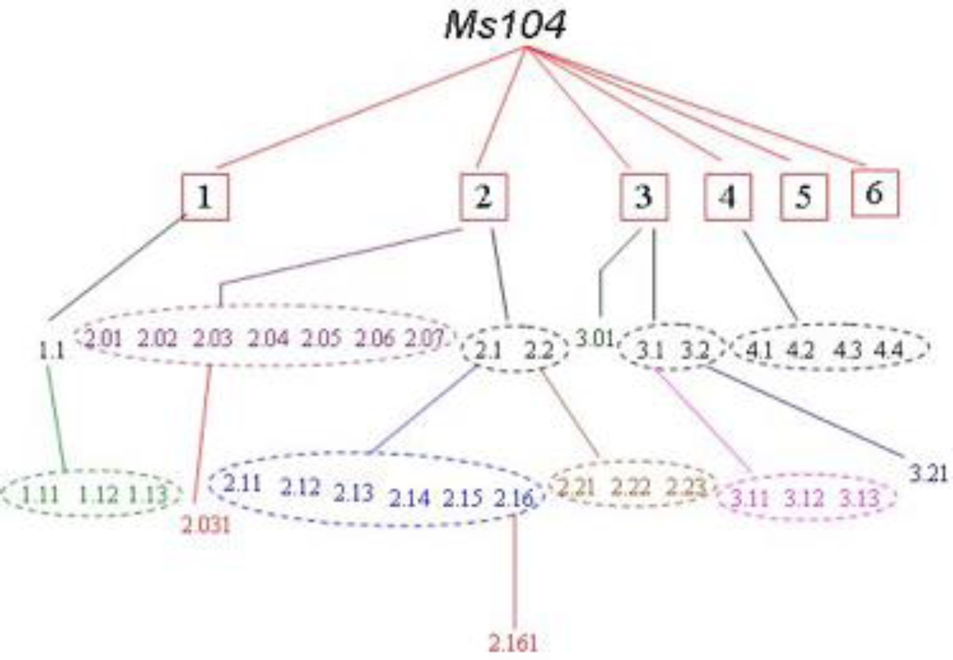
Notes:
Unless provided in the caption above, the following copyright applies to the content of this slide: © The Author 2015. Published by Oxford University Press on behalf of The Scots Philosophical Association and the Universityof St Andrews. All rights reserved. For permissions, please e-mail: journals.permissions@oup.com

Slide 2
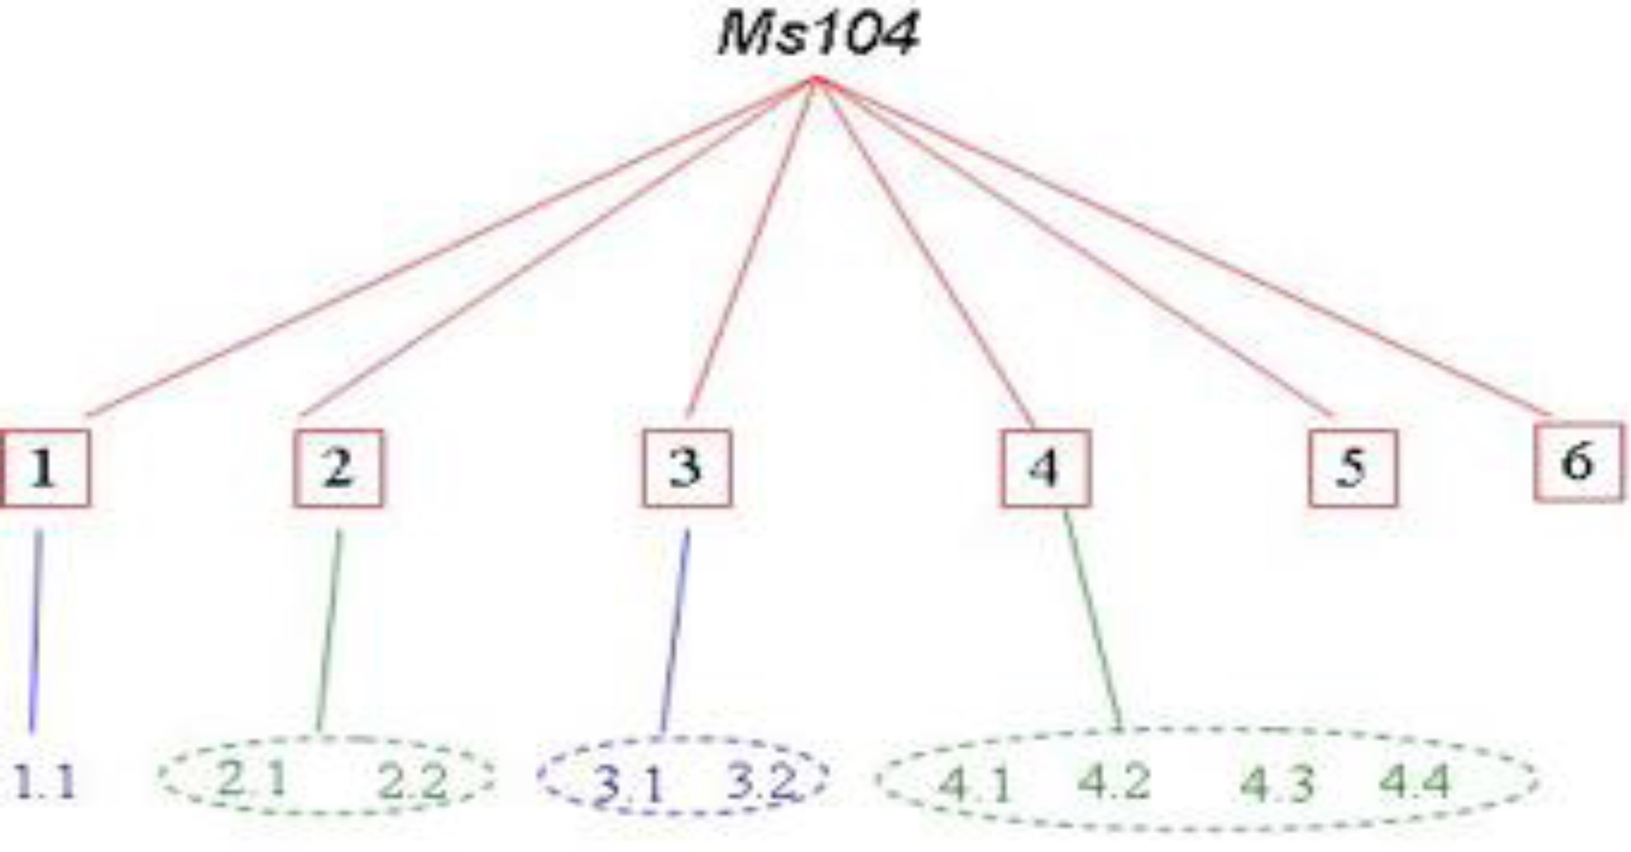
Notes:
Unless provided in the caption above, the following copyright applies to the content of this slide: © The Author 2015. Published by Oxford University Press on behalf of The Scots Philosophical Association and the Universityof St Andrews. All rights reserved. For permissions, please e-mail: journals.permissions@oup.com

Slide 3
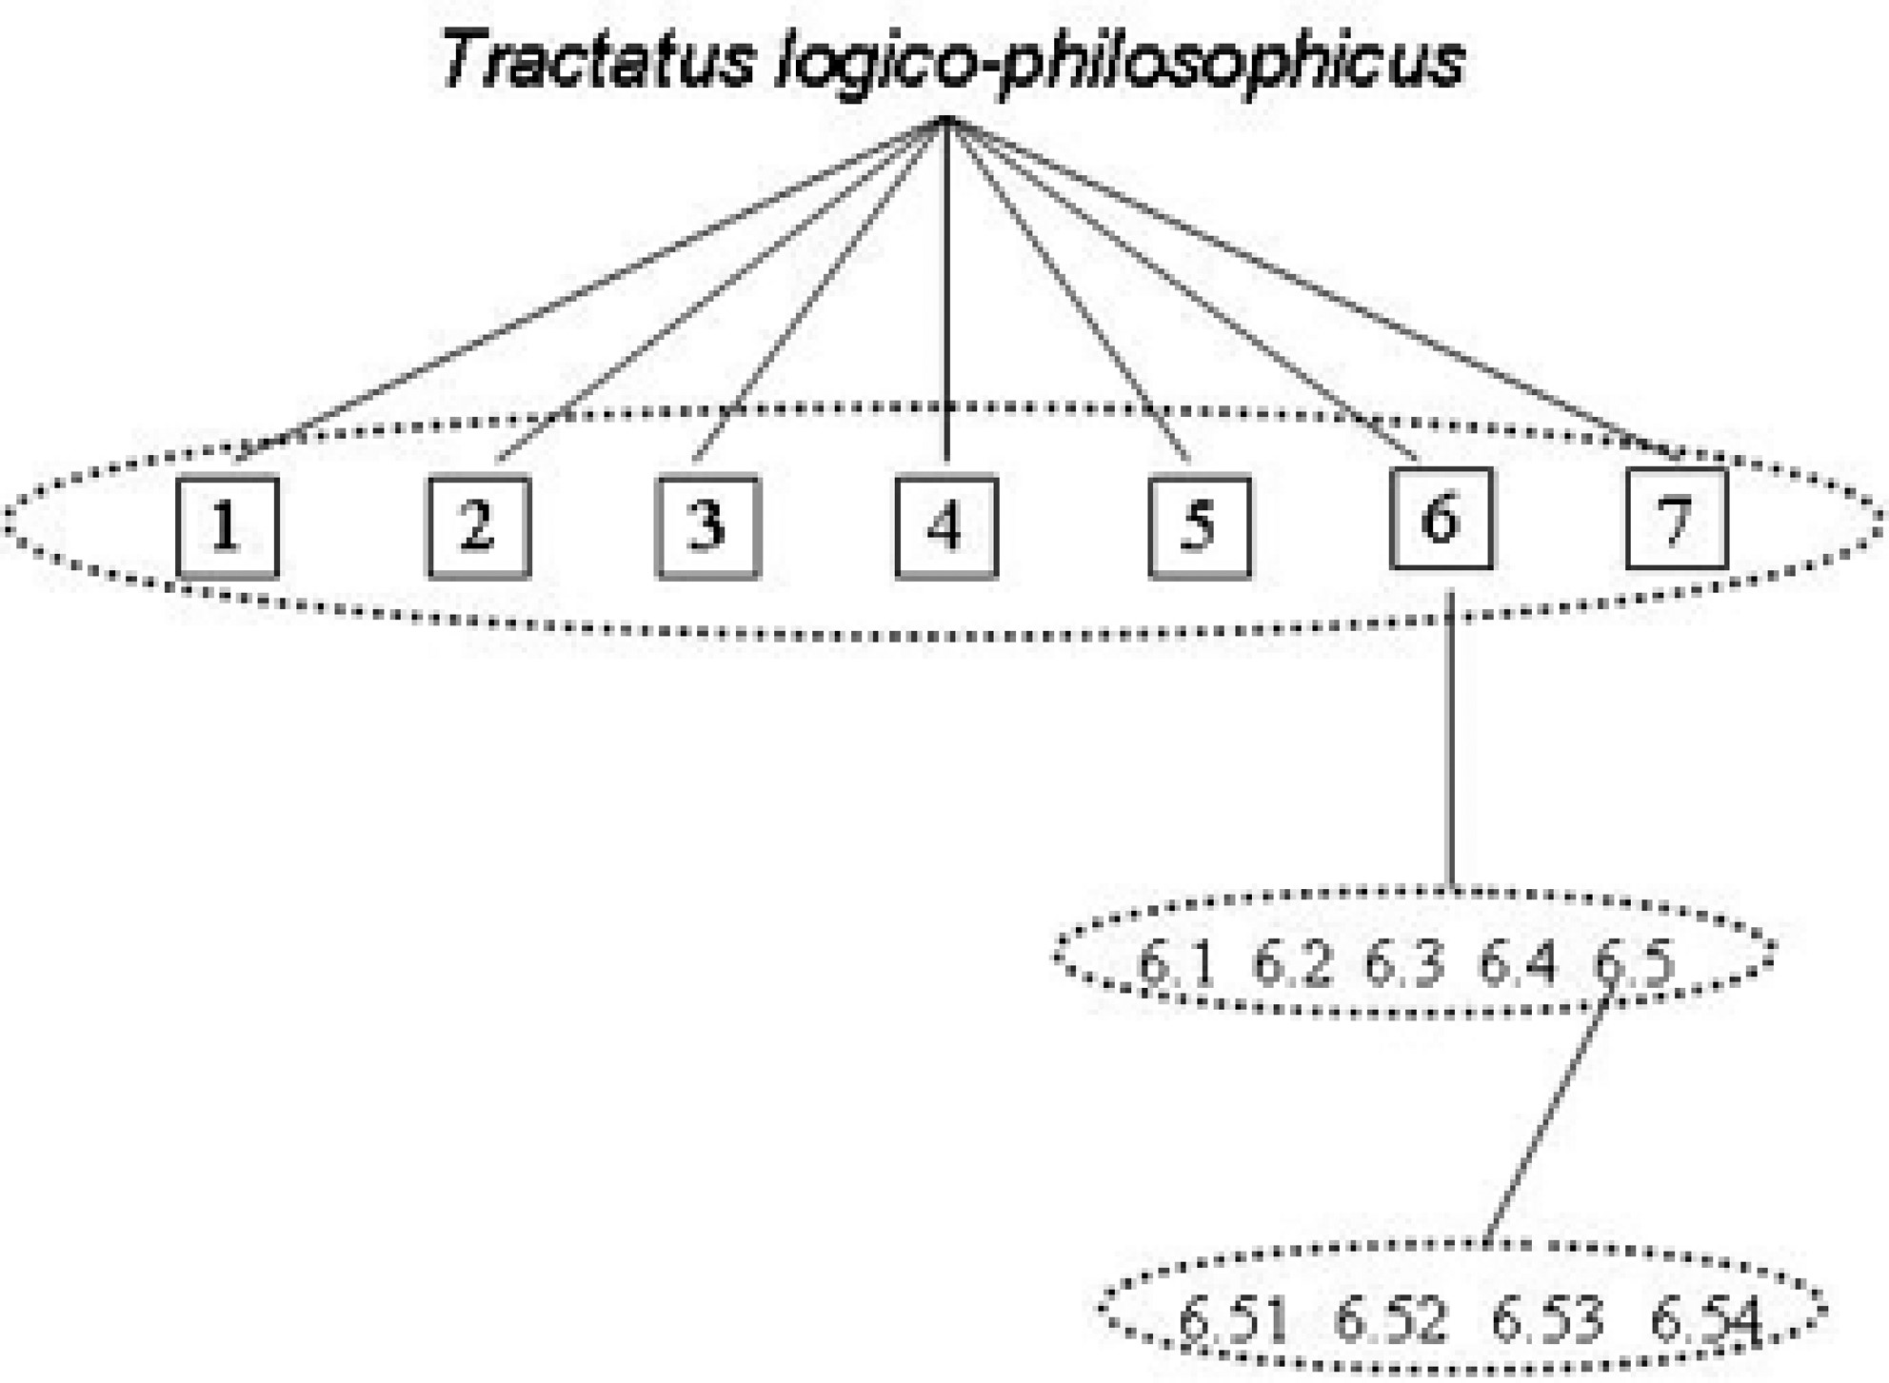
Notes:
Unless provided in the caption above, the following copyright applies to the content of this slide: © The Author 2015. Published by Oxford University Press on behalf of The Scots Philosophical Association and the Universityof St Andrews. All rights reserved. For permissions, please e-mail: journals.permissions@oup.com

