Slide 1
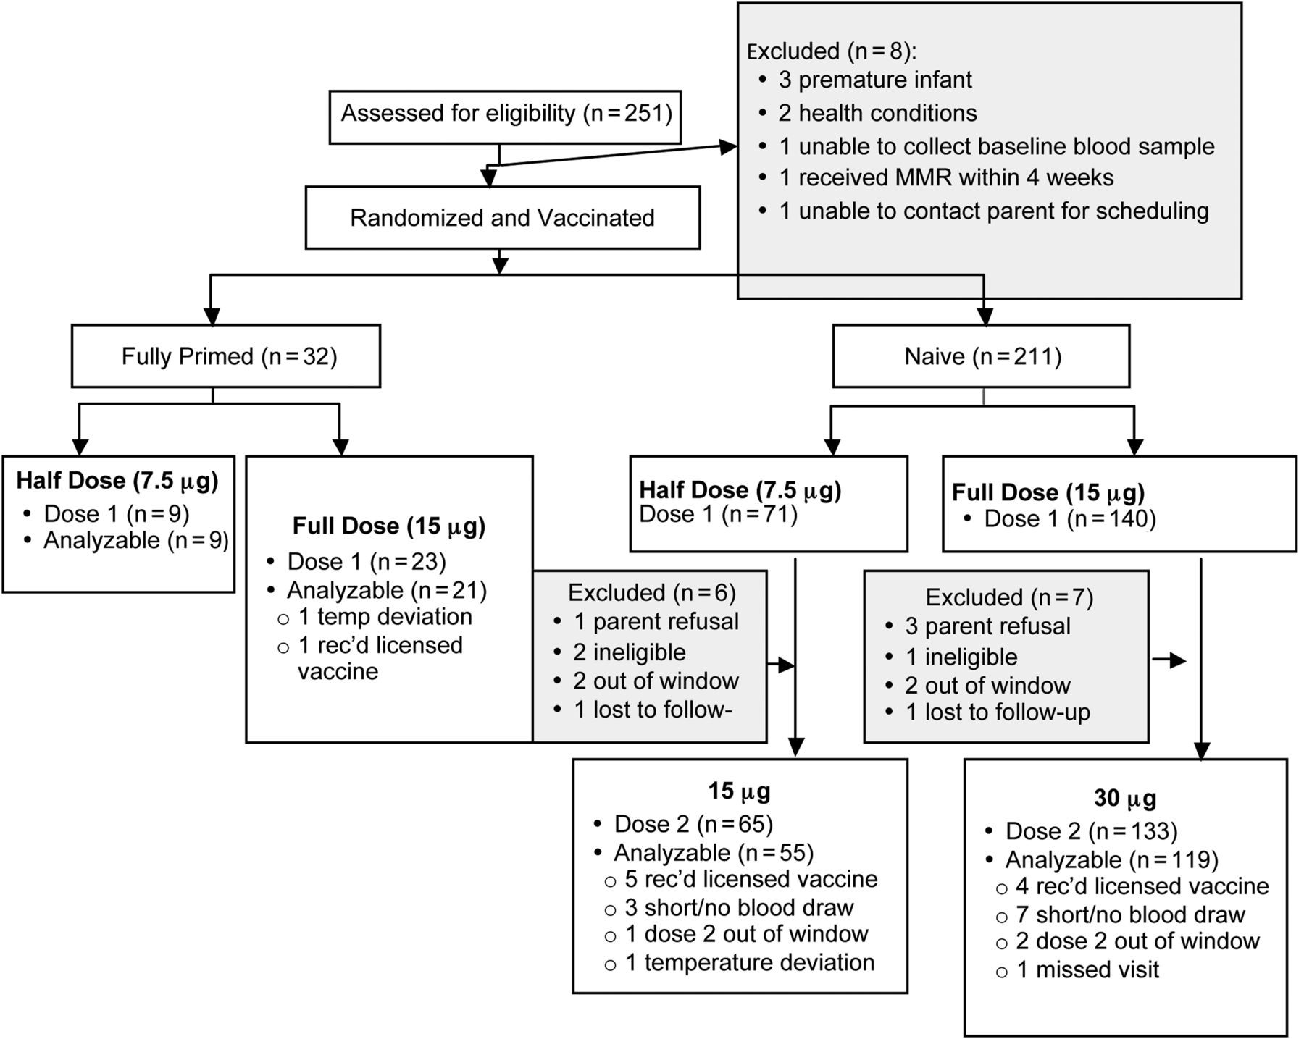
Figure 1. Children assessed for eligibility, randomized, vaccinated, and included in the analysis of safety and ...
Notes:
Figure 1. Children assessed for eligibility, randomized, vaccinated, and included in the analysis of safety and immunogenicity.
Unless provided in the caption above, the following copyright applies to the content of this slide: © The Author 2014. Published by Oxford University Press on behalf of the Pediatric Infectious Diseases Society. All rights reserved. For Permissions, please e-mail: journals.permissions@oup.com.

Slide 2
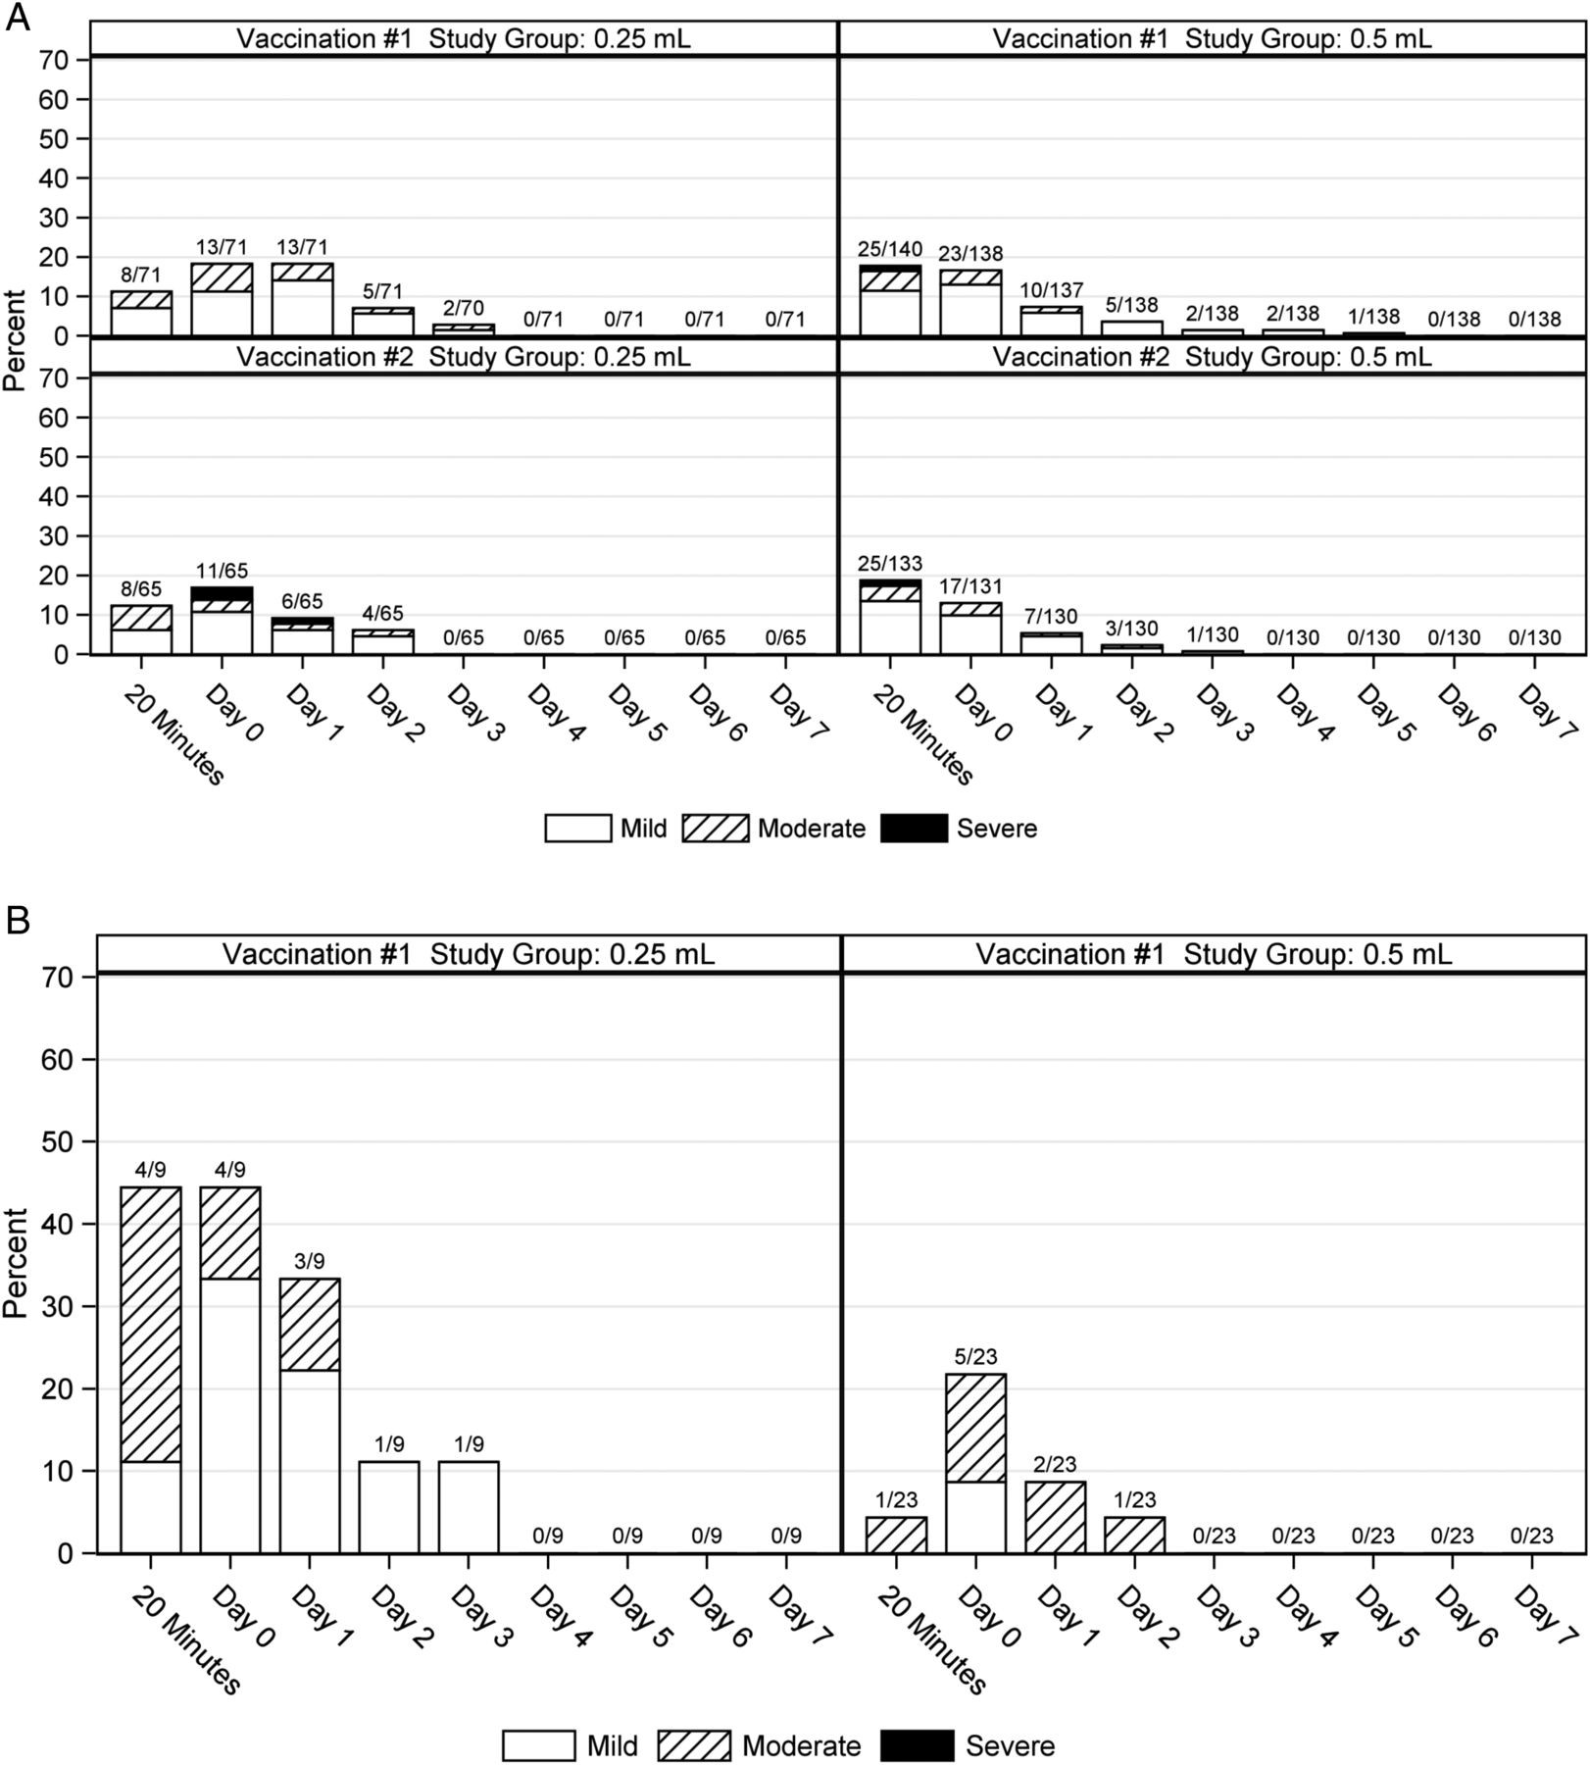
Figure 2. (A) Proportion of children in the naive group who experienced solicited local reactogenicity during the 8 ...
Notes:
Figure 2. (A) Proportion of children in the naive group who experienced solicited local reactogenicity during the 8 days after receiving 2 doses of either 0.5 mL or 0.25 mL of TIV. (B) Proportion of children in the primed group who experienced solicited local reactogenicity during the 8 days after receiving 1 dose of either 0.5 mL or 0.25 mL TIV.
Unless provided in the caption above, the following copyright applies to the content of this slide: © The Author 2014. Published by Oxford University Press on behalf of the Pediatric Infectious Diseases Society. All rights reserved. For Permissions, please e-mail: journals.permissions@oup.com.

Slide 3
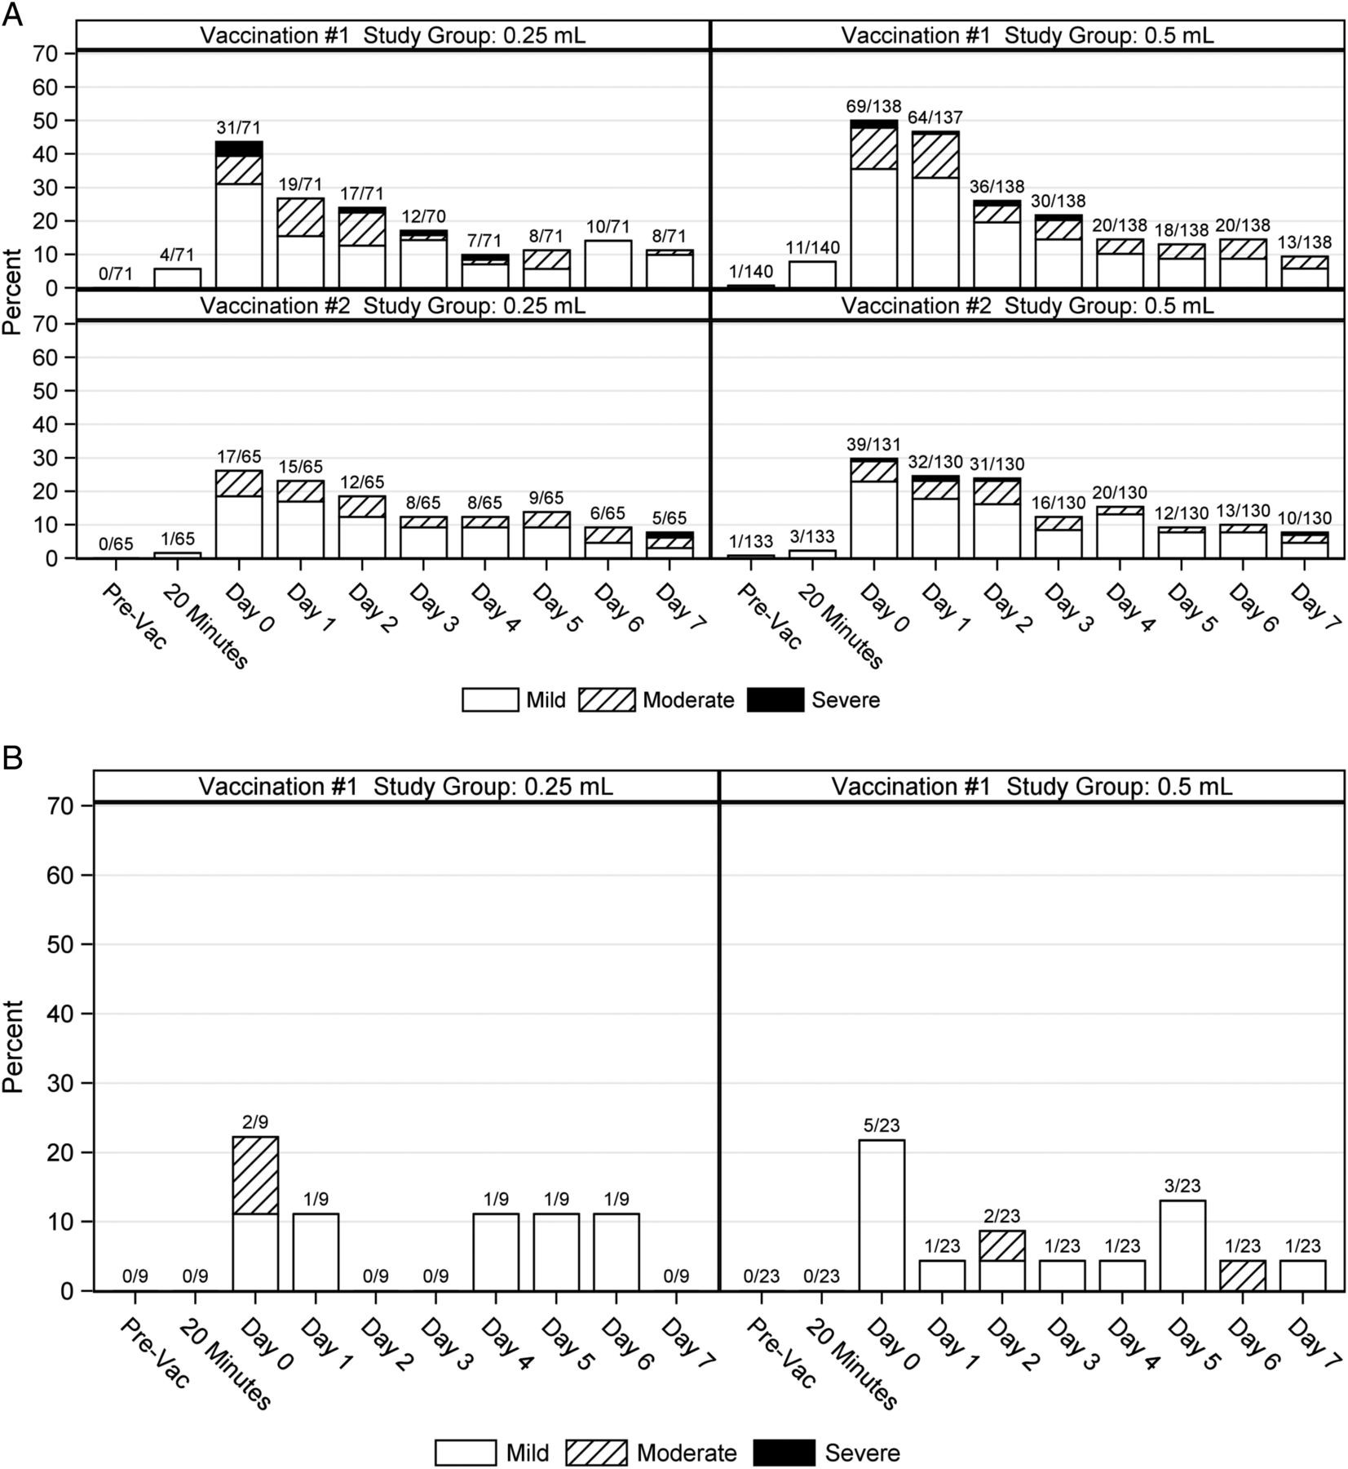
Figure 3. (A) Proportion of children in the naive group who experienced solicited systemic reactogenicity during the 8 ...
Notes:
Figure 3. (A) Proportion of children in the naive group who experienced solicited systemic reactogenicity during the 8 days after receiving 2 doses of either 0.5 mL or 0.25 mL TIV. (B) Proportion of children in the primed group who experienced solicited systemic reactogenicity during the 8 days after receiving 1 dose of either 0.5 mL or 0.25 mL TIV. Vac, vaccine.
Unless provided in the caption above, the following copyright applies to the content of this slide: © The Author 2014. Published by Oxford University Press on behalf of the Pediatric Infectious Diseases Society. All rights reserved. For Permissions, please e-mail: journals.permissions@oup.com.

