Slide 1
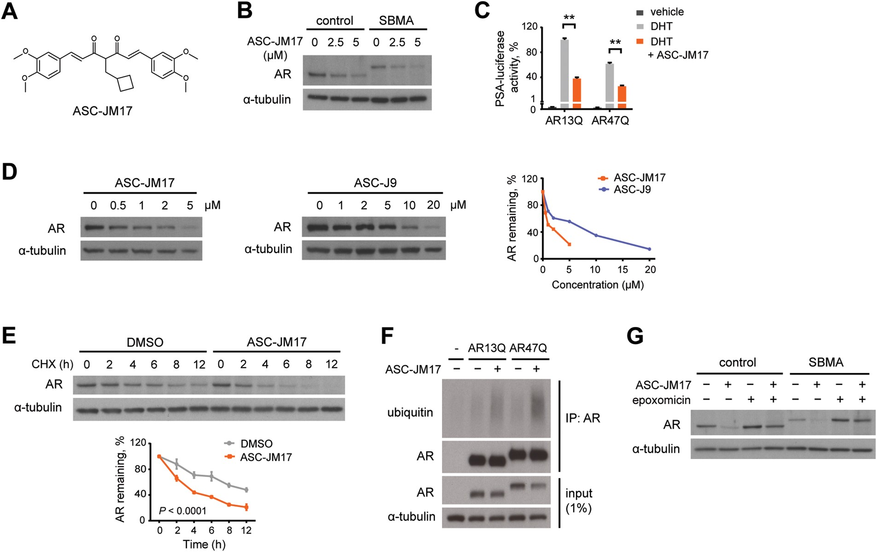
Figure 1. ASC-JM17 reduces AR protein through enhanced degradation by the UPS. (A) Chemical structure of ASC-JM17. (B) ...
Notes:
Figure 1. ASC-JM17 reduces AR protein through enhanced degradation by the UPS. (A) Chemical structure of ASC-JM17. (B) Effect of ASC-JM17 on AR protein levels. Fibroblasts derived from a healthy control and an SBMA patient with 68 CAG repeats were treated with 10 nm DHT and indicated concentrations of ASC-JM17, and analyzed by western blotting. (C) Effect of ASC-JM17 on AR transcriptional activity. PC12 cells expressing AR with wild-type (AR13Q) or expanded (AR47Q) polyglutamine tracts were incubated with ethanol vehicle or DHT (10 nm), with and without 5 µm ASC-JM17. PSA-luciferase activity was measured using the dual luciferase assay (n = 3). Data are expressed as mean ± SEM. **P < 0.01 (two-way ANOVA). (D) Patient fibroblasts were treated with indicated concentrations of ASC-JM17 or ASC-J9 and analyzed by western blotting. AR band intensities were quantified and normalized to α-tubulin. (E) Patient fibroblasts were treated with 10 µm cycloheximide (CHX), with or without 5 µm ASC-JM17 and harvested at indicated time points. The graph shows quantification of AR band intensities normalized to α-tubulin (n = 3). Data are expressed as mean ± SEM (two-way ANOVA). (F) PC12 cells transfected with AR13Q, AR47Q or empty vector were treated with 5 µm ASC-JM17 or DMSO vehicle. AR was immunoprecipitated from whole-cell extracts and its ubiquitylation status was assessed using the ubiquitin antibody FK2. (G) Fibroblasts were incubated with 5 µm ASC-JM17 in the presence or absence of 100 nm epoxomicin.
Unless provided in the caption above, the following copyright applies to the content of this slide: Published by Oxford University Press 2016. This work is written by (a) US Government employee(s) and is in the public domain in the US.

Slide 2
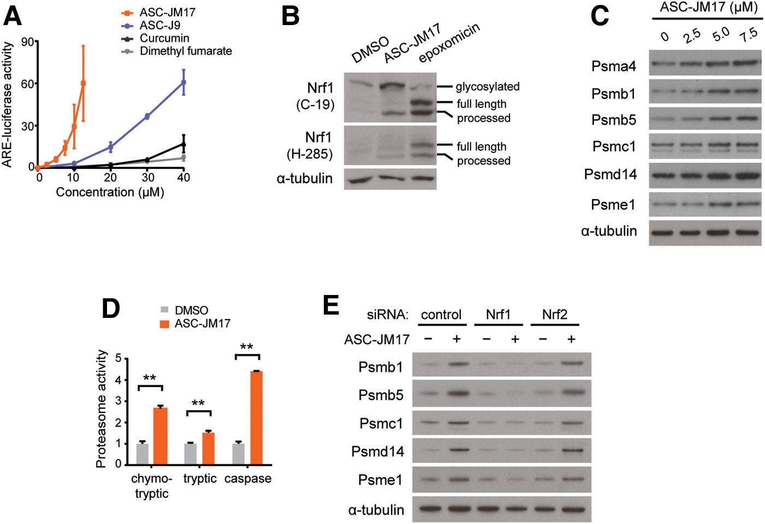
Figure 2. ASC-JM17 increases levels of active proteasomes through Nrf1. (A) Effect of ASC-JM17 on the antioxidant ...
Notes:
Figure 2. ASC-JM17 increases levels of active proteasomes through Nrf1. (A) Effect of ASC-JM17 on the antioxidant response. PC12 cells transfected with ARE-luciferase were treated with increasing concentrations of ASC-JM17, ASC-J9, curcumin or dimethyl fumarate, and analyzed using the dual luciferase assay. Data are expressed as mean ± SEM (n = 3). (B) PC12 cells were treated with ASC-JM17 or epoxomicin and analyzed by western blotting using Nrf1 antibody clones C-19 and H-285. (C) Expression of proteasome subunits in PC12 cells following treatment with indicated concentrations of ASC-JM17. (D) Proteasome activity was measured in PC12 cells after incubation with ASC-JM17. Data are expressed as mean ± SEM (n = 3). **P < 0.01 (Student's t-test). (E) Expression of proteasome subunits in MCF7 cells following transfection with indicated siRNAs and incubation with ASC-JM17.
Unless provided in the caption above, the following copyright applies to the content of this slide: Published by Oxford University Press 2016. This work is written by (a) US Government employee(s) and is in the public domain in the US.

Slide 3
Figure 3. ASC-JM17 increases the expression of antioxidant enzymes via Nrf2. (A) Expression of antioxidant enzymes in ...
Notes:
Figure 3. ASC-JM17 increases the expression of antioxidant enzymes via Nrf2. (A) Expression of antioxidant enzymes in PC12 cells following treatment with indicated concentrations of ASC-JM17. (B) PC12 cells were transfected with indicated siRNAs, treated with ASC-JM17 and analyzed by western blotting. (C) PC12 cells were treated with indicated concentrations of ASC-JM17 for 16 h, or with 1 mm H2O2 for 30 min, which induces oxidative stress in cells. The oxidation status of total cellular proteins was visualized by western blotting after derivatization with 2,4-dinitrophenyl hydrazine. HO-1 protein levels were also analyzed. (D) MCF7 cells transfected with indicated siRNAs were pretreated with 2.5 µm ASC-JM17 for 16 h, followed by indicated concentrations of H2O2 for 4 h. Cell viability was assessed using the XTT assay. Data are expressed as mean ± SEM (n = 3). **P < 0.01 (one-way ANOVA).
Unless provided in the caption above, the following copyright applies to the content of this slide: Published by Oxford University Press 2016. This work is written by (a) US Government employee(s) and is in the public domain in the US.

Slide 4
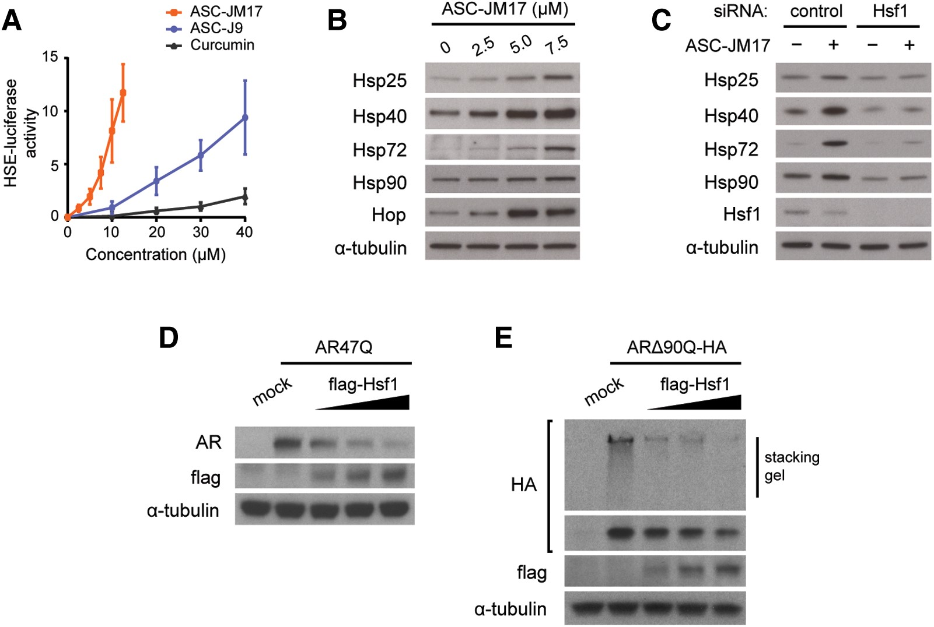
Figure 4. ASC-JM17 activates the heat shock response via Hsf1, which influences mutant AR protein levels and ...
Notes:
Figure 4. ASC-JM17 activates the heat shock response via Hsf1, which influences mutant AR protein levels and aggregation. (A) Effect of ASC-JM17 on the heat shock response. PC12 cells transfected with HSE-luciferase were treated with increasing concentrations of ASC-JM17, ASC-J9 or curcumin, and analyzed using the dual luciferase assay. Data are expressed as mean ± SEM (n = 3). (B) Expression of heat shock proteins in PC12 cells following treatment with indicated concentrations of ASC-JM17. (C) MCF7 cells were transfected with indicated siRNAs, treated with ASC-JM17 and analyzed by western blotting. (D and E) Effect of Hsf1 overexpression on protein levels (D) and aggregation (E) of polyglutamine-expanded AR. PC12 cells were transfected with AR47Q or an HA-tagged amino-terminal fragment of the mutant AR (ARΔ90Q-HA) and increasing concentrations of flag-Hsf1.
Unless provided in the caption above, the following copyright applies to the content of this slide: Published by Oxford University Press 2016. This work is written by (a) US Government employee(s) and is in the public domain in the US.

Slide 5
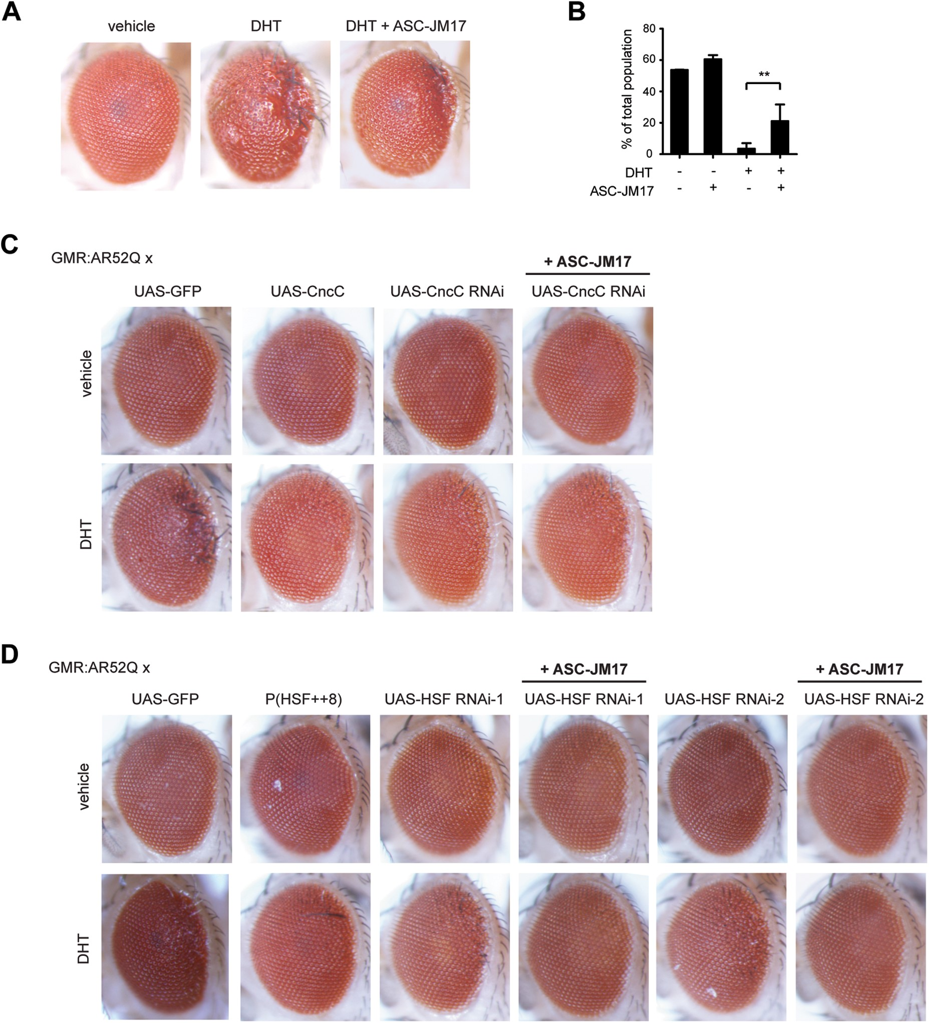
Figure 5. ASC-JM17 rescues mutant AR toxicity in Drosophila. (A) Eye phenotypes of adult GMR:UAS-AR52^{II} ...
Notes:
Figure 5. ASC-JM17 rescues mutant AR toxicity in Drosophila. (A) Eye phenotypes of adult GMR:UAS-AR52II flies following treatment with vehicle, DHT or DHT and ASC-JM17. (B) Viability of Elav > AR52Q flies reared in the presence or absence of DHT and ASC-JM17 was scored over the course of 10 days. **P < 0.01 (χ2 test). (C) Effect of CncC overexpression or knockdown on the DHT-dependent eye phenotype in GMR:UAS-AR52II flies. (D) Effect of HSF overexpression or knockdown in GMR:UAS-AR52II flies. Two independent HSF RNAi lines were evaluated.
Unless provided in the caption above, the following copyright applies to the content of this slide: Published by Oxford University Press 2016. This work is written by (a) US Government employee(s) and is in the public domain in the US.

Slide 6
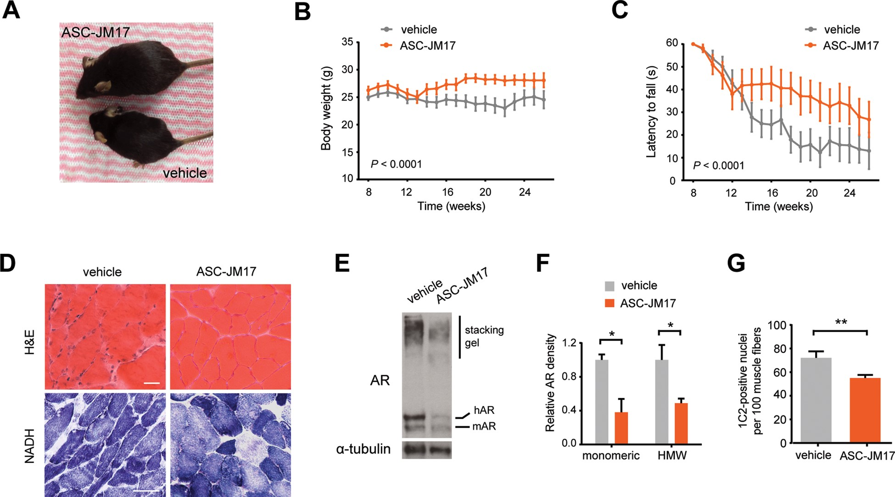
Figure 6. ASC-JM17 ameliorates the disease phenotype in AR97Q mice and reduces mutant AR accumulation in vivo. (A) ...
Notes:
Figure 6. ASC-JM17 ameliorates the disease phenotype in AR97Q mice and reduces mutant AR accumulation in vivo. (A) Picture of two representative AR97Q mice from the same litter treated with 120 mg/kg of ASC-JM17 or vehicle for 6 weeks. (B and C) Body weight (B) and hang time (C) of AR97Q mice treated with ASC-JM17 or vehicle daily from 10 to 26 weeks of age (n = 15 per group). Data are expressed as mean ± SEM (two-way ANOVA). (D) Representative cross-sections of quadriceps muscle from AR97Q mice following treatment with vehicle or ASC-JM17 for 6 weeks. Sections were processed with H&E or NADH staining. Scale bar: 50 μm. (E) AR protein levels in quadriceps muscle of AR97Q mice. (F) Quantification of the monomeric and high molecular weight (HMW) AR signal shown in (E) (n = 3). Data are expressed as mean ± SEM. *P < 0.05 (Student's t-test). (G) Quantification of 1C2-positive nuclei in quadriceps muscle of AR97Q mice (n = 3 per group). Data are expressed as mean ± SEM. **P < 0.01 (Student's t-test).
Unless provided in the caption above, the following copyright applies to the content of this slide: Published by Oxford University Press 2016. This work is written by (a) US Government employee(s) and is in the public domain in the US.

Slide 7
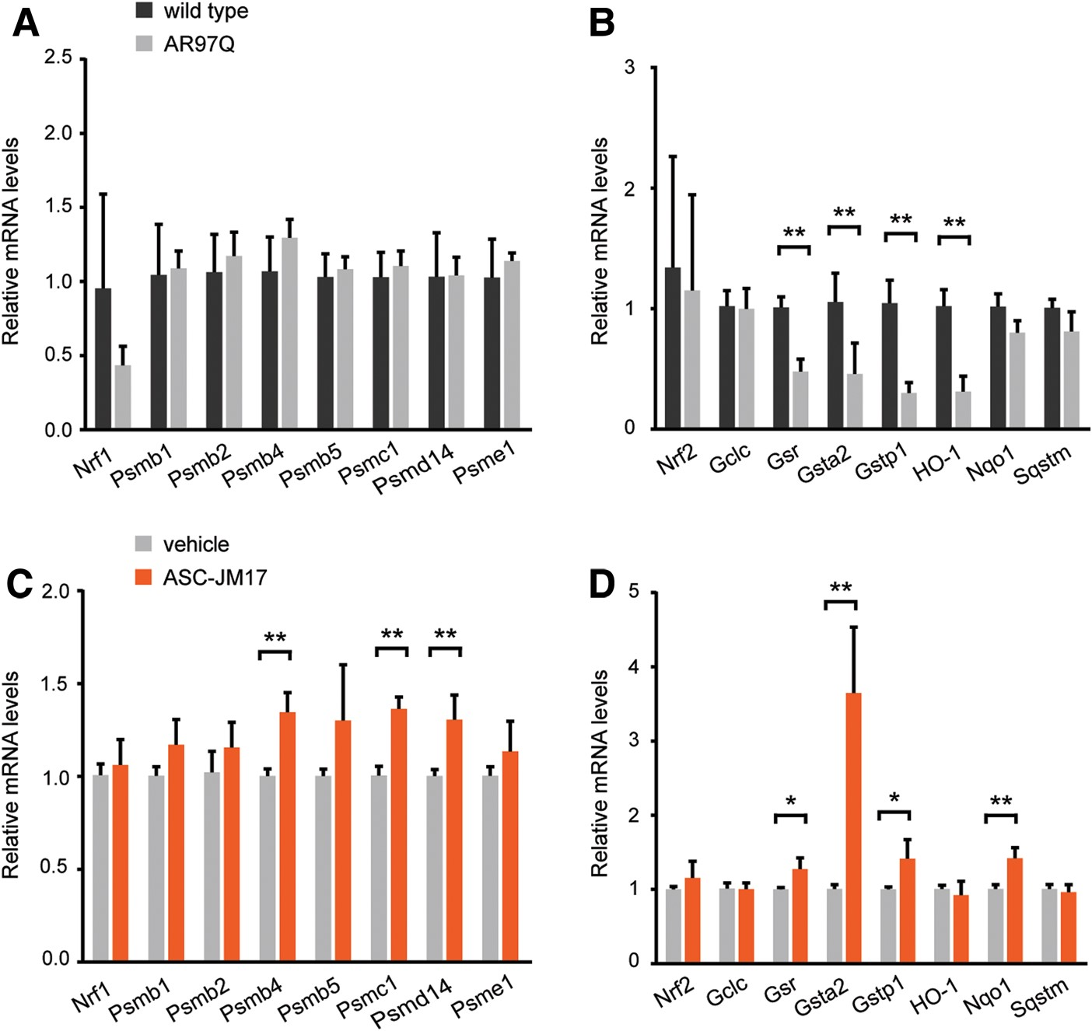
Figure 7. ASC-JM17 increases the expression of Nrf1 and Nrf2 target genes in AR97Q mice. (A and B) Gene expression ...
Notes:
Figure 7. ASC-JM17 increases the expression of Nrf1 and Nrf2 target genes in AR97Q mice. (A and B) Gene expression analysis of Nrf1 (A) and Nrf2 (B) targets in AR97Q mice and non-transgenic littermates (n = 4 per group). Total RNA was extracted from quadriceps muscle of 16-week-old mice. All transcript levels were normalized to Gusb. Data are expressed as mean ± SEM. *P < 0.05, **P < 0.01 (Student's t-test). (C and D) Gene expression analysis of Nrf1 (C) and Nrf2 (D) and downstream targets in AR97Q mice treated with ASC-JM17 or vehicle for 6 weeks.
Unless provided in the caption above, the following copyright applies to the content of this slide: Published by Oxford University Press 2016. This work is written by (a) US Government employee(s) and is in the public domain in the US.

