Slide 1
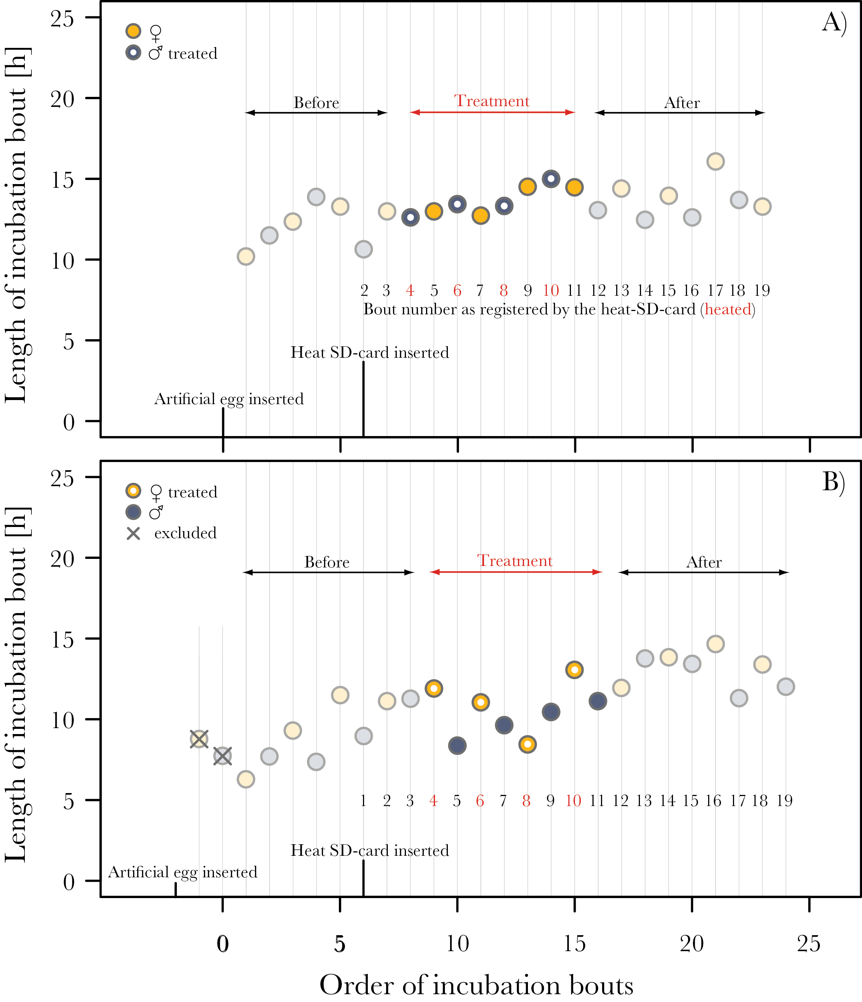
Figure 1 Examples illustrating the experimental procedure. The first bout after introduction of the artificial egg ...
Notes:
Figure 1 Examples illustrating the experimental procedure. The first bout after introduction of the artificial egg marked the start of the before-treatment period (first circle), which lasted until the first heated bout (first circle emphasized by a white point inside); maximum 4 before-treatment bouts per individual were used in the statistical analyses (i.e., earlier bouts were excluded; indicated by crosses in (B). Once the incubation monitoring system received a “heat-SD-card” (sixth circle in (A) and sixth uncrossed circle in (B), it started to count the incubation bouts (black and red numbers). The egg produced heat during bout 4, 6, 8, and 10 (depicted in red and emphasized by white points inside the circles); these bouts together with the subsequent bouts of the untreated parent (5, 7, 9, and 11) were called treatment bouts. The following bouts (maximum 4 per individual) were defined as after-treatment bouts. If the treated bird incubated when the heat-SD-card was inserted, this bout was recorded as number 2 (A); if the untreated bird incubated, this bout was recorded as number 1 (B). Similar graphs depicting the raw data for all treated and control nests are in Supplementary 2 .
Unless provided in the caption above, the following copyright applies to the content of this slide: © The Author 2014. Published by Oxford University Press on behalf of the International Society for Behavioral Ecology.This is an Open Access article distributed under the terms of the Creative Commons Attribution License (http://creativecommons.org/licenses/by/3.0/), which permits unrestricted reuse, distribution, and reproduction in any medium, provided the original work is properly cited.

Slide 2
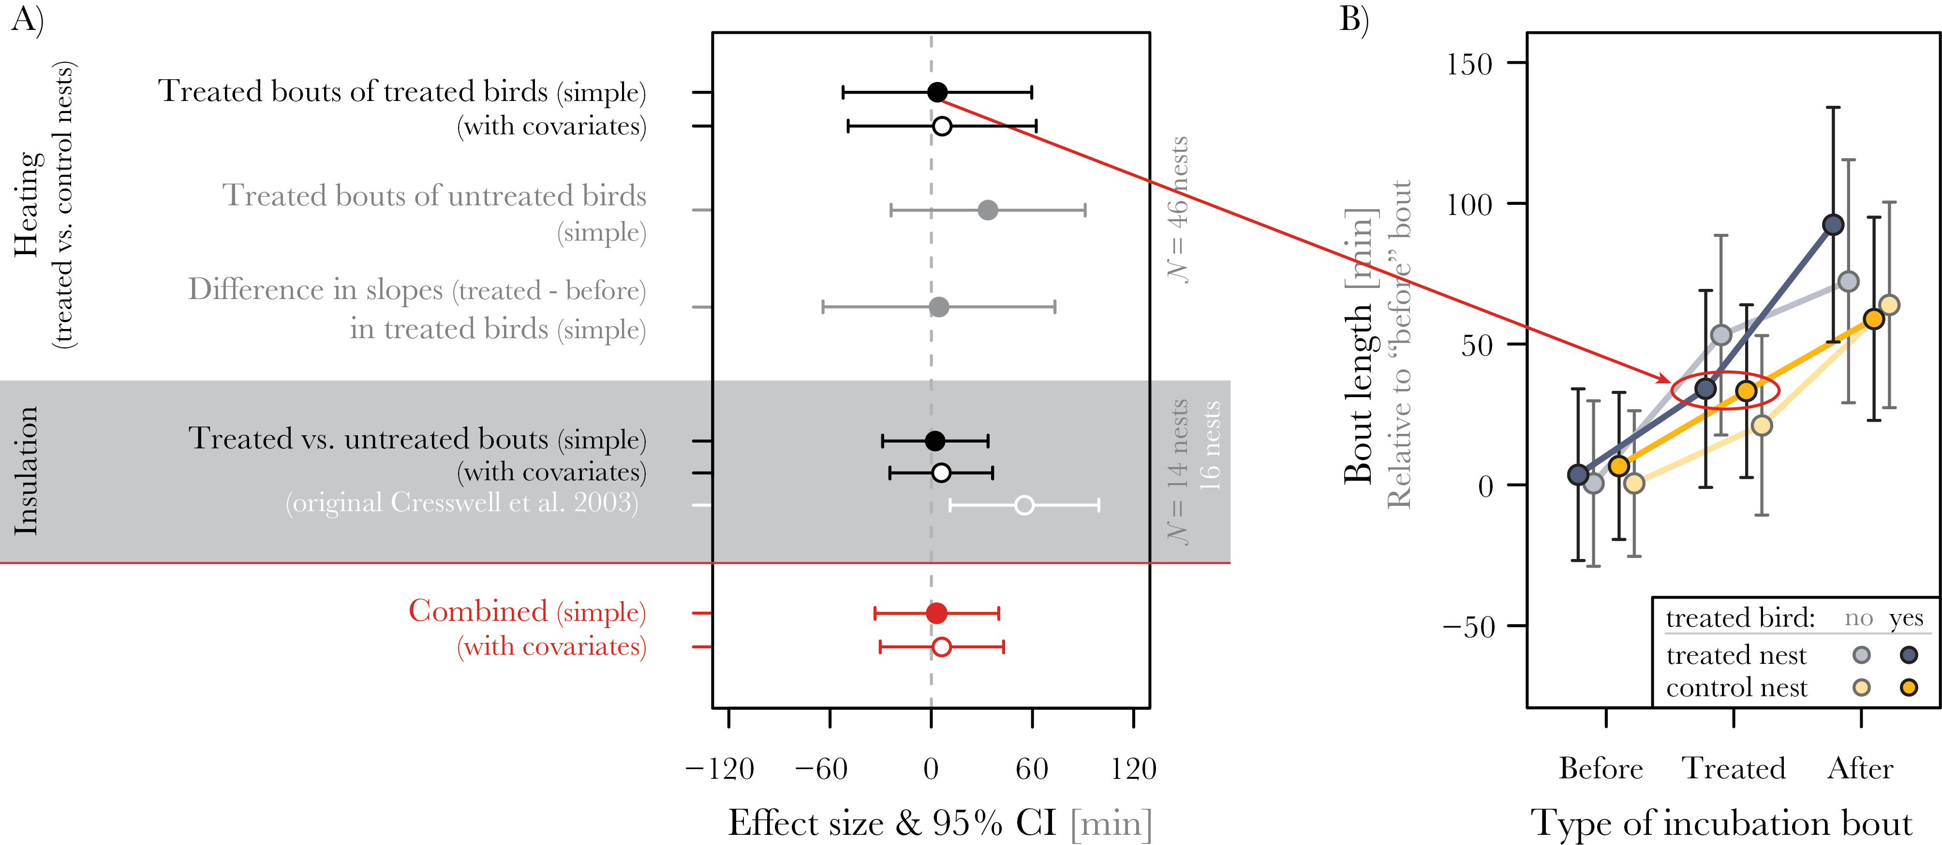
Figure 2 No major effects of heating (A and B) or nest insulation (A, gray area) on the length of incubation bouts. ...
Notes:
Figure 2 No major effects of heating (A and B) or nest insulation (A, gray area) on the length of incubation bouts. In (A), the red dots show the combined effect size for the heating and insulation experiment; filled circles: simple model estimates (statistical details are in Supplementary 1: Section 6, Tables S3 and S5 ); open circles: estimates from complex models with covariates (statistical details are in Supplementary 1: Section 6, Tables S4 and S6 ); in white: the estimate from the original insulation study ( Cresswell et al. 2003 ). In (B), the red ellipse highlights the main comparison of interest, namely the difference between treated bouts in treated nests (heated bouts) and control nests (nonheated bouts). The values depicted in (B) are derived from the simple model using the “allEffects” function of the R package “effects” ( Fox 2003 ); shown are bout lengths relative to the before-treatment bout length (i.e., for each individual, the mean before-bout length was calculated and subtracted from all incubation bouts). This allowed direct comparison of the treatment effects among nests, and controlled for changes in bout length with date and with day of incubation.
Unless provided in the caption above, the following copyright applies to the content of this slide: © The Author 2014. Published by Oxford University Press on behalf of the International Society for Behavioral Ecology.This is an Open Access article distributed under the terms of the Creative Commons Attribution License (http://creativecommons.org/licenses/by/3.0/), which permits unrestricted reuse, distribution, and reproduction in any medium, provided the original work is properly cited.

