Slide 1
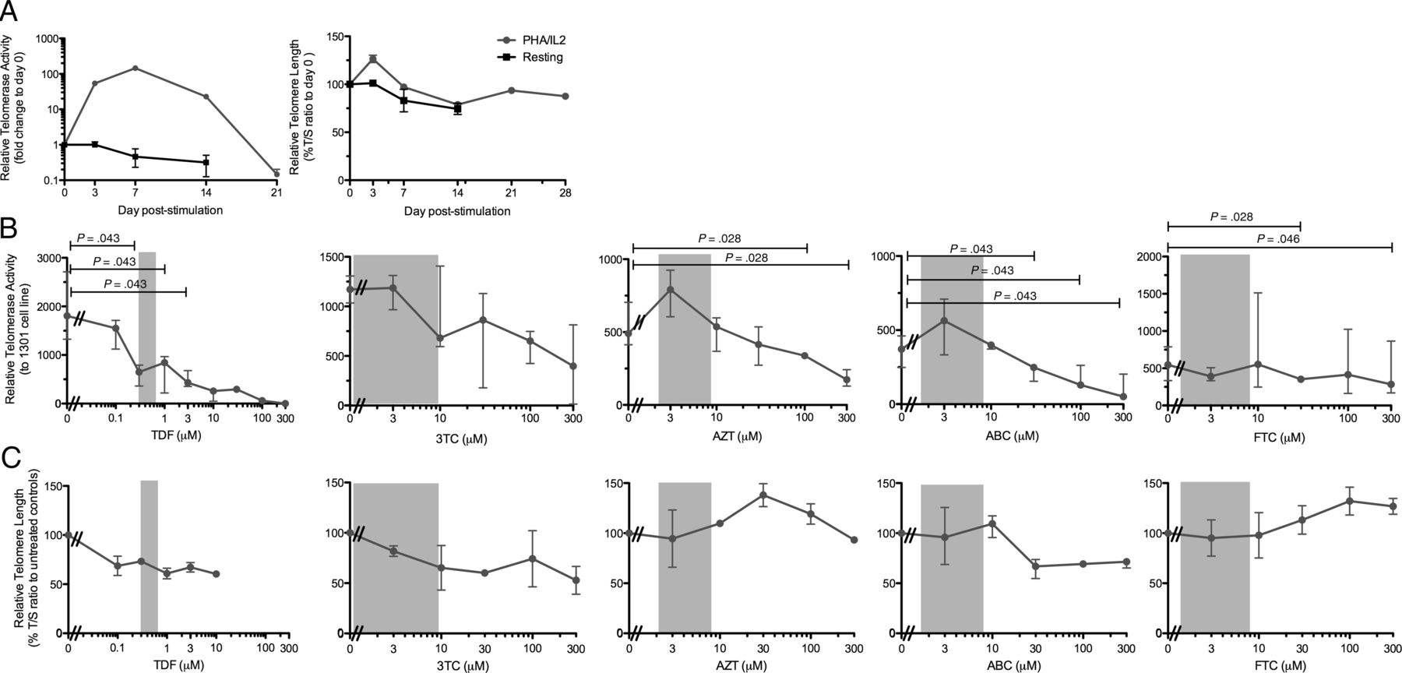
Figure 1. The effect of nucleos(t)ide reverse transcriptase inhibitors (NRTIs) on telomerase activity and telomere ...
Notes:
Figure 1. The effect of nucleos(t)ide reverse transcriptase inhibitors (NRTIs) on telomerase activity and telomere length (TL) in mitogen-activated peripheral blood mononuclear cells (PBMCs). A. Freshly isolated PBMCs were cultured in media alone (black lines and square symbols) and with 10 μg/mL phytohaemagglutinin (PHA) supplemented with 10 U/mL interleukin-2 (IL-2) every 48-hours (black line and round symbols). Then 1–2 × 105 cells were harvested at indicated time points, and telomerase-containing extracts and genomic DNA were prepared. Relative telomerase activity and TL were measured using real-time quantitative telomerase repeats amplification protocol and quantitative polymerase chain reaction, respectively. Telomerase activity was expressed relative to the telomerase-positive 1301 cell line, and TL was expressed relative to that of the single copy housekeeping gene 36B4. Telomerase activity and TL are shown as relative to day 0. Freshly isolated PBMCs were stimulated with 10 μg/mL PHA and supplemented with 10 U/mL IL-2. Cells were harvested after 3 days of stimulation for telomerase activity (B) or after 21 days for TL (C). Effect of lamivudine (3TC), abacavir (ABC), zidovudine (AZT), emtricitabine (FTC), and tenofovir disoproxil fumarate (TDF) on telomerase activity and TL was determined in PHA-activated PBMCs. For telomerase activity (B), the median (closed circles) and interquartile ranges (error bars) are shown for 3TC (n = 4), ABC, TDF (n = 5) or AZT, FTC (n = 6). For TL (C), the median (closed circle) and range (error bars) are shown (n = 2 experiments for all NRTIs). Gray bars represent the expected steady-state plasma levels in vivo for each NRTI. Statistical significance for telomerase activity was calculated using the Friedman test followed with Wilcoxon signed rank test.
Unless provided in the caption above, the following copyright applies to the content of this slide: © The Author 2013. Published by Oxford University Press on behalf of the Infectious Diseases Society of America. All rights reserved. For Permissions, please e-mail: journals.permissions@oup.com.

Slide 2
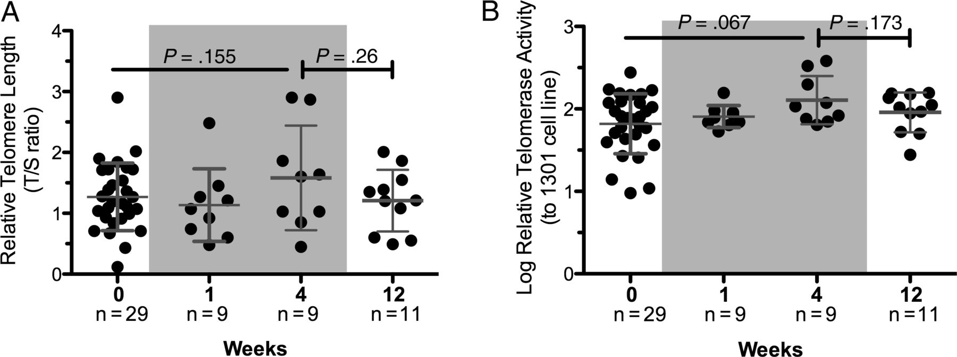
Figure 2. Short-term exposure to nucleos(t)ide reverse transcriptase inhibitors (NRTIs) did not significantly affect ...
Notes:
Figure 2. Short-term exposure to nucleos(t)ide reverse transcriptase inhibitors (NRTIs) did not significantly affect telomerase activity and telomere length (TL) in HIV-uninfected individuals. TL was determined by quantitative polymerase chain reaction and expressed relative to the single copy gene 36B4 (A), and telomerase activity was measured using real-time quantitative telomerase repeats amplification protocol and expressed relative to that of telomerase-positive 1301 cell line (B) in activated peripheral blood mononuclear cells (PBMCs) from HIV-uninfected individuals receiving NRTI-containing nonoccupational postexposure prophylaxis (NPEP). Horizontal lines represent the mean and error bars represent the standard deviation. Statistical significance over weeks 0, 1, and 4 was determined using a generalized estimating equations method, and significance between week 4 and week 12 was determined using the Wilcoxon signed rank test for paired data. Gray bars represent the period when subjects were on NPEP.
Unless provided in the caption above, the following copyright applies to the content of this slide: © The Author 2013. Published by Oxford University Press on behalf of the Infectious Diseases Society of America. All rights reserved. For Permissions, please e-mail: journals.permissions@oup.com.

Slide 3
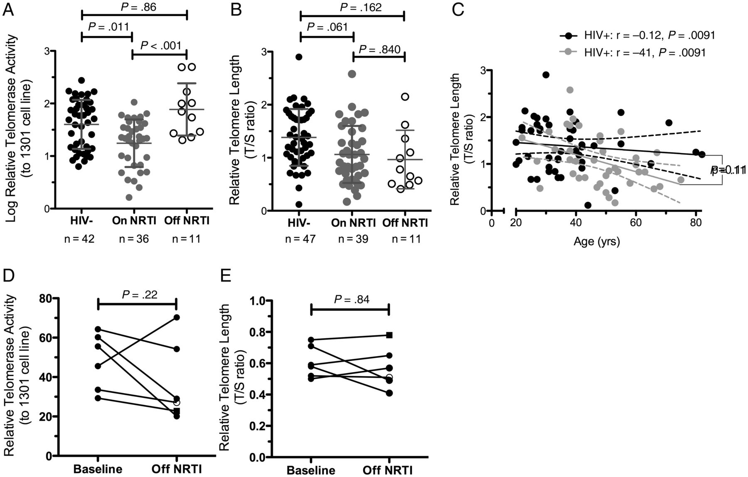
Figure 3. Telomerase activity and telomere length (TL) in peripheral blood mononuclear cells (PBMCs) from human ...
Notes:
Figure 3. Telomerase activity and telomere length (TL) in peripheral blood mononuclear cells (PBMCs) from human immunodeficiency virus (HIV)-infected patients receiving nucleos(t)ide reverse transcriptase inhibitors (NRTI)-containing and non-NRTI–containing combination active antiretroviral therapy (cART). Genomic DNA and telomerase-containing extracts were prepared from PBMCs from uninfected individuals, HIV-infected patients who were receiving NRTI-containing cART, and HIV-infected patients who had discontinued NRTI and were receiving non-NRTI–containing cART. A, Relative telomerase activity was measured using real-time quantitative telomerase repeats amplification protocol and expressed relative to that of telomerase-positive 1301 cell line. B, TL was determined by quantitative polymerase chain reaction and expressed relative to the single copy gene 36B4. Horizontal lines represent the mean and error bars represent the standard deviation. Significance was determined using a linear regression analysis adjusted for age. C, Correlation between TL and age in uninfected (black symbols and black line) and HIV-infected patients (gray symbols and gray line) was determined using a simple linear regression analysis. Relative telomerase activity (D) and TL(E) were measured in HIV-infected patients with HIV RNA < 50 copies/mL while on NRTI-containing cART (baseline) and after stopping NRTI for 36 weeks (open circle), 48 weeks (closed circles), and 60 weeks (closed square). Statistical significance was determined using the Wilcoxon signed rank test.
Unless provided in the caption above, the following copyright applies to the content of this slide: © The Author 2013. Published by Oxford University Press on behalf of the Infectious Diseases Society of America. All rights reserved. For Permissions, please e-mail: journals.permissions@oup.com.

