Slide 1
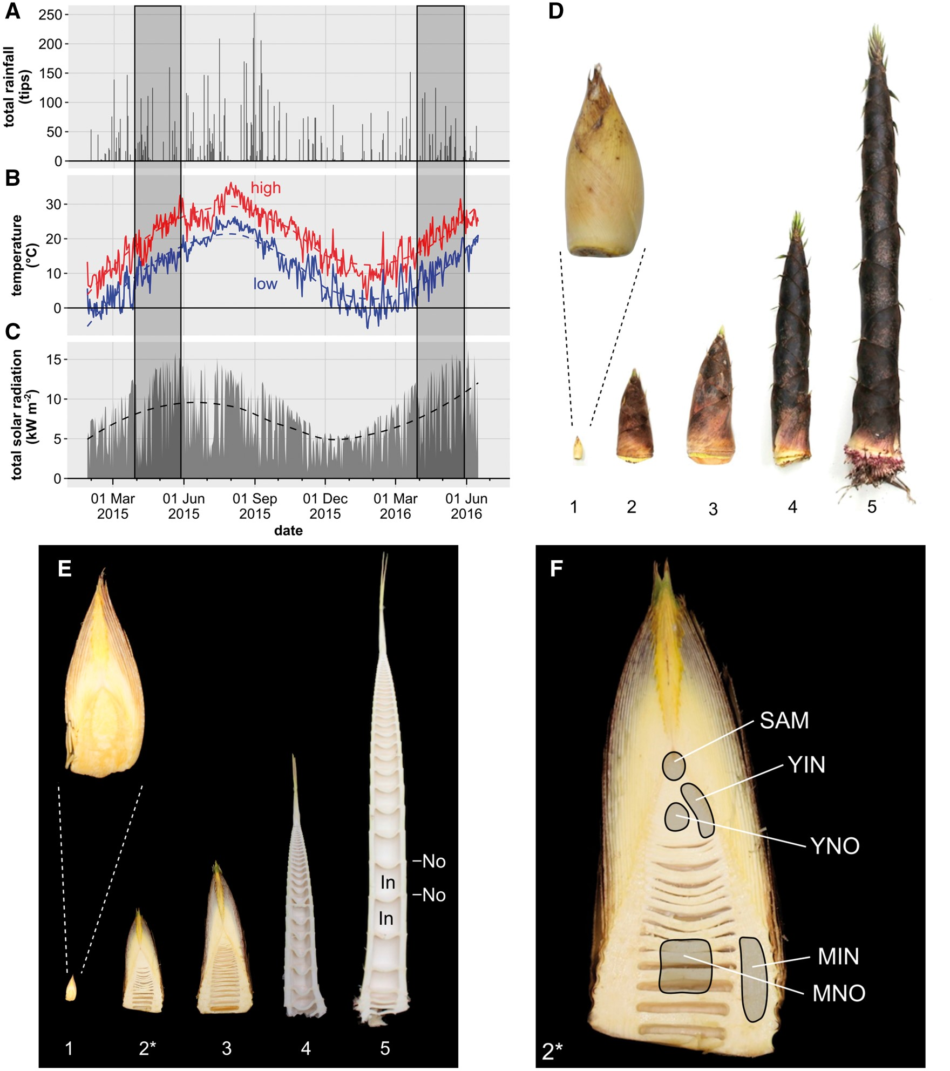
Fig. 1 Weather data and bamboo shoot morphology. Total rainfall (A), highest (red) and lowest (blue) daily ...
Notes:
Fig. 1 Weather data and bamboo shoot morphology. Total rainfall (A), highest (red) and lowest (blue) daily temperatures (B) and total solar radiation (C) at the sampling site from February 2015 until May 2016 were recorded by a nearby weather monitoring station (DavisVantagePro2, co-ordinates 35°06′40.2″N 137°05′04.2″E). Dashed trendlines in (B) and (C) were calculated using R’s ‘loess’ function. Two shaded boxes indicate the seasonal time window of shoot elongation. Intact (D) and half-cut (E) bamboo stems at different developmental stages (1–5) showing elongating internodes (In) separated by nodes (No). The approximate height of stems from each stage was: 1, 5 cm; 2, 25 cm; 3, 35 cm; 4, 50 cm; 5, 90 cm. Stage 2 shoots (F), marked by an asterisk in (E) were used for molecular analyses. Sampled tissues marked in (F) included the shoot apical meristem (SAM) region, young internode (YIN), mature internode (MIN), young node (YNO) and mature node (MNO). Collection of samples was conducted in May 2014.
Unless provided in the caption above, the following copyright applies to the content of this slide: © The Author 2017. Published by Oxford University Press on behalf of Japanese Society of Plant Physiologists. All rights reserved. For permissions, please email: journals.permissions@oup.com

Slide 2
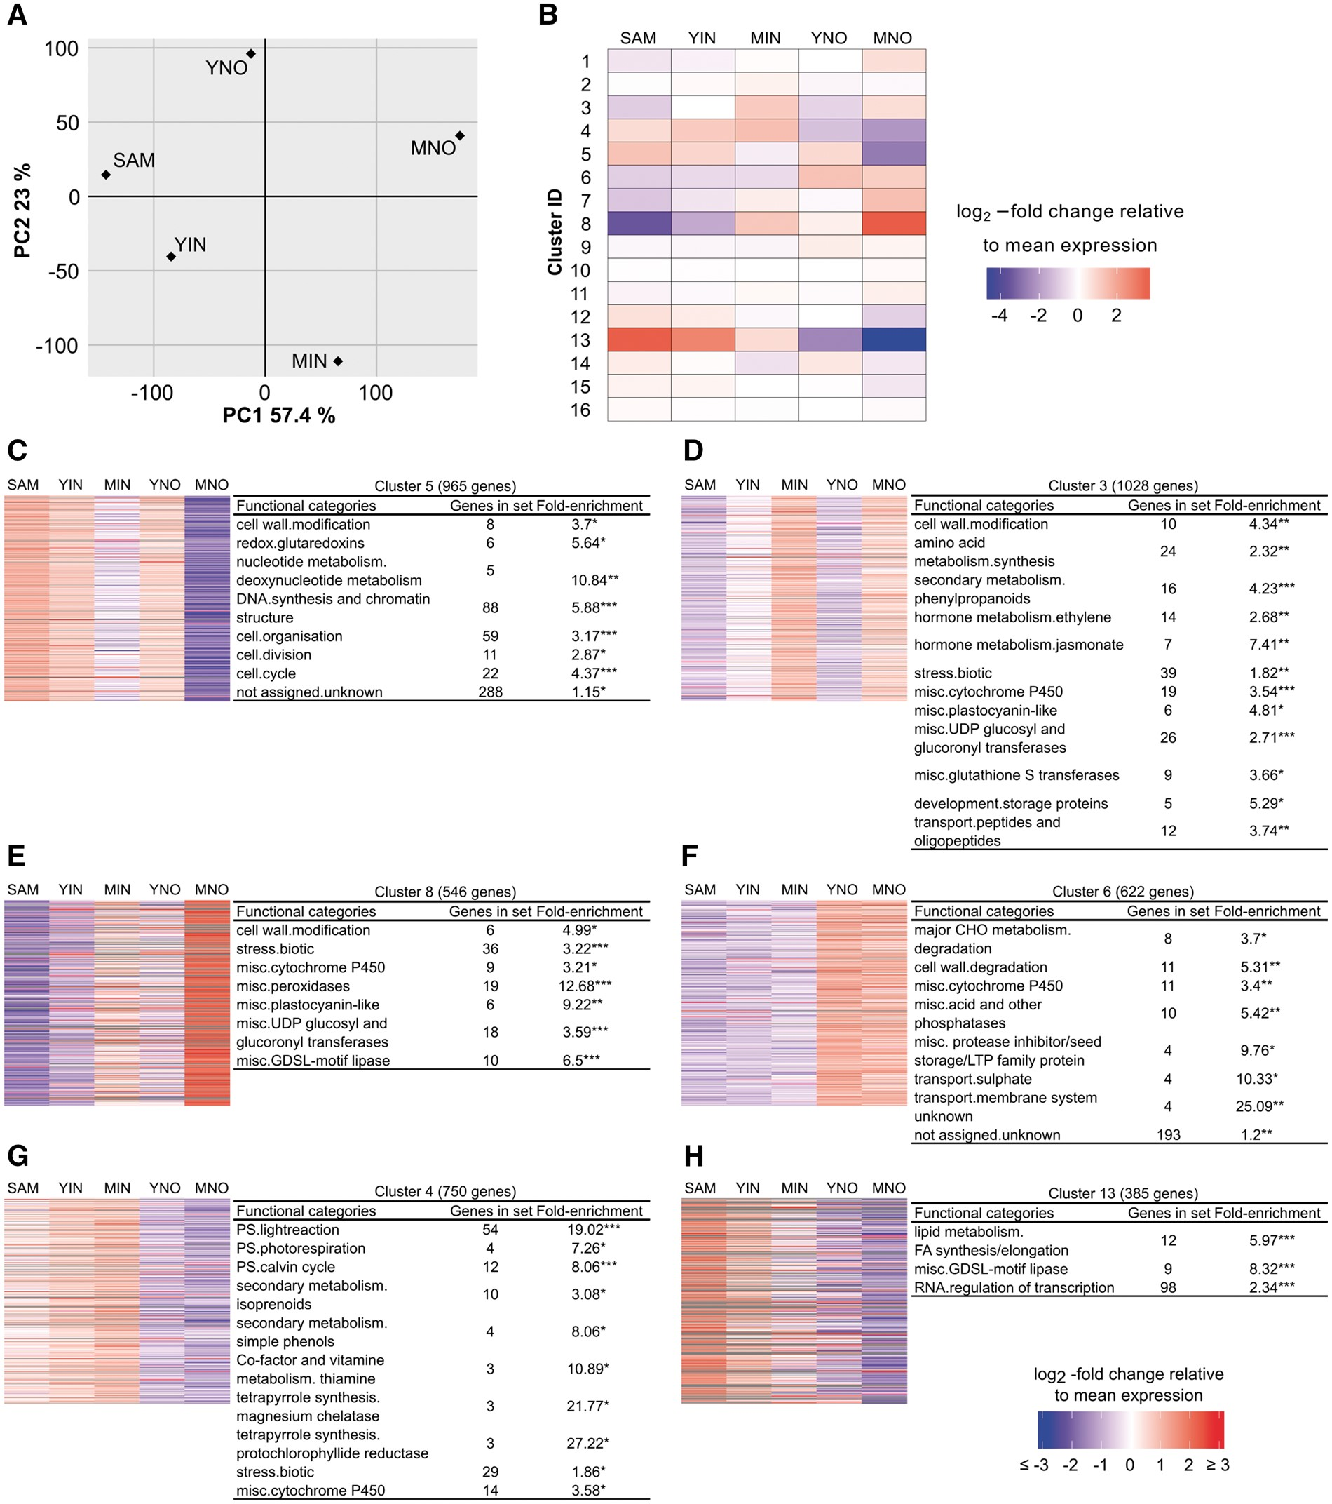
Fig. 2 Gene enrichment in selected k-means clusters. Principal component analysis showing each tissue (SAM, shoot ...
Notes:
Fig. 2 Gene enrichment in selected k-means clusters. Principal component analysis showing each tissue (SAM, shoot apical meristem; YIN, young internode; YNO, young node; MIN, mature internode; MNO, mature node) plotted along the first two principal components (PC 1 and PC 2) with the percentage of variance explained (A). A heatmap representation shows the results of k-means clustering of genes (B). Each column represents one tissue, and each row represents the average relative gene expression of all genes in that cluster. In (C–H), relative gene expression is shown for all genes in the indicated cluster. Gene expression was calculated as the log2-fold change of reads per kilobase of transcript per million (rpkm) relative to the mean expression of each gene. The total number of genes in each cluster is shown along with the results from gene enrichment analysis. For each cluster, significantly enriched MAPMAN level 2 bins are shown. Significance was calculated using Fisher’s exact test followed by Bonferroni–Holm correction (*0.05 > P ≥ 0.01, **0.01 > P ≥ 0.001, ***0.001 > P).
Unless provided in the caption above, the following copyright applies to the content of this slide: © The Author 2017. Published by Oxford University Press on behalf of Japanese Society of Plant Physiologists. All rights reserved. For permissions, please email: journals.permissions@oup.com

Slide 3
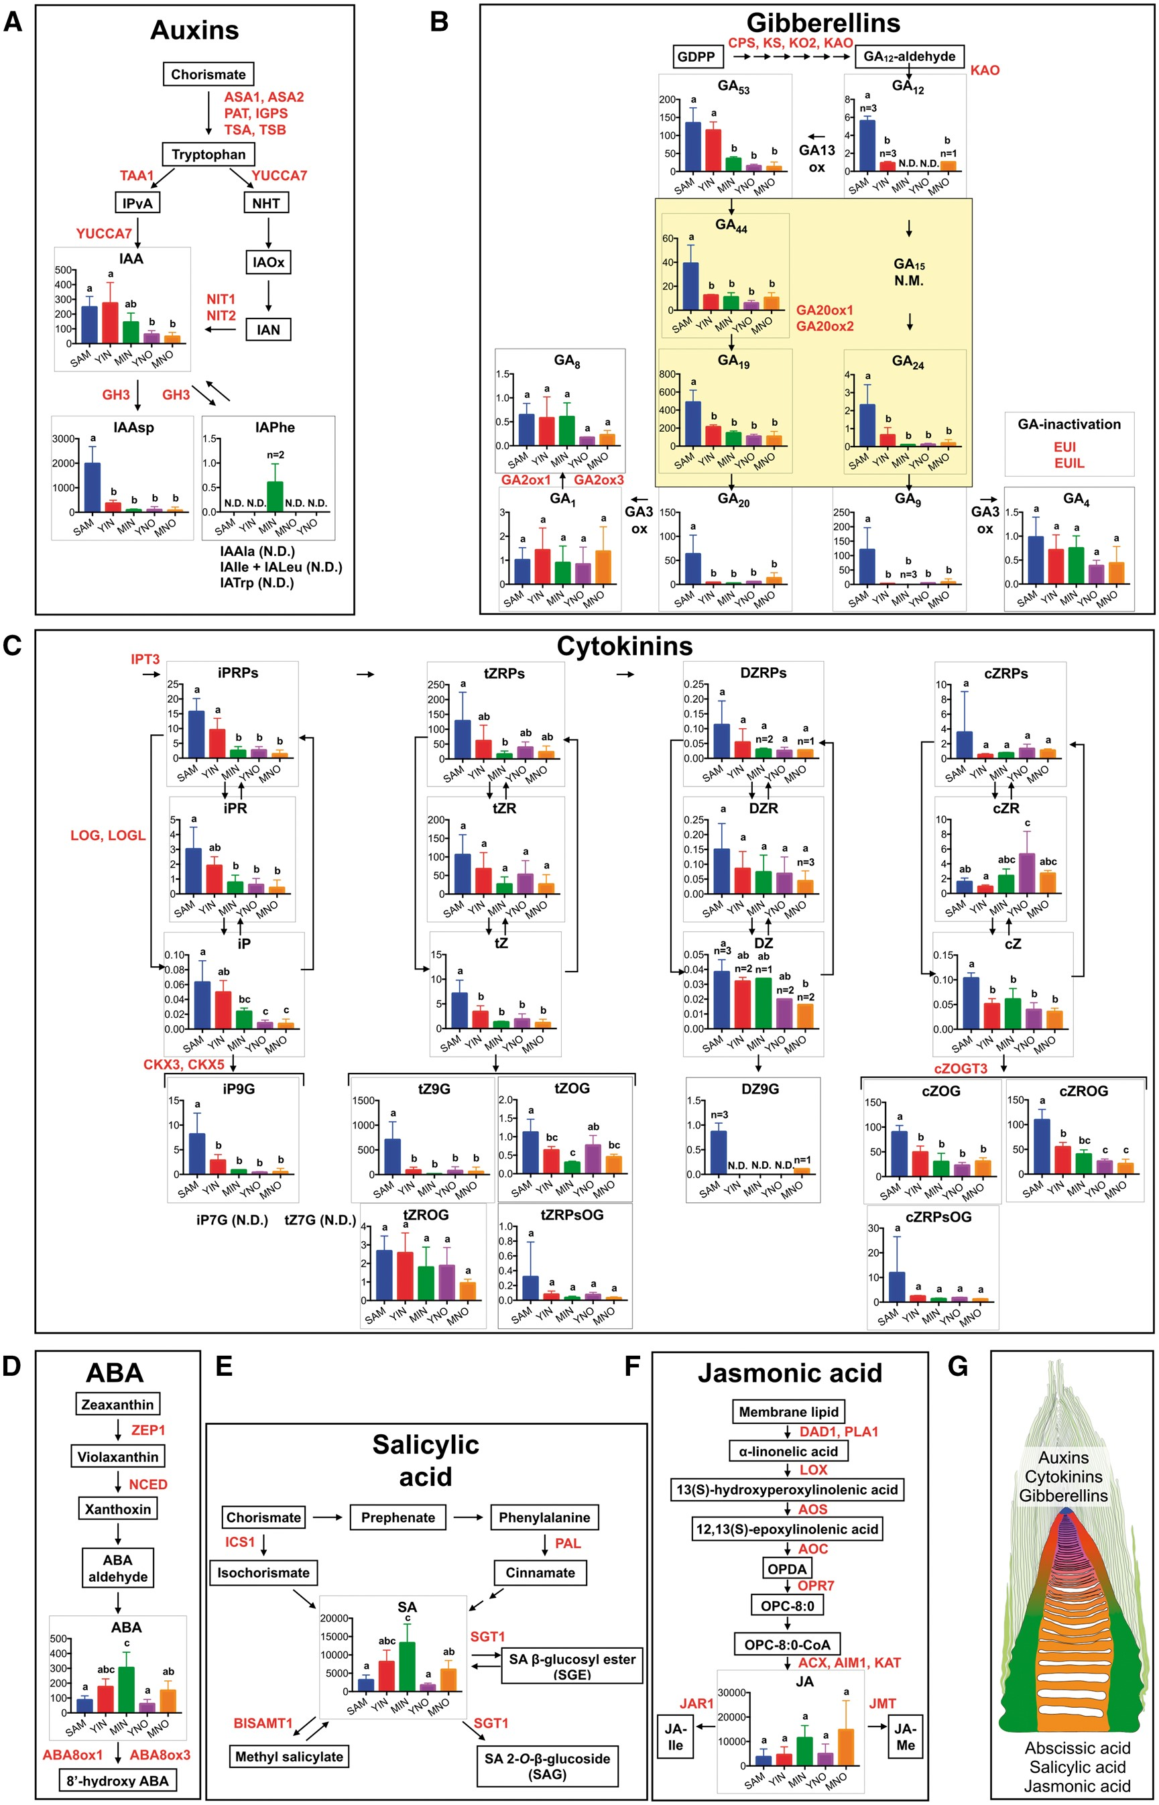
Fig. 3 Biosynthesis and distribution of phytohormones in the bamboo shoots. Auxins (A), gibberellins (B), cytokinins ...
Notes:
Fig. 3 Biosynthesis and distribution of phytohormones in the bamboo shoots. Auxins (A), gibberellins (B), cytokinins (C), ABA (D), salicylic acid (SA) (E) and jasmonic acid (JA) (F) in specific stem regions (see Fig. 1) were quantified as pmol g–1 FW on the y-axis of each graph, and results were summarized in an illustration (G). For each tissue, the number of biological replicates is n = 4 unless stated otherwise. N.D. indicates not detected, while N.M. means not measured. Error bars indicate the SD. Significant differences in metabolite concentrations among the tissues were analyzed by analysis of variance and Tukey’s multiple comparison’s test. Different letters indicate significant differences of the means (P < 0.05). Means with the same letter or with a common letter are not significantly different from each other. Red font indicates hormone metabolism genes detected in our RNA-Seq data. The yellow box in (B) indicates the reactions catalyzed by the enzymes GA20ox1 and GA20ox2. The description of gene abbreviations and detailed expression levels are shown in Supplementary Table S4. The colors in (A) to (G) indicate the stem regions: blue, SAM region; red, YIN; green, MIN; purple, YNO; orange, MNO.
Unless provided in the caption above, the following copyright applies to the content of this slide: © The Author 2017. Published by Oxford University Press on behalf of Japanese Society of Plant Physiologists. All rights reserved. For permissions, please email: journals.permissions@oup.com

Slide 4
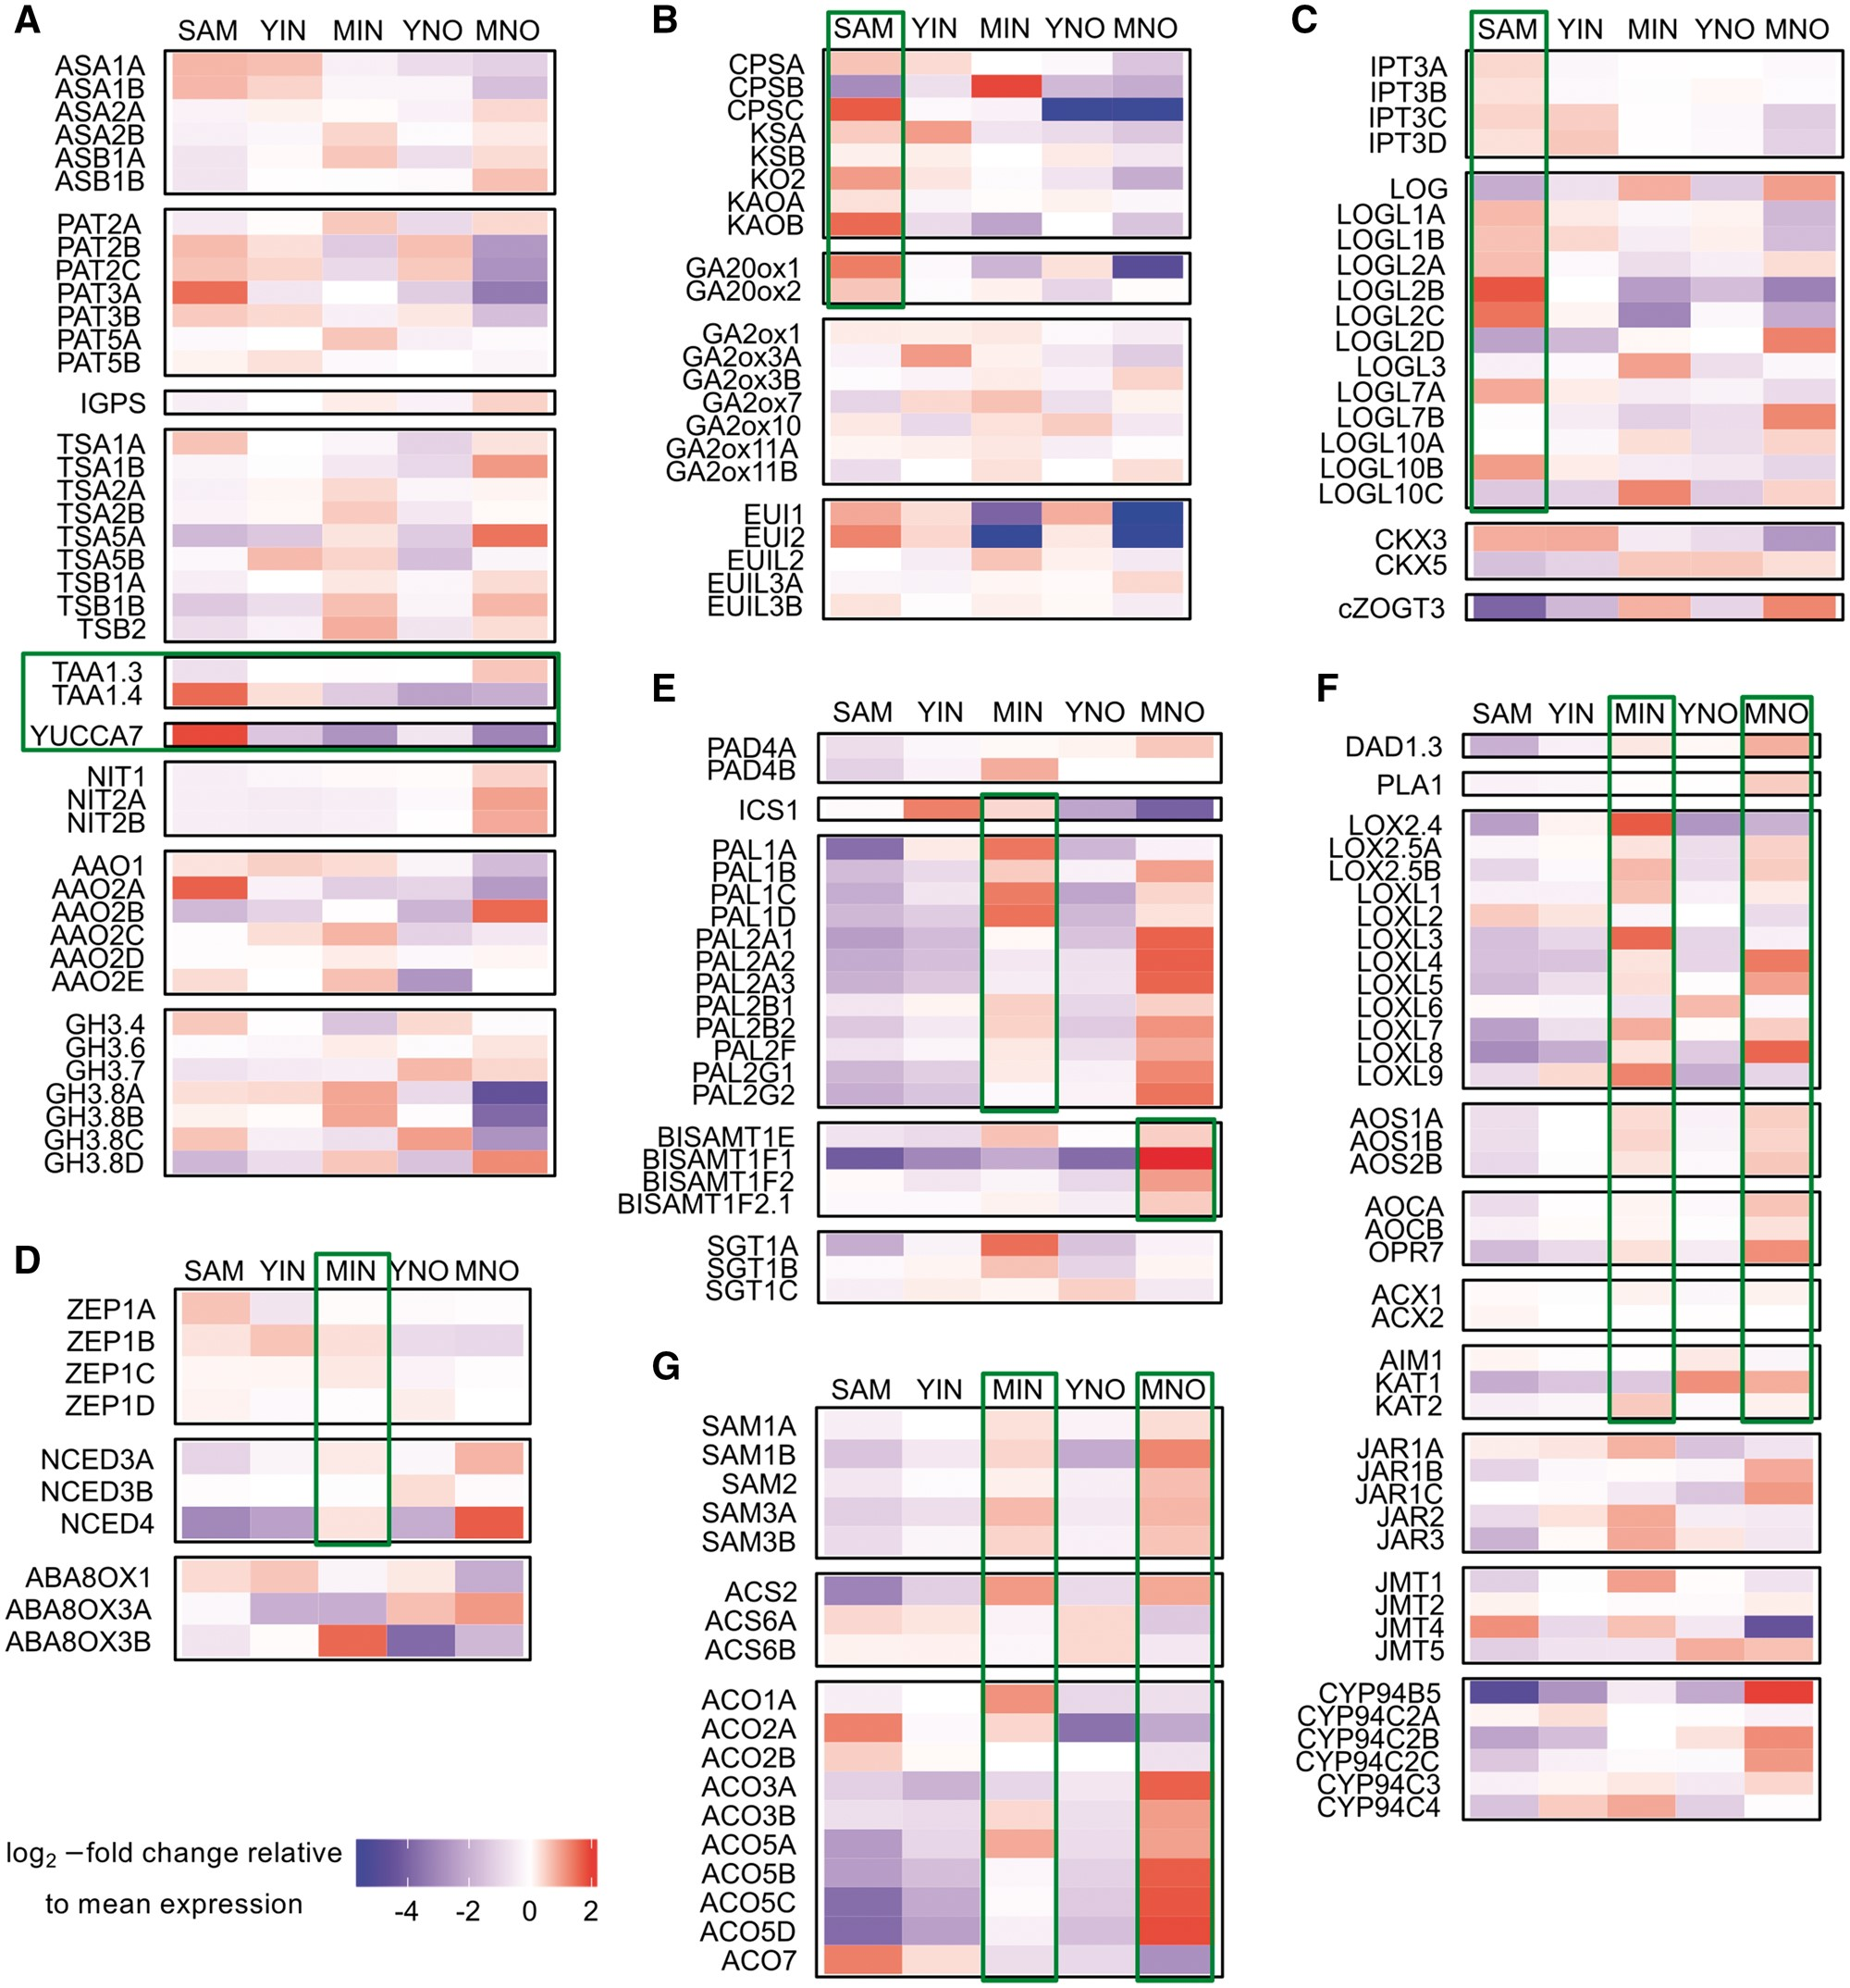
Fig. 4 Expression of hormone metabolism-related genes. Relative expression of selected genes responsible for key ...
Notes:
Fig. 4 Expression of hormone metabolism-related genes. Relative expression of selected genes responsible for key steps in the metabolism of seven plant hormones is shown as heatmap representations. Panels show auxin (A), gibberellin (B), cytokinin (C), ABA (D), SA (E), JA (F) and ethylene (G) metabolism. Each column represents one tissue (SAM, shoot apical meristem; YIN, young internode; YNO, young node; MIN, mature internode; MNO, mature node) and each row represents one transcript. Transcripts are grouped according to gene families or metabolic functions. Gene expression was calculated as the log2-fold change of reads per kilobase of transcript per million (rpkm) relative to the mean expression of each gene. For each tissue, four replicate samples were used. Green boxes indicate genes that are highlighted in the manuscript text.
Unless provided in the caption above, the following copyright applies to the content of this slide: © The Author 2017. Published by Oxford University Press on behalf of Japanese Society of Plant Physiologists. All rights reserved. For permissions, please email: journals.permissions@oup.com

