Slide 1
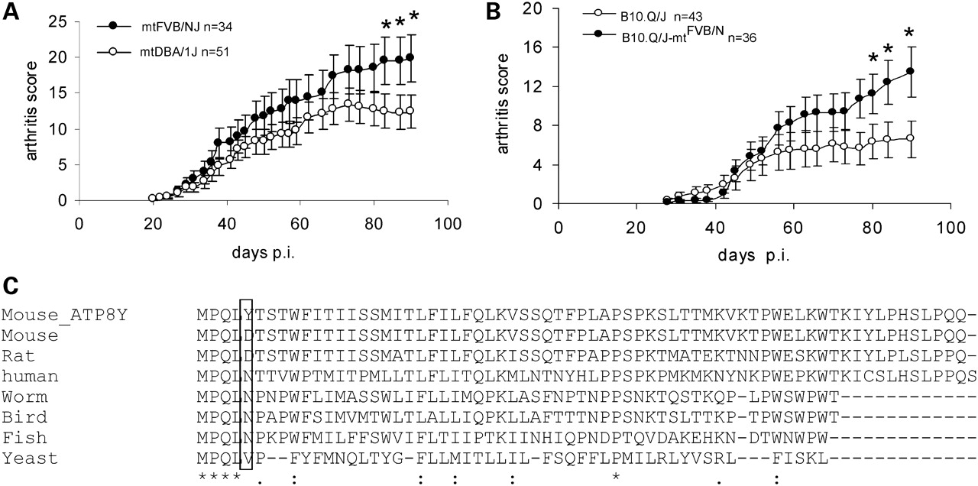
Figure 1. Identification of the mtAtp8 polymorphism. (A) Development of CIA in (DBA/1J×FVB/NJ)F2 mice with FVB/NJ mtDNA ...
Notes:
Figure 1. Identification of the mtAtp8 polymorphism. (A) Development of CIA in (DBA/1J×FVB/NJ)F2 mice with FVB/NJ mtDNA or DBA/1J mtDNA. Both male and female mice that developed arthritis were included for calculation. (B) Development of CIA in conplastic strain (B10.Q/J-mtFVB/N) and the control (B10.Q/J). Data are presented as mean ± SEM of the clinical arthritis score at the indicated number of day after immunization. Both diseased and non-diseased mice are included for comparison. (C) Evolutionary comparison of ATP8 protein. Protein sequence alignment was performed for seven species including yeast (Saccharomyces cerevisiae, CAA09831), worm (Eudromia elegans, NP_115277), fish (Danio rerio, Q9MIY6), bird (Anser albifrons, NP_777306), mouse (Mus musculus, AAR21199), rat (Rattus norvegicus, AP_004896) and human (Homo sapiens, ABQ09378) as well as the mouse with the ATP8 D-Y polymorphism. *Indicates P < 0.05.
Unless provided in the caption above, the following copyright applies to the content of this slide: © The Author 2009. Published by Oxford University Press. All rights reserved. For Permissions, please email: journals.permissions@oxfordjournals.org

Slide 2
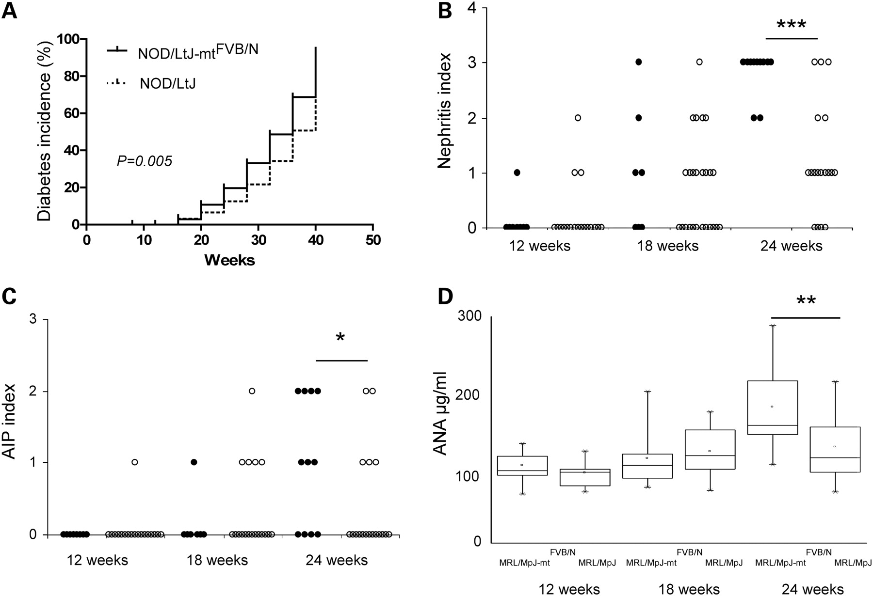
Figure 2. The mtAtp8 polymorphism affects multiple autoimmune diseases. (A) Development of autoimmune diabetes in ...
Notes:
Figure 2. The mtAtp8 polymorphism affects multiple autoimmune diseases. (A) Development of autoimmune diabetes in NOD/LtJ (n = 50) and NOD/LtJ-mtFVB/N (n = 50) female mice. The P-value was calculated with Gehan–Breslow–Wilcoxon test. (B) Interstitial nephritis in MRL/MpJ (open circle) and MRL/MpJ-mtFVB/N (closed circle) female mice. (C) AIP in MRL/MpJ (open circle) and MRL/MpJ-mtFVB/N (closed circle) female. Nephritis and AIP scores were evaluated histopathologically according to the severity of the disease. (D) Anti-nuclear antibody levels in MRL/MpJ and MRL/MpJ-mtFVB/N female mice. * P < 0.05, ** P < 0.01 and *** P < 0.001.
Unless provided in the caption above, the following copyright applies to the content of this slide: © The Author 2009. Published by Oxford University Press. All rights reserved. For Permissions, please email: journals.permissions@oxfordjournals.org

Slide 3
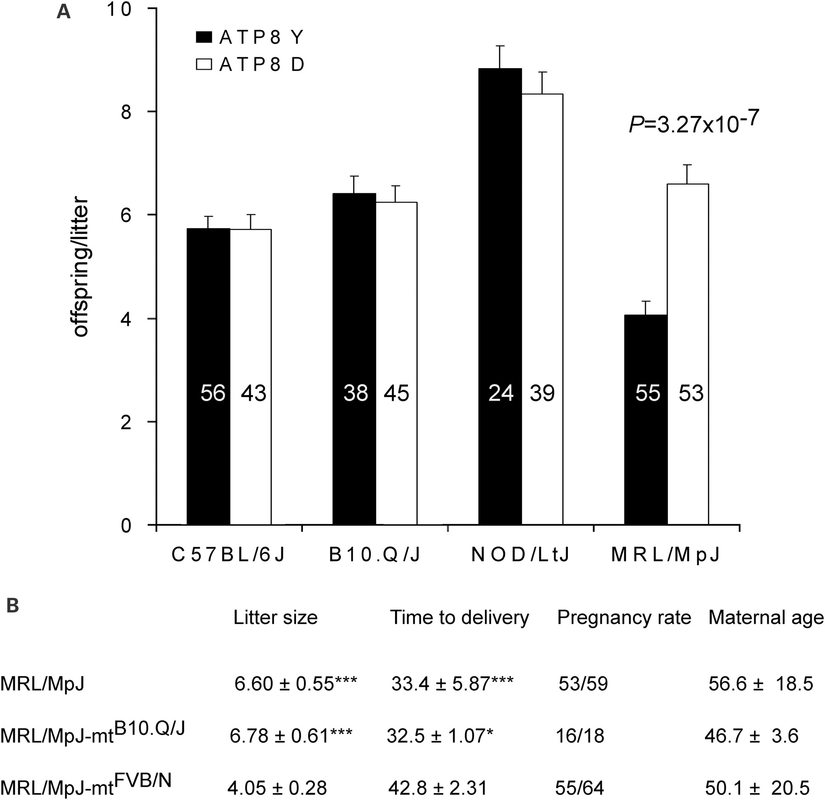
Figure 3. The mtAtp8 polymorphism affects female reproductive performance. (A) A survey of the effect of the ATP8 D-Y ...
Notes:
Figure 3. The mtAtp8 polymorphism affects female reproductive performance. (A) A survey of the effect of the ATP8 D-Y polymorphism on litter size in four genetic backgrounds. The number of litters is depicted inside the bars for each strain. The maternal age on the day starting mating are 56.6 ± 18.5 days for MRL/MpJ strain and 50.1 ± 20.5 days for MRL/MpJ-mtFVB/N strain. Shown are means ± SEM. (B) Reproductive performance of the MRL/MpJ mice. Time to delivery (in days) represents the time period from mating to birth, and fertility rate represents a ratio between numbers of female mice giving birth to those used for matings. Control ATP8 wild-type mice (MRL/MpJ and MRL/MpJ-mtB10.Q/J) were compared with ATP8 mutant mice (MRL/MpJ-mtFVB/N). The maternal age presented in days stands for the age of the female mice on the day starting mating. * Indicates P < 0.05, and *** indicates P < 0.001.
Unless provided in the caption above, the following copyright applies to the content of this slide: © The Author 2009. Published by Oxford University Press. All rights reserved. For Permissions, please email: journals.permissions@oxfordjournals.org

Slide 4
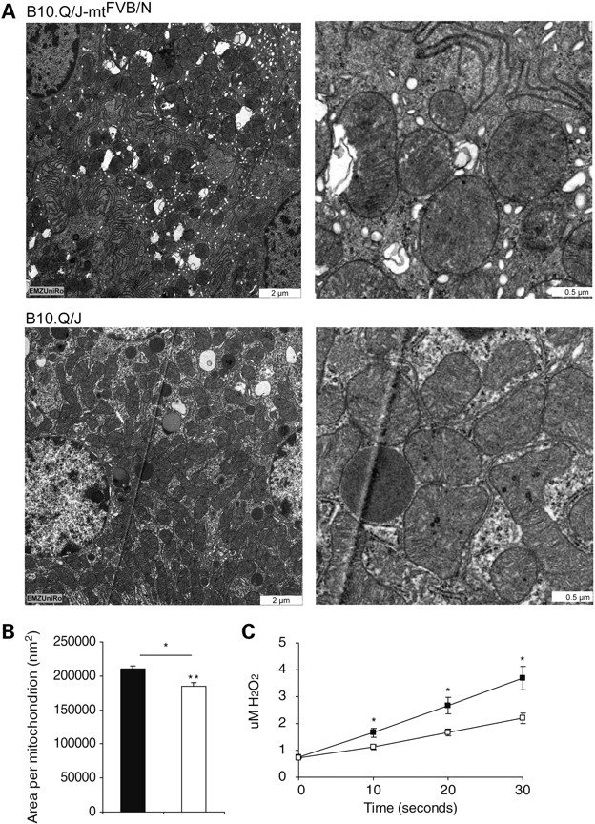
Figure 4. Functional analysis of the mtAtp8 polymorphism. (A) Transmission electron microscopy of mitochondrial ...
Notes:
Figure 4. Functional analysis of the mtAtp8 polymorphism. (A) Transmission electron microscopy of mitochondrial ultrastructure in kidney of B10.Q/J-mtFVB/N and B10.Q/J mice. (B) Comparison of the size of mitochondria between B10.Q/J-mtFVB/N (filled bars) and B10.Q/J (open bars) in Kidney. The size is presented as mitochondrial area calculated using the software Image J. In total, >800 individual mitochondria were analyzed per genotype, and the P-value was calculated using Student's t test. (C) H2O2-production in mitochondria isolated from spleen cells of B10.Q/J-mtFVB/N (n = 5, filled square) and B10.Q/J (n = 5, open square). The P-value was calculated using Mann–Whitney U test. H2O2-production was measured under respiratory state 4 conditions with 200 µg mitochondrial proteins. Shown are means ± SEM, * indicates P < 0.05 and ** indicates P < 0.01.
Unless provided in the caption above, the following copyright applies to the content of this slide: © The Author 2009. Published by Oxford University Press. All rights reserved. For Permissions, please email: journals.permissions@oxfordjournals.org

Slide 5
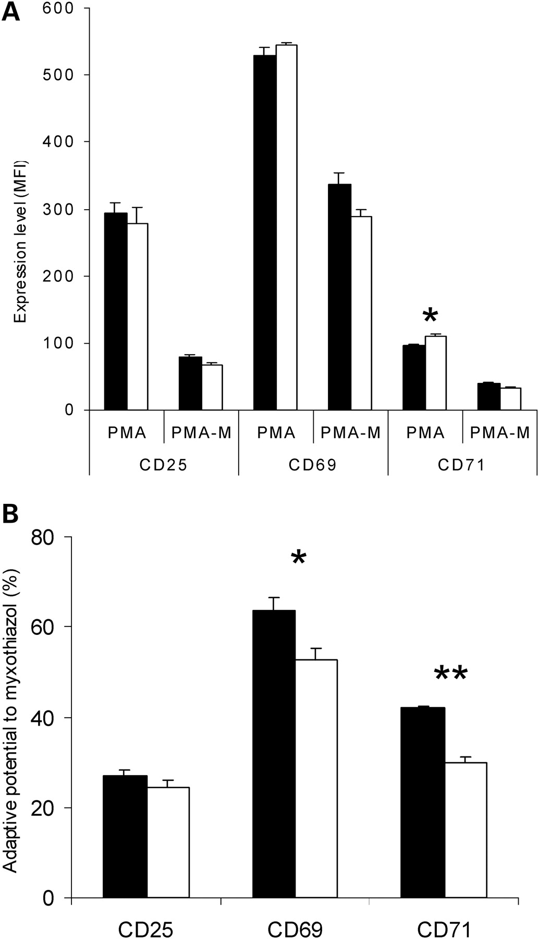
Figure 5. Effect of the mtAtp8 polymorphism on CD4 T cell activation. (A) Effect of the mtAtp8 polymorphism on the ...
Notes:
Figure 5. Effect of the mtAtp8 polymorphism on CD4 T cell activation. (A) Effect of the mtAtp8 polymorphism on the expression of T cell activation markers on CD4 T cells under PMA stimulation in the absence (PMA) or the presence of myxothiazol (PMA-M). The expression level of activation markers are presented as mean fluorescence intensity (MFI). (B) The adaptive potential to myxothiazol of CD4+ T cells with two genotypes. The adaptive potential was calculated as MFIPMA-M/MFIPMA × 100%. Filled bars show C57BL/6J-mtFVB/N mice (n = 4) and open bars C57BL/6J-mtAKR/J (n = 4). Shown are means ± SEM, * indicates P < 0.05 and ** indicates P < 0.01. P-values are calculated using Mann–Whitney U test.
Unless provided in the caption above, the following copyright applies to the content of this slide: © The Author 2009. Published by Oxford University Press. All rights reserved. For Permissions, please email: journals.permissions@oxfordjournals.org

