Slide 1
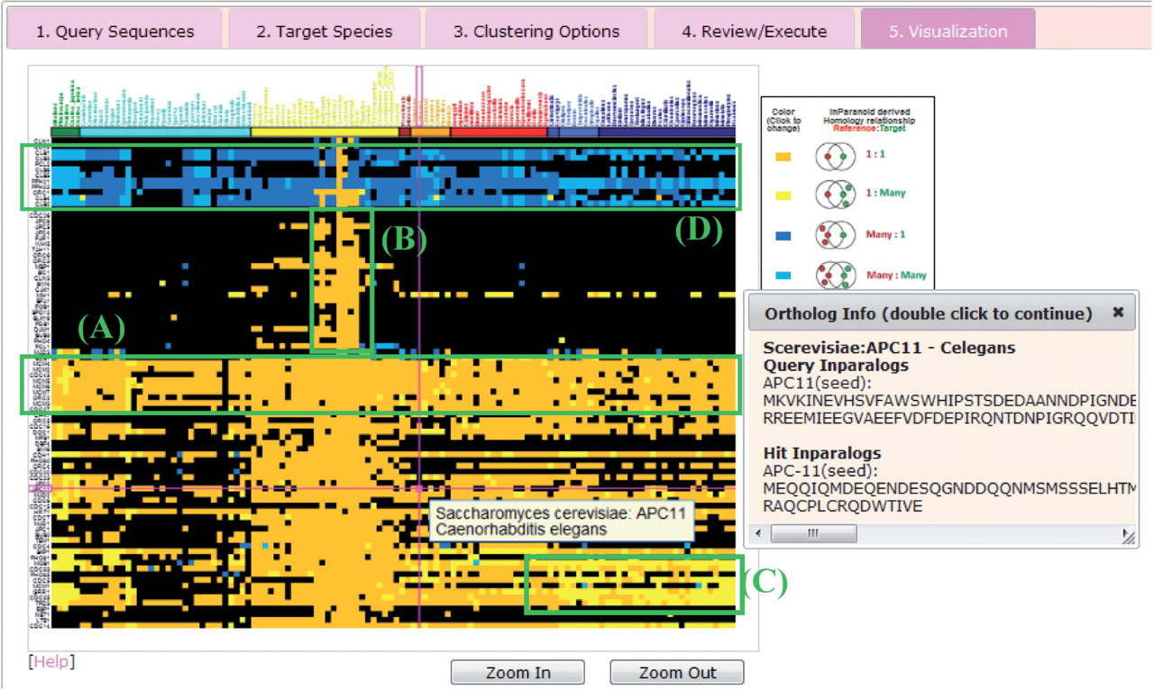
Fig. 1. Screenshot from PhyloPro showing the phylogenetic profiles of 86 genes involved in the yeast cell cycle. ...
Notes:
Fig. 1. Screenshot from PhyloPro showing the phylogenetic profiles of 86 genes involved in the yeast cell cycle. Colored tiles indicate the type of orthology relationship between the query gene and the target species: black, no ortholog detected; orange, 1:1 relationship; yellow, 1:M relationship; dark blue, M:1 relationship and light blue indicates M:M relationship. Mousing over tiles indicates the query gene and target species. Clicking colored tiles allows the IDs and sequences of the query and orthologous genes to be shown in a pop-up window. (A–D) Groups of genes with distinct patterns of conservation—see main text for more details.
Unless provided in the caption above, the following copyright applies to the content of this slide: © The Author 2011. Published by Oxford University Press. All rights reserved. For Permissions, please email: journals.permissions@oup.com

