Slide 1
FIG. 1. A summary of the combined model. $Q_{\rm F}$, glomerular filtration rate; $Q_{\rm JM,EA}$, efferent arteriole ...
Notes:
FIG. 1. A summary of the combined model. $Q_{\rm F}$, glomerular filtration rate; $Q_{\rm JM,EA}$, efferent arteriole blood flow of juxtamedullary nephrons; $Q_{\rm DVR}$, DVR inflow; $c_{\rm pelvis}$, pelvic, O$_2$ concentration; $c_{\rm bladder}$, bladder O$_2$ concentration. For details see main text.
Unless provided in the caption above, the following copyright applies to the content of this slide: © The authors 2016. Published by Oxford University Press on behalf of the Institute of Mathematics and its Applications. All rights reserved.

Slide 2
FIG. 2. Schematic diagram of the model vasculature. A pre-afferent arteriole vascular resistor ($\Omega_{\rm RA}$) ...
Notes:
FIG. 2. Schematic diagram of the model vasculature. A pre-afferent arteriole vascular resistor ($\Omega_{\rm RA}$) delivers blood to the afferent arteriole ($\Omega_{\rm AA}$). At the glomerulus, which is located at the exit of the afferent arteriole, blood is divided between the proximal tubule of the associated nephron (not shown) and the efferent arteriole ($\Omega_{\rm EA}$). $Q_{\rm AA}$ and $Q_{\rm F}$ denote blood flow through the afferent arteriole and SNGFR, respectively. $P_{\rm RA}$, $P_{\rm D}$ and $P_{\rm V}$ denote the renal perfusion pressure, glomerular capillary pressure and renal venous pressure, respectively.
Unless provided in the caption above, the following copyright applies to the content of this slide: © The authors 2016. Published by Oxford University Press on behalf of the Institute of Mathematics and its Applications. All rights reserved.

Slide 3
FIG. 3. Schematic diagram of the model ureter. Peristaltic boluses of volume $V_{\rm bolus}$ and contact area $S_{\rm ...
Notes:
FIG. 3. Schematic diagram of the model ureter. Peristaltic boluses of volume $V_{\rm bolus}$ and contact area $S_{\rm bolus}$ travel from the renal pelvis (left) to the bladder (right) at a speed $u_{\rm bolus}$. $L_{\rm bolus}$ and $R_{\rm bolus}$ characterize the bolus' dimensions.
Unless provided in the caption above, the following copyright applies to the content of this slide: © The authors 2016. Published by Oxford University Press on behalf of the Institute of Mathematics and its Applications. All rights reserved.

Slide 4
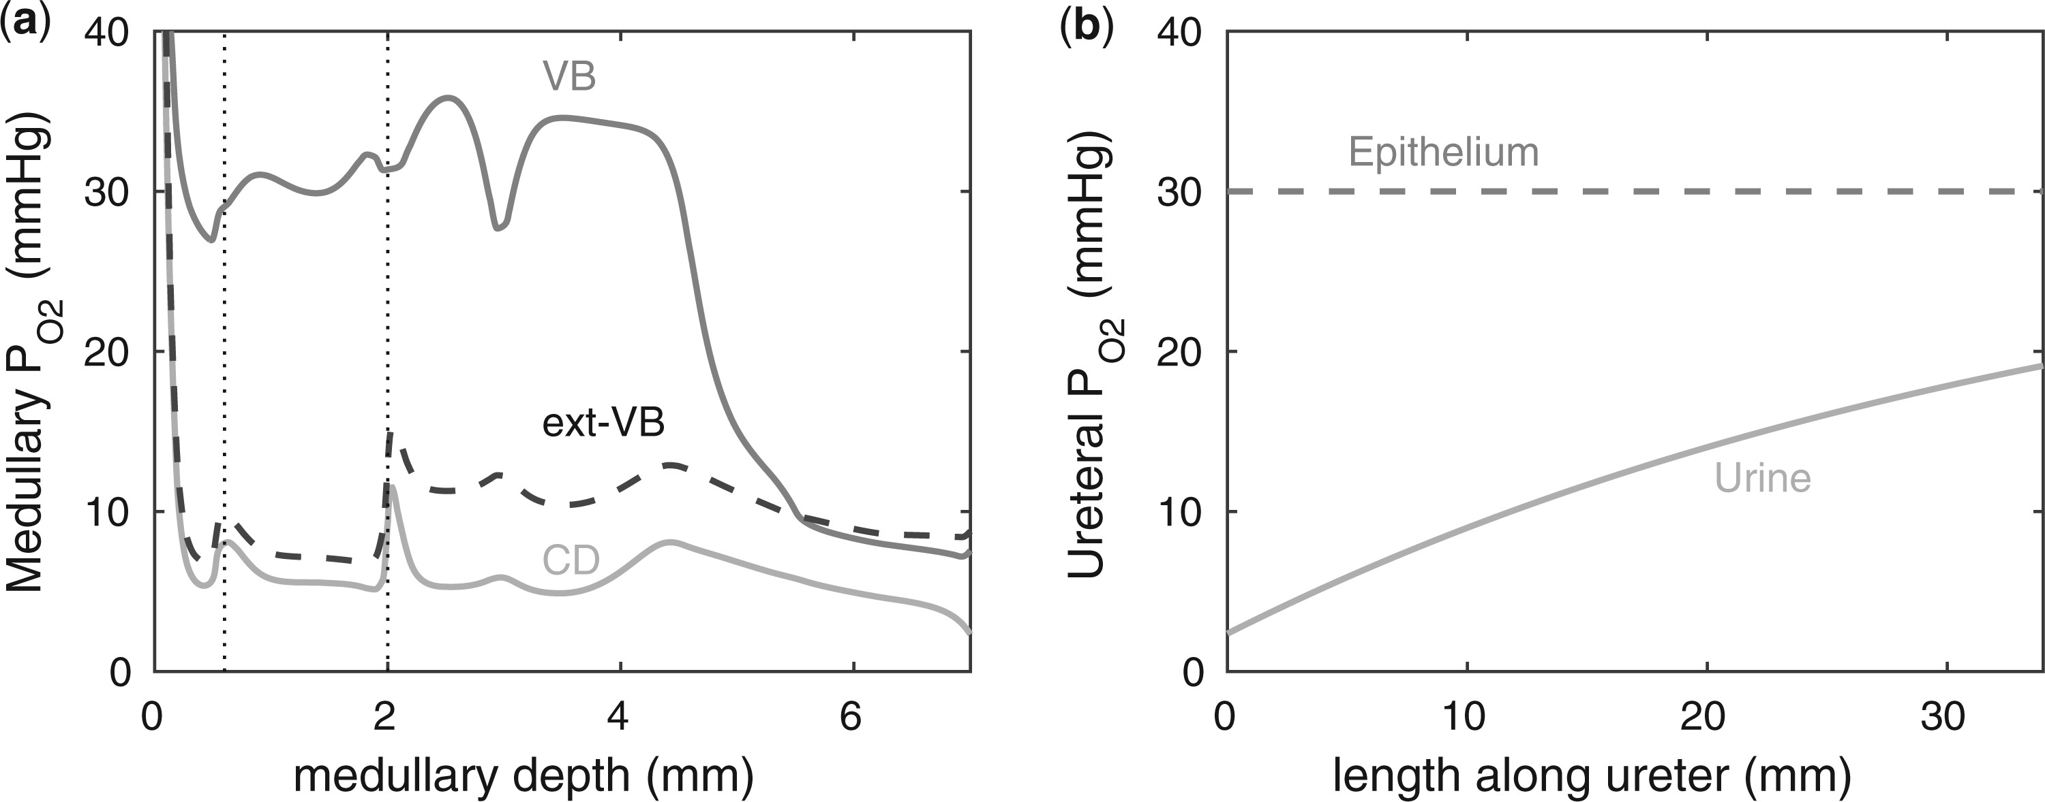
FIG. 4. Baseline model predictions. (a) Interstitial fluid P$_{\rm O2}$ profiles in selected regions along the model ...
Notes:
FIG. 4. Baseline model predictions. (a) Interstitial fluid P$_{\rm O2}$ profiles in selected regions along the model medulla: VB, interstitial fluid P$_{\rm O2}$ within the vascular bundles; Ext-VB, interstitial fluid P$_{\rm O2}$ external to the vascular bundles and CD, collecting duct luminal fluid P$_{\rm O2}$. Dotted lines indicate the boundaries of inner/outer stripes (at $x=0.6$ mm) and inner/outer medulla (at $x=2$ mm). (b) Urine P$_{\rm O2}$ along the ureter. Dashed line indicates P$_{\rm O2}$ along the ureter walls.
Unless provided in the caption above, the following copyright applies to the content of this slide: © The authors 2016. Published by Oxford University Press on behalf of the Institute of Mathematics and its Applications. All rights reserved.

Slide 5
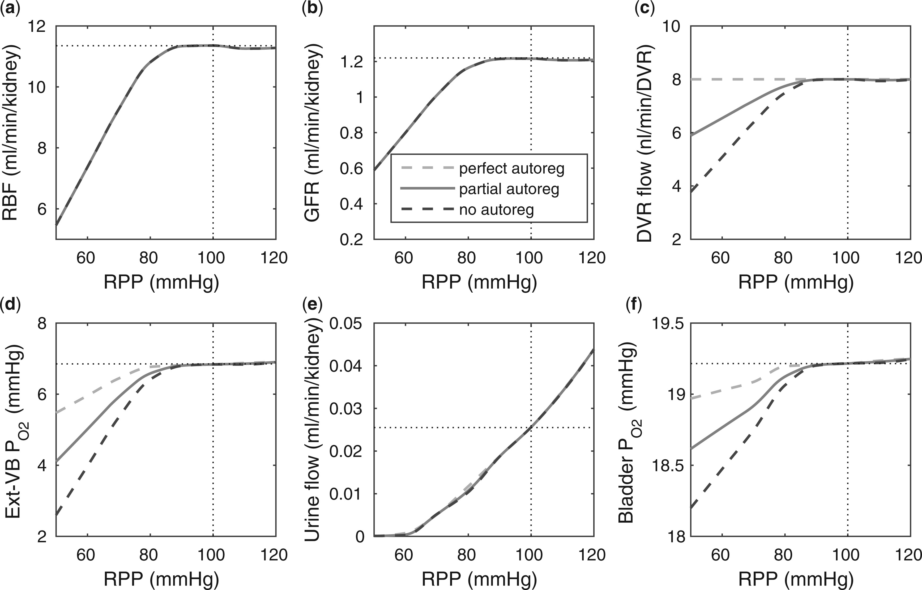
FIG. 5. Effects of variations in RPP on: (a), renal blood flow; (b) glomerular filtration rate; (c) DVR flow at the ...
Notes:
FIG. 5. Effects of variations in RPP on: (a), renal blood flow; (b) glomerular filtration rate; (c) DVR flow at the cortico-medullary boundary; (d) interstitial fluid P$_{\rm O2}$ in the lower inner stripe outside the vascular bundles; (e) urine flow and (f) urinary P$_{\rm O2}$ in the bladder. Results were computed for three different scenarios of medullary blood flow autoregulation. Dotted lines indicate baseline values.
Unless provided in the caption above, the following copyright applies to the content of this slide: © The authors 2016. Published by Oxford University Press on behalf of the Institute of Mathematics and its Applications. All rights reserved.

Slide 6
FIG. 6. Effects of variations in systemic hematocrit (Htc) on: (a) renal blood flow; (b) glomerular filtration rate; ...
Notes:
FIG. 6. Effects of variations in systemic hematocrit (Htc) on: (a) renal blood flow; (b) glomerular filtration rate; (c) DVR flow at the cortico-medullary boundary; (d) interstitial fluid P$_{\rm O2}$ in the lower inner stripe outside the vascular bundles; (e) urine flow and (f) urinary P$_{\rm O2}$ in the bladder. Results were computed for three different scenarios of medullary blood flow autoregulation. Dotted lines indicate baseline values.
Unless provided in the caption above, the following copyright applies to the content of this slide: © The authors 2016. Published by Oxford University Press on behalf of the Institute of Mathematics and its Applications. All rights reserved.

Slide 7
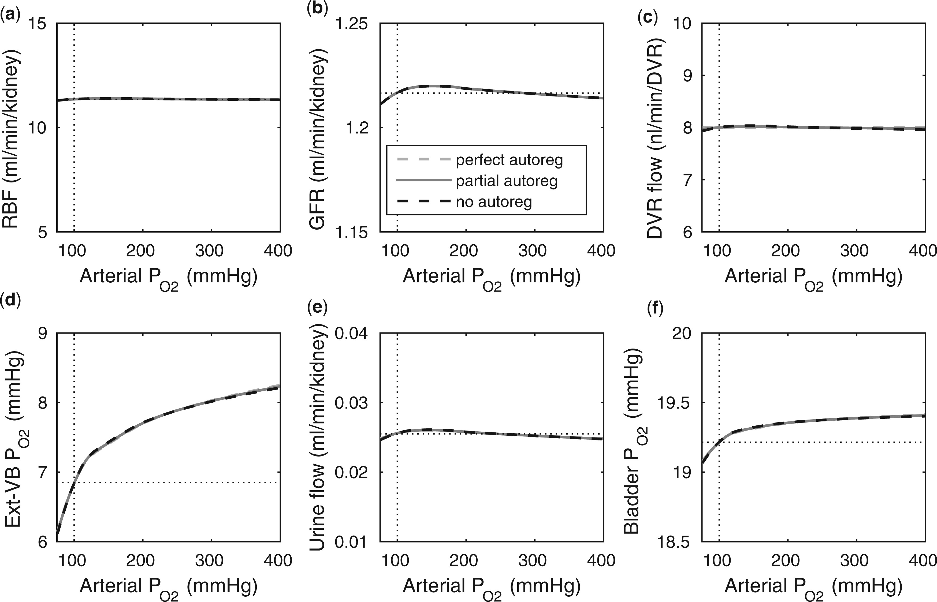
FIG. 7. Effects of variations in arterial P$_{\rm O2}$ on: (a) renal blood flow; (b) glomerular filtration rate; (c) ...
Notes:
FIG. 7. Effects of variations in arterial P$_{\rm O2}$ on: (a) renal blood flow; (b) glomerular filtration rate; (c) DVR flow at the cortico-medullary boundary; (d) interstitial fluid P$_{\rm O2}$ in the lower inner stripe outside the vascular bundles; (e) urine flow and (f) urinary P$_{\rm O2}$ in the bladder. Results were computed for three different scenarios of medullary blood flow autoregulation. Dotted lines indicate baseline values.
Unless provided in the caption above, the following copyright applies to the content of this slide: © The authors 2016. Published by Oxford University Press on behalf of the Institute of Mathematics and its Applications. All rights reserved.

Slide 8
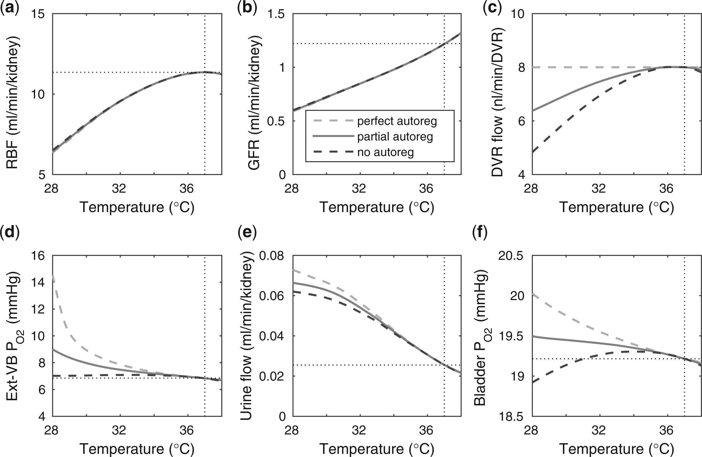
FIG. 8. Effects of variations in body temperature on (a) renal blood flow; (b) glomerular filtration rate; (c) DVR ...
Notes:
FIG. 8. Effects of variations in body temperature on (a) renal blood flow; (b) glomerular filtration rate; (c) DVR flow at the cortico-medullary boundary; (d) interstitial fluid P$_{\rm O2}$ in the lower inner stripe outside the vascular bundles; (e), urine flow and (f), urinary P$_{\rm O2}$ in the bladder. Results were computed for three different scenarios of medullary blood flow autoregulation. Dotted lines indicate baseline values.
Unless provided in the caption above, the following copyright applies to the content of this slide: © The authors 2016. Published by Oxford University Press on behalf of the Institute of Mathematics and its Applications. All rights reserved.

Slide 9
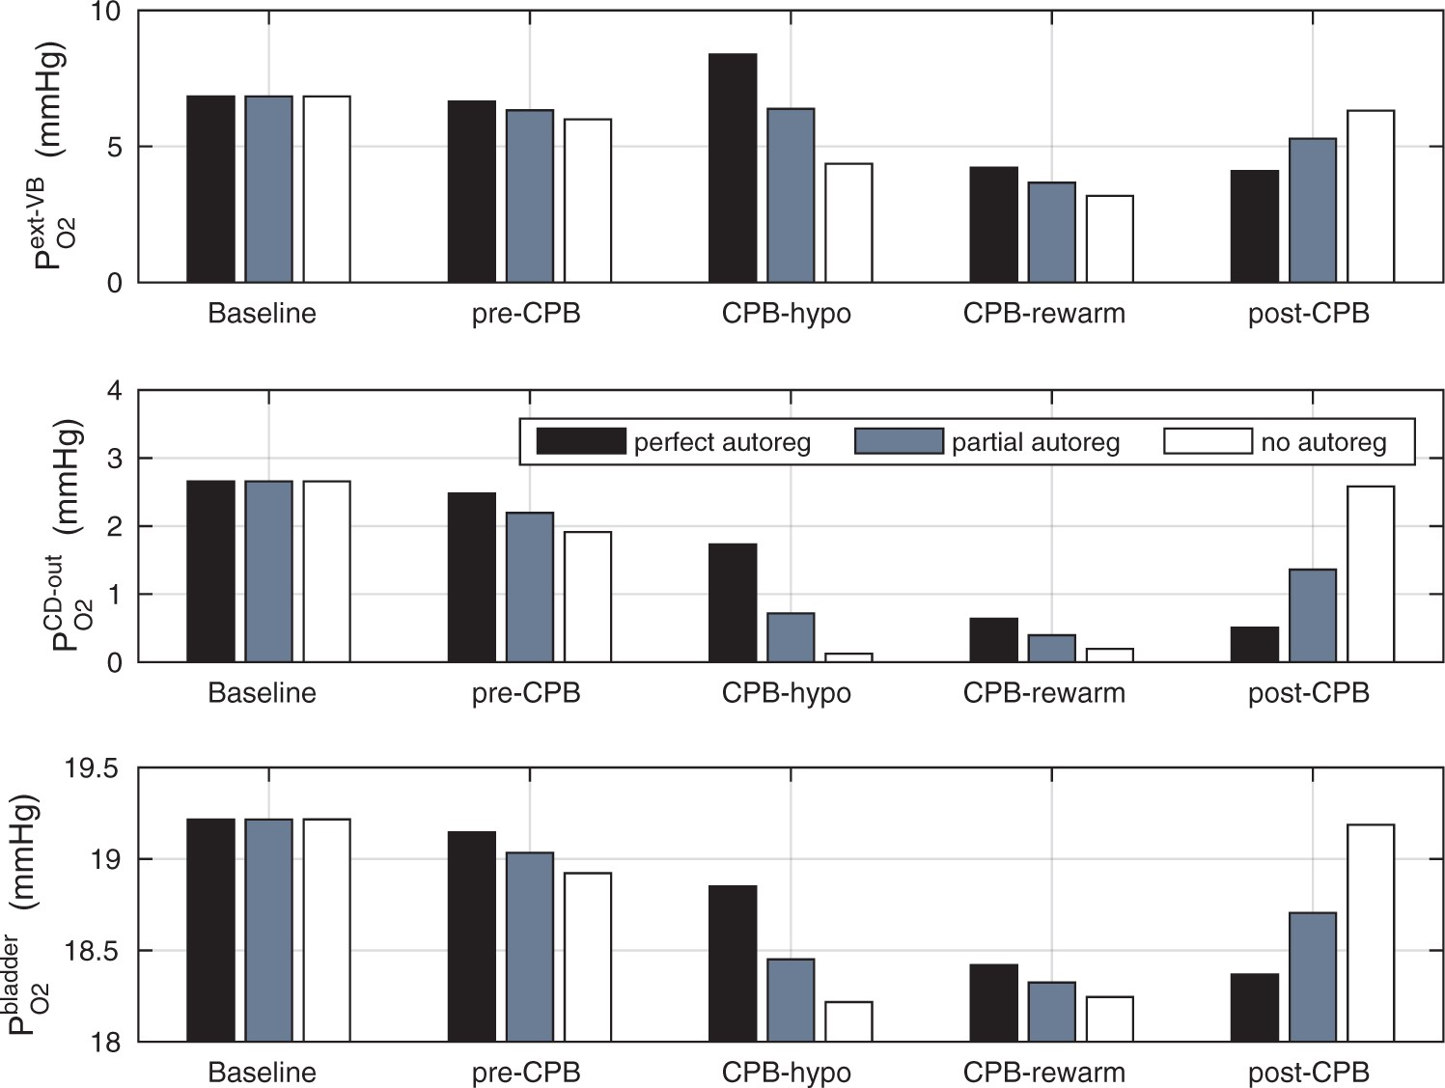
FIG 9. Renal oxygenation during CPB surgery. Top panel, interstitial fluid P$_{\rm O2}$ in the interbundle region in ...
Notes:
FIG 9. Renal oxygenation during CPB surgery. Top panel, interstitial fluid P$_{\rm O2}$ in the interbundle region in the lower inner stripe of the outer medulla. Middle panel, fluid P$_{\rm O2}$ at the CD outlet (i.e. renal pelvis). Bottom panel, urinary P$_{\rm O2}$ in the bladder. Results were obtained for the five phases of Table 1 each for three different degrees of medullary blood flow regulation.
Unless provided in the caption above, the following copyright applies to the content of this slide: © The authors 2016. Published by Oxford University Press on behalf of the Institute of Mathematics and its Applications. All rights reserved.

Slide 10
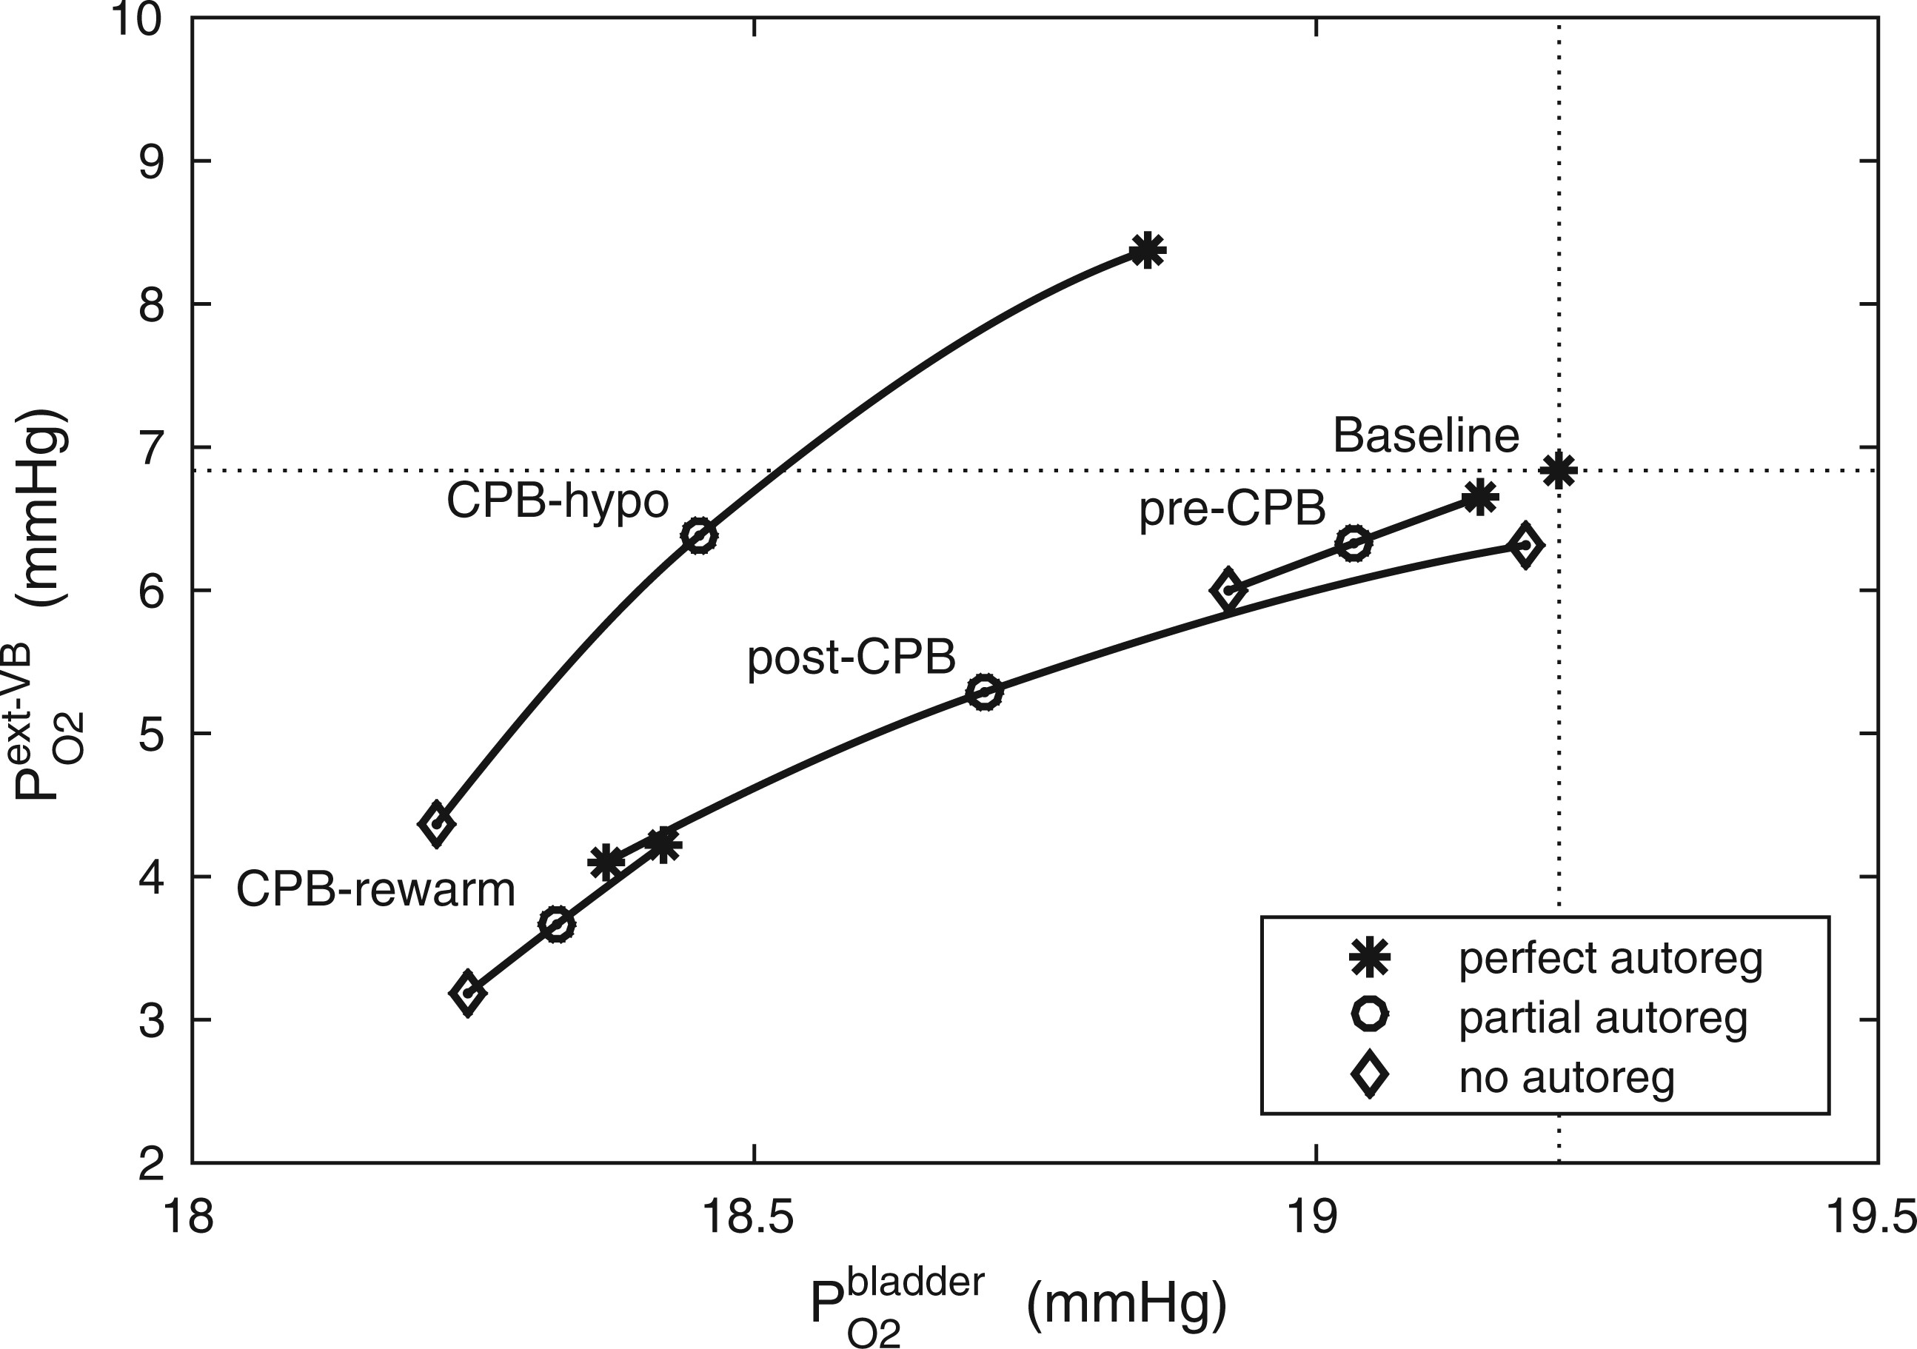
FIG 10. Relationship between lower inner stripe P$_{\rm O2}$ and urinary bladder P$_{\rm O2}$. Results were obtained ...
Notes:
FIG 10. Relationship between lower inner stripe P$_{\rm O2}$ and urinary bladder P$_{\rm O2}$. Results were obtained for the five phases of Table 1 each for different degrees of medullary blood flow regulation that ranges from $\beta=0$ (perfect autoreg) to $\beta=100%$ (no autoreg).
Unless provided in the caption above, the following copyright applies to the content of this slide: © The authors 2016. Published by Oxford University Press on behalf of the Institute of Mathematics and its Applications. All rights reserved.

